Slide 1



Seam 2: Real Integration Testing with Arquillian
Michael Schütz

Slide 2

Who I am…
Michael Schütz
Moderator of Seam group
?
Contributor
Profile
@michaelschuetz

Slide 3
Agenda
What will you expect today?
Focus on practical experiences
Introduction
Live demo
Status

Slide 4
Seam 2? … I think it‘s outdated?
So why using Seam 2?
TODO: Hier einige Argumente als Stichworte einfügen
Seam 3 modules far away from Seam 2 complexity (security)

Slide 5
Arquillian
What are the key issues?
TODO: Aufzählen der Kernpunkte, die du rüber bringen willst

Slide 6
ShrinkWrap – Skip the Build!
Saving of time…
ShrinkWrap – Programmatic archive creation
Simple API
Micro deployments
IDE incremental compilation
Save and re-run
Skip the Build!

Slide 7
Java EE testing
Combination of Arquillian and Seam…
Shrink Wrap
Container
Java EE app server
Servlet container
Weld SE
Test case
Arquillian
Unit testing framework
JUnit
TestNG
Seam

Slide 8
Real practice
3 TODOszenarios…
1.
2.
3.
SAP-Integration
JMS: AS4.2.3 – AS 5.1
Seam2-Integration
TODO: hier jeweils die positiven bzw. negativen Punkte aufzählen…
JCA container configuration
multiple containers,
tests against AS5.1
focus

Slide 9



Practice – Seam 2-Integration
Local development
Seam
AS5.1/GateIn
Remote container
Deployment against running instance
Fast feedback
mvn verify -Pit,jbossas51_remote

Slide 10

Practice – Seam 2-Integration
CI – Continuous Integration
Started automatically by Hudson
Seam
AS5.1/GateIn
Managed container
Automatic nightly hudson build
Full Lifecycle support
mvn verify -Pit,jbossas51_managed

Slide 11
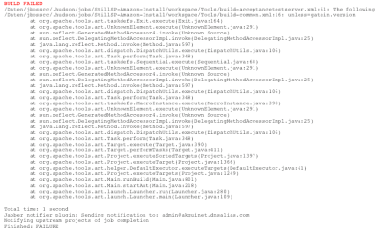
It’s time for Live Coding
EJB injected Seam test
Native Seam injection

Slide 12
Seam 2 and Arquillian Roadmap
API support --> where to put it?
Extending --> @In Enricher
Arquillian base in lots of open source projects CDI/Weld Jboss EJBimpl, …
JSFUnit

Slide 13
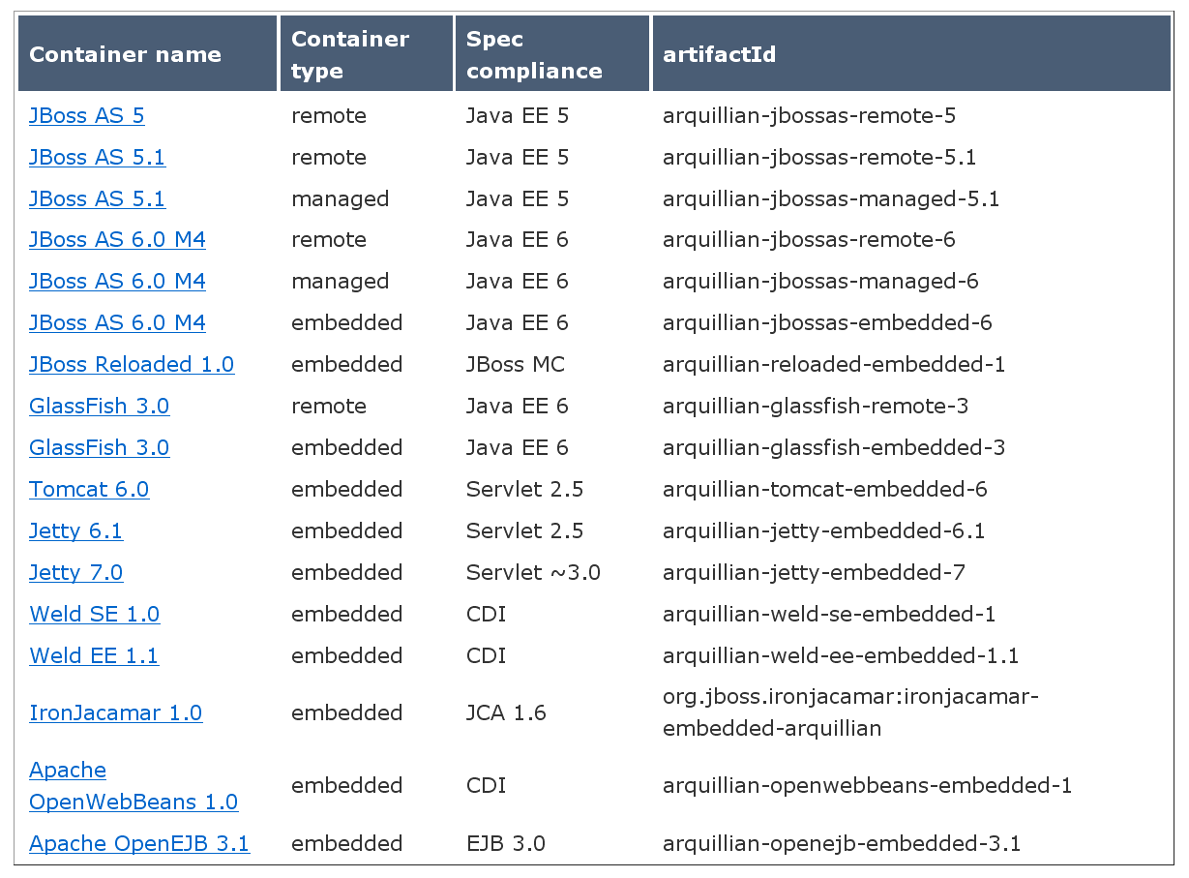
Multiple containers

Slide 14
Future
More containers – Weblogic, Spring, Hibernate, Drools...
Frameworks: Selenium
multiple deploy against containers
cloud deployment (jClouds, Steamcannon)

Slide 15
Thank you
TODO: Daten/URLs eintragen zum Herunterladen der Daten
Twitter Account etc…
Email
Download code

