Slide 1


Slide 2



Seam 2: Real Integration Testing with Arquillian
Michael Schütz

Slide 3

Who I am…
Michael Schütz
Moderator of Seam group
?
Contributor
Profile
@michaelschuetz
BED-Con 2011

Slide 4
Agenda
What will you expect today?
Introduction
Arquillian warm up
Focus on practical experiences
Live coding
The future

Slide 5
Seam 2? … I think it‘s outdated?
So why are we using Seam 2 still?
Cool: Seam 3, CDI, Weld, Java EE 6, JSF 2, GF3, JBossAS 6
Seam 3 – bunch of independent modules
First final release of hole bundle 3 days old (-:
Portal Context!
GateIn 3.1. “final” (JBoss Portal + exo + JBoss AS 5.1)
No JSF 2 Portlet Bridge ready to use
JBoss Portlet Bridge 3.0.0.ALPHA (JSF2 + CDI + Seam3)
JBossAS6 final since end of 2010
No official GateIn portal integration

Slide 6
Arquillian – future of Java EE testing
What are the key issues?
Project lead: Aslak Knutsen
Archives
ShrinkWrap
Multiple Test frameworks
JUnit, TestNG
Multiple Run modes
In container, as client
Multiple Enrichers
CDI, EJB, Resources
Multiple Containers

Slide 7
ShrinkWrap – Skip the Build!
Saving time…
ShrinkWrap – Programmatic archive creation
Simple API
Micro deployments
IDE incremental compilation
Save and re-run
Skip the Build!

Slide 8
Java EE testing
Combining Arquillian and Seam…
Shrink Wrap
Container
Java EE app server
Servlet container
Test case
Arquillian
Unit testing framework
JUnit
TestNG
Seam

Slide 9
Real practice
3 usecases
1.
2.
3.
SAP-Integration
JMS: AS4.2.3 – AS 5.1
Seam 2-Integration
EJB3, JCA container configuration
multiple containers, Cargo
focus

Slide 10
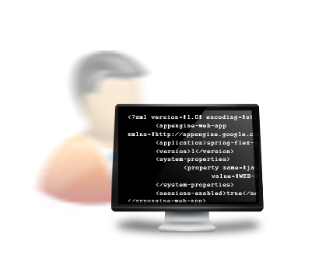


Practice – Seam 2-Integration
Local development
Seam
AS5.1/GateIn
Remote container
Deployment against running instance
Fast feedback
mvn verify -Pit,jbossas51_remote

Slide 11

Practice – Seam 2-Integration
CI – Continuous Integration
Started automatically by Hudson/Jenkins
Seam
AS5.1/GateIn
Managed container
Automatic nightly Hudson/Jenkins build
Full Lifecycle support
mvn verify -Pit,jbossas51_managed

Slide 12
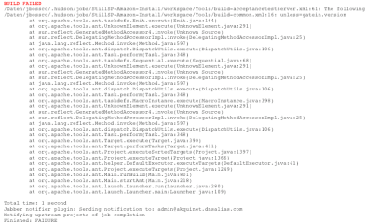
It’s time for Live Coding
EJB injected Seam test
Native Seam injection

Slide 13

Seam 2 and Arquillian Roadmap
API support → as Arquillian extension?
Extending → @In Enricher
MavenArtifactResolver → ShrinkWrap API
JSFUnit Arquillian integration

Slide 14
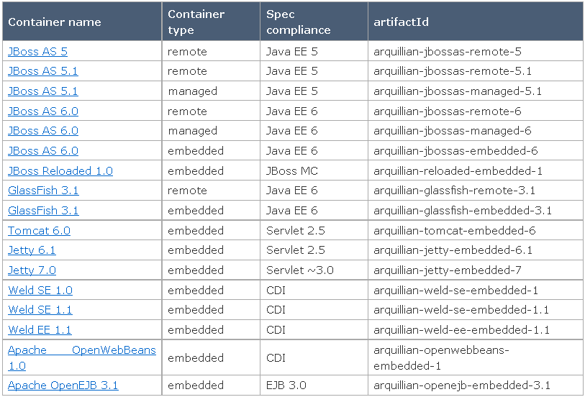
Multiple containers

Slide 15
The future
1.0.0.Alpha5 out, 1.0.0.Beta1 this week (-;
More containers – Weblogic, Spring, Hibernate, Drools...
Frameworks: Selenium, DBUnit
Multiple deploy against containers
Cloud deployment (jClouds, Steamcannon/DeltaCloud)

Slide 16
Thank you
Email
michael.schuetz@akquinet.de
Twitter
@michaelschuetz
Source Code
http://github.com/michaelschuetz/seamArquillian-sdc2011

