Slide 1
Linux and Amateur Radio
A Match Made in Heaven?
Michael Schulz K5TRI
mschulz@creative-chaos.com

Slide 2
Focus Of this Talk
Linux and Amateur Radio
Contact Logging
Rig & Rotor Control
Digital Modes
Satellite Tracking
APRS

Slide 3
Linux and Amateur Radio
Amateur Radio – the original Open Source project
A flexible platform for experimentation
Sharing of ideas and knowledge
If you can't open it, you don't own it.
Yet, most hams use Windows

Slide 4
Contact Logging

Slide 5
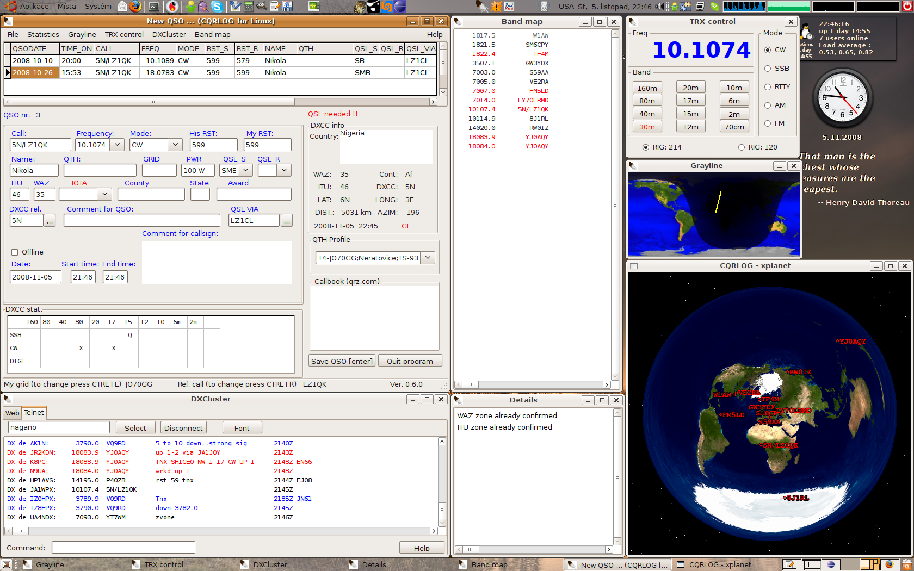
CQRLOG

Slide 6
CQRLOG
General logging
Rig control
MySQL DB as backend
LoTW & eQSL support
Fldigi integration
Club membership tracking
Award tracking
CW keyer
Real DX cluster support

Slide 7
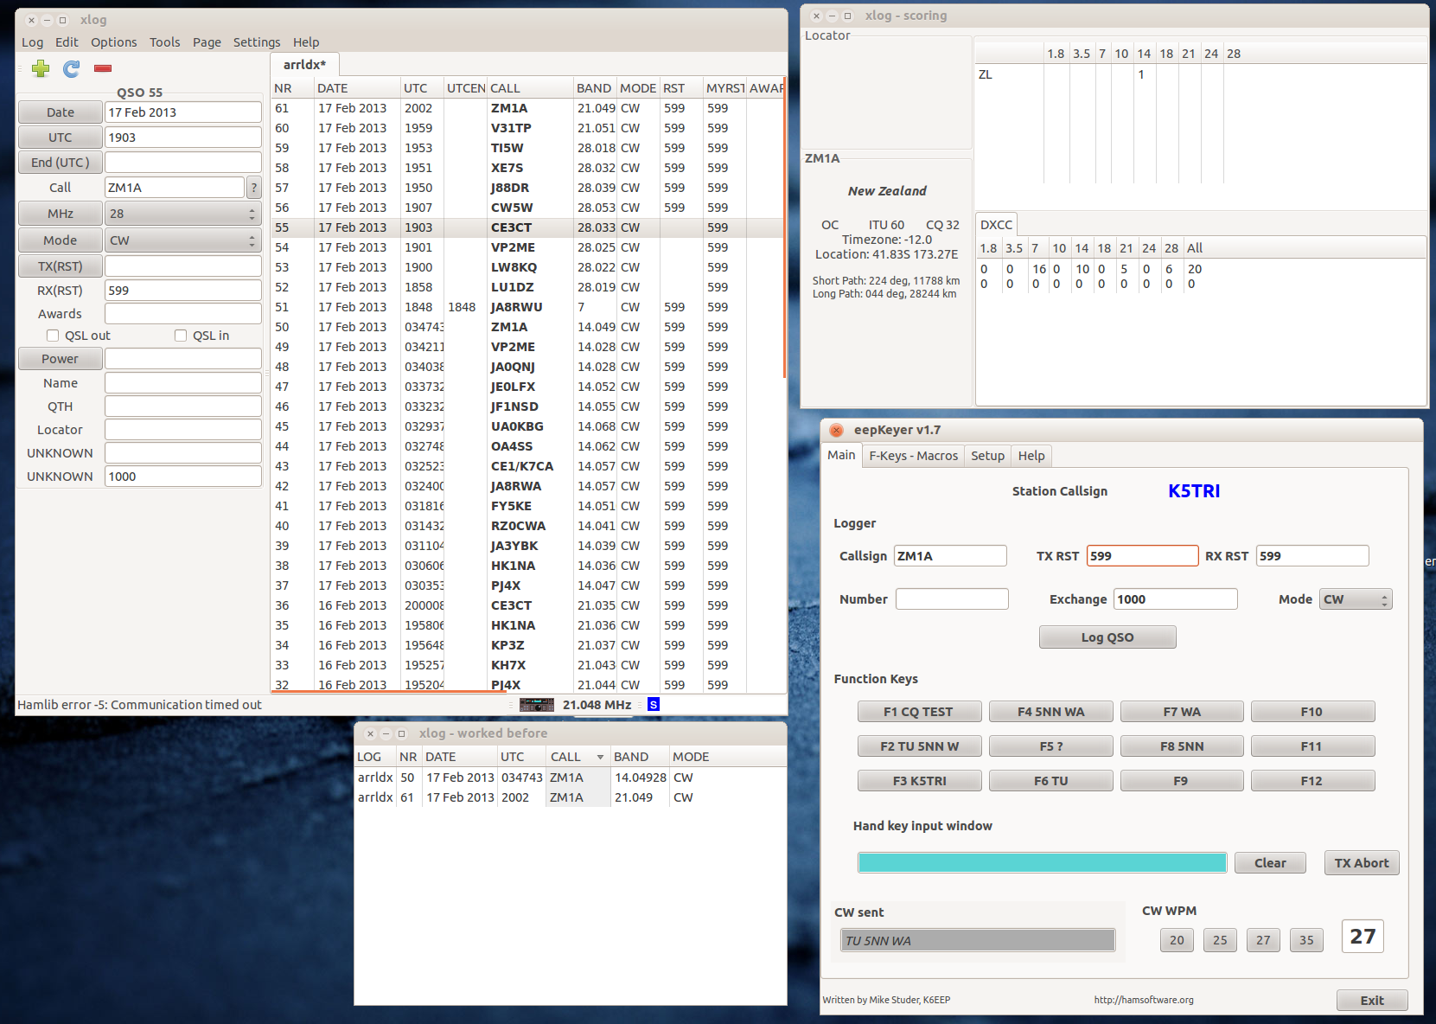
xlog

Slide 8
xlog
Simple logging program
Can be used for contesting
Flexible interface (built in editor)
eepKeyer interfaces for CW keying

Slide 9
Rig & Rotor Control

Slide 10
hamlib
Provides a standard API for rig control
Available on Linux, Mac OS X & Windows
Can control radio and rotor
Network capable – connect to socket
Command line interface

Slide 11
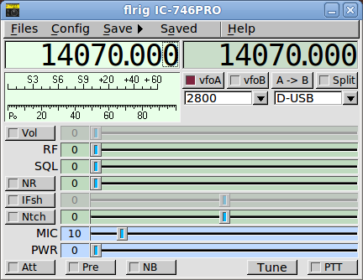
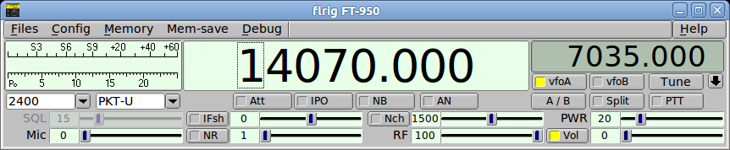
Flrig
GUI interface for radio control
Can be used in combination with Fldigi

Slide 12
Digital Modes

Slide 13
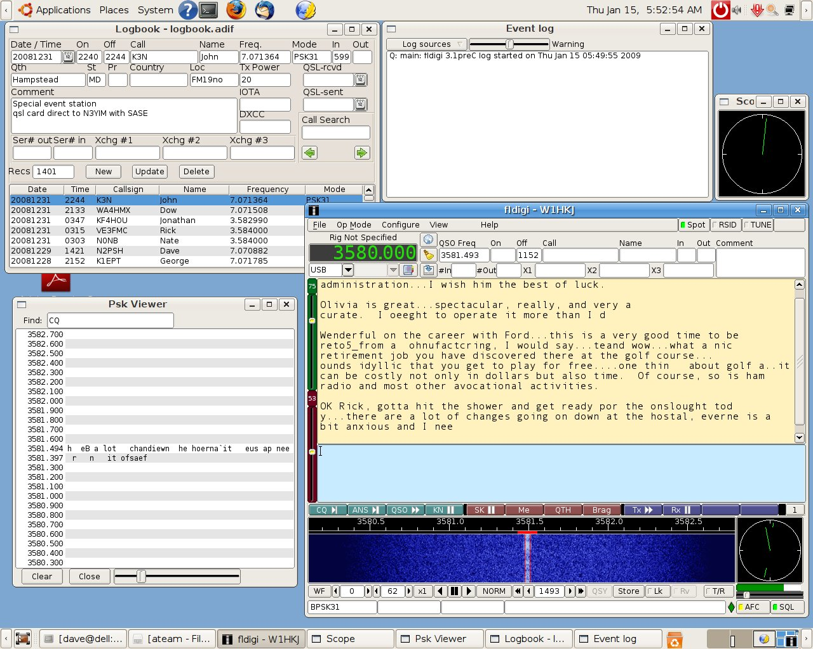
Fldigi

Slide 14
Fldigi
Available on multiple platforms
The gold standard for digital modes
Supports several modes like RTTY, PSK, CW, Hellschreiber, Thor, WEFAX and more.
Can be used stand alone for contesting
Several ways for radio interfacing

Slide 15
Satellite Tracking

Slide 16
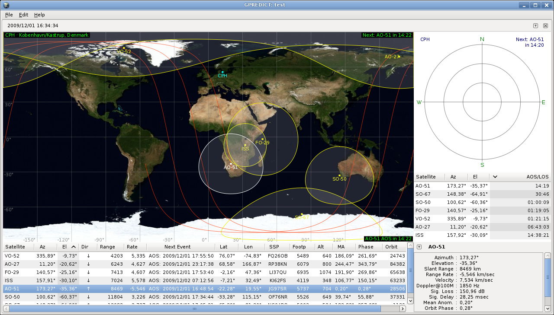
Gpredict

Slide 17
Gpredict
Provides comprehensive sat tracking
Radio & rotor control through hamlib
Doppler shift correction
Customizable by user

Slide 18
APRS

Slide 19
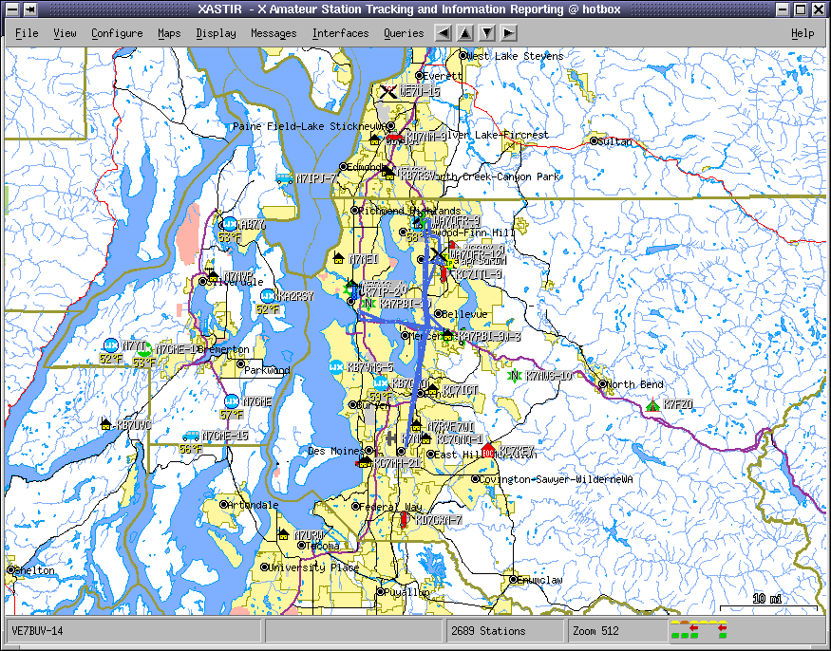
Xastir

Slide 20
Xastir
Can be used to track stations
Display information being received via AX.25
Includes iGate feature
Messaging interface
Can use Tigermaps, OpenStreetMaps, Terraserver or Toporama maps + more
Interface with weather station and GPS

Slide 21
aprsd & aprsdigi
aprsd
  Provides iGate functionality
aprsdigi
  UI-Frame digipeater
  Can tunnel packets via Internet

Slide 22
Questions?

Slide 23
Linux and Amateur Radio
A Match Made in Heaven?
Michael Schulz K5TRI
mschulz@creative-chaos.com

