Slide 1


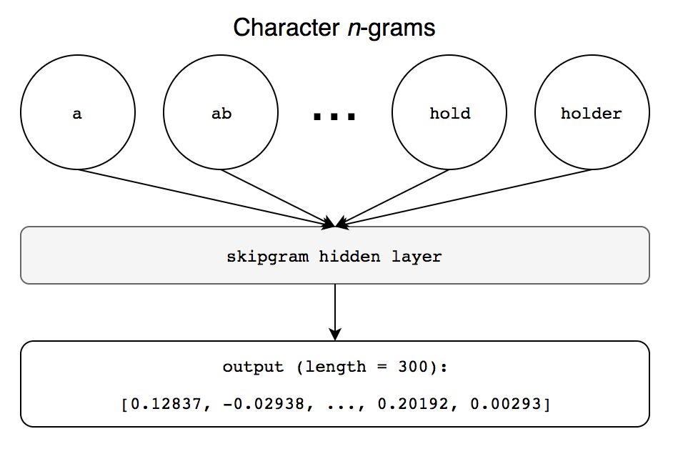
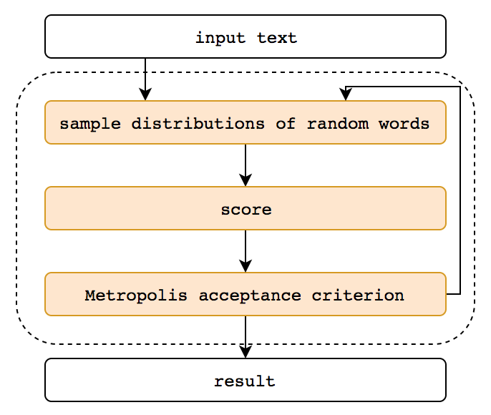
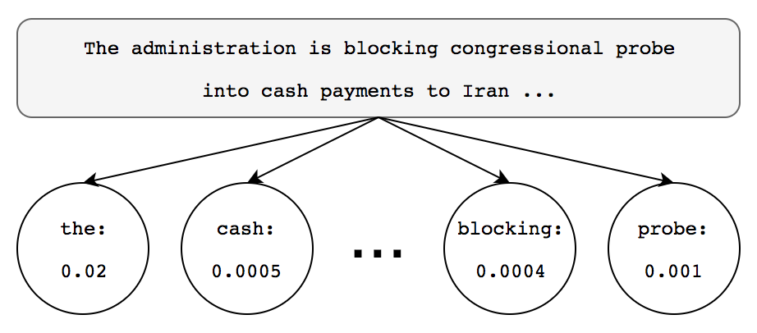
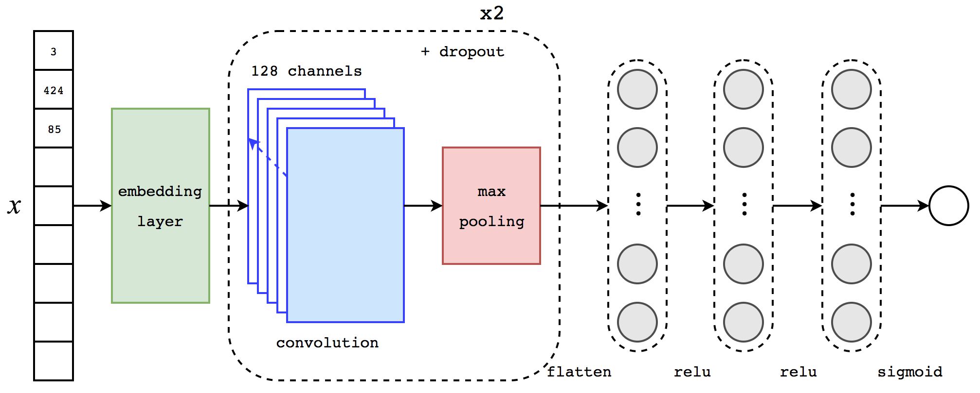
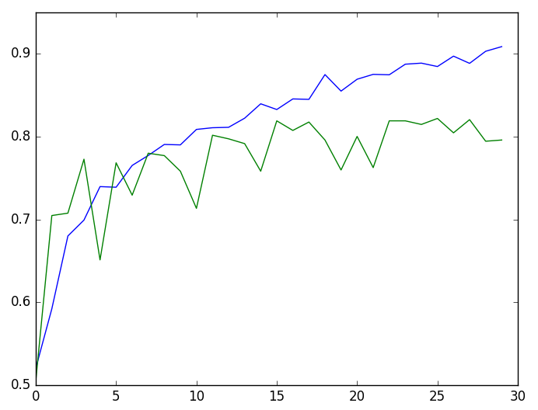
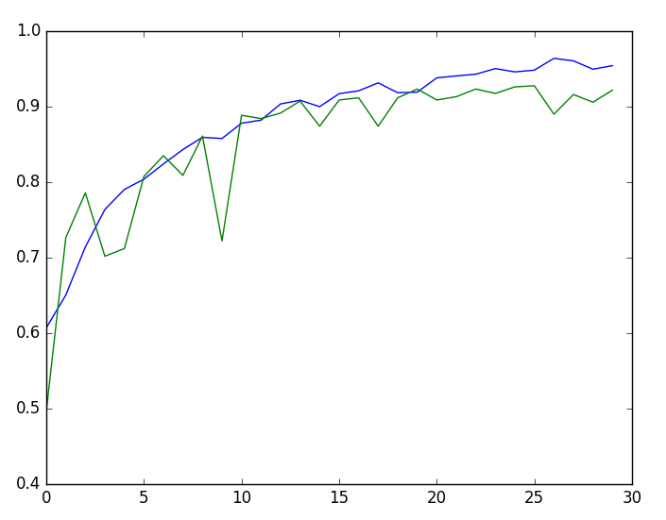
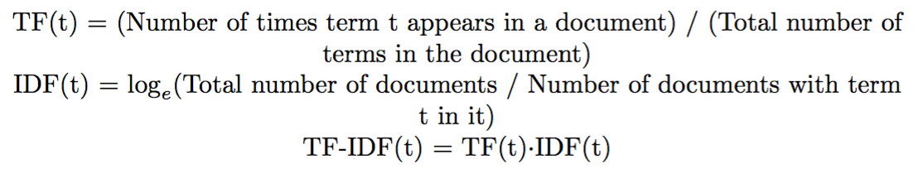
Fake News Through the Lens of Classification and Generation
Derek Tsui | Winston Wang | {dtsui,wwang13} @stanford.edu | CS 221, Autumn 2017
Motivation
Methodology
Results
Fake news is an increasingly serious problem that is too vast and burdensome to deal with manually. Our project is focused on two goals:
Classification to automatically detect “fake” news from reputable news, and
Generation to transform a piece of text into the style of fake news.
Previous work on fake news detection has included features encoding metadata (e.g., publisher, headline). We hypothesized that a model based on latent features of the text itself would have wider applications and extensibility.
a
b
d
Classification
Classification resulted in some promising results.
* = top 1% variance of word features
Learning Curves
Since the CNN is time-intensive to train when given entire documents (order of 10000 words), we decided to test preliminarily on the first 100 and first 1000 words of each article, with encouraging results that improved as the number of words was increased.
Generation
Currently, we use the XGBoost model trained on TF-IDF to score the generated texts. However the results were suboptimal due to the locality of replacement. A n-gram based proposal is mentioned in Discussion below.
Method | Features | Accuracy | F1 | Precision | Recall
Naïve Bayes | Bag of Words | 0.8358 | 0.8220 | 0.9238 | 0.7405
Naïve Bayes | TF-IDF | 0.8899 | 0.8899 | 0.9119 | 0.8690
XGBoost | Bag of Words | 0.9003 | 0.9040 | 0.8922 | 0.9160
XGBoost | TF-IDF* | 0.8834 | 0.8875 | 0.8770 | 0.8982
XGBoost | TF-IDF*+Custom | 0.9010 | 0.9043 | 0.8952 | 0.9135
XGBoost | TF-IDF*+Custom+FastText | 0.9062 | 0.9085 | 0.9074 | 0.9097
CNN | FastText (1K words) | 0.9270 | 0.9279 | 0.9388 | 0.9173
c
Figure 1.
(a) Graphical representation of how the Bag of Words model represents a text.
(b) Graphical representation of how FastText word vectors are generated.
(c) Graphical representation of the convolutional neural network used.
(d) Flowchart describing how a text is iteratively mutated to become more “fake”
100 Words
1000 Words
Dataset
Accuracy
Data
6,000 articles separated into two classes (fake and real) of roughly equal split, all from 2016.
Most frequent subset of a pre-trained English corpus containing 2.6 million words, each in the form of a 300-vector.
Training-testing split is 75/25. Validation set of 15% was used to tune hyper-parameters.
Preprocessing
Significant preprocessing was done before FastText could be performed correctly. Some manual changes include:
Removal of obscure ASCII characters, characters in other languages
Removal of punctuation and numbers
Removal of information within the body containing identifying metadata (publisher, author)
Feature Sets
Bag of Words Model Converts the text into a sparse array corresponding to the raw word frequencies within the text. See Figure 1a.
TF-IDF Vectorization Metric Uses the common TF-IDF method to adjust raw word frequency to commonality across documents, correcting for word such as “the” and “a”.
Domain-Specific Features This is a set of manually engineered features that utilize domain knowledge in order to more accurately represent the text:
Contains special punctuation “?”, “!”
Mean, variance of sentence length
Vocabulary variation
FastText Word Vectors This model utilizes Facebook’s FastText model to vectorize words, and is pre-trained on the Wikipedia corpus to map words to vectors of size 300. See Figure 1b.
Models
Naïve Bayes Our baseline classification algorithm.
Extreme Gradient Boosting (xgboost) Aggregates strong predictions from many weak-learning decision trees.
Convolutional Neural Nets (CNN) Uses convolution layers and deep neural network to make minimal assumptions on the text structure. See Figure 1c.
Generative Algorithm
Uses Gibbs sampling and the Metropolis acceptance criterion to iteratively mutate the input text so that it achieves a higher “fake” score.
Training
Testing
Training
Testing
Number of Epochs
Number of Epochs
Discussion/Future Work
Overall the results for classification are comparable to the results found in existing work. One possible improvement on the current model would be to expand the training window of the CNN past the current limit of 1,000 words per document. Additional improvements could come from further optimizing for CNN hyper-parameters, including convolution structure and a better regularization approach.
Next, we found that the XGBoost model is not the ideal method for generation, since it optimizes only on local word frequency, so the generated article tends towards random high-scoring words. In the future, we plan to change the generation model to the CNN model instead so that latent “fake” structure can be imputed onto the original text, and introduce an improved random sampling method of choosing replacement words.

