Slide 1


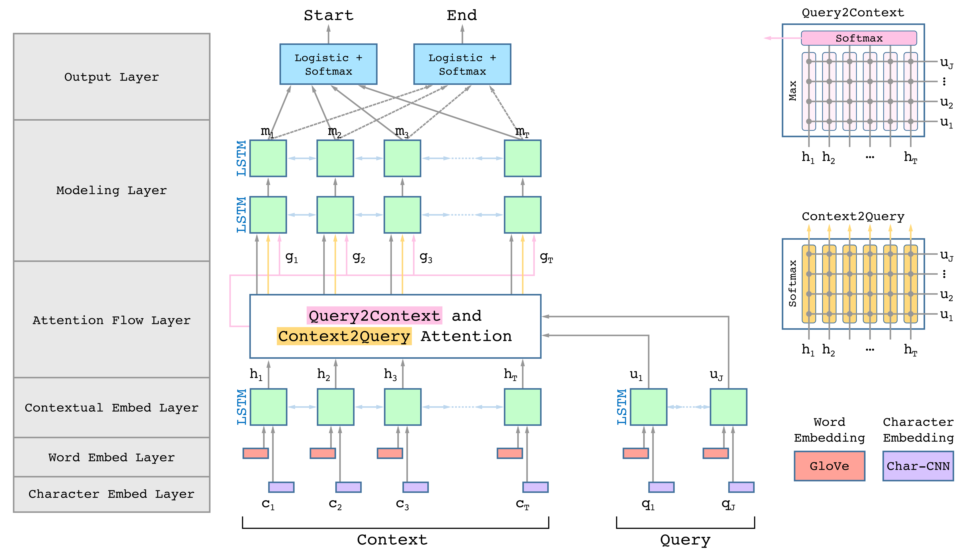
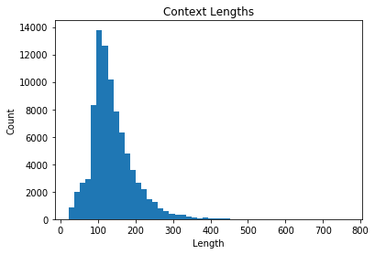
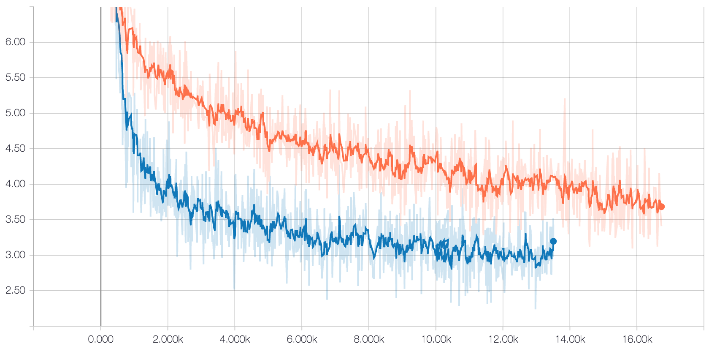
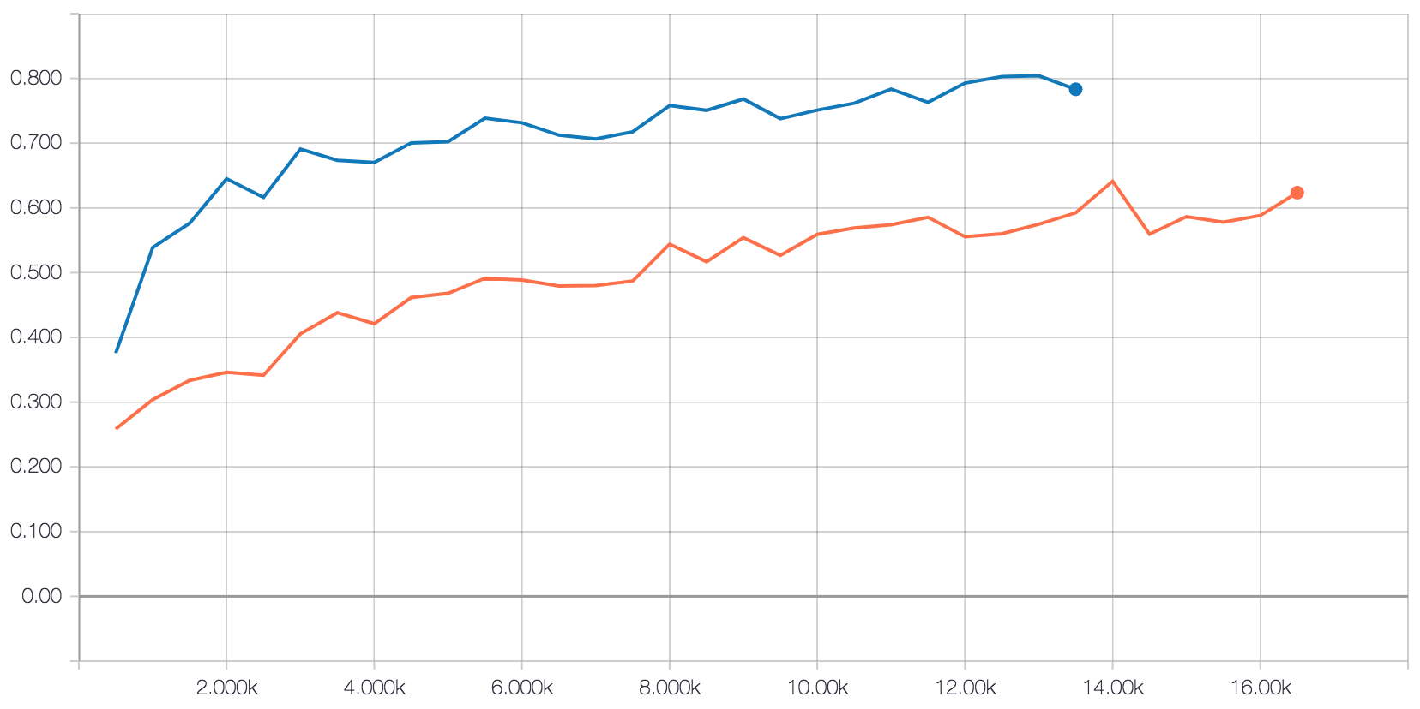
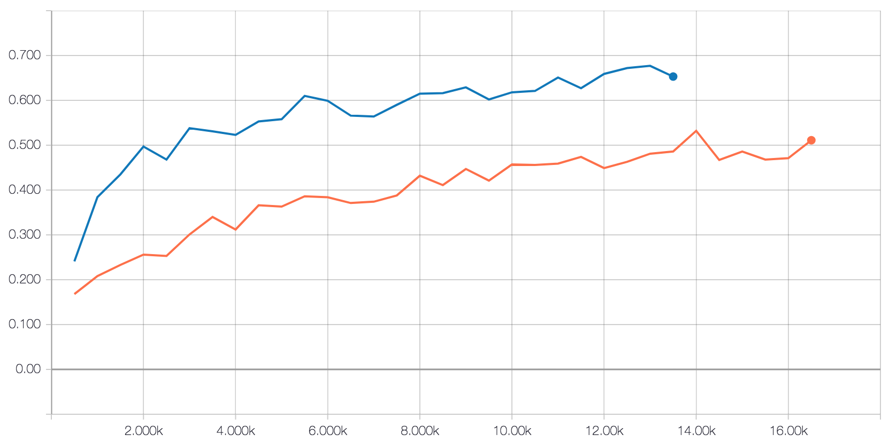
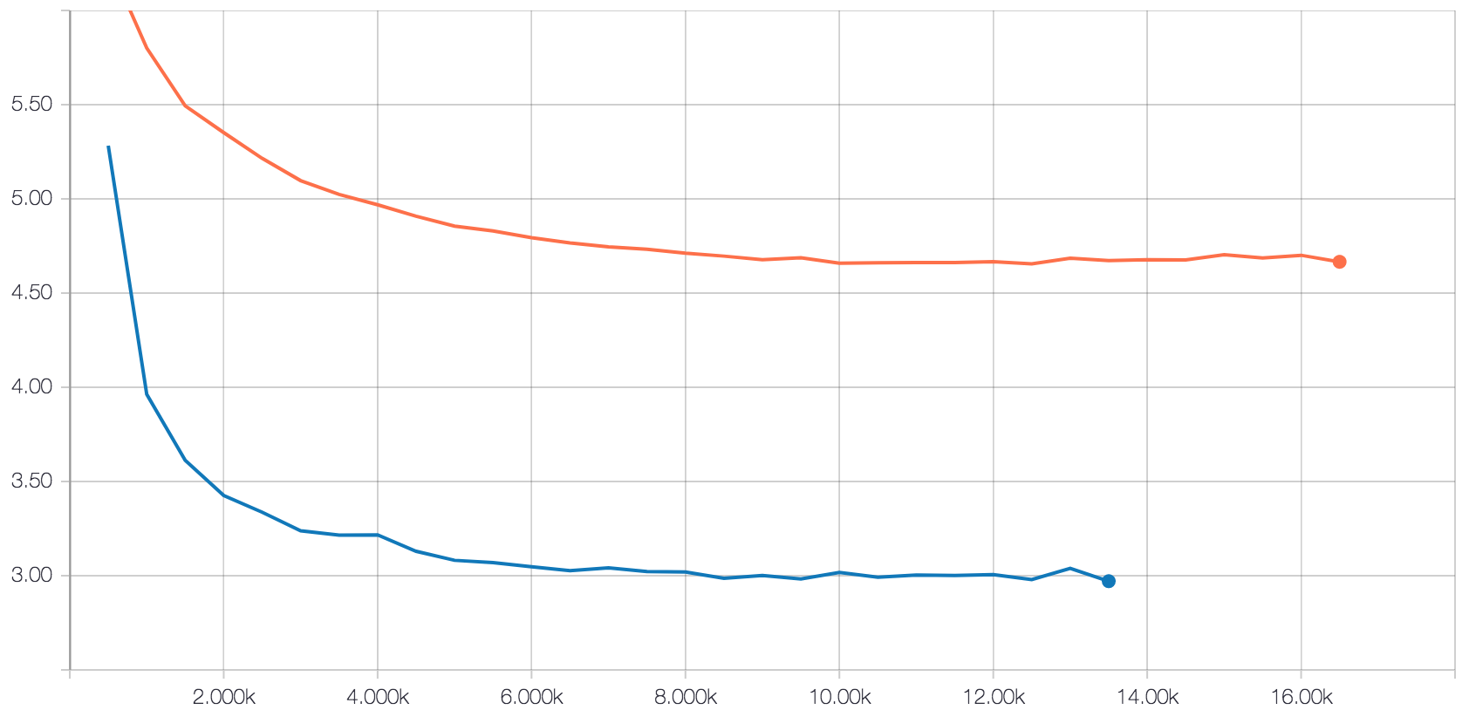
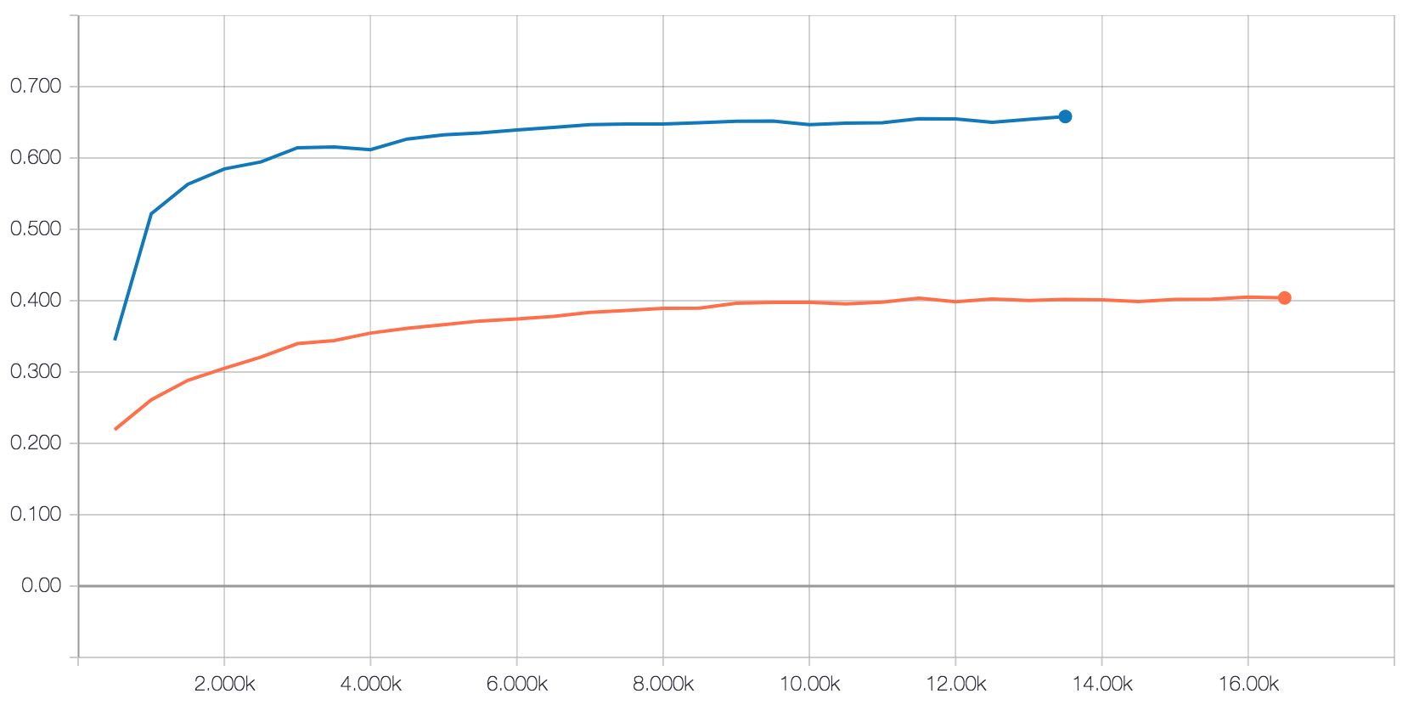
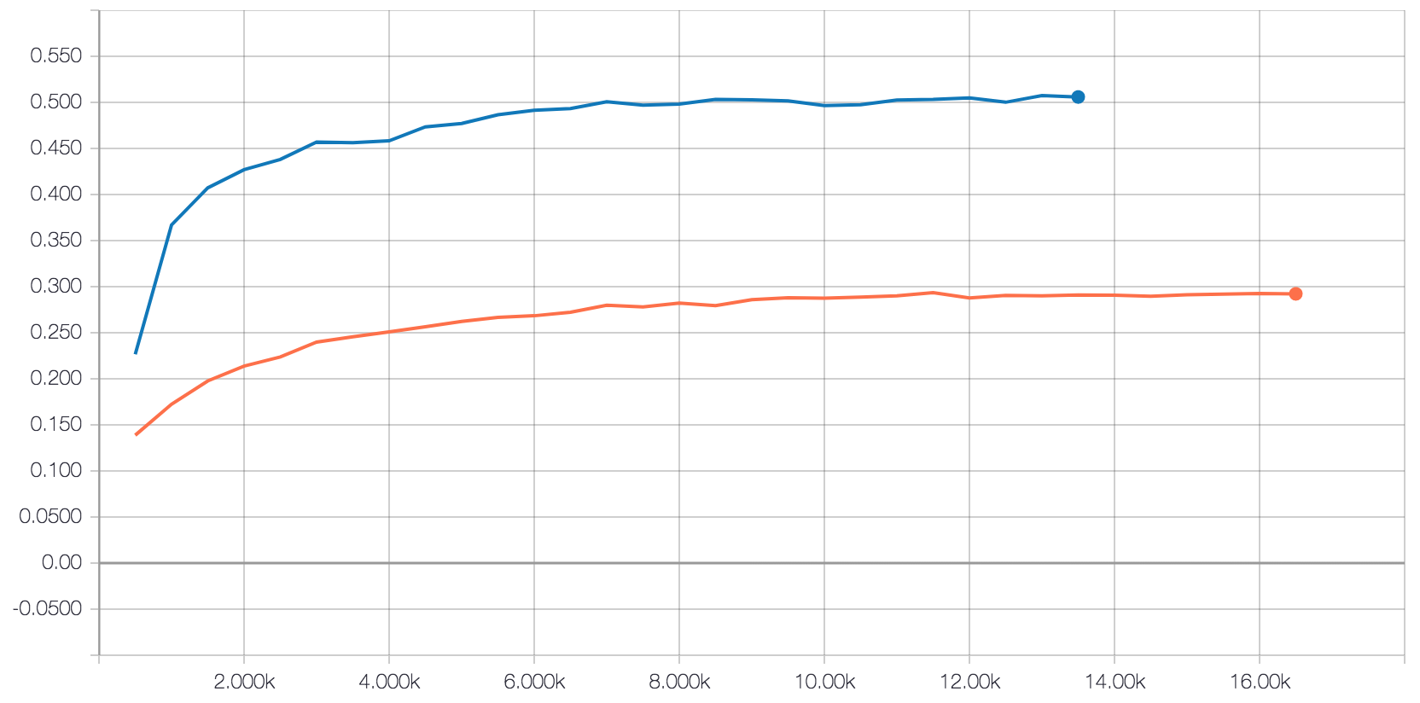
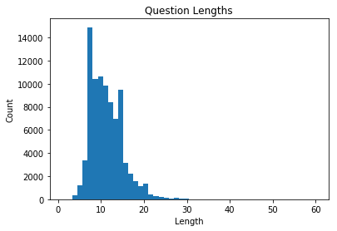
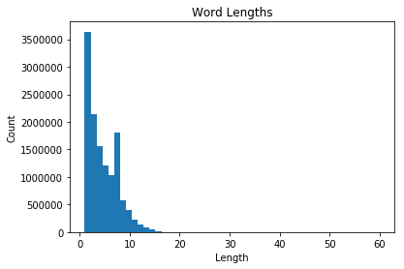
Machine Comprehension Using the SQuAD Dataset
Michael Chung | Winston Wang | {mchung96, wwang13}@stanford.edu | CS 224N, Winter 2018
Abstract
Methodology
Results
For the final project for CS 224N: Natural Language Processing with Deep Learning, we implemented a machine comprehension model that utilizes a character-level CNN, BiDirectional Attention Flow (BiDAF), and a modeling layer. We achieved a maximum F1 score of ??? and an EM score of ??? on the test set.
A
Parameters | EM | F1
Motivation
For humans, reading and understanding text, images, audio, and other inputs seems like second nature. However, for computers, this remains an open problem. Done correctly, machine comprehension has the potential to streamline a myriad of real-world problems, from answering Jeopardy questions to searching through medical articles and records. Rather than having to manually search through relevant articles to find answers to questions, having an operational machine comprehension system would allow automatic detection of key pieces of text within the actual articles, saving hours upon hours of time. Therefore, we attempt to improve on current NLP and deep learning models for this question and answering problem.
B1
C
 | Loss | F1 | EM
Train
Dev
Dataset
Data:
The data used for this project is the Stanford Question Answering Dataset (SQuAD). Each example in this dataset consists of three parts: a context, a question, and an answer span. The context is guaranteed to contain the answer to the associated question, and the goal of the question answering system is to predict the span of text in the context that answers the question. The ground truth, i.e. the provided answer span, was created based off of humans.
Preprocessing
All words were split by whitespace and converted to lowercase. In addition, all possible quotation marks were converted to a consistent quotation mark, in this case, double quotes.
Discussion/Future Work
B2
In conclusion, we were able to significantly improve on the baseline model, achieving a maximum F1 score of ????? and an EM score of ?????? on the test set. We noticed that although bidirectional attention with the modeling layer provided the majority of the improvements, the attention and modeling separately had minimal effects. We also saw that the character leve CNN tended to improve models by about 2% in the F1 score.
In the future, there are many further improvements we can try. For example, it is possible to condition the end prediction on the start prediction. It might also be useful to take multiple models and ensemble them using a voting scheme.
Figure A: Diagram displaying the architecture of the neural network used to predict answers based on the context and the questions. Some layers include a character-level CNN, GloVe word vector embeddings, and bidirectional attention. Figure B: Graphs displaying basic characteristics of the provided training set. 1. Context lengths (vast majority less than 400 words long) 2. Question lengths (vast majority less than 30 words long) 3. Word lengths (vast majority less than 25 characters long). Figure C: Graphs comparing the baseline model (orange) and the [l2_endonstart] model (blue). Displayed are graphs for the loss, F1, and EM scores for both training and dev sets.
B3

