Slide 1
GPU Simulation of a
Synthetic Germinal Center
In silico modelling of affinity maturation
in an engineered bacterial system
Michael Sedbon · Lab Meeting · March 2026
1 / 20

Slide 2
INTRODUCTION
The Challenge: Affinity Maturation
Natural germinal centers (GCs)
B cells undergo iterative cycles of somatic hypermutation (SHM) in the dark zone and antigen-based selection in the light zone, progressively improving antibody affinity.
The problem
Standard directed evolution lacks the DZ/LZ architecture. Mutations and selection happen in the same environment, limiting exploration of sequence space.
Our approach
Engineer a synthetic GC in E. coli: physically separate mutagenesis (DZ) from selection (LZ) and use robotic transfers to cycle between compartments.
DZ → LZ → DZ
cycle
Mutation Selection
(Growth) (Beads)
2 / 20

Slide 3
INTRODUCTION
The Synthetic Germinal Center
DARK ZONE (DZ)
LIGHT ZONE (LZ)
• E. coli grow with error-prone T7 RNAP
• T7 replicates a nanobody gene cassette
• Mutations accumulate at rate set by T7 variant
• 6 divisions (doublings) per cycle
• Turbidostat maintains constant population
• Cells migrate after 6 DZ divisions
• Hill function selection: a³/(a³+K³)
• Survival depends on affinity to antigen
• No division in LZ (selection only)
• Survivors return to DZ for next cycle
3 / 20

Slide 4
INTRODUCTION
The GC Cycle
Founders
(n=50)
DZ Growth
6 divisions
Mutation
(T7 RNAP)
LZ Selection
Hill: a³/(a³+K³)
Return to DZ
(survivors)
← Cycle repeats (140 cycles = ~7 GC days) ←
Key parameters: N = 10,000 cells | L = 400 (shape space) | 140 cycles | Turbidostat mode
4 / 20

Slide 5
SIMULATION DESIGN
Shape Space & Affinity Model
Shape space representation
Each cell's antibody = binary string of length L (400 bases)
Antigen = fixed binary target string
Affinity = Gaussian on Hamming distance:
a(x) = exp( -γ · (d(x, target) / L)² )
Where d(x, target) = number of mismatched positions
γ = 105 (L=400) or 10.5 (L=40) — controls landscape steepness
Mutation: each position flips with probability = mutation_rate
Expected mutations per division = mutation_rate × L
5 / 20

Slide 6
SIMULATION DESIGN
Hill Function Selection
P(survive) = a³ / (a³ + K³)
K value | Survival at a=0.58 | Selection type
K = 0.001 | ~100% | No selection (control)
K = 0.05 | ~99.9% | Very weak
K = 0.1 | ~99.5% | Weak
K = 0.2 | ~96% | Moderate
K = 0.3 | ~88% | Standard
K = 10 | ~0.02% | Lethal (control)
6 / 20

Slide 7
SIMULATION DESIGN
Implementation: Python + JAX
Framework
Python + JAX (GPU-accelerable NumPy) on RTX 2080 Ti (11 GB VRAM)
Architecture
Padded fixed-size arrays (Structure-of-Arrays) for GPU compatibility
11 modules: config, state, growth, migration, selection, simulation, analysis + GPU variants
Performance (N=10K, L=400)
CPU: ~45s/cycle at N=1M | GPU: 185ms/step for natural GC
Validation
5 controls pass: zero mutation, no selection, perfect selection, low mutation, lethal selection
7 / 20

Slide 8
FIRST RESULTS
First Working Simulation: Turbidostat v2
Version | Mode | Mean Aff | Max Aff | Issue
v1 (batch) | Random 10% transfer | 0.13→0.15 | 0.88 | Selection diluted
v2 (turbidostat) | Division-triggered | 0.13→0.53 | 1.00 | Working ✓
Key insight: Division-triggered migration (cells move to LZ after 6 doublings rather than random transfer) makes selection work. Affinity increases from 0.13 to 0.53 — genuine maturation.
8 / 20

Slide 9
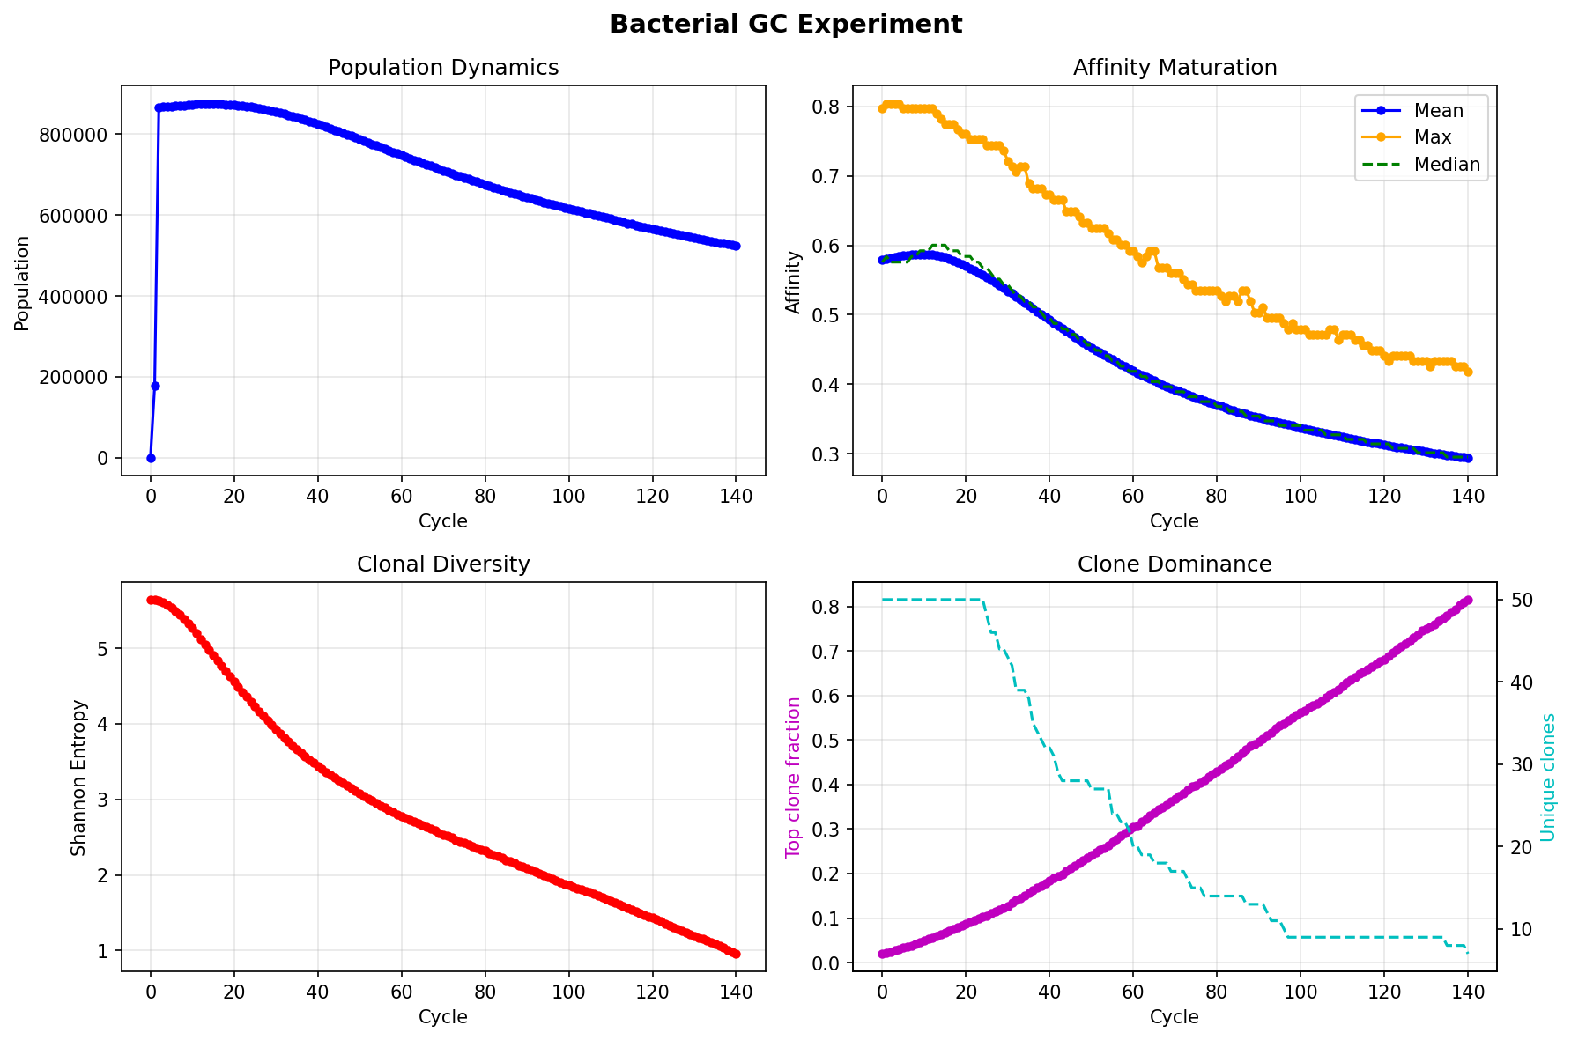
FIRST RESULTS
N=1M Run — Muller's Ratchet
Parameters
N = 1,000,000
L = 400, mut_rate = 5×10⁻⁴
140 cycles, 108 min runtime
Result
Mean aff: 0.58 → 0.29
Max aff: 0.80 → 0.42
Top clone: 2% → 80%
Diagnosis: mutation load
overwhelms selection
(Muller's ratchet)
9 / 20

Slide 10
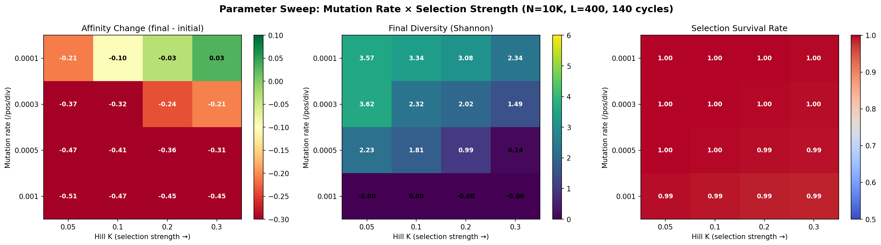
FIRST RESULTS
Parameter Sweep: mutation_rate × hill_k
L=400, N=10K, 140 cycles | 4×4 grid | 1 MATURATION, 1 STABLE, 14 DEGRADATION
10 / 20

Slide 11
FIRST RESULTS
Why Stronger Selection Makes Things Worse
Counter-intuitive result:
K=0.05 (strong selection) degrades FASTER than K=0.3 (weak selection)
Mechanism — the death spiral:
1. Strong selection kills low-affinity cells
2. Reduced population → less diversity
3. Mutations mostly deleterious at these rates
4. Best clone degrades → gets killed → spiral continues
Why weak selection works:
K=0.3 gives ~88% survival — keeps population large and diverse.
Large population = more chances for rare beneficial mutations to arise.
Selection is gentle enough to favor but not destroy.
11 / 20

Slide 12
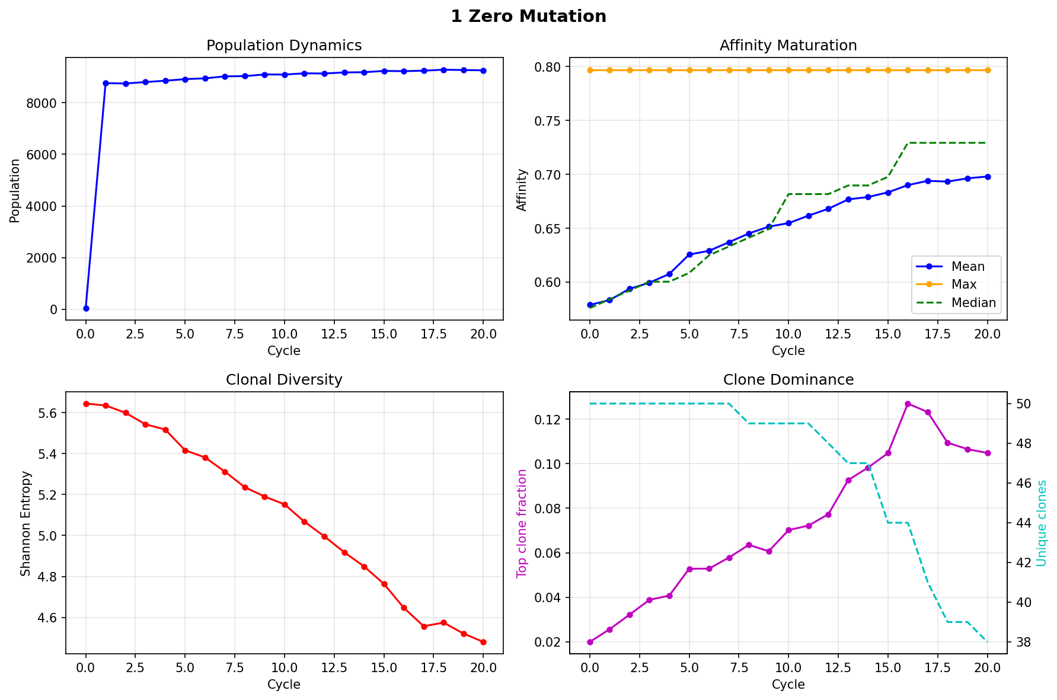
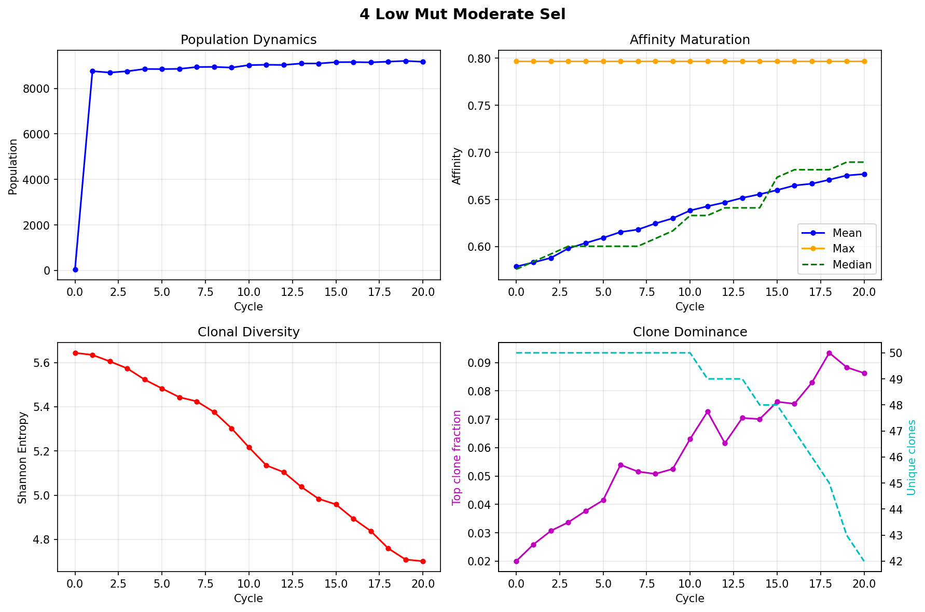
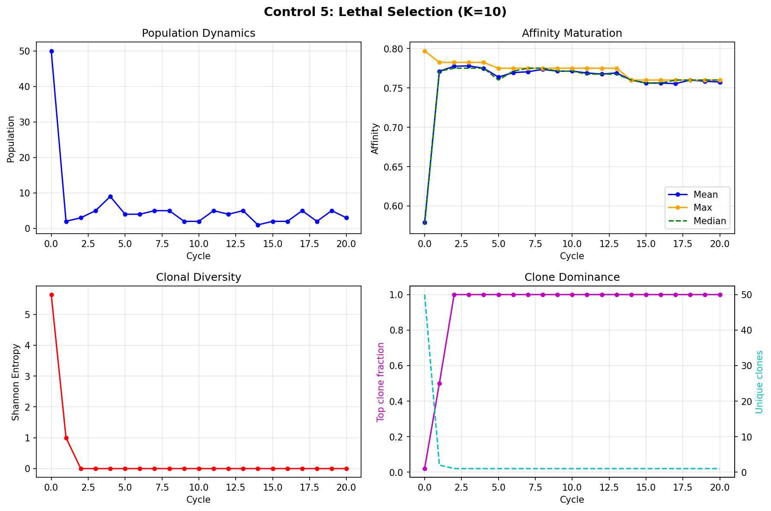
VALIDATION
5 Simulation Validation Controls
# | Control | Expected | Δ Affinity | Pop | Verdict
1 | Zero mutation, K=0.3 | Aff rises (pure selection) | +0.11 | 9,253 | PASS ✓
2 | No selection (K=0.001) | Pop stable, aff drifts | -0.05 | 10,000 | PASS ✓
3 | DE top-1%, no mutation | Single best clone | 0.00 | 100 | PASS ✓
4 | Low mut (10⁻⁵) + K=0.3 | Slow maturation | +0.09 | 9,168 | PASS ✓
5 | Lethal selection (K=10) | Pop collapse | -0.01 | 3 | PASS ✓
12 / 20

Slide 13
VALIDATION
Mutation Rate Calibration Error
⚠ First sweep rates (10⁻⁴ – 10⁻³/bp/div) were 10–100× ABOVE actual T7 variant range
This explains why almost everything degraded —
we were running at impossibly high mutation rates.
Control 4 proved maturation works at 10⁻⁵ — which IS a real T7 rate.
13 / 20

Slide 14
VALIDATION
T7 Polymerase Variant Rates
Variant | Description | Rate (/bp/div) | mut/gene/div | In sweep?
WT E. coli | Normal replication | 10⁻⁹ | 4×10⁻⁷ | Baseline
T7 V1 | WT + exo + thioredoxin | 10⁻⁸ | 4×10⁻⁶ | NEW ✓
T7 V2 | WT + exonuclease | 10⁻⁷ | 4×10⁻⁵ | NEW ✓
T7 V3 | WT exonuclease⁻ | 10⁻⁶ | 4×10⁻⁴ | NEW ✓
T7 V4 | Error-prone exo⁻ | 10⁻⁵ | 4×10⁻³ | NEW ✓
T7 V5 | Highest error | 10⁻⁴ | 0.04 | = old 0.0001
The previous sweep's ONLY maturation point (rate=0.0001) = T7 V5 (highest error variant)
14 / 20

Slide 15
L-SCALING VALIDATION
L=400 → L=40: Scaling for GPU
Parameter | L=400 | L=40 | Rule
shape_space_dim | 400 | 40 | ÷10
mutation_rate | varies | ×10 | rate × L constant
affinity_gamma (γ) | 105 | 10.5 | ÷10
initial_hamming | 50-100 | 5-10 | ÷10
N, cycles, dz_div | same | same | unchanged
Why L=40? At L=40, N=10⁷ fits in 1.6 GB VRAM vs 16 GB at L=400. This enables GPU-scale experiments on the RTX 2080 Ti.
15 / 20

Slide 16
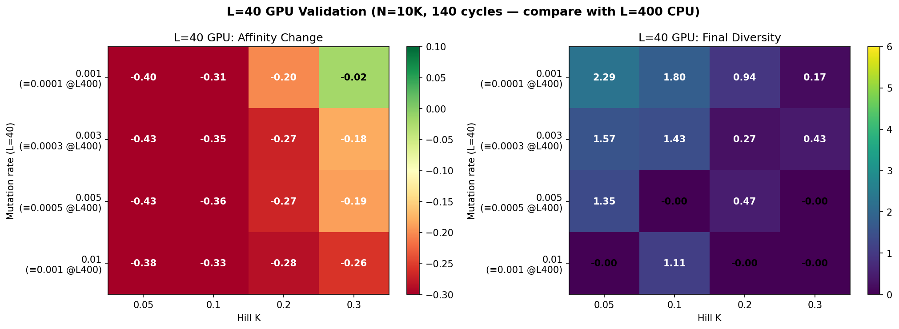
L-SCALING VALIDATION
L=400 vs L=40: Heatmap Comparison
L=400 (CPU)
L=40 (GPU validation)
✓ Same qualitative pattern | Maturation boundary at same position | Quantitative differences explained by L discretisation
16 / 20

Slide 17
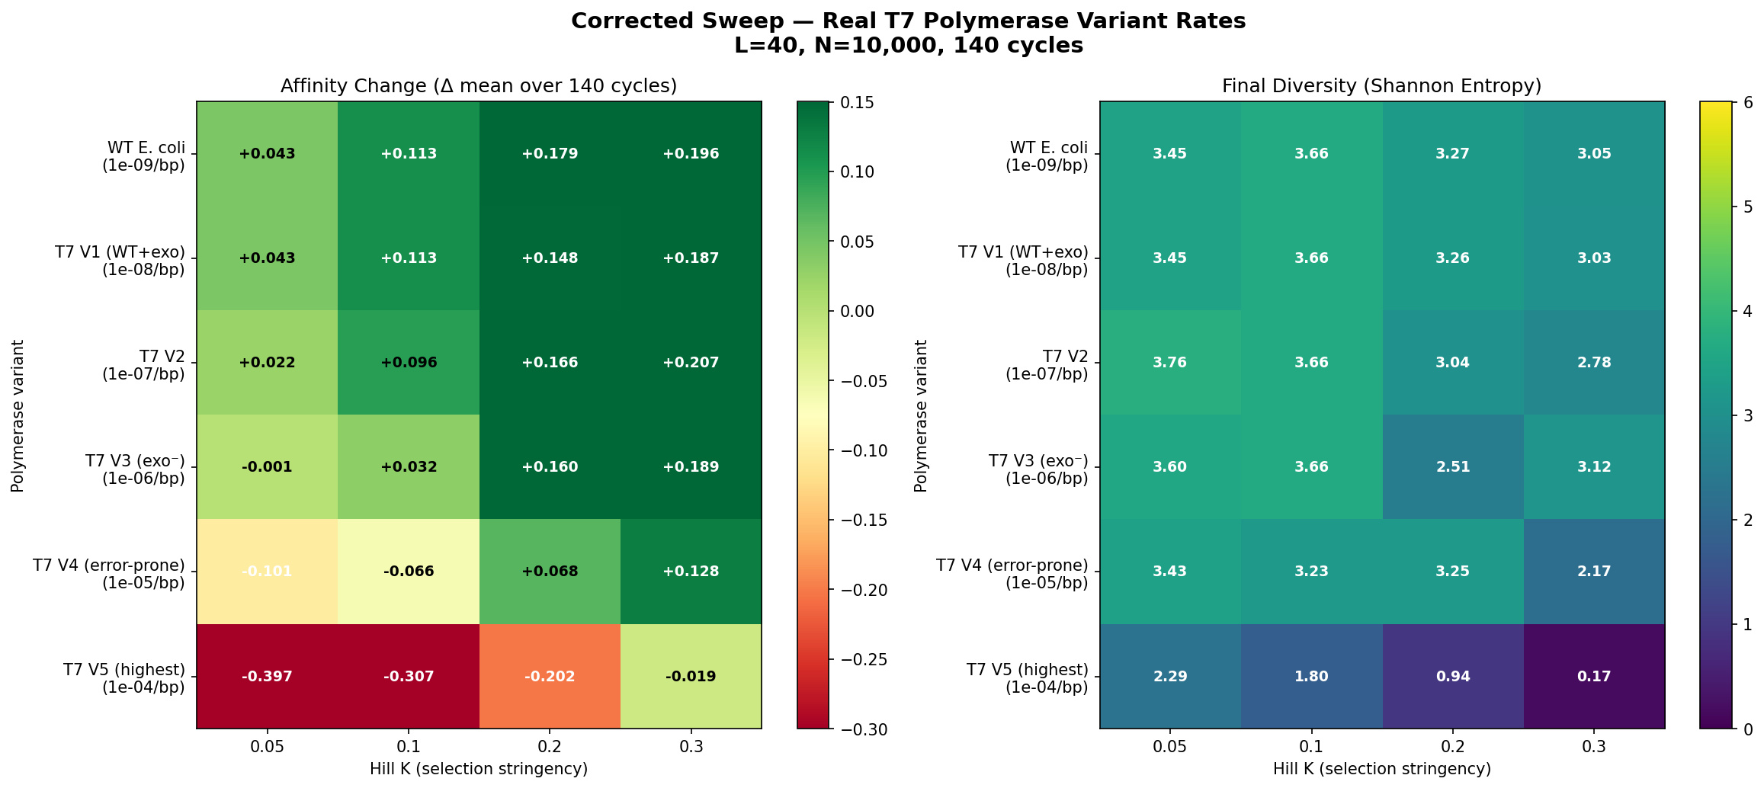
CORRECTED RESULTS
Corrected Sweep: Real T7 Variant Rates
6 biologically grounded rates × 4 hill_k = 24 runs | L=40, N=10K, 140 cycles
17 / 20

Slide 18
CORRECTED RESULTS
Key Insight: Maturation at Biologically Relevant Rates
At real T7 rates (≤10⁻⁵/bp/div), the simulation consistently
produces affinity maturation — the system works!
What we learned:
1. Mutation rate is the dominant parameter
Rate determines maturation vs degradation. Selection strength is secondary.
2. Weaker selection consistently outperforms stronger selection
K=0.3 (~88% survival) > K=0.05 (~99.9% survival) at every mutation rate.
3. There exists a critical mutation rate threshold
Below this threshold → maturation. Above → Muller's ratchet.
18 / 20

Slide 19
OUTLOOK
Next Steps
HIGH
• GPU scaling to N=10⁷ — does larger pop shift maturation boundary?
• GC vs directed evolution — code ready, run on T7 rate grid
MEDIUM
• DZ/LZ cycling speed sweep (dz_divisions ∈ {2,3,4,6,8,12})
• Initial library affinity sweep — does quality matter?
• Multi-seed validation (5-10 seeds at boundary)
FUTURE
• Multi-epitope (3 antigens) — can GC maintain parallel maturation?
• 96-well parallel simulation
• Antigen co-evolution
19 / 20

Slide 20
OUTLOOK
Open Scientific Questions
Q1: How large must N be for reliable maturation?
Q2: What is the max mutation rate for maturation at a given N?
Q3: How does DZ/LZ cycling frequency affect mutation load?
Q4: Does the GC architecture outperform directed evolution?
Q5: How realistic is Hill selection vs bead binding?
Q6: Can the system mature against multiple epitopes?
Q9: How sensitive is maturation to landscape shape?
Q11: How much does initial library affinity matter?
20 / 20

