Slide 1
NEB Boost for Small Municipalities 2026
Information Session
6 March 2026

Slide 2
Welcome

Slide 3
AGENDA
Introduction to NEB Boost for Small Municipalities 2026
Eligibility criteria
Award criteria
Timeline
Useful tools
Q&A

Slide 4

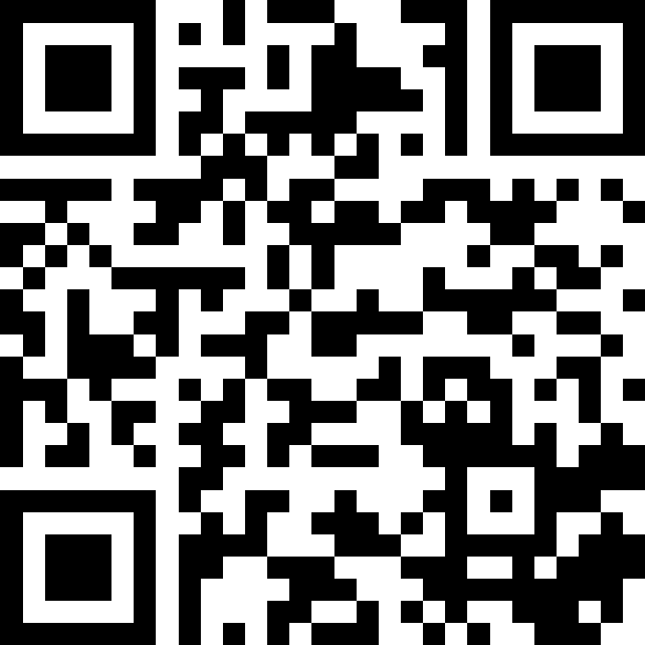
QR CODE
Please ask your questions throughout the presentation. We will take 30 minutes at the end to answer your questions.
Slido code: # 5679761

Slide 5
Introduction to NEB Boost for Small Municipalities
QUESTIONS?
Slido code: # 5679761

Slide 6
The NEB Boost for Small Municipalities
The first edition of the Boost was launched in 2025 and awarded 20 Boost prizes to small municipalities.
With the support of the European Parliament, the NEB boost to small municipalities aims to provide support to small players that want to develop projects that are inclusive, sustainable and beautiful by helping them to overcome early barriers.

Slide 7
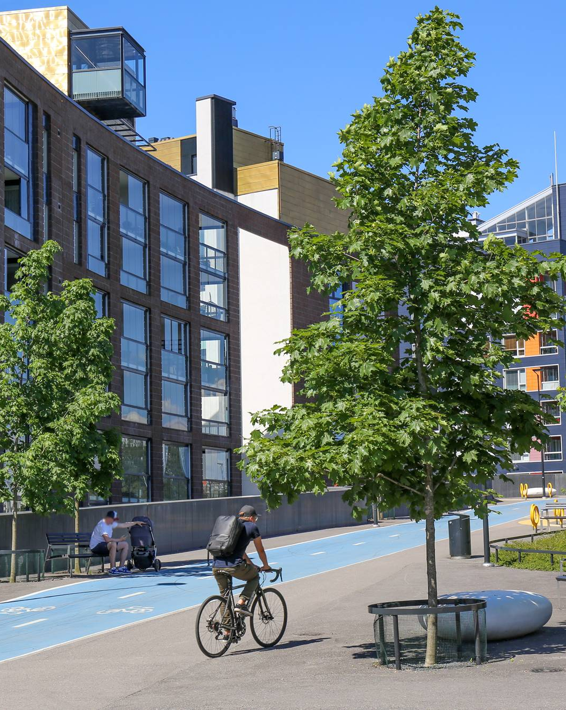
NEB Boost Prize 2026 Awards
20 Winners
each receiving €30,000

Slide 8




The 4 Categories
Enhancing Circularity, Sustainability, and Innovation
Strengthening Local Democracy and Inclusion
Arts, Culture, and Heritage as Drivers of Change
Enablers for New European Bauhaus Transformation

Slide 9
Eligibility criteria
The following slides provide a high-level overview of the eligibility criteria. The full and legally binding eligibility conditions are set out in the official guidance documents
QUESTIONS?
Slido code: # 5679761

Slide 10
Eligibility criteria
What type of projects?
The project should be aligned with NEB values (sustainable, inclusive, beautiful) and working principles (participatory process, multi-level engagement, transdisciplinary approach).
The project must focus on the built environment – such as the construction, renovation, and adaptation of buildings and public spaces.
Eligible projects should have achieved a sufficient level of maturity and demonstrate an emerging participatory approach.
Projects must be replicable in other contexts.

Slide 11
Eligibility criteria
Who can apply?
All applications must be submitted by a public authority representing a Local Administrative Unit (LAU) within an EU Member State. To be eligible, these authorities must meet at least one of the following criteria:
Classified by Eurostat's degree of urbanisation (DEGURBA code 2 or 3), meaning they are recognised as a town, suburb, or rural area.
Have a population of less than 20,000 inhabitants.
Projects, that have received a monetary EU prize are ineligible for this competition. However, projects that have previously received public funding, including from the EU, (e.g. a grant) are eligible, as long as they have not won a monetary EU prize.

Slide 12
Award criteria
QUESTIONS?
Slido code: # 5679761

Slide 13
Award Criteria
The quality assessment of applications will be conducted by external, independent experts based on the following award criteria :
Exemplary character in the 3 core values of NEB (40 / 100 points)
Exemplary character in the 3 main working principles of NEB (40 / 100 points)
Innovative dimension (10 / 100 points)
High potential for transferability (5 / 100 points)
Demonstrated feasibility and strong potential for implementation (5 / 100 points)

Slide 14
Timeline
QUESTIONS?
Slido code: # 5679761

Slide 15
Timeline
Eligibility check (planned for March 2026)
Quality assessment (planned for April 2026)
Establishment of the list of finalists
Jury assessment (planned for June 2026)
Establishment of the results (planned for July-September 2026)
CALL OPEN PERIOD
Launch: 20 February 2026
Deadline: 17 March 2026

Slide 16
Useful tools
QUESTIONS?
Slido code: # 5679761

Slide 17
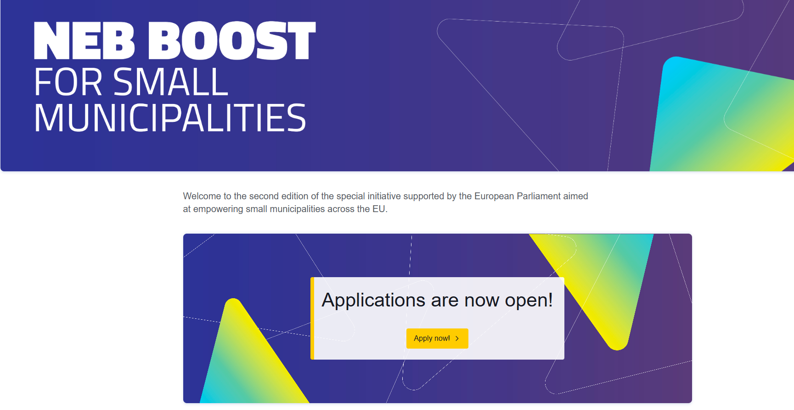
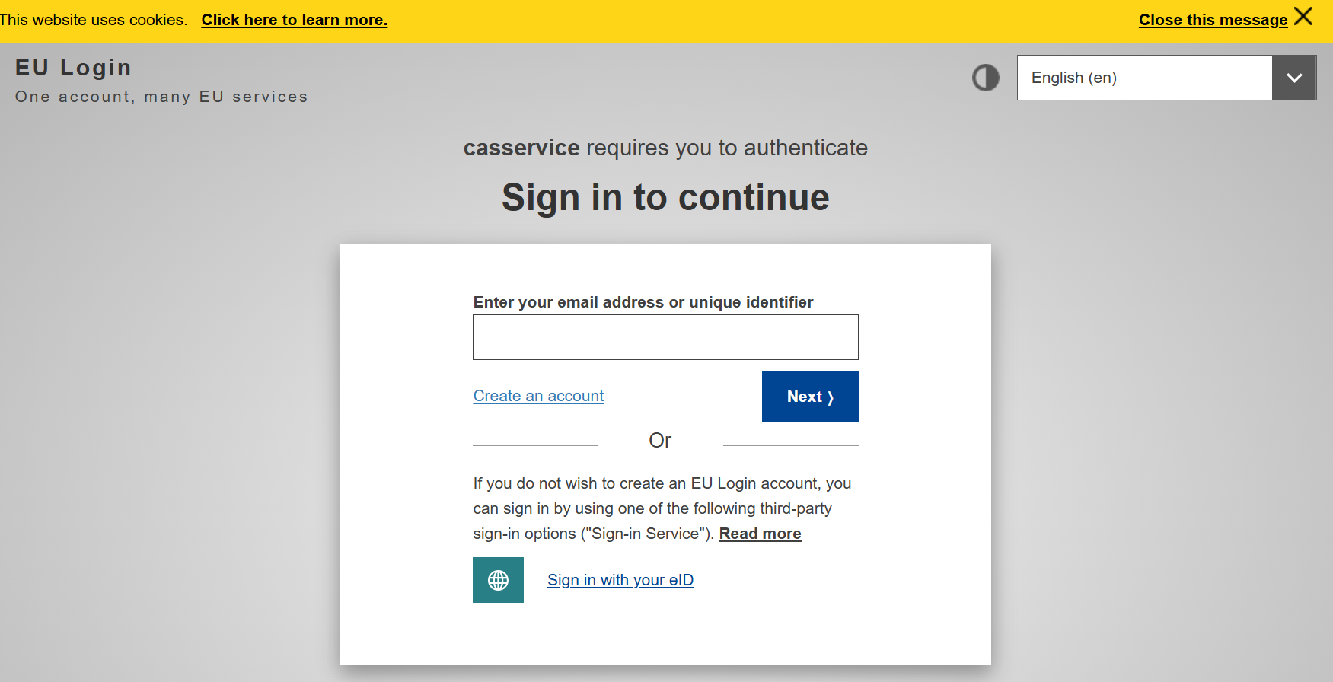
Online Application Form
Your application must be submitted online. Use the « Apply now » button on the home page of the NEB Boost Prizes website
You will be redirected to the online platform to fill in the application form

Slide 18
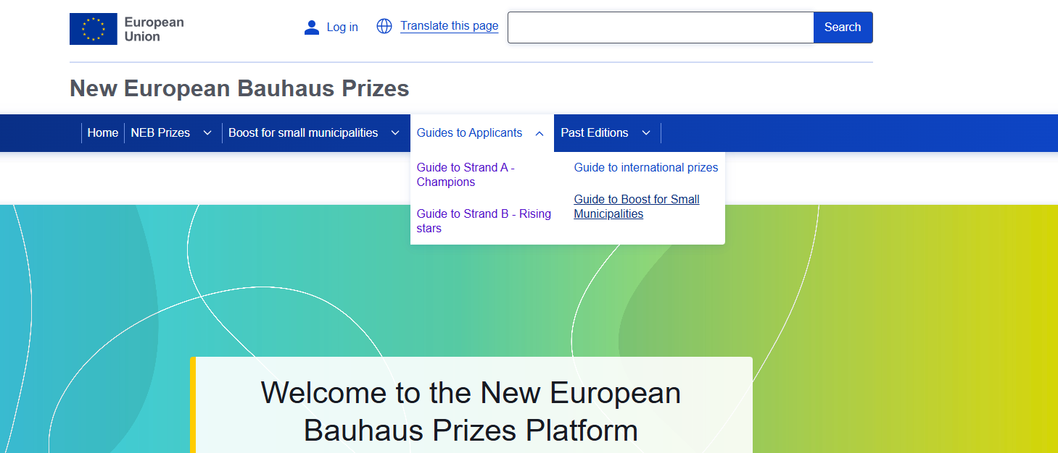
Guides to applicants
On the NEB Prizes webpage, you can find guides to applicants for each prize https://prizes.new-european-bauhaus.europa.eu/

Slide 19
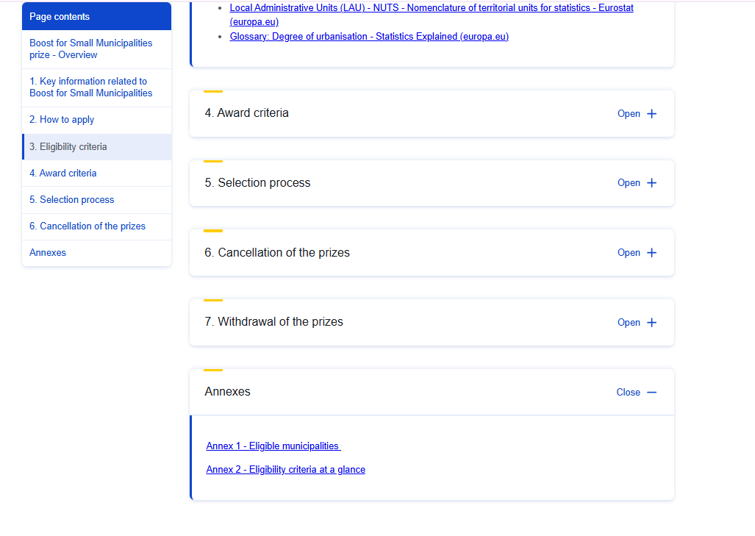
Guides to applicants
Annex 1 of the guide lists Eligibile municipalities
https://prizes.new-european-bauhaus.europa.eu/guide-boost-small-municipalities#section-367538

Slide 20
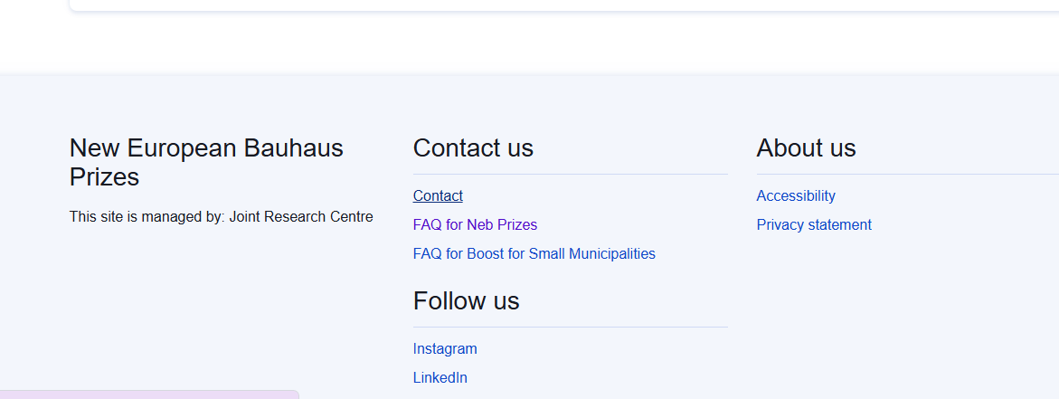
Other existing resources
On the New European Bauhaus general page https://new-european-bauhaus.europa.eu/tools-and-resources_en
NEB compass, which outlines the values and working principles of the initiative and illustrates diverse levels of ambition
NEB checklist to test the coherence of your application.
On the NEB Prizes website: https://prizes.new-european-bauhaus.europa.eu/
Examples of winning applications are available
FAQ and contact form
Home page of the NEB Prizes website

Slide 21
Q&A

Slide 22
QR CODE
Please ask your questions throughout the presentation. We will take 30 minutes at the end to answer your questions.
Slido code: # 5679761

Slide 23
THANK YOU!

