Slide 1


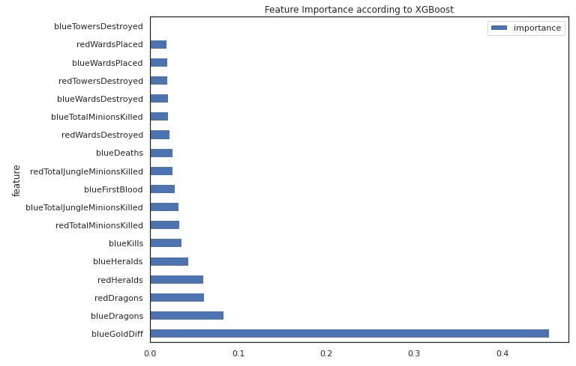
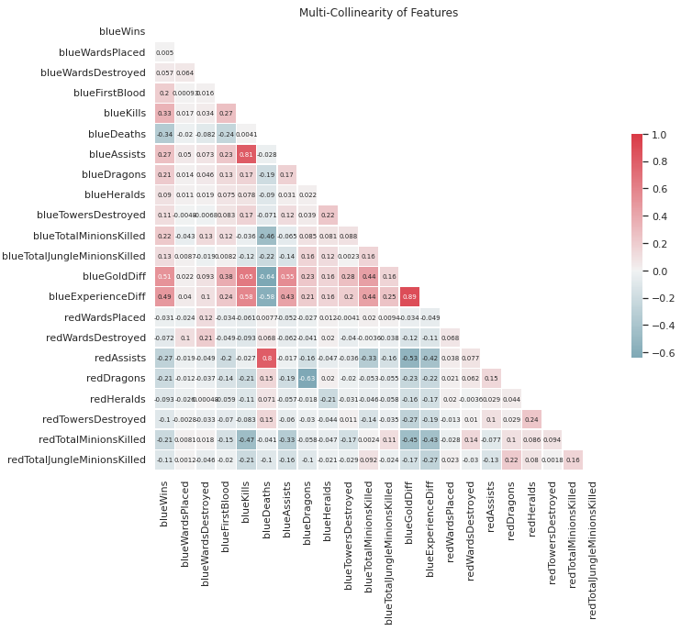
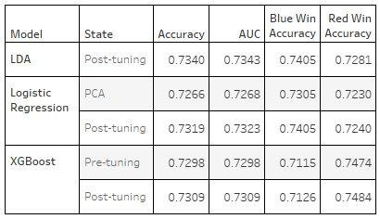
League of Legends Game Outcome Predictor
Frank Rodriguez and Michael Seman
Miami Dade College – CAP 4767 – Data Mining
INTRODUCTION
METHODS
RESULTS
CONCLUSIONS
Every day over 12 million people log on to their PC to play League of Legends. A free to play, team based, 5 vs 5 online game, League generated nearly $1.8 billion in revenue last year. It features 5 different roles/positions for a player and over 160 characters to choose from. The goal is to fight from one end of the map to the other, destroying minions, towers, and killing enemy players on the way to the goal of destroying the enemy’s nexus (base) to win the game.
Feature Selection resulted in using only 21 features.
Outliers were removed by eliminating any records with a Z-score over 4. The result being 9,398 game results were analyzed.
Ten different models we examined,
The top three performing models (Logistic Regression, LDA, and XGBoost) were tuned to maximize accuracy scores.
Gold difference between the teams had the highest correlation (.51) with a team winning.
Tuning the results did not even increase model accuracy by 1%.
Our best algorithm was Linear Discriminate Analysis with 73.4% accuracy.
Being almost 75% accurate with only team statistics, 10 minutes into a game is a satisfactory result.
Any further research would necessitate more complete data including information like champions selected and individual statistics.
Feature Importance
Correlation Coefficients
OBJECTIVES
Our objective was simple: to train a machine learning model to predict as accurately as possible, the outcome of a match based on the teams’ stats at the 10-minute mark of the game. These matches last anywhere from 15 minutes to over an hour in length.
Model Performance
REFERENCES
https://coderzcolumn.com/tutorials/machine-learning/bayes-opt-bayesian-optimization-for-hyperparameters-tuning
https://towardsdatascience.com/bayesian-optimization-with-python-85c66df711ec
https://leaguefeed.net/did-you-know-total-league-of-legends-player-count-updated/
https://www.kaggle.com/datasets/bobbyscience/league-of-legends-diamond-ranked-games-10-min
DATASET
Our dataset consisted of nearly 10,000 records with 40 rows of statistics with the game state at 10 minutes from Diamond 1 to Masters ranked games.

