Slide 1
CSC 4780 – Routing Security
Susmit Shannigrahi

Slide 2
BGP is an OLD protocol
Has been in use since 1994
https://datatracker.ietf.org/doc/html/rfc1654
Security was not a concern and not baked into the protocol
Believes (without help) all advertisements from peers with no checks.
It also by default can re-advertise to other peers what it learns.

Slide 3
BGP: Path vector protocol
Loop!
Path: AS 223, AS 225, AS 245, AS 7770
Path: AS 223, AS 225, AS 245, AS 7770
AS 7770
AS 223
AS 225
Path: AS 223
Path: AS 223, AS 225
AS 245
Path: AS 223, AS 225, AS 245

Slide 4
Internet routing
What we call “The Internet” is actually an interconnection of autonomous, independent networks which use BGP to exchange routing information
BGPv4, 1994
No built-in security in BGP protocol
IRR
AS1=193.x.x.x
AS2=195.x.x.x
query
query
AS 1
193.x.x.x
AS 2
195.x.x.x

Slide 5
Incidents are common
A route leak or a route hijacks is defined as the illegitimate advertisement of an IP space
2018 routing security review
12.6k incidents
4.4% of all ASNs affected
3k ASNs victims of at least one incident
1.3k ASNs caused at least one incident
source: https://www.bgpstream.com/

Slide 6
See for yourself!
https://observatory.manrs.org/#/overview

Slide 7
What are the attacks?
Prefix Hijacking
Unauthorized AS announces someone else’s prefix.
Subprefix Hijacking
Attacker announces more specific prefix.
Route Leak
AS exports routes beyond intended scope.
AS Path Shortening
Malicious AS removes intermediate AS numbers.
AS Insertion Attack
AS Insertion Attack

Slide 8
Route / Prefix Hijacking
When a network advertises/originates a route that belongs to another network (without permission)
Not always malicious can easily be caused by misconfiguration
https://www.manrs.org/2020/09/what-is-bgp-prefix-hijacking-part-1/

Slide 9
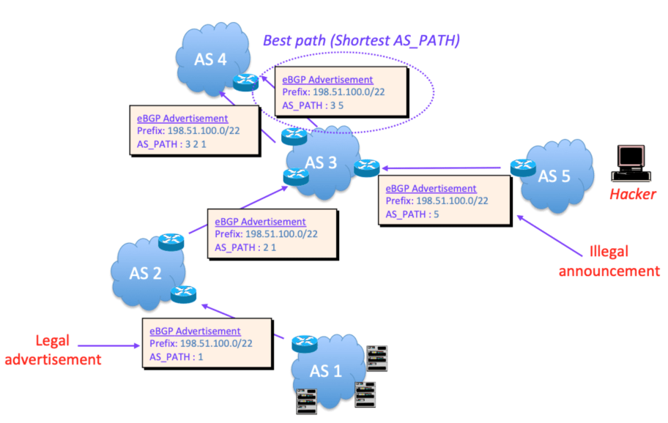
Route / Prefix Hijacking - How it works
AS Path length
https://www.manrs.org/2020/09/what-is-bgp-prefix-hijacking-part-1/

Slide 10
Sub-prefix Hijacking - How it works
Similar – but use a more specific prefix
https://www.manrs.org/2020/09/what-is-bgp-prefix-hijacking-part-1/

Slide 11
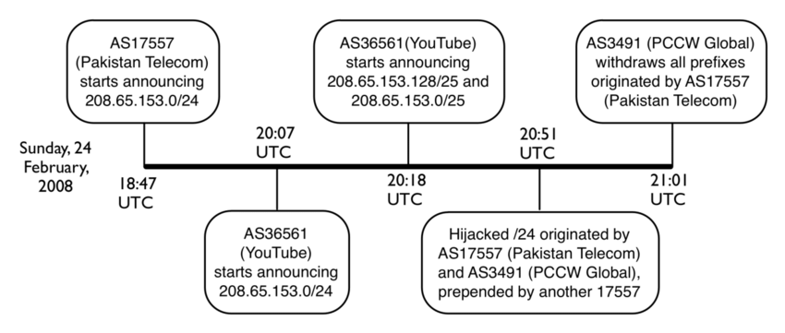
Example: Youtube and Pakistan Telecom

Slide 12
Other Hijacking examples
2018: Amazon DNS routes hijacked and redirected to malicious DNS server: https://www.internetsociety.org/blog/2018/04/amazons-route-53-bgp-hijack/
2020: Rostelecom hijacks internet traffic for Google, AWS, Cloudflare, and others: https://www.zdnet.com/article/russian-telco-hijacks-internet-traffic-for-google-aws-cloudflare-and-others/

Slide 13
Route Leak
RFC7908 - “A route leak is the propagation of routing announcement(s) beyond their intended scope.”
A multihomed stub network announces routes from one upstream providers routes to one or more of its other upstream providers
Stub network becomes an inadvertent transit provider.
Only announce AS’s and prefixes that you originate.
https://datatracker.ietf.org/doc/html/rfc7908

Slide 14
Simple Campus/Institution Route Leak Example
X: AS5, AS1
X: AS4, AS5, AS1
AS5
AS4
X: AS1
X: AS2, AS4, AS5, AS1
X
AS1
AS2
X: AS2, AS3, AS1
X: AS3, AS1
AS3
Stub network AS3 creates route leak advertising AS1 to AS2.

Slide 15
Route Leak Example
2017: Rostelecom Route Leak Targets E-Commerce Services: https://www.thousandeyes.com/blog/rostelecom-route-leak-targets-ecommerce-services
Confirmation that traffic destined for those E-Commerce sites went through the leakers network (possible inspection?)

Slide 16
So, some sort of security is needed?
Yes? No?
Where?

Slide 17
RPKI + BGPSEC
RPKI – Validates the origins
BGPSEC – Validates the paths

Slide 18
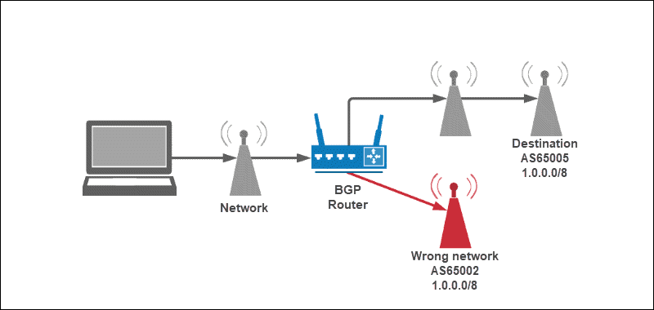
RPKI – Sign your announcements

Slide 19
What is RPKI
Resource Public Key Infrastructure is a PKI framework designed to secure the Internet Infrastructure
Helps to secure Internet routing by validating routes
The 5 RIRs hold a self-signed root certificate for all the resources they have in the registry
The root certificate is used to sign a certificate that lists your resources
The certificate hierarchy follows the same structure as the Internet Number Resource allocation
All certificates are published in publicly accessible repositories

Slide 20
RPKI – Threat Model
Unauthorized origin AS announces prefix
Traffic interception or blackholing
Accidental misconfiguration at ISP scale
Need for cryptographic origin validation

Slide 21
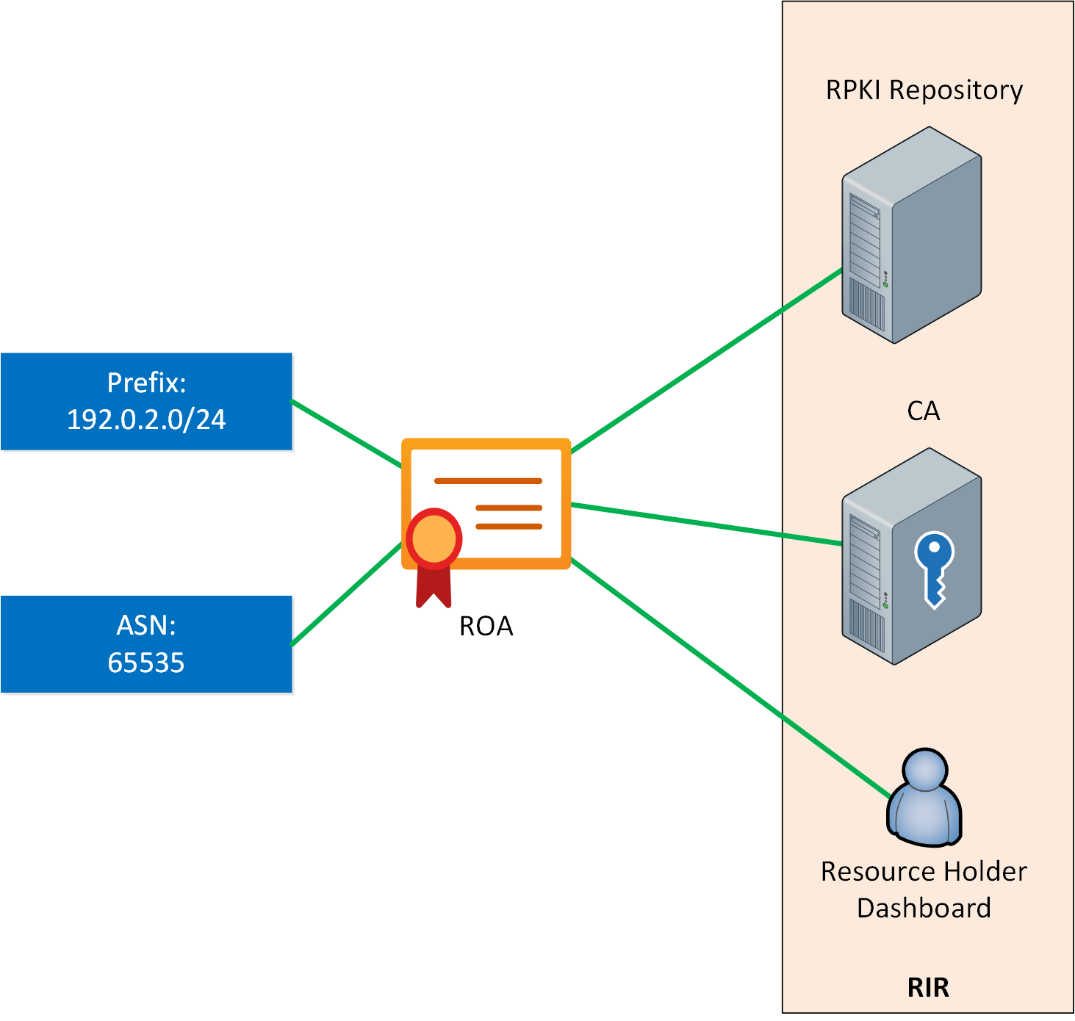
RPKI – How it works? Certificates
Create Cerifiicates
Have them signed by trust anchors (TA)
RIRs
ARIN
APNIC
RIPE
LACNIC
AFRINIC
Create signed Route Origin Authorization (ROA)
The authorized AS number.
The prefix that the AS can originate
The maximum prefix length (maxLength).

Slide 22
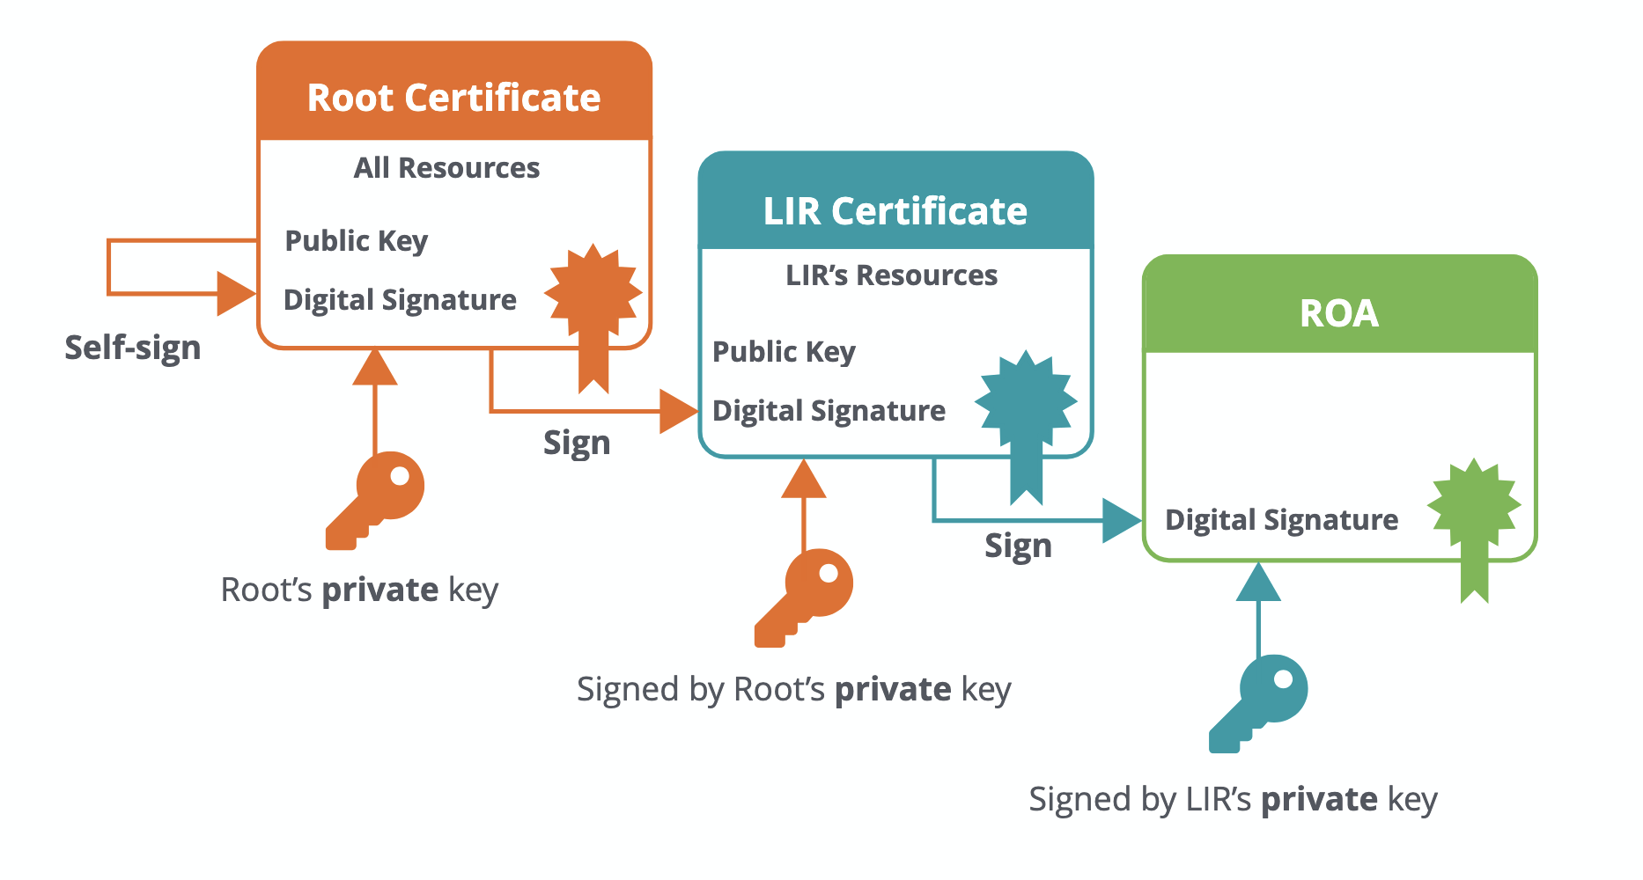
RPKI – How it works? Certificates
Create Cerifiicates
Have them signed by trust anchors (TA)
RIRs
ARIN
APNIC
RIPE
LACNIC
AFRINIC
Create signed Route Origin Authorization (ROA)
The authorized AS number.
The prefix that the AS can originate
The maximum prefix length (maxLength).

Slide 23
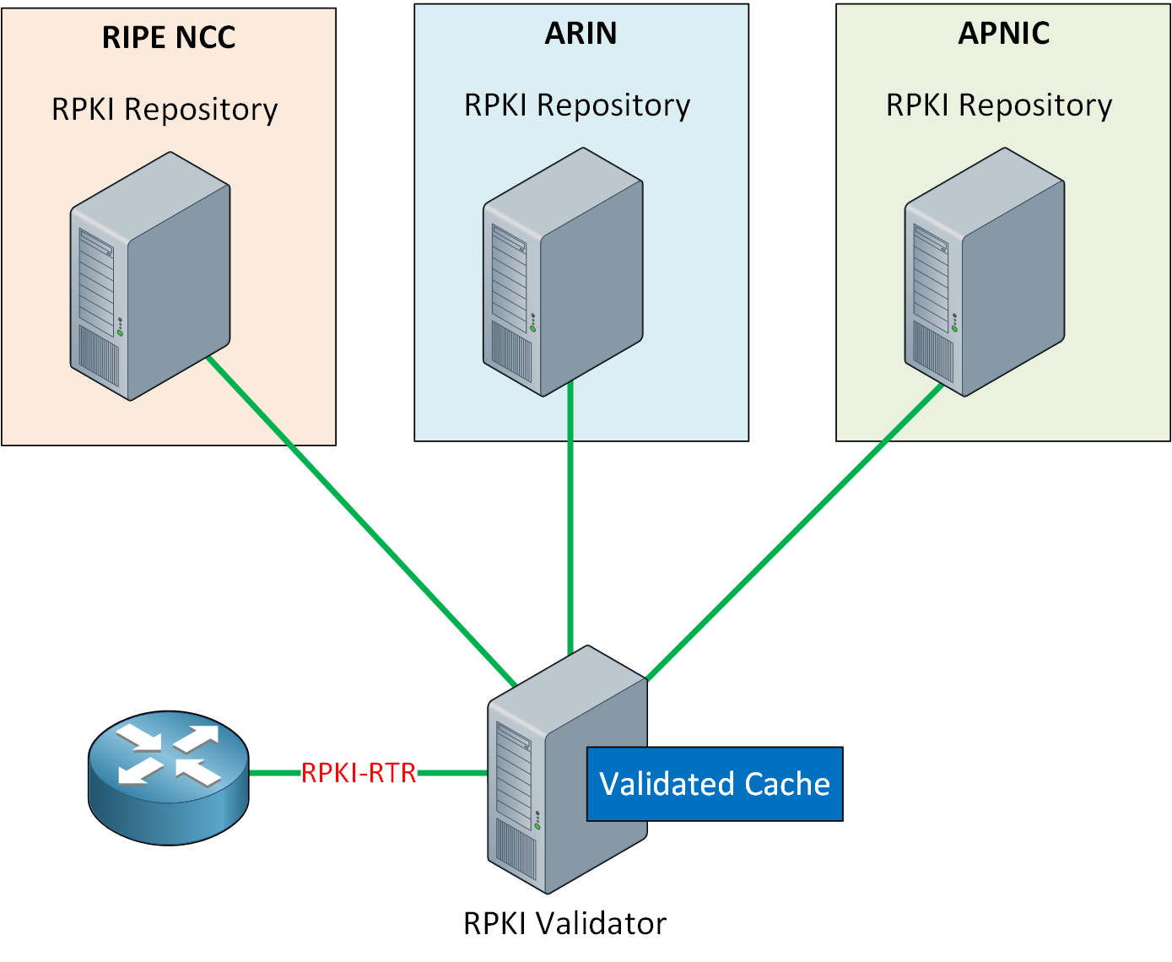
RPKI – How it works? Validation
If you receive a route advertisement, you can now validate it.
How?
One route at a time?
All at once?
RPKI validator
Looks up all records
Rsync/RRDP
Keep in cache
Routers can do quick look-up
Assign state: VALID, INVALID, NOT FOUND

Slide 24
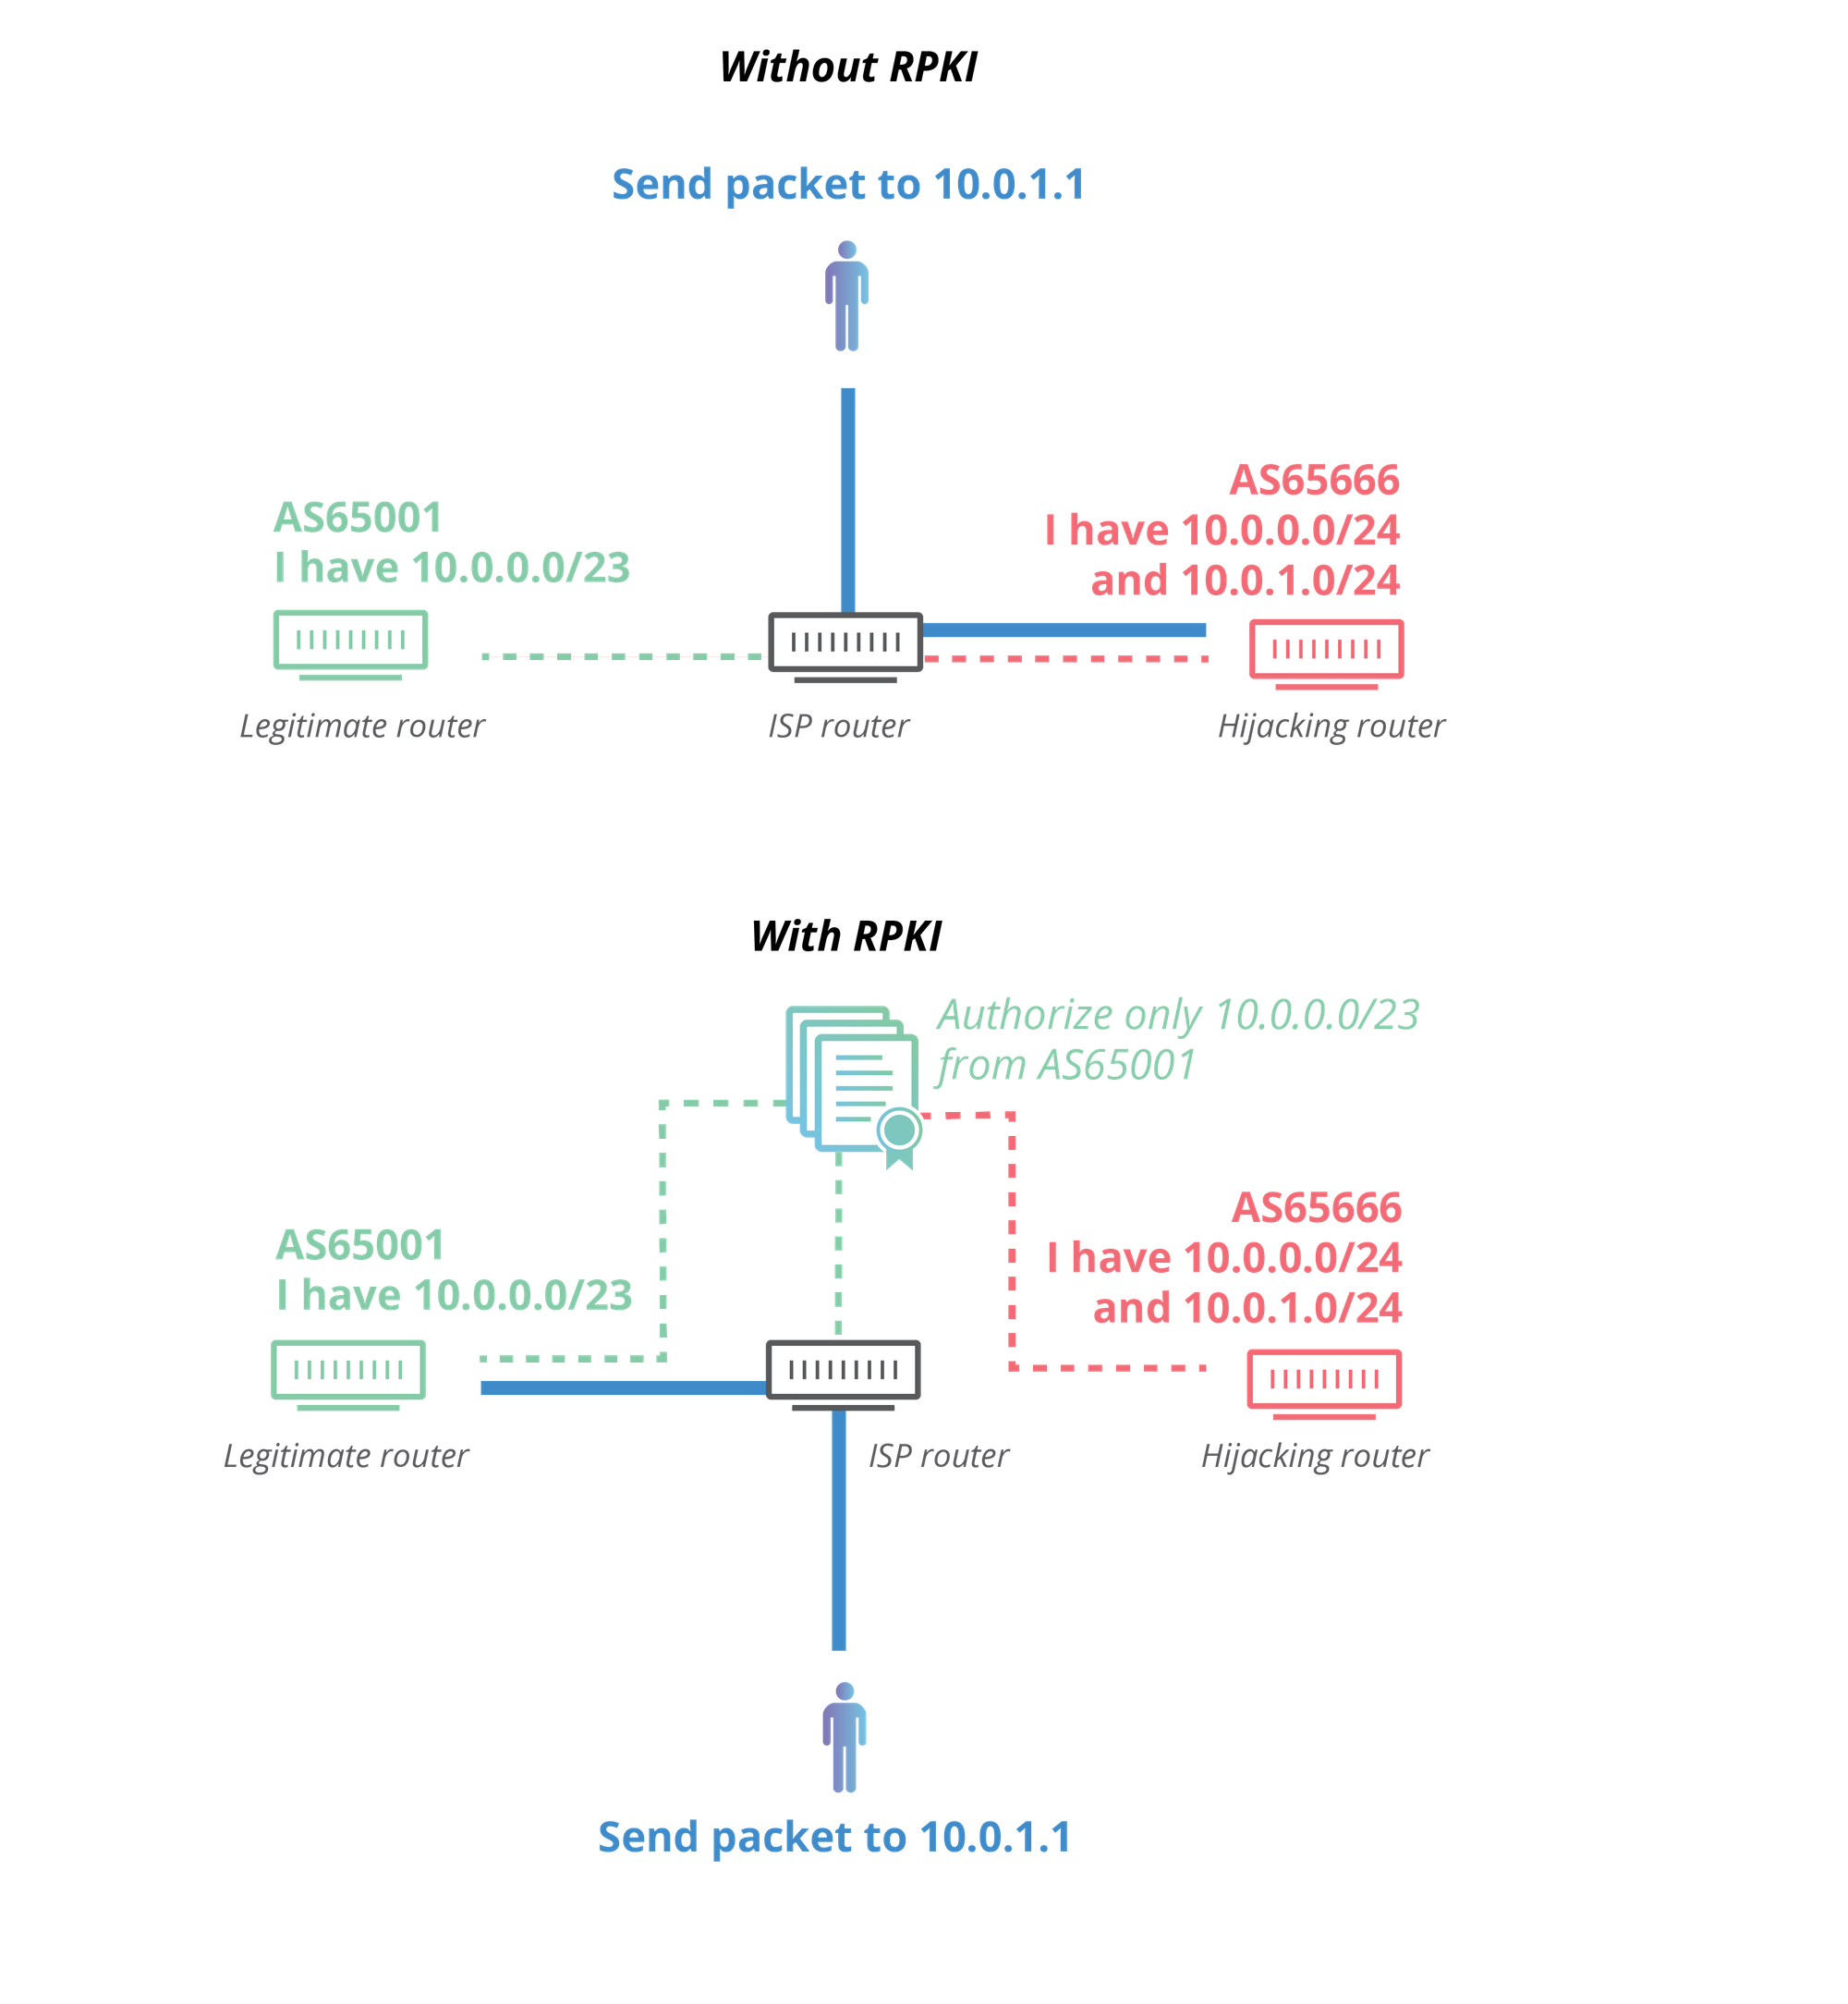
RPKI – Preventing Hijack

Slide 25
RPKI Operational Risks
Incorrect ROA causes legitimate outage
Validator synchronization delays
Fail-open vs fail-closed design choice

Slide 26
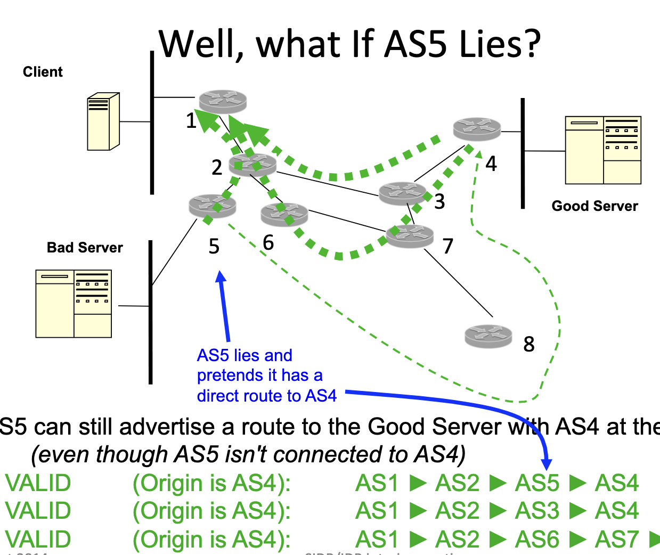
We are good – right?
No AS_PATH validation
Does not prevent route leaks
Centralized trust model concerns
Dependent on global ROA coverage
https://www.ietf.org/proceedings/interim-2014-sidr-01/slides/slides-interim-2014-sidr-1-0.pdf

Slide 27
We are good – right?
No AS_PATH validation
Does not prevent route leaks
Centralized trust model concerns
Dependent on global ROA coverage
https://www.ietf.org/proceedings/interim-2014-sidr-01/slides/slides-interim-2014-sidr-1-0.pdf

Slide 28

Enters BGPSEC
RPKI certifies resource allocation.
RPKI enables origin validation.
BGPSEC enables path validation.
Origin validation verifies originating ASN.
Path validation verifies AS_PATH integrity.

Slide 29
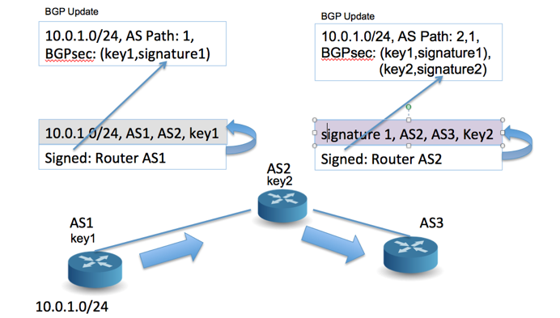
BGPSEC Core Idea
Each AS signs update before forwarding.
Signature covers accumulated path.
Covers destination (NLRI)
Signature includes neighbor ASN.
Prevents path fabrication and grafting.

Slide 30
BGPSEC Core Idea 2/2
Need to protect the formation of the AS_PATH
• Prevent grafting a valid origin onto a false path • Prevent path poisoning
• Sign each update you receive before forwarding it – Proves you did not invent the path – Include the neighbor AS in the signature – Prevent cut-and-paste reuse of signed paths
Introduce a new BGP attribute: BGPSEC_PATH
• Introduce a new capability – Send the new attribute only to neighbors that support BGPSEC

Slide 31
Standard BGP Process
Ingress filtering applied.
Best path selected.
Egress filtering applied.
AS_PATH carried as attribute.
BGPSEC_PATH replaces AS_PATH.
At ingress: validate all signatures.
At egress: append ASN and new signature.
Router keys bound to ASN in RPKI.

Slide 32
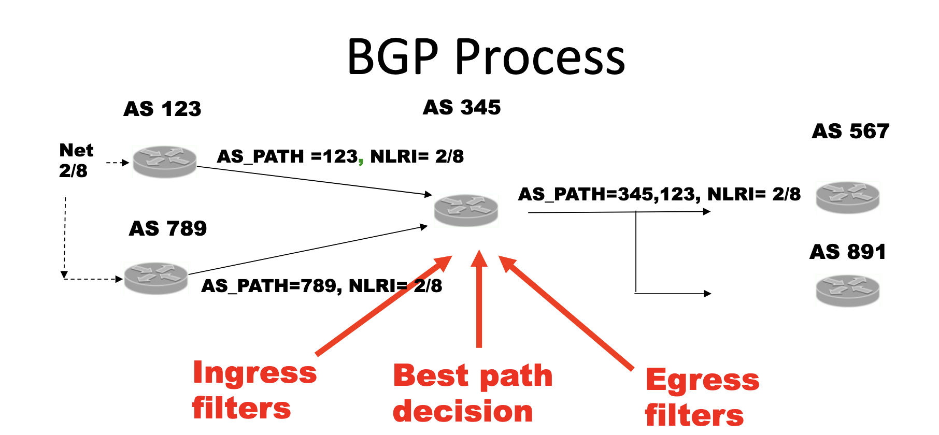
Standard vs BGPSEC Process
BGP receives many routes to the same prefix
•Ingress filter decides what routes to consider
•Decision process picks just one best route
•Egress filter decides what neighbors receive an update

Slide 33
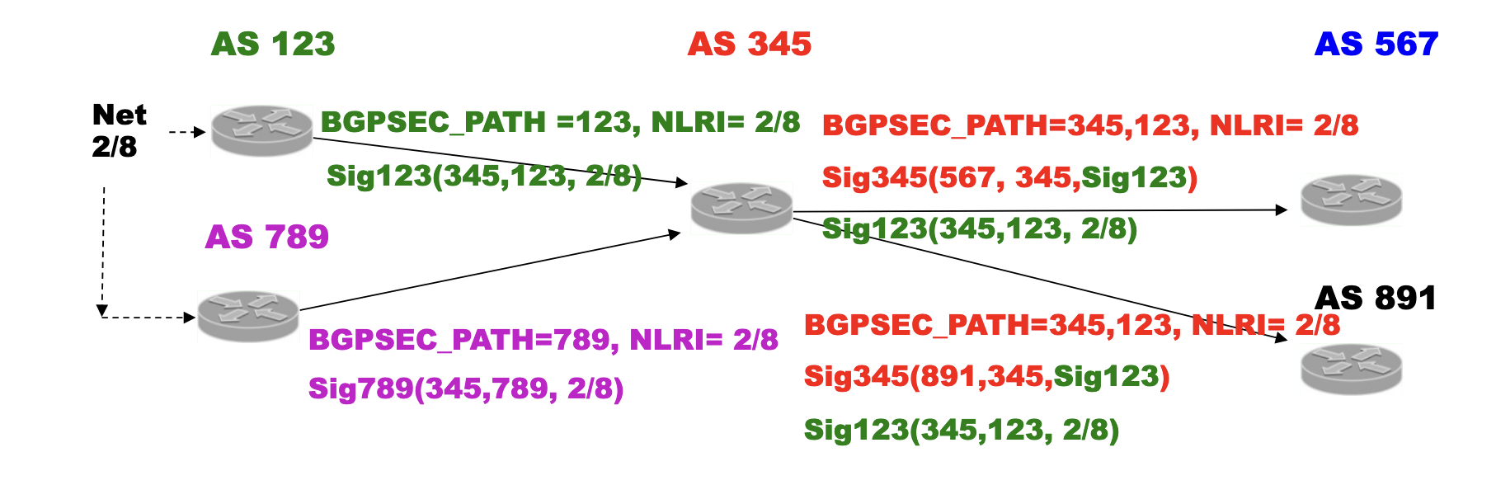
Standard vs BGPSEC Process
Each update has a signature for each AS in the BGPSEC_PATH
• Each signature covers BGPSEC_PATH to that point and the “sent-­‐to” AS
• At ingress, check all signatures
• At egress, add a new signature to the list when you add your AS, and
include the AS you are sending to in the signature
• Routers have keys ;ed to their AS in the RPKI

Slide 34
BGPSEC Process
AS1
(Origin)
AS2
AS3
(Validator)
BGPSEC_PATH replaces AS_PATH.
At ingress: validate all signatures.
At egress: append ASN and new signature.
Router keys bound to ASN in RPKI.
Prefix: 203.0.113.0/24
BGPSEC_PATH: [AS1, AS2]
AS1 signs and sends to AS2
AS2 signs and sends to AS3
AS3 validates both signatures
If valid, path is accepted

Slide 35
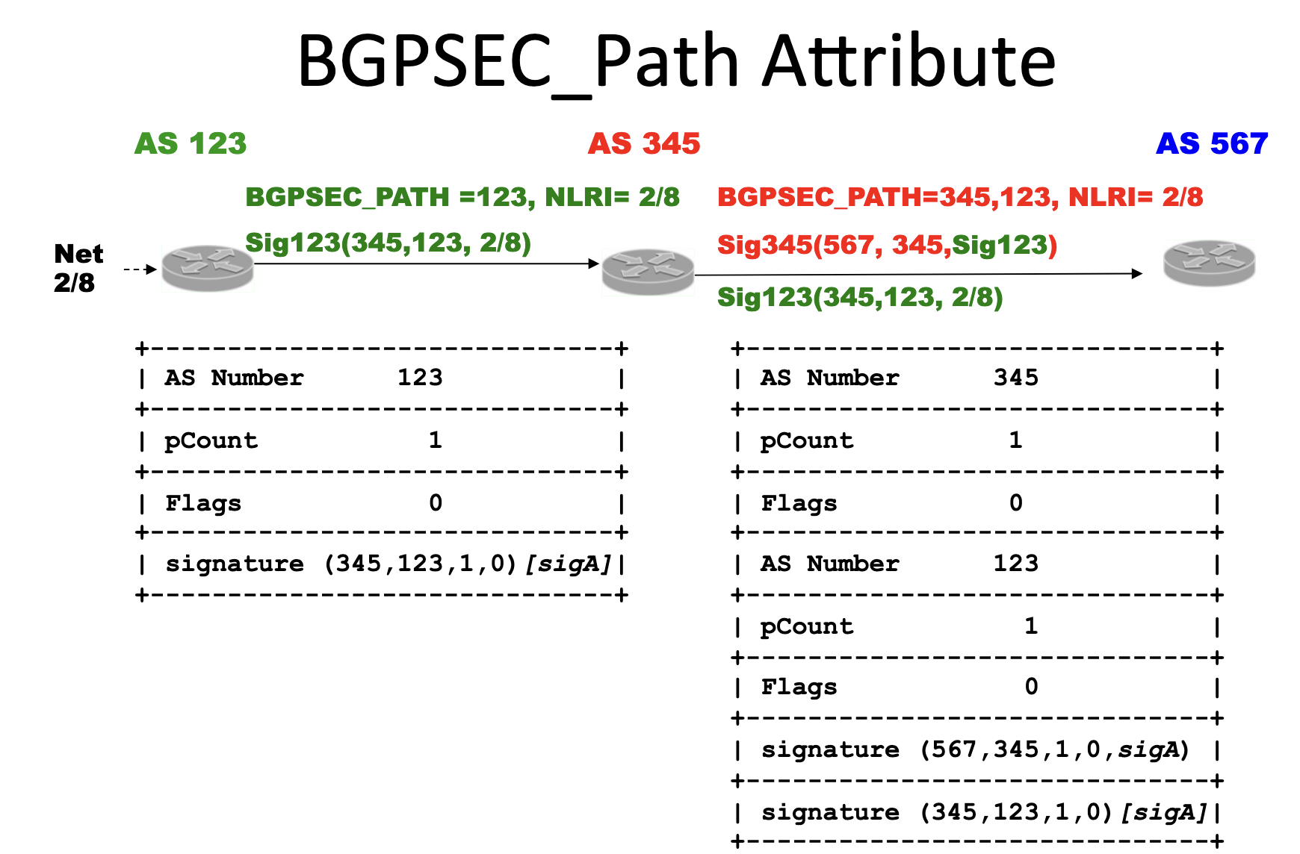
Key Differences from BGP
AS_PATH derived from BGPSEC_PATH.
One NLRI per update.
One neighbor per update.
Attribute stripped for non-BGPSEC peers.

Slide 36
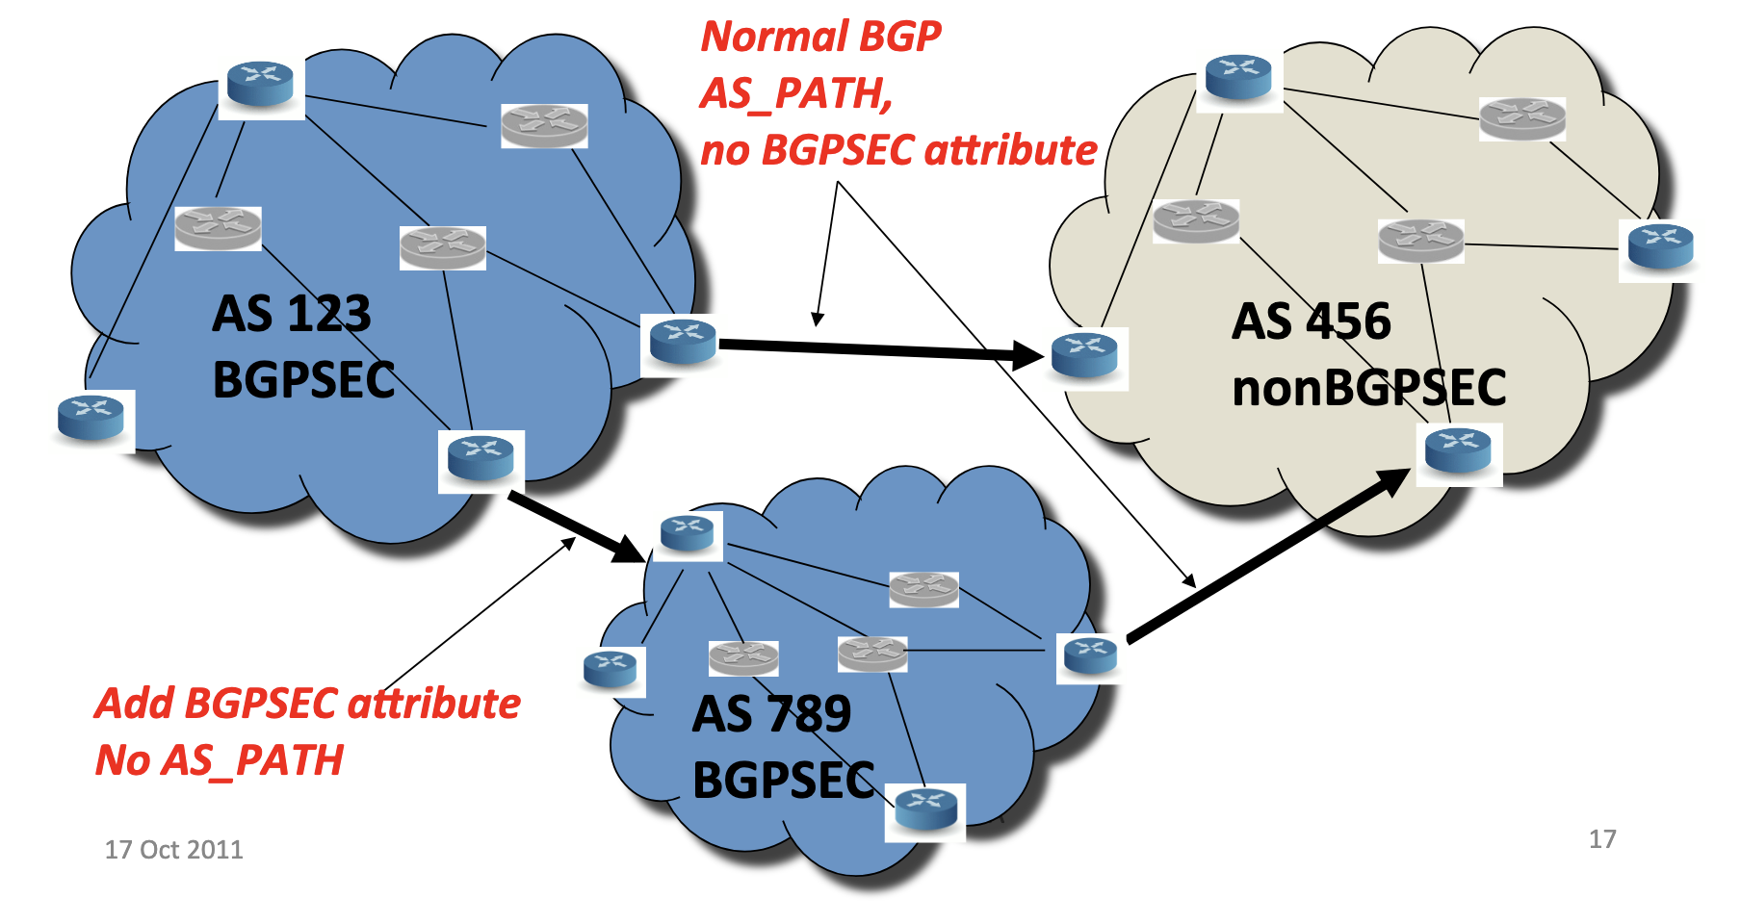
BGPSEC vs. non BGPSEC
BGPSEC akribute only used with BGPSEC speaking neighbor
BGPSEC akributes in an Update get stripped for nonBGPSEC neighbor

Slide 37
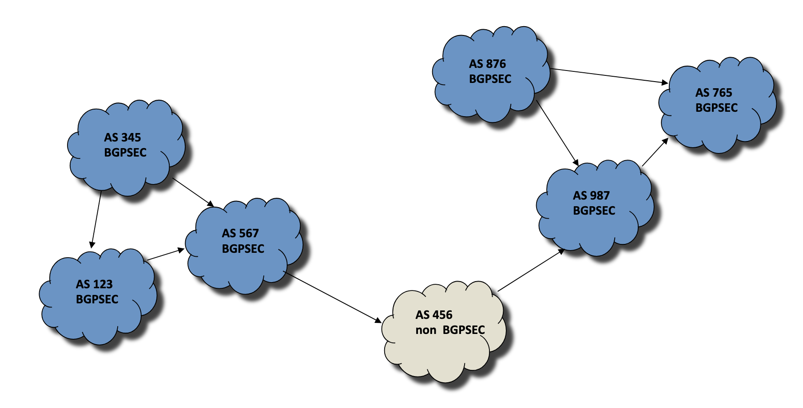
Islands of BGPSEC
Non BGPSEC speaker can’t pass BGPSEC attributes – keeps islands apart
Also a problem in deployment

Slide 38
No significant BGPSEC deployment
High computational cost due to per-hop cryptographic signatures • Increased router CPU, memory, and processing requirements • Limited benefit without widespread deployment • Vulnerable to downgrade to non-BGPsec paths • Primarily addresses origin hijacks, not complex route leaks • Reduces flexibility in prefix aggregation and optimization

Slide 39
Even if you did….IP Spoofing
Attacker creates and send IP packets with false source address
Commonly used in Distributed Denial of Service (DDOS) attacks
DNS, memcached, NTP, UDP - lots of vulnerabilities
November 2021: Microsoft detects and mitigates a 3.47Tbps (340 million packets per second) 15 minute long DDOS attack using UDP reflection.
https://azure.microsoft.com/en-us/blog/azure-ddos-protection-2021-q3-and-q4-ddos-attack-trends/

Slide 40
Reading Material
https://www.ietf.org/proceedings/interim-2014-sidr-01/slides/slides-interim-2014-sidr-1-0.pdf
RPKI - https://www.youtube.com/watch?v=Pxsk5stzJCs
https://conference.apnic.net/33/pdf/120227.apricot-rtgsec.pdf

