Slide 1
CSC 4780 – MISC
Susmit Shannigrahi

Slide 2
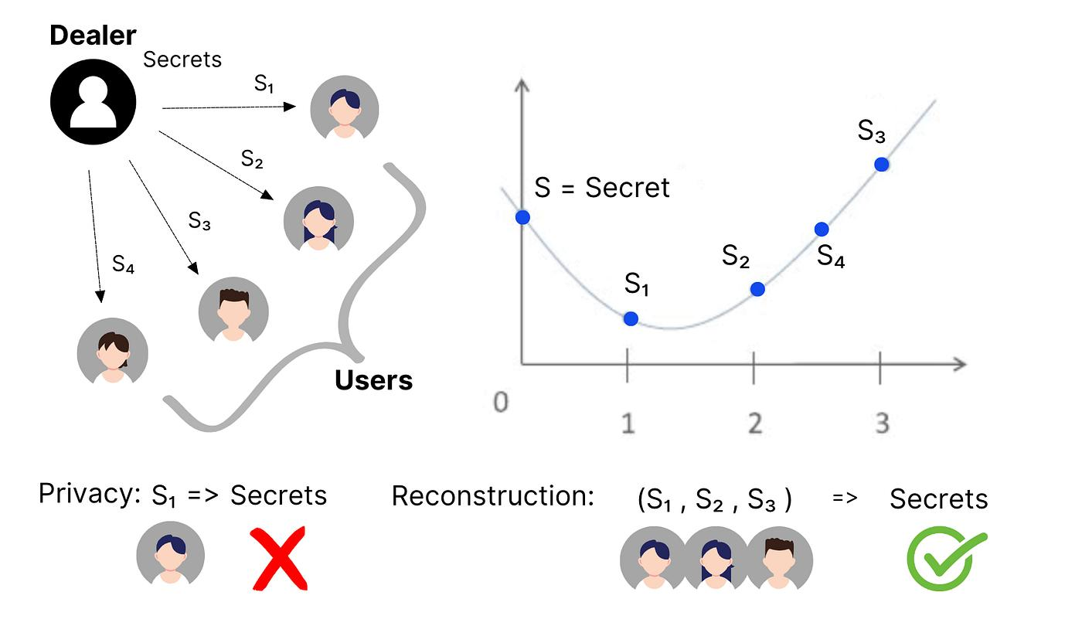
Secret Sharing - Mechanism
Secret S encoded as constant in polynomial.
Degree k-1 polynomial created.
Shares are points on curve.
Any k points reconstruct polynomial.
Fewer than k reveal nothing.

Slide 3
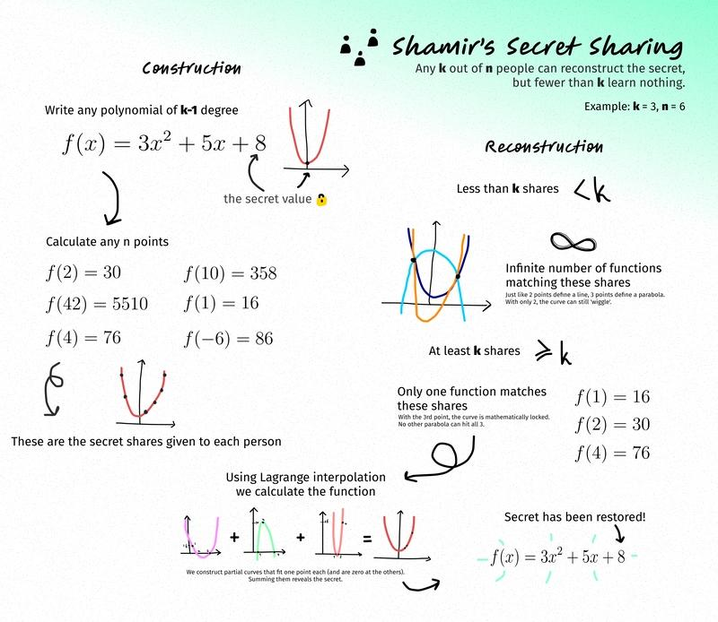
Secret Sharing - Mechanism
Secret S encoded as constant in polynomial.
Degree k-1 polynomial created.
Shares are points on curve.
Any k points reconstruct polynomial.
Fewer than k reveal nothing.

Slide 4
Blind Signature - Mechanism
Message m blinded using random R.
Blinded message sent to signer.
Signer applies private key.
User unblinds result.
Final output is valid signature on m.

Slide 5
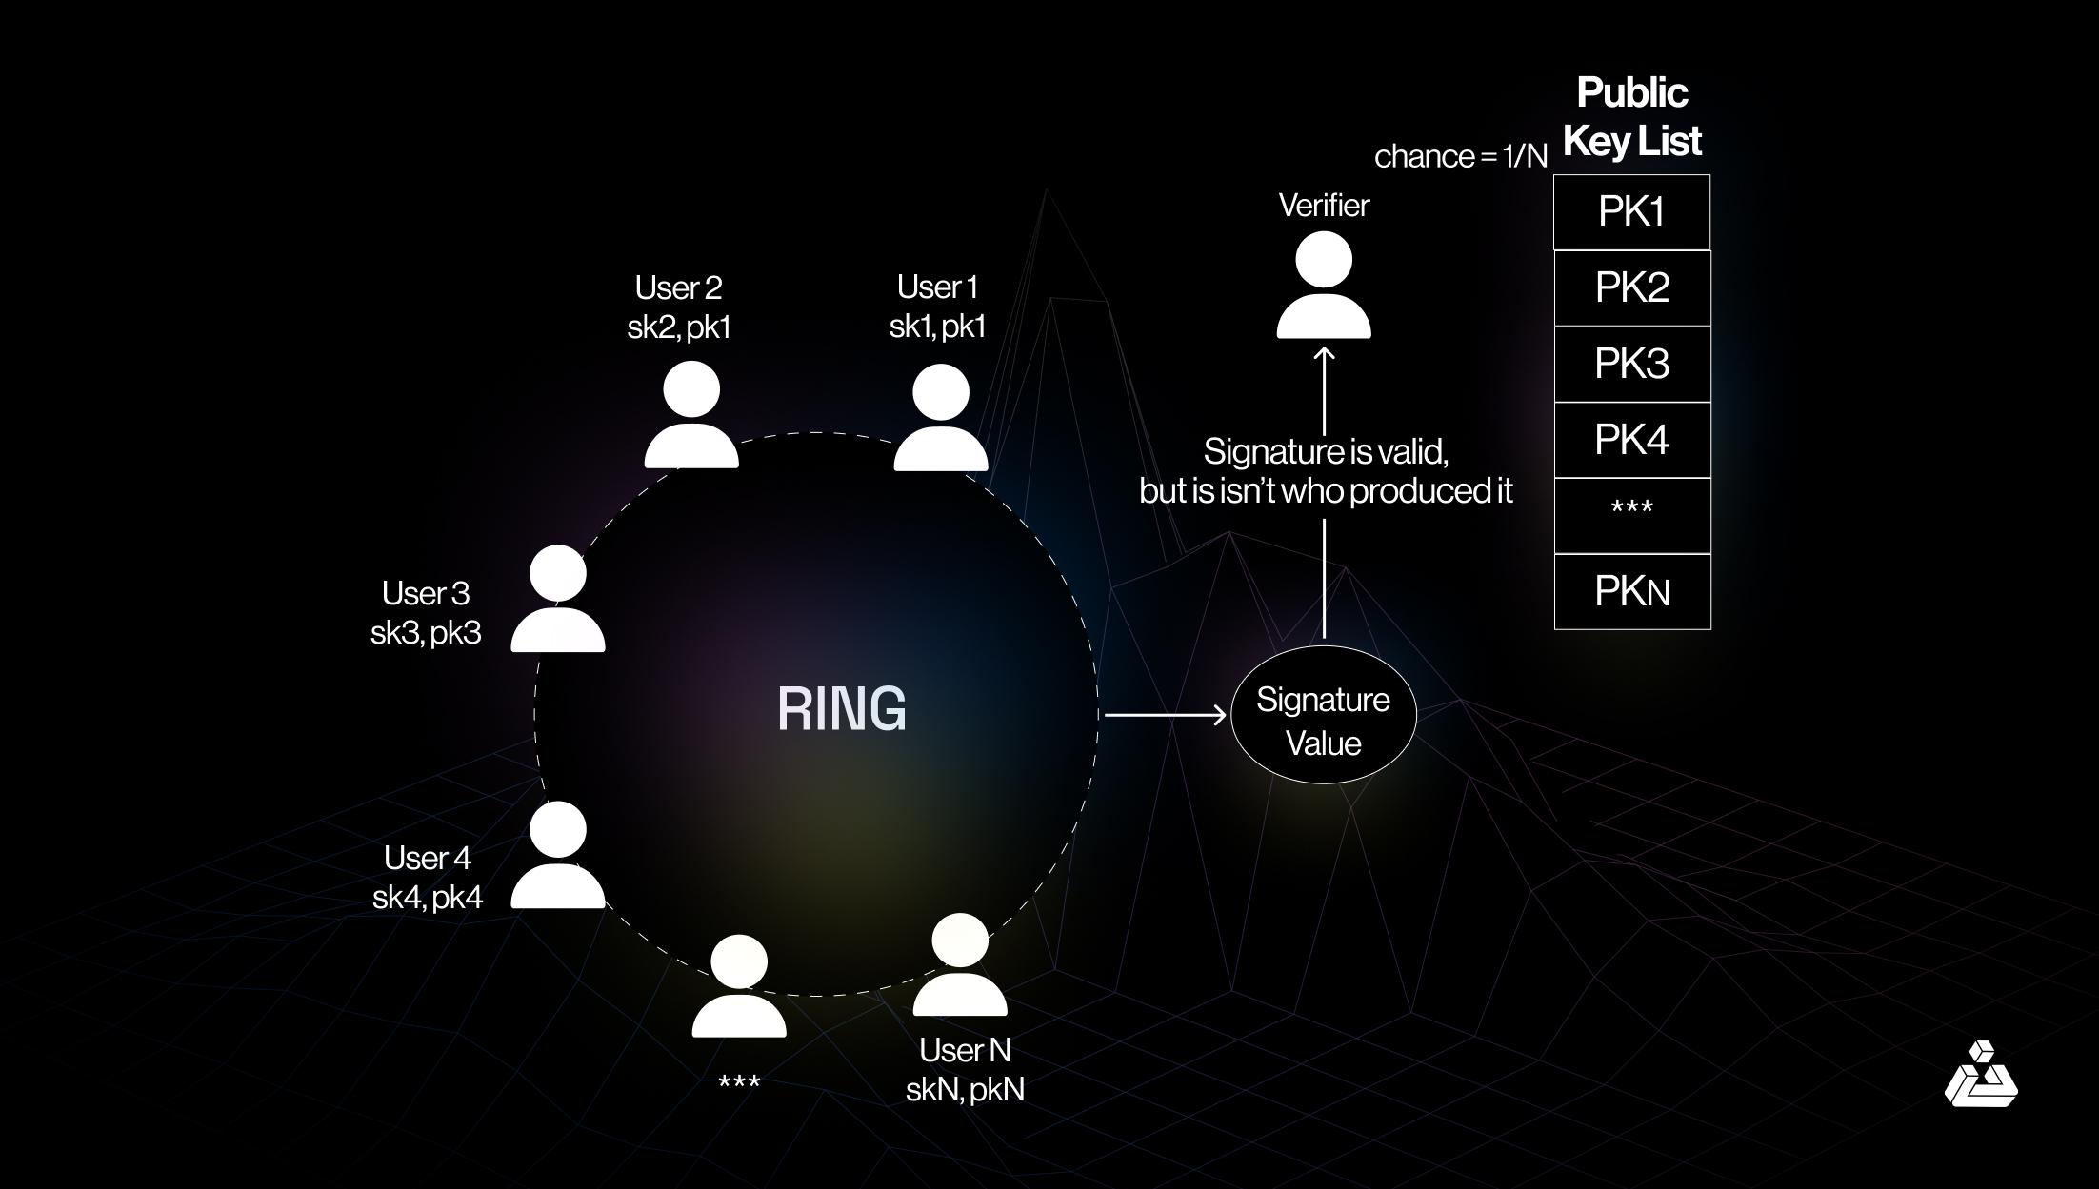
Group Signatures - Mechanism
Members generate key pairs.
Group: A set of public keys:
{PK1,PK2,...,PKn}\{PK_1, PK_2, ..., PK_n\} {PK1​,PK2​,...,PKn​}
Group manager signs certificates.
Signer uses private key + certificate.
Verifier checks certificate validity.
Identity hidden from verifier.

Slide 6
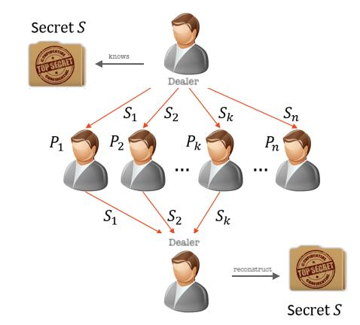
Secure Multiparty Computation (MPC)
Inputs split using secret sharing.
Shares distributed among participants.
Computation converted to circuit (AND, XOR).
Operations performed on shares.
Result reconstructed from shares.

Slide 7
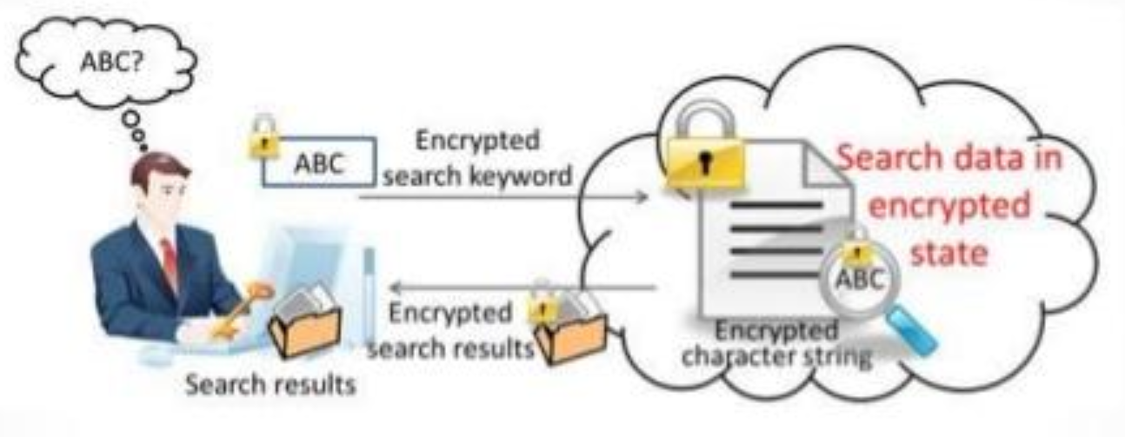
Fully Homomorphic Encryption (FHE)
Data encrypted bitwise.
Addition → XOR.
Multiplication → AND.
Operations increase noise.
Too much noise → decryption fails
Only limited operations possible (somewhat homomorphic)
Decryption recovers result if noise small.

Slide 8
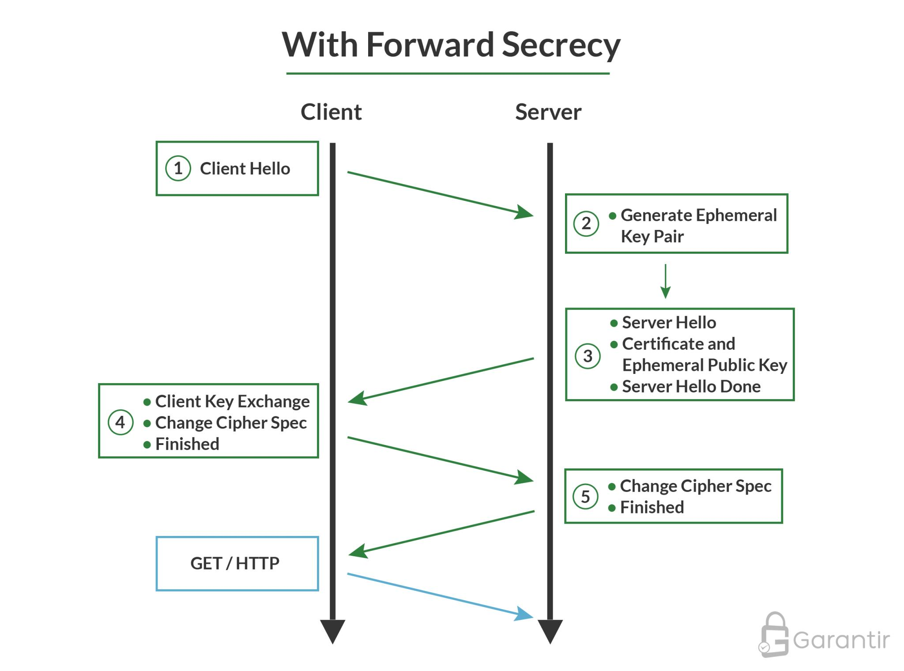
Perfect Forward Secrecy
Session keys derived per session.
Long-term keys used only for authentication.
Past session keys not recoverable.
Compromise does not expose history.

Slide 9
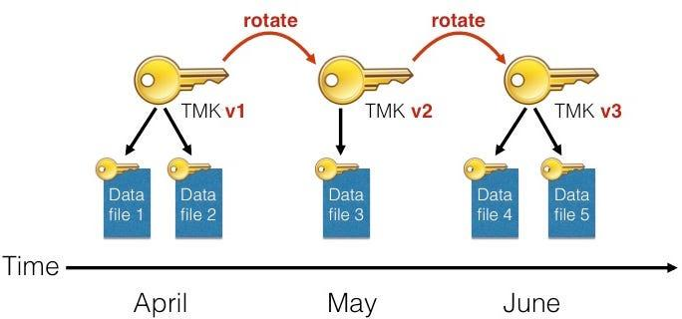
Key Rotation
Keys used for limited data/time.
Prevent collisions.
Reduce exposure.
Re-encrypt metadata if needed.

Slide 10
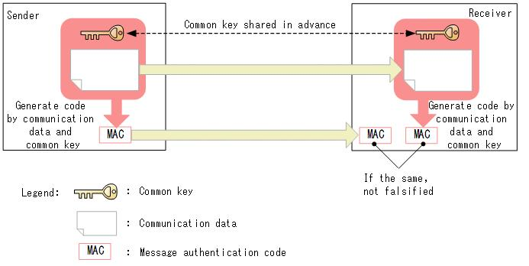
Integrity Protection
Encryption alone insufficient.
Bit flipping attacks possible.
Add MAC or authenticated encryption.
Detect tampering.

Slide 11
Use Separate Keys
Different keys for encryption and integrity.
Avoid cross-protocol leakage.
Limit impact of compromise.

Slide 12
Use Separate Public Keys
Different keys for signing and decryption.
Prevent misuse.
Avoid unintended operations.

Slide 13
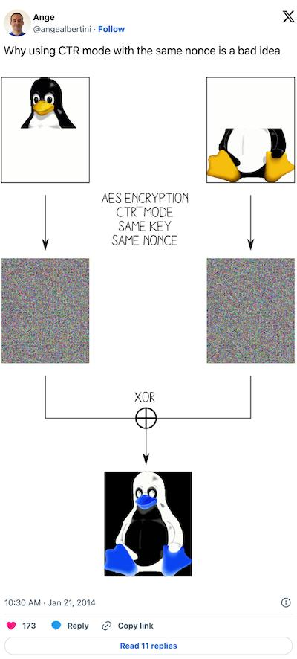
Nonce Usage
Unique nonce per message.
Reuse breaks security.
Ensures randomness in encryption.

Slide 14
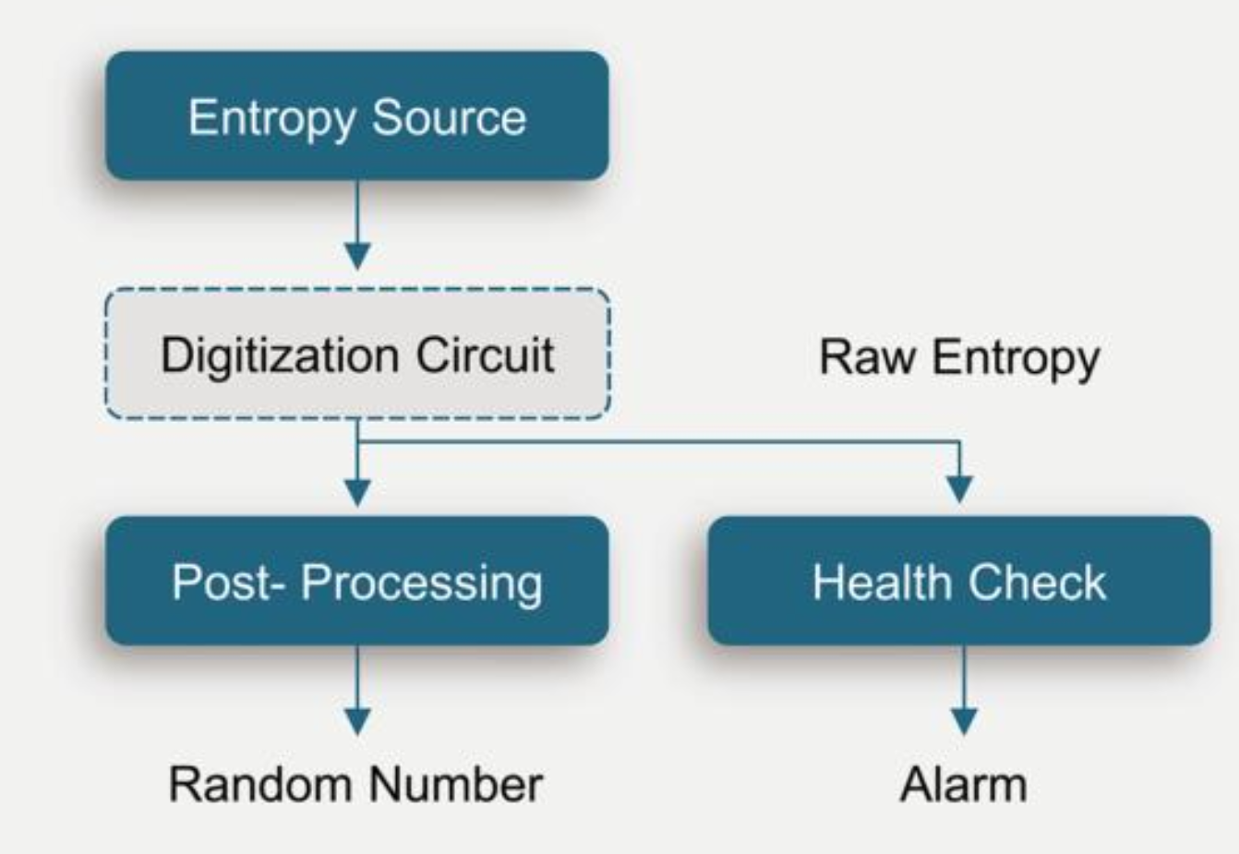
Randomness
Use strong entropy sources.
Predictable randomness breaks keys.
Many crypto failures are randomness failures, not protocol failure

Slide 15
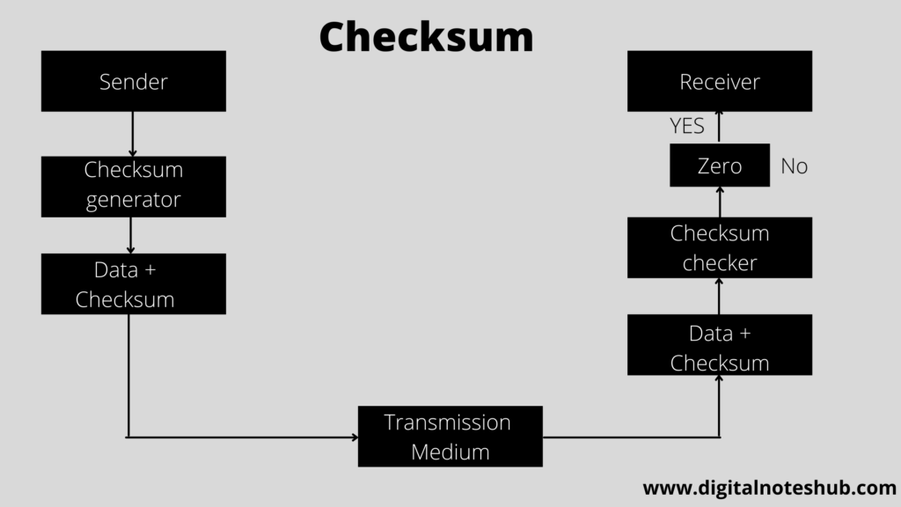
Checksums
Attach integrity checks.
Detect corruption or tampering.

Slide 16
Forward Compatibility
Design for algorithm replacement.
Avoid hard dependencies.
Enable upgrades.

Slide 17
Takeaway
Read relevant topics in chapters 16 and 17
Encryption alone is not enough
Combine: encryption + integrity + key management
Use techniques like secret sharing
Avoid single points of failure
Privacy ≠ anonymity ≠ authentication
Blind signatures → privacy
Ring/group signatures → anonymity
Each solves a different problem

Slide 18
Takeaway
Modern cryptography works—but only if used correctly.
Most real failures are practical
Nonce reuse
Weak randomness
Key misuse

