Slide 1
CSC 4780 – PKI and Trust
Susmit Shannigrahi

Slide 2
Overview
Introduction
Building Blocks
Certificates
Organization
Conclusions

Slide 3
Introduction In the beginning there were shared secret keys
Early cryptographic systems had to use the same key for encryption and decryption
To establish an encrypted channel both users needed to find out this key in some secure fashion
Limited – Users could meet and exchange the key
Flexible – Users could use a key server

Slide 4
Introduction Key Exchange – User to User
This exchange eliminates a communication channel that could be attacked
Limited - Users must meet all other users
In a system with n users, number of meetings is on the order of O(n²)
Users must recognize each other or show proper identification

Slide 5
Introduction Key Exchange – Key Server
K_{A,KS}
K_{B,KS}
Each user has set to up a key with the Key Server
Key Server creates and transmits secure session keys to users
Flexible – Users need only have a prior established key with the Key Server
For a system with n users only (n) meetings must occur
Key Server takes care of the initial validation of user’s identities

Slide 6
Symmetric Key Cryptography
Plain-text input
Cipher-text
Plain-text output
“The quick brown fox jumps over the lazy dog”
“The quick brown fox jumps over the lazy dog”
“AxCv;5bmEseTfid3)fGsmWe#4^,sdgfMwir3:dkJeTsY8R\s@!q3%”
Encryption
Decryption
Same key (shared secret)

Slide 7
Symmetric Pros and Cons
Strength:
Simple and really very fast (order of 1000 to 10000 faster than asymmetric mechanisms)
Super-fast (and somewhat more secure) if done in hardware (DES, Rijndael)
Weakness:
Must agree the key beforehand
Securely pass the key to the other party

Slide 8
Public Key Encryption
Clear-text Input
Cipher-text
Clear-text Output
“The quick brown fox jumps over the lazy dog”
“The quick brown fox jumps over the lazy dog”
“Py75c%bn&*)9|fDe^bDFaq#xzjFr@g5=&nmdFg$5knvMd’rkvegMs”
Encryption
Decryption
public
Different keys
private
Recipient’s public key
Recipient’s private key

Slide 9
Public Key Pros and Cons
Weakness:
Extremely slow
Susceptible to “known ciphertext” attack
Problem of trusting public key (see later on PKI)
Strength
Solves problem of passing the key
Allows establishment of trust context between parties

Slide 10
Building Blocks
Cryptographic tools
Putting them together
Names
Time
A secure communication session

Slide 11
Building Blocks Cryptographic Tools
Symmetric Key Cryptography
Encryption: SE_{K}(M) = C
Decryption: SD_{K}(C) = M
Secure as long as only communicating users know K
Having K lets one read C
Fast to calculate
Public Key Cryptography
Encryption: PE_{K+}(M) = C
Decryption: PD_{K-}(C) = M
Secure as long K- is only known by the receiver
Having K- lets one read C, but having K+ does not
Slow to calculate

Slide 12
Building Blocks Cryptographic Tools 2
Digital Signatures
Sign: PE_{K-}(H(M)) = S
Verify: PD_{K+}(S) = H(M)
Reliable as long as only the signer knows K-
Having K- allows one to sign, having K+ only allows one to verify the signature
Slow to calculate
K’s + and - could just be a user’s public and private keys

Slide 13
Building Blocks Putting Them Together
Symmetric cryptography is used for majority of communications
Public Key cryptography is used for exchanging Symmetric keys
Digital Signatures are used to validate Public Keys

Slide 14
Building Blocks Names
A name in PKI must be unique to a user
Assigning these names presents similar difficulties as found in other areas of Distributed Systems
Without proper and well thought out naming PKI is pretty much useless

Slide 15
Building Blocks Time
A PKI must know the current time
Much of a PKI’s security relies on having an accurate clock
For the most part, time does not need to be known extremely reliably and being off by a minute will usually not be an issue

Slide 16
Building Blocks A Secure Communications Session
Alice and Bob wish to set up a secure communications channel
They use Public Key Cryptography to exchange a Symmetric key
Alice: Private PK = K-_{A}, Public PK = K+_{A}
Bob: Private PK = K-_{B}, Public PK = K+_{B}
Time T and random Symmetric Key K_{S}
Simplified example:
1: Alice -> Bob: PE_{K+B}(Alice, T, K+_{A}, PE_{K-A}(T, K_{S}))
2: Bob -> Alice: PE_{K+A}(T, K_{S})
3: Alice <-> Bob: SE_{KS}(M_{i})

Slide 17
Certificates
What they are
How they are issued
How they are distributed
How they are revoked

Slide 18
Certificates What they are
The issue with building a secure session is that it assumes that both Alice and Bob know each others public keys
We need some way for them to learn this besides meeting each other (otherwise we are in the same predicament as with Symmetric Key exchange meetings)
We could use a similar strategy to the Key Server but can we do better?
This is where Certificates come in…

Slide 19
Certificates What they are 2/2
A Certificate is a combination of a user’s public key, unique name, Certificate start and expiration dates, and possibly other information
This Certificate is then digitally signed, by some Trusted 3rd Party, with the signature being attached to the rest of the Certificate
This Signed Certificate is commonly referred to as just the user’s Certificate
The Certificate for a user Bob, signed by signer Tim, in essence states
“I Tim certify that this Public Key belongs to Bob”

Slide 20
Certificates How they are issued
The users of a PKI must place their trust in a 3rd Party to carefully verify a user’s identity before signing his or her public key
Each user generates their own Public-Private Key pair and Certificate
A user then verifies them self to the 3rd Party and shows his or her Certificate’s content. At this point the third party will sign the Certificate.

Slide 21
Certificates How they are distributed
Users are free to distribute their signed Certificates over any medium, public or private, without concern
Other users may acquire this Certificate from any source and check the 3rd Party’s signature for tampering
If the signature is good then the other users know that the 3rd Party affirms that the Certificate belongs to the user who is listed in the Certificate

Slide 22
Certificates How they are Revoked
Periodically Certificates may become compromised, requiring a Certificate Revocation
A Certificate Revocation message is simply a message signed by K-_{i} (the private version of the Certificate’s K+_{i}) saying that the Certificate is revoked
A PKI will have a database of revoked Certificates (a Certificate Revocation List, CRL) that users may access periodically for the latest list of revoked Certificates
An alternative to certificate revoking is to set the expiration time to very shortly after the issue time. Thus every key in this system is revoked so rapidly that we do not need to worry what may happen to the compromised key

Slide 23
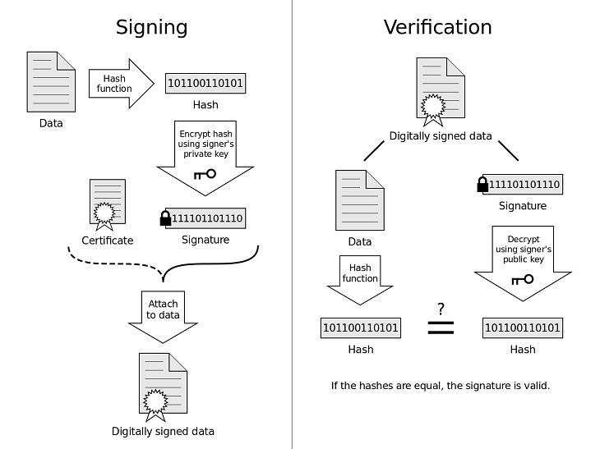
End-to-end use

Slide 24
Organization
What is “Trust”?
How do we organize a PKI to disseminate trust?

Slide 25
Organization Trust
Trust is based on real world contractual obligations between a 3rd Party and users [2]
This Trusted 3rd Party is referred to as a Certificate Authority (CA)
In other models trust is based on personal relationships that don’t have a contractual basis (e.g. PGP)
Users may allow a CA to delegate their trust
This delegation of trust is what allows us to build large PKI’s

Slide 26
Organization Trust 2/2
Root CA
Small CA
Alice
Bob
Chad
If Alice trusts Root CA then she trusts Bob’s Certificate signed by Root CA
If Alice trusts Root CA to delegate her trust to others then she trusts Chad’s Certificate signed by Small CA

Slide 27
Organization Organizing a PKI
A PKI may be organized based on a variety of models using delegation of trust
Strict Hierarchy
Networked
Web Browser
PGP

Slide 28
Organization Strict Hierarchy
Root CA
Small CA
Smaller CA
Alice
Bob
Chad
Dan
Emily
Fred
All users trust Root CA
Root CA may delegate that trust to other CA’s who in turn may be allowed to delegate that trust
In this way a PKI may grow without all the burden being placed on Root CA

Slide 29
Organization Networked
The Networked model addresses what to do when two or more PKIs wish to join together or merge
Two techniques
Mesh
Hub-and-Spoke
We only need the Root CAs of each PKI to participate in this model

Slide 30
Organization Networked – Mesh
Root CA₁
Root CA₂
Root CA₃
Root CA₄
Every Root CA signs every other Root CA’s Certificate
Hard to join a large numbers of CAs

Slide 31
Organization Networked – Hub-and-Spoke
Root CA₁
Root CA₂
Super Root CA
Root CA₃
Root CA₄
The Root CAs come together to create the Super Root CA
Each Root CA signs the Super Root CA’s certificate while the Super Root CA signs each of theirs
Easier to join large numbers of CAs
Question becomes, Who gets to manage the Super Root CA?

Slide 32
Organization Web Browser
Root CA₁
Root CA₂
Root CA₃
…
Root CA_{n}
Smaller CA
alice.com
bob.com
chad.com
dan.com
emily.com
fred.com
A Web Browser maintains a list of trusted Root CAs
Any Certificate signed by one of these Root CAs is trusted
Basically a list of n Hierarchy Models
Initial list decided on by Web Browser’s producer

Slide 33
Organization PGP
Bob
Emily
Gary
Chad
Dan
Alice
Fred
Each user’s Certificate is signed by zero or more other users
Certificate validity calculated from levels of trust assigned by signers
Assigned levels (Chad)
Implicit: User themselves – Chad
Complete: Any Certificate signed by the user them self – Fred and Emily
Intermediate Calculated Item
Partial Trust: Any Certificate signed by a ‘Complete’ Certificate – Bob and Dan
Calculated (Chad)
Valid: Any Certificate signed by an ‘Implicit’ or ‘Complete’ level Certificates – Chad, Fred, Emily, Dan, and Bob
Marginally Valid: Any Certificate signed by two or more ‘Partial’ trust Certificates – Gary
Invalid: Any Certificate signed by a ‘Marginally Valid’ or no one - Alice

Slide 34
Conclusions
A PKI allows us to take the concept of a Key Server and apply it to Public Keys
It allows greater flexibility then a Key Server in that users do not need to communicate with the Root CA every time a Session Key is needed
There are a vast variety of models for disseminating trust in a PKI
Even though PKIs look like an amazing idea, in practice there are numerous problems implementing them on a large scale
Who does everyone trust?
What format do people use?
Security of the multitude of programs that rely on PKIs

Slide 35
Sources
[1] Adams, Carlisle, and Steve Lloyd. Understanding PKI: Concaepts, Standards, and Deployment Considerations. Second ed. Boston, MA: Addison- Wesley, 2003.
[2] Ferguson, Neils, and Bruce Schneier. Practical Cryptography. Indianapolis, IN: Wiley, Inc., 2003.
[3] Stinson, Douglas R. Cryptography: Theory and Practice. 3rd ed. Boca Raton, FL: Chapman & Hall/CRC, 2006.
[4] Tanenbaum, Andrew S., and Maarten V. Steen. Distributed Systems: Principles and Paradigms. 2nd ed. Upper Saddle River, NJ: Pearson Prentice Hall, 2007.
[5] PKI – UMBC
[6] Tell me how PKI works in Plain English - Microsoft

