Slide 1
CSC 4780 – QUIC and Security
Susmit Shannigrahi

Slide 2

What have we done to the Internet?
More than 90% of all Internet traffic uses encrypted payloads

Slide 3

What have we done to the Internet?
More than 90% of all Internet traffic uses encrypted payloads
More than 70% of all Internet traffic is sourced from Cloud servers

Slide 4

What have we done to the Internet?
More than 90% of all Internet traffic uses encrypted payloads
More than 70% of all Internet traffic is sourced from Cloud servers
More than 20% of all traffic by volume uses QUIC
Q
* https://ripe86.ripe.net/wp-content/uploads/presentations/49-The_New_Encyrpyted_Stack_RIPE.pdf

Slide 5
What have we done to the Internet?
More than 90% of all Internet traffic uses encrypted payloads
More than 70% of all Internet traffic is sourced from Cloud servers
More than 20% of all traffic by volume uses QUIC
Whatever is happening to TCP on the Internet?
Q
* https://ripe86.ripe.net/wp-content/uploads/presentations/49-The_New_Encyrpyted_Stack_RIPE.pdf

Slide 6
Why was the Internet Protocol so special?
What made it so radically different from other network protocols of the 1980’s?
Why are we still using IP today?
The answer is TCP!

Slide 7
TCP is..
A transport protocol that constructs a reliable full duplex adaptive streaming service constructed on top of an unreliable IP datagram service
Uses a coordinated state between the two end systems without any network intervention or mediation
Uses a sliding window to allow lost data to be resent
Uses ACK-clocking to regulate the sending behaviour to match network path capacity estimate
Has been tweaked to support* multi-stream and RPC transport models
* to some degree!

Slide 8
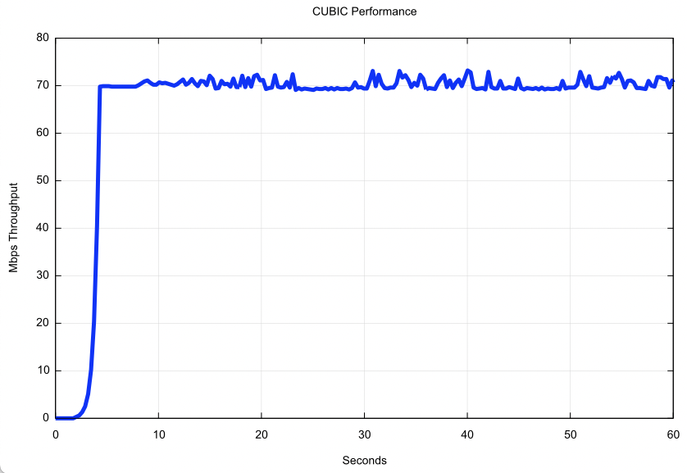
TCP is highly efficient
TCP will attempt to use all available network bandwidth
Path Capacity

Slide 9
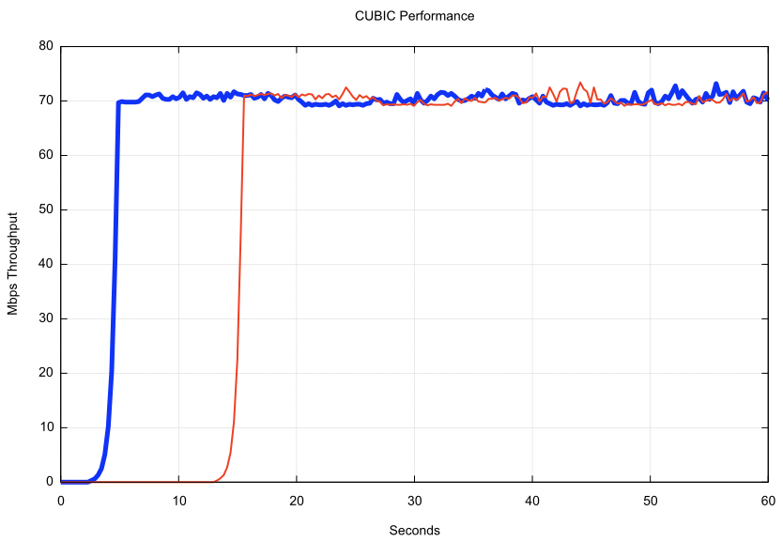
TCP is friendly!
TCP performs self-moderation to share available network capacity fairly across active TCP sessions

Slide 10
TCP is flexible
TCP behaviour is controlled by the server, not the client
The same client TCP engine can be used for a variety of server-side congestion control algorithms
Reno – classic AIMD
CUBIC
BBR
MulTCP
…
Different servers can use different TCP behaviours to achieve different service outcomes

Slide 11
Pushing TCP harder
We have been prodding and poking at TCP for decades:
T/TCP – TCP for Transactions which attempted to stash the payload and the response into the TCP handshake (since discarded due to its truly woeful security model!)
Multipath TCP – spread TCP session traffic across multiple outbound interfaces to allow for host-based load sharing and session resiliency (largely abandoned after just one large scale implementation)
Initial Window inflation – improve short flow performance by commencing the flow with a larger initial window size
Cached TCP performance – cache the achieved TCP performance to a server and start the next TCP session in congestion avoidance, bypassing initial slow start
ECN signalling – have the network mark packets when queries are forming in the network path, allowing hosts to react prior to packet loss events

Slide 12
But
There are some performance behaviours that you just can’t fix using TCP tweaking

Slide 13

Minimizing Latency
Proliferation of mobile and web applications has made latency a very important issue for online businesses
users might visit a web site less often if it is slower than a competitor by over 250ms, S. Lohler NY Times 2012
100ms latency costs Amazon 1% in sales, G. Linden, 2006
Bandwidth is cheap and will continue
to grow, but information cannot travel
faster than the speed of light
my internets are so slow!
Challenge: minimize number of RTT’s required
to establish a connection, without sacrificing security
Notes:
Latency is the time it takes to get the first byte of data
low bandwidth
Round Trip Times (RTT) required for connection establishment

Slide 14
TCP isn’t…
Fully independent of the underlying platform’s transport services
Fully multi-stream (TCP has head-of-line blocking)
Free from on-the-wire network intervention (TCP control parameters are sent in the clear)
Has e2e encryption as a second step / afterthought
Can’t support reliable datagram behaviour only with full session support
Relies on the application to perform data framing and in-band control
TCP isn’t everything for everyone

Slide 15
Choices:
Keep adjusting TCP at the edges and leave the basic TCP behaviour alone
or
Pull TCP functionality up into the application and implement more radical changes to the transport behaviour at the application level

Slide 16
QUIC is…
The second path!
Constructed upon a base datagram framing protocol through the use of UDP, placing all transport functions into the UDP payload
All end-to-end transport services (data integrity, session control, congestion control, encryption) are shifted towards the application.
A platform may provide a QUIC API, but the application can also provide its own service

Slide 17
QUIC is…
TLS transport layered over a UDP substrate
QUIC
HTTP/3
HTTP/2
HTTP
Multi-stream
HTTP
TLS
Session Encryption
QUIC
Multi-stream
Encryption
Data stream integrity
Congestion Control
e2e encrypted
TCP
Data stream integrity
Congestion Control
e2e encrypted
UDP
IP

Slide 18
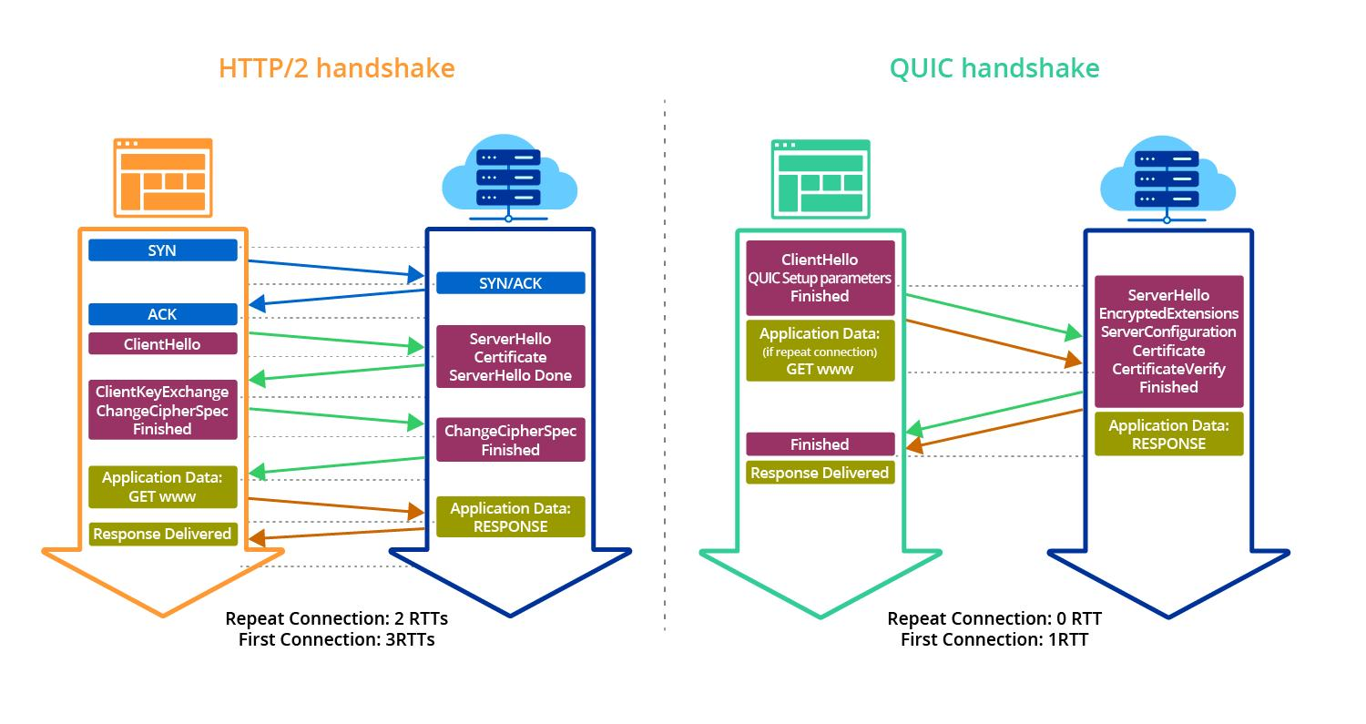
QUIC is…

Slide 19



Setup Time: QUIC vs TLS
TLS over TCP
QUIC
TCP session establishment
connection establishment
and key agreement
client
server
setup
latency
client
server
+
TLS key establishment
exchange data
TCP guarantees ordered delivery, provides protection against connection-spoofing, but
adds latency
suffers from subtle performance attacks, e.g., TCP reset, Clayton et al, 2006
exchange data
What about QUIC?
Notes:
Transport Layer Security (TLS) is one of the most widely used protocols, but has a relatively high latency
Motivate performance attacks: malicious intervention used for censorship by some governments

Slide 20
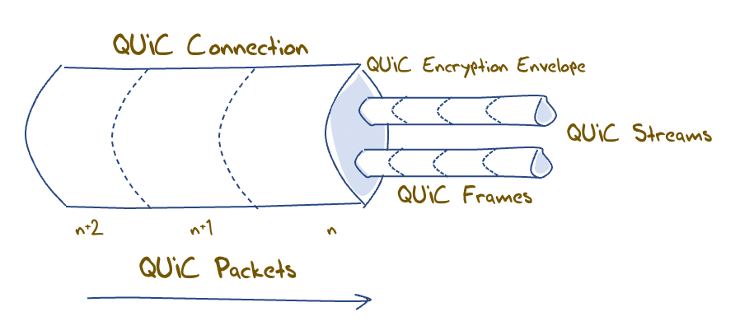
QUIC flow structuring
A QUIC connection is broken into “streams” which are reliable data flows – each stream performs stream-based loss recovery, congestion control, and relative stream scheduling for bandwidth allocation
QUIC also supports unreliable encrypted datagram delivery

Slide 21
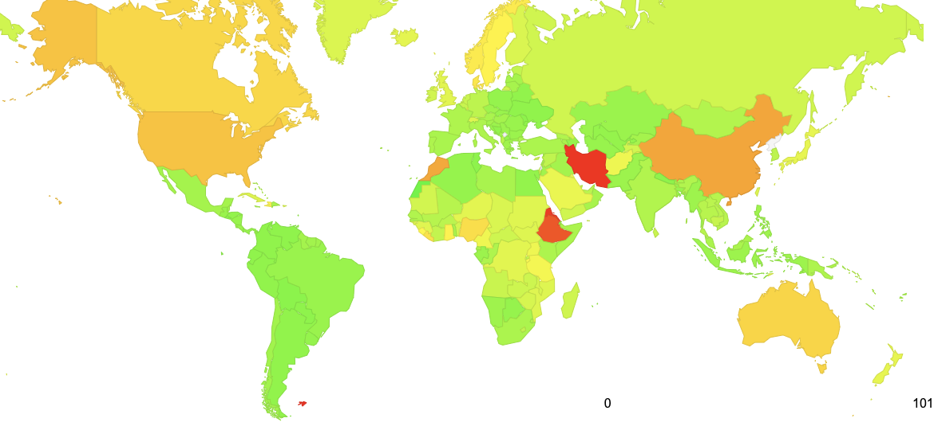
Where can we see QUIC capability today?
100%
https://stats.labs.apnic.net/quic
July 2023

Slide 22
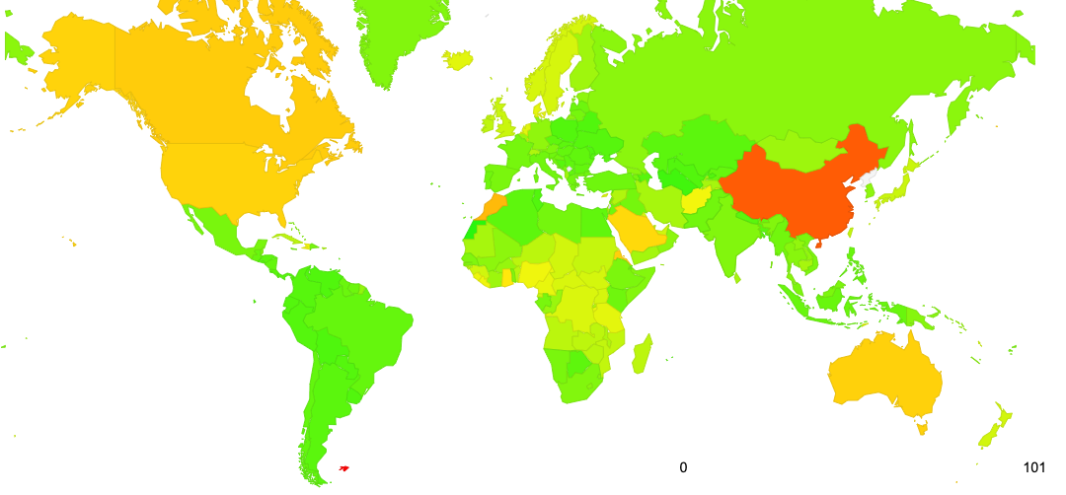
Almost Everywhere
100%
https://stats.labs.apnic.net/quic
September 2023

Slide 23
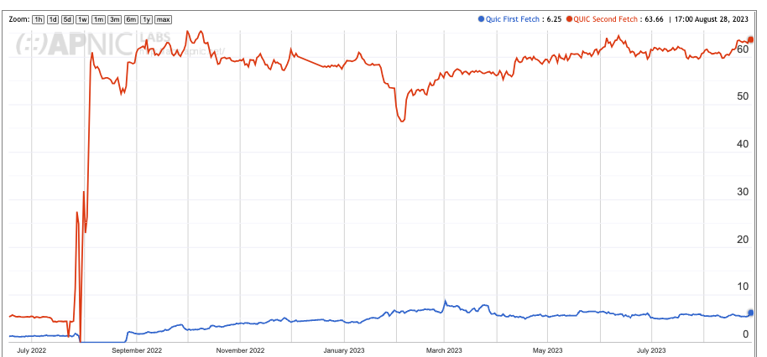
Overall Uptake

Slide 24
Measuring QUIC Use
This is a capability measure – how many users can use QUIC is the server advertises that is can serve web content using QUIC (HTTP/3)?
The measurement uses both HTTPS capability in the DNS (used by Apple Safari clients) and content-tagging with Alt-Svc directive (used by Chrome clients)

Slide 25
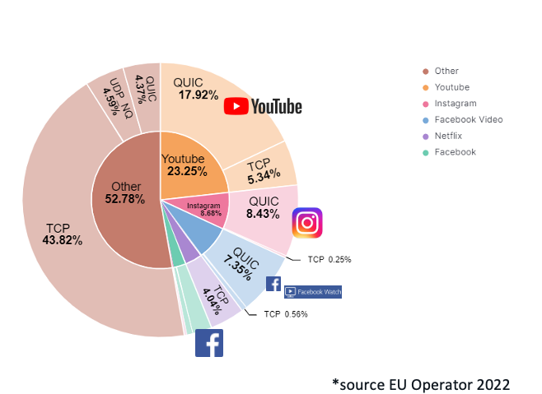
Other Measures: Network Traffic Volume
Presentation to RIPE 86: The New Encrypted Protocol Stack and How to Deal with it – Bart van de Velde, Cisco

Slide 26
Measuring QUIC Performance
In this test (between the same endpoints) over a Starlink circuit, TCP CUBIC underperforms badly, while TCP BBR and QUIC both perform reasonably well

Slide 27
Why is QUIC important?
Because QUIC encrypts everything
No visible transport control settings
No visible Server Name Indication in the crypto-setup
No visible traffic profile other than inter-packet timing
And if you use a MASQUE-based VPN then there no residual visibility!
Because QUIC is an application capability
QUIC can interact with the platform through the UDP API, so all of QUIC can be implemented within the application. This gives the application more control over its service outcomes and reduces external dependencies

Slide 28
What does this mean for TCP?
It’s not looking all that good for TCP’s prospects
QUIC not only does faster start up, but it supports multi-channel in a frictionless manner
QUIC resists network operator efforts to perform traffic shaping through direct manipulation of TCP control parameters
QUIC allows the application service provider to control the congestion behaviour of its sessions

Slide 29
QUIC Security?
Google’s answer to the latency challenge
Stands for Quick UDP Internet Connections
Communication protocol developed by Google and implemented as part of Chrome browser in 2013
Was designed to
produce security protection comparable to TLS
reduce connection latency
Can QUIC do this in presence of attackers?
How Secure and Quick is QUIC?
Provable Security and Performance Analyses https://faculty.cc.gatech.edu/~aboldyre/papers/quic.pdf

Slide 30
Setup Time: QUIC vs TLS
TLS over TCP
QUIC
TCP session establishment
connection establishment
and key agreement
client
server
setup
latency
client
server
+
TLS key establishment
exchange data
TCP guarantees ordered delivery, provides protection against connection-spoofing, but
adds latency
suffers from subtle performance attacks, e.g., TCP reset, Clayton et al, 2006
exchange data
What about QUIC?
Notes:
Transport Layer Security (TLS) is one of the most widely used protocols, but has a relatively high latency
Motivate performance attacks: malicious intervention used for censorship by some governments

Slide 31
Starting Data Exchange: QUIC vs TLS
TLS
QUIC
client
server
client
server
session key establishment
initial key establishment
data exchange with session key
data exchange
with initial key
session key establishment
Parties can often avoid 1 RTT in initial key establishment of QUIC by caching some parameters (achieving 0-RTT connections)
data exchange
with session key
What implications does this have on security?
Notes:
Drive the point that although QUIC has been deployed there has not been formal verification of its security properties until our work.

Slide 32
Previous Work on QUIC
Fischlin & Günther, ACM CCS 2014
develop a security definition for multi-stage key agreement and show that QUIC’s key exchange meets this definition
show how to modify QUIC so that it can compose with any secure data exchange protocol
prove QUIC’s key exchange with a modification is secure
What about security of the whole protocol as is?
What about its latency in presence of attackers?
Notes:
Need to motivate performance attacks somehow.

Slide 33
Main Questions We Address
What provable security guarantees does QUIC provide, and under which assumptions?
How effective is QUIC at minimizing latency in presence of attackers?

Slide 34
Summary of Our Results
What provable security guarantees does QUIC provide, and under which assumptions?
we develop a security definition suitable for performance driven protocols and show that QUIC satisfies it
QUIC does not satisfy the traditional notion of forward secrecy, provided by some TLS modes, e.g., TLS-DHE
How effective is QUIC at minimizing latency in presence of attackers?
with simple attacks on some parameters, it is easy to prevent QUIC from achieving its minimal latency goals
we have implemented these attacks and demonstrated that they are practical
Notes:
The caveat here is that currently many implementations of TLS do not provide forward secrecy

Slide 35
QUIC Protocol Connection Resumption
client
server
1 RTT
$
cid {0,1}⁶⁴
-
-generate DH values
(sec_{c}, pub_{c})
c_hello: (cid, stk, scfg, pub_{c})
-verify stk
-establish initial
key using pub_{c}
-establish initial
key using scfg
initial data exchange
-generate session
DH values (sec_{s},pub_{s})
s_hello: (cid, pub_{s})
-establish session key
using pub_{s}
-establish session
key using pub_{c}
data exchange
cid is the new connection id picked by the client
stk can be reused before expiration
scfg can be reused before expiration

Slide 36
QUIC Protocol Connection Resumption
client
server
-can achieve 0-RTT connections!
$
cid {0,1}⁶⁴
-
-generate DH values
(sec_{c}, pub_{c})
c_hello: (cid, stk, scfg, pub_{c})
-verify stk
-establish initial
key using pub_{c}
-establish initial
key using scfg
initial data exchange
-generate session
DH values (sec_{s},pub_{s})
s_hello: (cid, pub_{s})
-establish session key
using pub_{s}
-establish session
key using pub_{c}
data exchange
-client cannot initially check stk authenticity, so this
can lead to inconsistent view of the handshake
-compromising the server before scfg expires can
reveal data encrypted with initial key

Slide 37
Security Analysis Main Challenges
Previous analyses of TLS are not suitable (Jager et al, Krawzcyk et al, Bhargavan et al, Crypto 2012, 2013, 2014)
data in QUIC can be exchanged using initial key before the session key is set
Parties can set distinct initial keys
notion of having a ‘matching conversation’ is not sufficient
need new notion of ‘setting a key with’ to capture data privacy
scfg is public and can be reused before it expires
need weaker notion for forward secrecy for initial keys
use traditional notion of forward secrecy for session keys
UDP does not address unordered delivery and spoofing
need to capture attacks involving misordering, selectively delaying or dropping packets, and connection spoofing
Notes:
There are other issues, such congestion control and error correction, that we do not address in this paper

Slide 38
Outline
Provable Security Analysis of QUIC
QUIC Performance-degradation attacks
types of performance-degradation attacks on QUIC
performance-degradation attacks we have implemented
Summary and Future Work

Slide 39
Performance Attack Overview
Replaying public, cacheable content, e.g, scfg and stk
results in fooling client and/or server parties into trying to achieve a connection and maintain state
Manipulating unprotected packet fields, e.g., cid & stk
leads clients and server to have a distinct view of the key exchange resulting in a failure to establish a session key
The attacks we have studied
cause servers and clients to waste time and resources
stem from parameters whose purpose was to minimize latency, e.g., scfg and stk
do not concern data authenticity and confidentiality

Slide 40
Attacks Implemented
targeted QUIC Chromium implementation from October 1, 2014
used Python scapy library (http://www.secdev.org/projects/scapy/)
Attack Name | Attack Type | Impact
scfg Replay Attack | Replay | Connection Failure
stk Replay Attack | Replay | Server DoS
cid Manipulation Attack | Manipulation | Connection Failure, Server Load
stk Manipulation Attack | Manipulation | Connection Failure, Server Load
Crypto Stream Offset Attack | Other | Connection Failure
Attacks can be used to deny clients access to any
application of choice and cause servers to waste resources!

Slide 41
Summary and Future Work
Quic the new de-facto protocol for the web
As always, there is a balance between security and other properties
It might be over for TCP in a few years but who knows.
Application takeover of the Internet as carriers fade away.
“The challenges of epistemic justice and epistemic rights in this new era are summarized in three essential questions about knowledge, authority and power: Who knows? Who decides who knows? Who decides who decides who knows?” - Age of Surveillance Capitalism (Shoshana Zuboff)
low
latency
security

Slide 42
References
https://ieeexplore.ieee.org/document/7163028 https://blog.apnic.net/2019/03/04/a-quick-look-at-quic/ https://www.cerias.purdue.edu/assets/symposium/2015-posters/D58-DCA.pdf

Slide 43
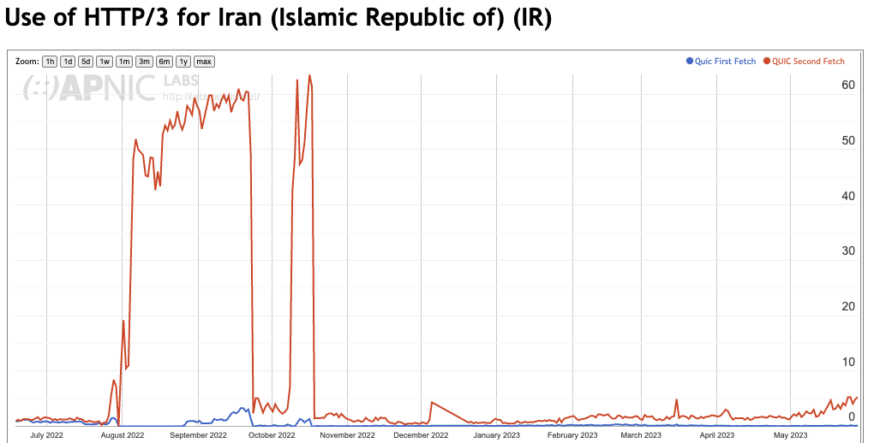
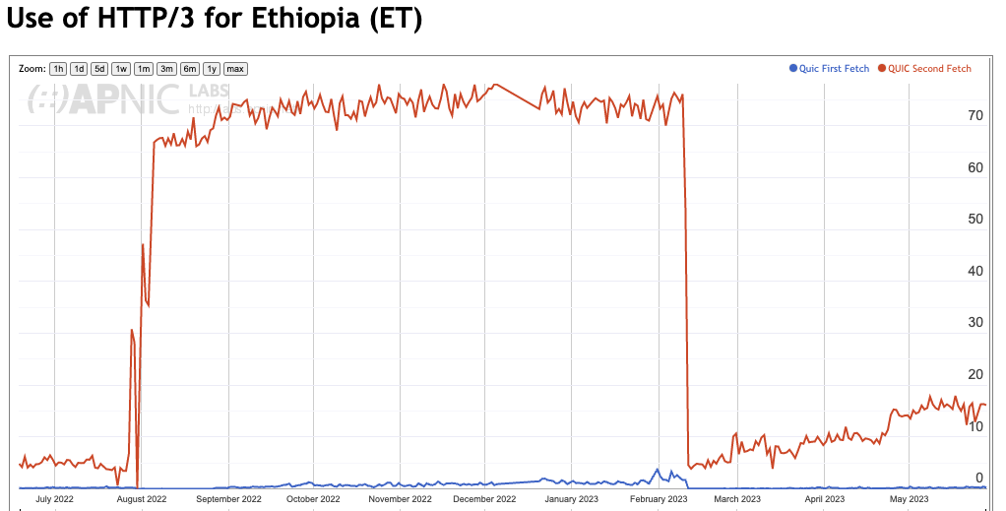
Almost Everywhere

Slide 44
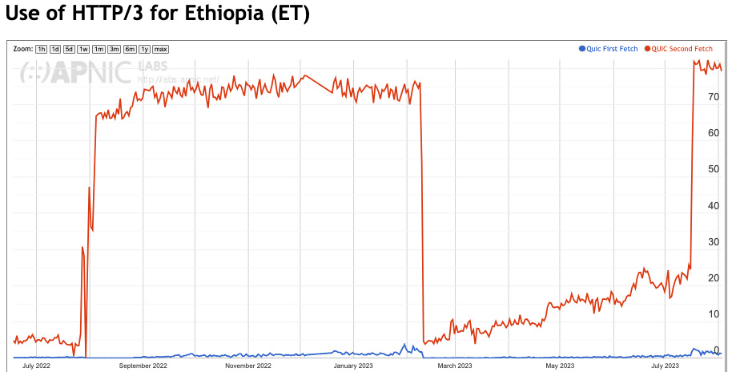
Almost Everywhere

Slide 45
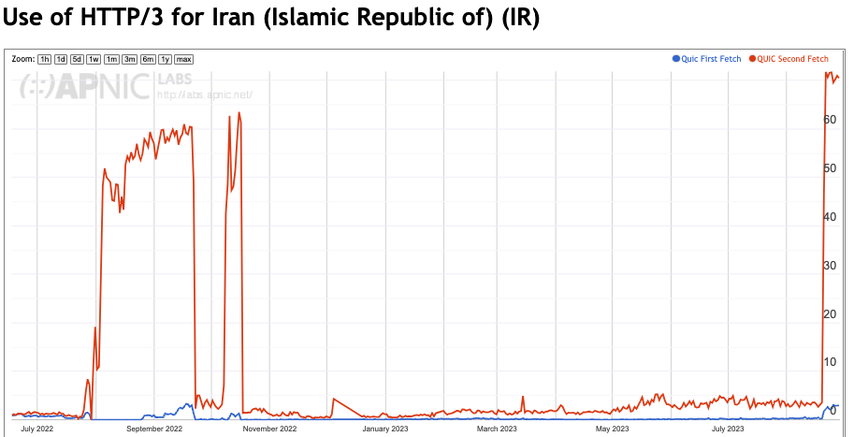
Almost Everywhere

Slide 46
QUIC is…
So much more than just “encrypted TCP over UDP”:
More Flexible - Support for multi-stream multiplexing that avoids head-of-line blocking and exploits a shared congestion and encryption state
Faster - Combines transport and encryption setup exchange in a single 3-way exchange
Customisable - QUIC implementations can use individual flow controllers per flow
QUIC places its transport control fields inside the encryption envelope, so QUIC has minimal exposure to the network
Supports record and RPC service models as well as streaming and datagram

Slide 47
QUIC is…
Endpoint address agile
NATs are potentially hostile to QUIC because of the outer UDP wrapper
A NAT may rebind (shift the externally visible address/port of a host during a session), as NATs are not generally aware of UDP streaming states
QUIC uses a persistent “connection ID”
If a host receives a QUIC frame with the same connection ID and a new IP address / port it will send a challenge by way of a random value that should be echoed back. This is all performed within the e2e encryption envelope. That way a QUIC e2e session can map into new address/port associations on the fly

Slide 48
QUIC is…
IP fragmentation intolerant – QUIC uses PMTUD, or defaults to 1,200 octet UDP payloads
Never retransmits a QUIC packet – retransmitted data is sent in the next QUIC packet number – this avoids ambiguity about packet retransmission
Extends TCP SACK to 256 packet number ranges (up from 3)
Separately encrypts each QUIC packet
May load multiple QUIC packets in a single UDP frame (countering some forms of network level packet fingerprinting efforts)

Slide 49
What does this mean for TCP?
Normally you would expect any transition from TCP to QUIC to take forever
BUT:
QUIC gives benefit to adopters through more responsive web services
QUIC does a better job of hiding content, which is a benefit to the service operator
QUIC has fewer external dependencies
QUIC can be deployed on a piecemeal basis
So it all may be over for TCP in a very small number of years!

Slide 50
What does this mean for the Internet?
IP was a network protocol that provided services to attached devices
The network service model used by IP was minimal
Packets may be dropped, fragmented, duplicated, corrupted and/or reordered on their path through the network
Its left to the edge systems to recover from this network behaviour.
Efforts to expand the network’s role have foundered
QoS has just got nowhere!
Various forms of source-directed forwarding are resisted by network operators who want control over traffic engineering
Networks took up a role of defending the network resource against aggressive application behaviour
Some networks enabled user surveillance
apps
TCP Transport
$$$
network
media

Slide 51
The new Network Space
And this is why QUIC is so interesting – it is pushing both carriage and platform into commodity roles in networking and allowing applications to effectively customize the way in which they want to deliver services and dominating the entire networked environment
QUIC is the application’s view of what Transport should be!
apps
$$$
apps
TCP Transport
Internal
Transport +
session security
QUIC and value transform
in the network stack
network
UDP Transport
network
media
media

Slide 52
What does this mean for the Internet?
The relationship between hosts and networks has soured into mutual distrust and suspicion
The application now defends its integrity by wrapping up as much of the service transaction with encryption and indirection
QUIC (and MASQUE) is an intrinsic part of this process of wrapping up traffic in encryption and redirection
For the network operator there is little left to see
And I suspect that there is no coming back from here!

Slide 53
What can a Network Operator Do?
When all customer traffic is completely obscured and encrypted?
Traffic Shaping?
Regulatory Requirements for traffic interception?
Load Balancing / ECMP

Slide 54
The new Internet Space
“What you can’t dominate, you commoditise*”
Vertically integrated service providers have faded away into history - the deregulated competitive service industry continues to specialize rather than generalize at every level
Carriage is no longer an inescapable monopoly - massively replicated content can be used as a substitute for many carriage service elements
Control over the platform is no longer control over the user. Operating systems have been pushed back into a basic task scheduling role, while functions are being absorbed into the application space
* A related quote is Peter Thiel’s “Competition is for losers!”

Slide 55
Comments / Questions?

Slide 56


Recall: Secret (Symmetric) Key (DES, 3DES, AES)
Plaintext
Plaintext
Encrypt with
Decrypt with
secret key
secret key
Ciphertext
3DES applies DES 3 times with 3 different keys
AES (Advanced Encryption Standard) uses larger blocks (128-bits), larger keys (128-, 192-, or 256-bit), is fast in both hardware and software, and doesn’t require much memory (so it works well on mobile devices)
Notes:
Each side has the same key
Encryption/decryption is symmetric (the exact inverses)
Need to securely share the key before encrypting

Slide 57
Recall: Public Key (RSA)
Plaintext
Plaintext
Encrypt with
Decrypt with
public key
private key
Ciphertext
First published by Diffie and Hellman (others like NSA claim to have invented it earlier)
Several orders of magnitude slower than symmetric key

Slide 58
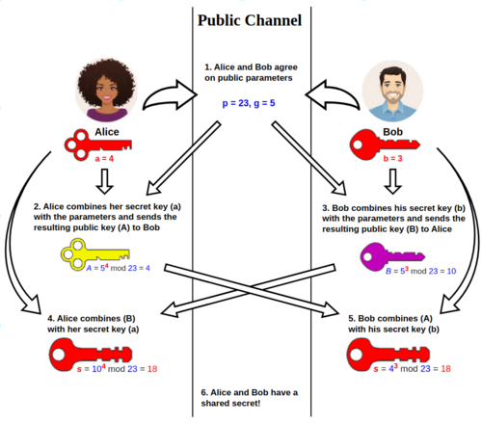
Recall: Daffie-Hellman Key Exchange
The Diffie–Hellman key exchange method allows two parties that have no prior knowledge of each other to jointly establish a shared secret key over an insecure channel.

Slide 59
Recall: Public key authentication
B authenticated to A
Key can be signed by having server encrypt message with private key; client can verify the message came from the server by decrypting the message with the public key

Slide 60
What is SSH?
It is a set of standards and associated protocols to establish a secure channel between two computers.
It provides mutual authentication, data confidentiality, and data integrity.
Originally, it was designed as a replacement of insecure applications like r-commands (i.e., Berkeley remote commands, e.g., rlogin, rsh, rcp).

Slide 61
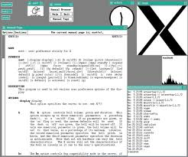
Motivations of Designing the SSH
The following is a list of drawbacks in some traditional applications:
Authentication is based on IP address
Authentication is based on reusable password
Data is transmitted in clear text
X protocol is vulnerable to attack
Intermediate hosts can hijack sessions
For X protocol, see http://en.wikipedia.org/wiki/X_Window_System

Slide 62
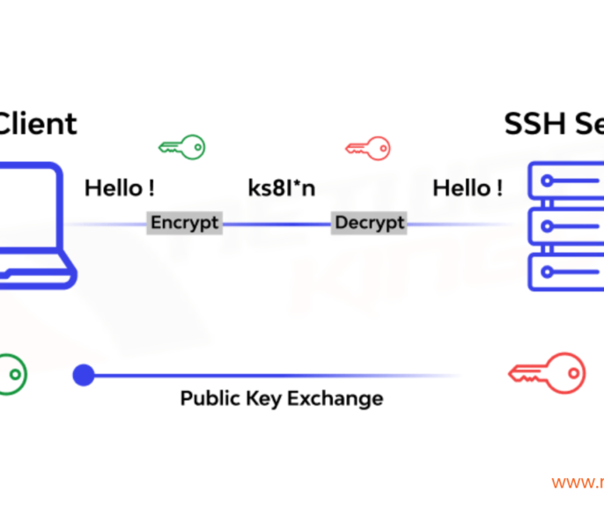
Applications of SSH
Secure remote login (ssh client)
Secure remote command execution
Secure file transfer and backup (sftp/rsync/scp)
Public-private key pair generation for you and an agent for taking care of your public-
private key pair
Port forwarding and tunnelling (x11 forwarding and tunnelling using SSH)

Slide 63
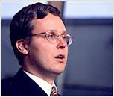
Brief History
Tatu Ylönen, a researcher at Helsinki University of Technology, Finland, developed the first version of SSH in 1995.
Very popular, 20K users in 50 countries in the first year.
Ylönen found the SSH Communications Security (www.ssh.com) to maintain, develop and commercialize SSH, in Dec. 1995.
SSH2 was released in 1998.

Slide 64
Brief History (cont.)
1999, Björn Grönvall developed the OSSH.
“OpenBSD” then extended Grönvall's work,and
launched the OpenSSH project (www.openssh.org),
OpenSSH was ported to Linux, Solaris, AIX, Mac OS X, Windows (cygwin) and etc.
Currently, OpenSSH is the single most popular SSH implementation in most operating systems.
Remark: The OpenBSD project produces a FREE, multi-platform UNIX-like operating system.

Slide 65
SSH Implementations
Name | UNIX | WIN | MAC | Clients | Server | FREE
SSH.COM | X | X |  | X | X
OpenSSH | X | X |  | X | X | X
F-Secure SSH | X | X | X | X | X
PuTTY |  | X |  | X |  | X
SecureCRT, SecureFX |  | X |  | X
VShell |  | X |  |  | X
TeraTerm |  | X |  | X |  | X
MindTerm | X | X | X | X |  | X
MacSSH |  |  | X | X |  | X

Slide 66
IPSec & SSL vs. SSH
IPSec is a lower level (IP-based) security solution than SSH. More fundamental but really expensive. SSH is quicker and easier to deploy.
SSL or TLS is TCP-based and “mainly” used in WEB applications.
There are some SSL-enhanced Telnet/FTP applications. SSH is a more integrated toolkit designed just for security.

Slide 67
SSH Architecture
SSH protocol is based on a client/server
architecture
A ssh server running on the server side is listening on the 22 TCP port for incoming connection
joseph@hlt029:~> sudo netstat --tcp --listening --program tcp6 0 0 *:ssh *:* LISTEN 3075/sshd
A client who wants to connect to a remote host will execute the ssh command
joseph@PeT43:~> ssh hlt029
Remark: Port 22/TCP,UDP: for SSH (Secure Shell) - used for secure logins,
file transfers (scp, sftp) and port forwarding

Slide 68
Building Blocks
SSH-2 Protocol has the following three building blocks (RFC 4251, 29 pages):
Transport Layer (RFC 4253, 31 pages):
Initial key exchange, server authentication, data confidentiality, data integrity, compression (optional), and key re-exchange.
User Authentication Layer (RFC 4252, 16 pages):
Client authentication, provide various authentication
methods.
Connection Layer (RFC 4254, 28 pages):
Defines the logical channels and the requests to handle the services like: secure interactive shell session, TCP port forwarding and X11 forwarding.

Slide 70
SSH security features
strong algorithms
uses well established strong algorithms for encryption, integrity, key exchange, and public key management
large key size
requires encryption to be used with at least 128 bit keys
supports larger keys too
algorithm negotiation
encryption, integrity, key exchange, and public key algorithms are negotiated
it is easy to switch to some other algorithm without modifying the base protocol

Slide 71
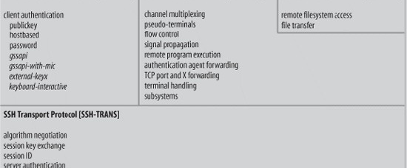
Structure of the Building Blocks

Slide 72

Outline
Protocol Details
Transport Layer
User Authentication Layer
Connection Layer

Slide 73
Transport Layer
It is a fundamental building block of SSH.
It provides services such as the initial connection, server authentication, data encryption and data integrity.
It is used for the negotiation of cryptographic algorithms.

Slide 74
SSH TLP – Overview
client
server
TCP connection setup
SSH version string exchange
SSH key exchange
(includes algorithm negotiation)
SSH data exchange
termination of the TCP connection

Slide 75
Connection setup and version string exchange
TCP connection setup
the server listens on port 22
the client initiates the connection
SSH version string exchange
both side must send a version string of the following form:
“SSH-protoversion-softwareversion comments” \CR \LF
used to indicate the capabilities of an implementation
triggers compatibility extensions
current protocol version is 2.0
all packets that follow the version string exchange is sent using the Binary Packet Protocol

Slide 76
Computing other Keys
Based on the shared master key, both sides compute the data encryption keys and data integrity keys (details are omitted)
The two encryption keys are independent
The two data integrity keys (i.e., authentication keys) are independent
After finishing the server authentication and the key exchange, the client has a single, secure, full duplex stream to an authenticated server

Slide 77

Server Authentication (continued)
It is done by verifying the server’s digital signature with the RSA or DSS public key of the server.
If a client is contacting a server with SSH the first time, the client needs the public key of the server for server authentication.
How does the client get the public key of the server the first time???

Slide 78
How to get server’s public key the 1st
time?
Two trusted methods:
the client maintains a local database that associates
each server name and the corresponding public key.
The client gets the public key of a server from a trusted 3rd party (e.g. Certification Authority)
These two methods are rarely used.
Another Option: server authenticity is not checked the first time
After the first connection, the public key of the server is saved in a database of the client.
This is the most used method.

Slide 79
Required/Recommended Algorithms
Key Exchange:
diffie-hellman-group1-sha1 [Required]
diffie-hellman-group14-sha1 [Required]
Data Encryption:
3des-cbc [Required]
aes128-cbc [Recommended]
Data Integrity:
hmac-sha1 [Required],
hmac-sha1-96 [Recommended]
Public Key for Authentication:
ssh-dss [Required]
ssh-rsa [Recommended]

Slide 80
Outline
Protocol Details
Transport Layer
User Authentication Layer
Connection Layer

Slide 81
User Authentication Layer (1)
It runs atop of the Transport Layer
It relies on the data privacy and integrity, provided by the Transport Layer
Service ID: “ssh-userauth”
Several user authentication methods are available

Slide 82
User authentication overview
USERAUTH_REQUEST
user name
service name
method name
… method specific fields …
USERAUTH_FAILURE
list of authentication methods that can continue
partial success flag
TRUE: previous request was successful, but further authentication is needed
FALSE: previous request was not successful
USERAUTH_SUCCESS
(authentication is complete, the server starts the requested service)
client
server
SSH_MSG_USERAUTH_REQUEST
SSH_MSG_USERAUTH_FAILURE
(further authentication needed)
SSH_MSG_USERAUTH_REQUEST
SSH_MSG_USERAUTH_FAILURE
(further authentication needed)
…
SSH_MSG_USERAUTH_REQUEST
SSH_MSG_USERAUTH_SUCCESS

Slide 83
User Authentication Layer (2)
Client requests the service “ssh-userauth”
Server responds with the list of available user authentication methods. More than one user authentication methods may be required.
Methods:
[Required]
Public key
Password
Host-based

Slide 84
The “publickey” method
all implementations must support this method
however, most local policies will not require authentication with this method in the near future, as users don’t have public keys
authentication is based on demonstration of the knowledge of the private key (the client signs with the private key)
the server verifies that
the public key really belongs to the user specified in the authentication request
the signature is correct

Slide 85
The “publickey” method cont’d
SSH_MSG_USERAUTH_REQUEST
user name
service name
“publickey”
TRUE (a flag set to TRUE)
public key algorithm name (e.g., ssh-dss)
public key
signature (computed over the session ID and the data in the request)
the server responds with SSH_MSG_USERAUTH_FAILURE if the request failed or more authentication is needed, or SSH_MSG_USERAUTH_SUCCESS otherwise

Slide 86
The “publickey” method cont’d
using the private key
involves expensive computations
may require the user to type a password if the private key is stored in encrypted form on the client machine
in order to avoid unnecessary processing, the client may check whether authentication using the public key would be acceptable
SSH_MSG_USERAUTH_REQUEST
user name
service name
“publickey”
FALSE
public key algorithm name
public key
if OK then the server responds with SSH_MSG_USERAUTH_PK_OK

Slide 87
The “password” method
all implementations should support this method
this method is likely the most widely used
SSH_MSG_USERAUTH_REQUEST
user name
service name
“password”
FALSE (a flag set to FALSE)
password (plaintext)
the server may respond with SSH_MSG_USERAUTH_FAILURE, SSH_MSG_USERAUTH_SUCCESS, or SSH_MSG_USERAUTH_PASSWD_CHANGEREQ

Slide 88
The “password” method cont’d
changing the password
SSH_MSG_USERAUTH_REQUEST
user name
service name
“password”
TRUE
old password (plaintext)
new password (plaintext)

Slide 89
The “hostbased” method
authentication is based on the host where the user is coming from
this method is optional
the client sends a signature that has been generated with the private host key of the client
the server verifies that
the public key really belongs to the host specified in the authentication request
the signature is correct

Slide 90
The “hostbased” method cont’d
SSH_MSG_USERAUTH_REQUEST
user name
service name
“hostbased”
public key algorithm name
public key and certificates for client host
client host name
user name on client host
signature (computed over the session ID and the data in the request)

Slide 91
User Authent. Request & Server Response
User Authentication Request is driven by the client and has the following parts:
user name
service name
method name
Authentication Response from the server:
SUCCESS: user authentication done.
FAILURE: return a list of user authentication methods that can continue

Slide 92
Outline
Protocol Details
Transport Layer
User Authentication Layer
Connection Layer

Slide 93
Connection Layer
It runs over the Transport Layer, and utilizes the User Authentication Layer
It multiplexes the encrypted connection provided by the Transport Layer into several logical channels
Channel type:
Interactive session
Remote command execution
An X11 client connection
TCP/IP port forwarding
...

Slide 94
SSH – Connection Protocol
provides
interactive login sessions
remote execution of commands
forwarded TCP/IP connections
forwarded X11 connections
all these applications are implemented as “channels”
all channels are multiplexed into the single encrypted tunnel provided by the SSH Transport Layer Protocol
channels are identified by channel numbers at both ends of the connection
channel numbers for the same channel at the client and server sides may differ

Slide 95
Channel mechanisms
opening a channel
SSH_MSG_CHANNEL_OPEN
channel type
sender channel number
initial window size
maximum packet size
… channel type specific data …
SSH_MSG_CHANNEL_OPEN_CONFIRMATION
recipient channel number (sender channel number from the open request)
sender channel number
initial window size
maximum packet size
… channel type specific data …
SSH_MSG_CHANNEL_OPEN_FAILURE
recipient channel number (sender channel number from the open request)
reason code and additional textual information

Slide 96
Channel mechanisms cont’d
data transfer over a channel
SSH_MSG_CHANNEL_DATA
recipient channel number
data
SSH_MSG_CHANNEL_WINDOW_ADJUST
recipient channel number
bytes to add to the window size
closing a channel
SSH_MSG_CHANNEL_EOF
recipient channel number
(sent if the party doesn’t want to send more data)
SSH_MSG_CHANNEL_CLOSE
recipient channel
(receiving party must respond with an SSH_MSG_CHANNEL_CLOSE,
the channel is closed if the party has sent and received the closing msg)

Slide 97
Channel mechanisms cont’d
channel type specific requests
SSH_MSG_CHANNEL_REQUEST
recipient channel number
request type
want reply flag (TRUE if reply is needed)
… request type specific data …
SSH_MSG_CHANNEL_SUCCESS
recipient channel
SSH_MSG_CHANNEL_FAILURE
recipient channel

Slide 98
Example: Starting a remote shell
C → S: SSH_MSG_CHANNEL_OPEN
channel type = “session”
sender channel number = 5
initial window size
maximum packet size
C ← S: SSH_MSG_CHANNEL_OPEN_CONFIRMATION
recipient channel number = 5
sender channel number = 21
initial window size
maximum packet size

Slide 99
Example: Starting a remote shell cont’d
C → S: SSH_MSG_CHANNEL_REQUEST
recipient channel number = 21
request type = “pty-req” (pseudo terminal request)
want reply flag = TRUE
TERM environment variable value (e.g., vt100)
terminal width in characters (e.g., 80)
terminal height in rows (e.g., 24)
…
C ← S: SSH_MSG_CHANNEL_SUCCESS
recipient channel number = 5

Slide 100
Example: Starting a remote shell cont’d
C → S: SSH_MSG_CHANNEL_REQUEST
recipient channel number = 21
request type = “shell”
want reply flag = TRUE
C ← S: SSH_MSG_CHANNEL_SUCCESS
recipient channel number = 5
C ←→ S: SSH_MSG_CHANNEL_DATA,
SSH_MSG_CHANNEL_WINDOW_ADJUST
…

Slide 101

Applications of SSH

Slide 102
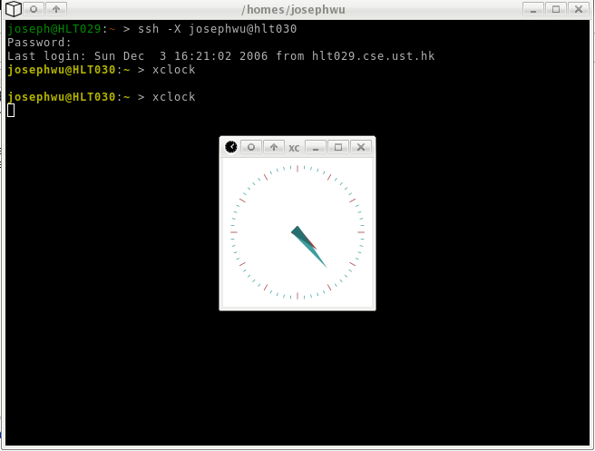
X11 Forwarding

Slide 103
Port Forwarding
SSH port forwarding is a mechanism in SSH for tunneling application ports from the client machine to the server machine, or vice versa.
The application data traffic is directed to flow inside an encrypted SSH connection so that it cannot be eavesdropped or intercepted while it is in transit.
SSH tunneling adds network security to legacy applications that do not natively support encryption.

Slide 104
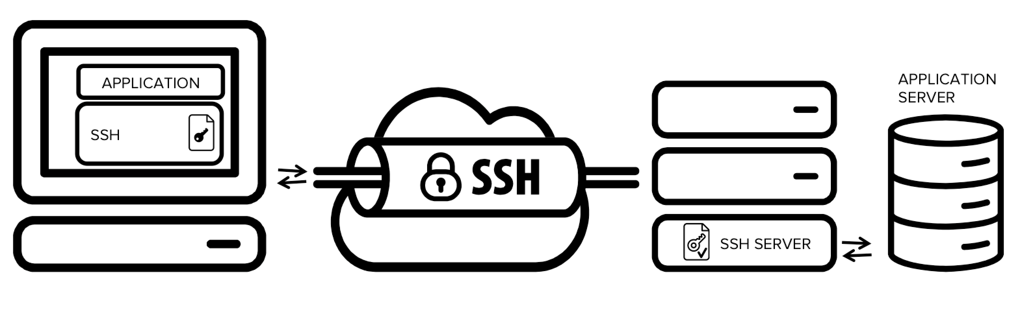
Port Forwarding (Continued)

Slide 105
SCP, and SFTP
SCP: copying files btw. hosts by using SSH for data transfer.
SFTP: Secure FTP over SSH.

Slide 106
SSH Public Key Authentication
Using “ssh-keygen” you can ask SSH to generate an RSA or DSA key pair for you, with protection of your private key from a passphrase:
SSH will then add your public key into the server's “authorized_keys” database. (~/.ssh/authorized_keys)
Later you can connect to the server by authenticating yourself with your public key.

Slide 107
Question for you
* SSH relies heavily on Trust On First Use (TOFU) where public keys are stored in ~/.ssh/known_hosts – what can go wrong?
* If an attacker steals your server's private host key tomorrow, can they decrypt the SSH traffic they recorded yesterday?

Slide 108
References
SSH: The Secure Shell The Definitive Guide 2E
SSH FAQ
OPENSSH Project Official Site
SSH Communications Security
The Secure Shell (SSH) Protocol Architechture https://datatracker.ietf.org/doc/html/rfc4251
The SSH Transport Layer Protocol
https://www.rfc-editor.org/rfc/rfc4253#section-7.1

