Slide 1
CSC 4780 – SSH
Susmit Shannigrahi

Slide 2
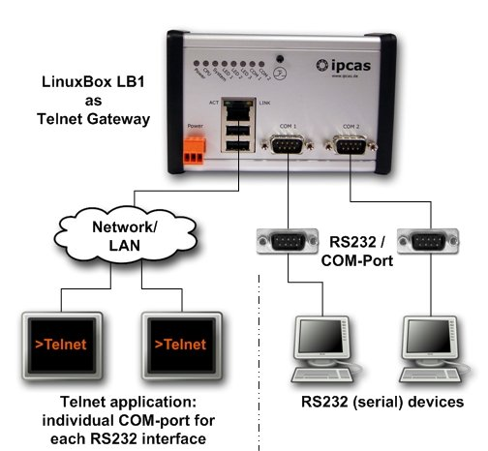
https://telnet.org/history/

Slide 3


Recall: Secret (Symmetric) Key (DES, 3DES, AES)
Plaintext
Plaintext
Encrypt with
Decrypt with
secret key
secret key
Ciphertext
3DES applies DES 3 times with 3 different keys
AES (Advanced Encryption Standard) uses larger blocks (128-bits), larger keys (128-, 192-, or 256-bit), is fast in both hardware and software, and doesn’t require much memory (so it works well on mobile devices)
Notes:
Each side has the same key
Encryption/decryption is symmetric (the exact inverses)
Need to securely share the key before encrypting

Slide 4
Recall: Public Key (RSA)
Plaintext
Plaintext
Encrypt with
Decrypt with
public key
private key
Ciphertext
First published by Diffie and Hellman (others like NSA claim to have invented it earlier)
Several orders of magnitude slower than symmetric key

Slide 5
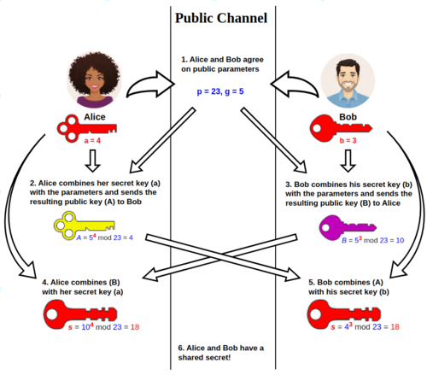
Recall: Daffie-Hellman Key Exchange
The Diffie–Hellman key exchange method allows two parties that have no prior knowledge of each other to jointly establish a shared secret key over an insecure channel.

Slide 6
Recall: Public key authentication
B authenticated to A
Key can be signed by having server encrypt message with private key; client can verify the message came from the server by decrypting the message with the public key

Slide 7
What is SSH?
It is a set of standards and associated protocols to establish a secure channel between two computers.
It provides mutual authentication, data confidentiality, and data integrity.
Originally, it was designed as a replacement of insecure applications like r-commands (i.e., Berkeley remote commands, e.g., rlogin, rsh, rcp).

Slide 8
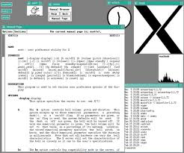
Motivations of Designing the SSH
The following is a list of drawbacks in some traditional applications:
Authentication is based on IP address
Authentication is based on reusable password
Data is transmitted in clear text
X protocol is vulnerable to attack
Intermediate hosts can hijack sessions
For X protocol, see http://en.wikipedia.org/wiki/X_Window_System

Slide 9
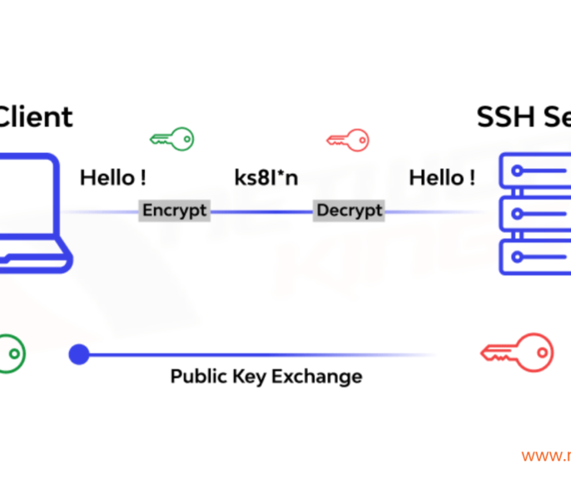
Applications of SSH
Secure remote login (ssh client)
Secure remote command execution
Secure file transfer and backup (sftp/rsync/scp)
Public-private key pair generation for you and an agent for taking care of your public-
private key pair
Port forwarding and tunnelling (x11 forwarding and tunnelling using SSH)

Slide 10
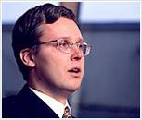
Brief History
Tatu Ylönen, a researcher at Helsinki University of Technology, Finland, developed the first version of SSH in 1995.
Very popular, 20K users in 50 countries in the first year.
Ylönen found the SSH Communications Security (www.ssh.com) to maintain, develop and commercialize SSH, in Dec. 1995.
SSH2 was released in 1998.

Slide 11
Brief History (cont.)
1999, Björn Grönvall developed the OSSH.
“OpenBSD” then extended Grönvall's work,and
launched the OpenSSH project (www.openssh.org),
OpenSSH was ported to Linux, Solaris, AIX, Mac OS X, Windows (cygwin) and etc.
Currently, OpenSSH is the single most popular SSH implementation in most operating systems.
Remark: The OpenBSD project produces a FREE, multi-platform UNIX-like operating system.

Slide 12
SSH Implementations
Name | UNIX | WIN | MAC | Clients | Server | FREE
SSH.COM | X | X |  | X | X
OpenSSH | X | X |  | X | X | X
F-Secure SSH | X | X | X | X | X
PuTTY |  | X |  | X |  | X
SecureCRT, SecureFX |  | X |  | X
VShell |  | X |  |  | X
TeraTerm |  | X |  | X |  | X
MindTerm | X | X | X | X |  | X
MacSSH |  |  | X | X |  | X

Slide 13
IPSec & SSL vs. SSH
IPSec is a lower level (IP-based) security solution than SSH. More fundamental but really expensive. SSH is quicker and easier to deploy.
SSL or TLS is TCP-based and “mainly” used in WEB applications.
There are some SSL-enhanced Telnet/FTP applications. SSH is a more integrated toolkit designed just for security.

Slide 14
SSH Architecture
SSH protocol is based on a client/server
architecture
A ssh server running on the server side is listening on the 22 TCP port for incoming connection
joseph@hlt029:~> sudo netstat --tcp --listening --program tcp6 0 0 *:ssh *:* LISTEN 3075/sshd
A client who wants to connect to a remote host will execute the ssh command
joseph@PeT43:~> ssh hlt029
Remark: Port 22/TCP,UDP: for SSH (Secure Shell) - used for secure logins,
file transfers (scp, sftp) and port forwarding

Slide 15
Building Blocks
SSH-2 Protocol has the following three building blocks (RFC 4251, 29 pages):
Transport Layer (RFC 4253, 31 pages):
Initial key exchange, server authentication, data confidentiality, data integrity, compression (optional), and key re-exchange.
User Authentication Layer (RFC 4252, 16 pages):
Client authentication, provide various authentication
methods.
Connection Layer (RFC 4254, 28 pages):
Defines the logical channels and the requests to handle the services like: secure interactive shell session, TCP port forwarding and X11 forwarding.

Slide 16
SSH security features
strong algorithms
uses well established strong algorithms for encryption, integrity, key exchange, and public key management
large key size
requires encryption to be used with at least 128 bit keys
supports larger keys too
algorithm negotiation
encryption, integrity, key exchange, and public key algorithms are negotiated
it is easy to switch to some other algorithm without modifying the base protocol

Slide 17
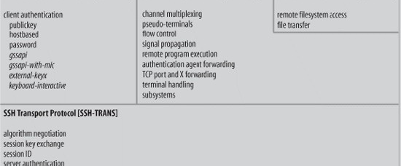
Structure of the Building Blocks

Slide 18

Outline
Protocol Details
Transport Layer
User Authentication Layer
Connection Layer

Slide 19
Transport Layer
It is a fundamental building block of SSH.
It provides services such as the initial connection, server authentication, data encryption and data integrity.
It is used for the negotiation of cryptographic algorithms.

Slide 20
SSH TLP – Overview
client
server
TCP connection setup
SSH version string exchange
SSH key exchange
(includes algorithm negotiation)
SSH data exchange
termination of the TCP connection

Slide 21
Connection setup and version string exchange
TCP connection setup
the server listens on port 22
the client initiates the connection
SSH version string exchange
both side must send a version string of the following form:
“SSH-protoversion-softwareversion comments” \CR \LF
used to indicate the capabilities of an implementation
triggers compatibility extensions
current protocol version is 2.0
all packets that follow the version string exchange is sent using the Binary Packet Protocol

Slide 22
Computing other Keys
Based on the shared master key, both sides compute the data encryption keys and data integrity keys (details are omitted)
The two encryption keys are independent
The two data integrity keys (i.e., authentication keys) are independent
After finishing the server authentication and the key exchange, the client has a single, secure, full duplex stream to an authenticated server

Slide 23

Server Authentication (continued)
It is done by verifying the server’s digital signature with the RSA or DSS public key of the server.
If a client is contacting a server with SSH the first time, the client needs the public key of the server for server authentication.
How does the client get the public key of the server the first time???

Slide 24
How to get server’s public key the 1st
time?
Two trusted methods:
the client maintains a local database that associates
each server name and the corresponding public key.
The client gets the public key of a server from a trusted 3rd party (e.g. Certification Authority)
These two methods are rarely used.
Another Option: server authenticity is not checked the first time
After the first connection, the public key of the server is saved in a database of the client.
This is the most used method.

Slide 25
Required/Recommended Algorithms
Key Exchange:
diffie-hellman-group1-sha1 [Required]
diffie-hellman-group14-sha1 [Required]
Data Encryption:
3des-cbc [Required]
aes128-cbc [Recommended]
Data Integrity:
hmac-sha1 [Required],
hmac-sha1-96 [Recommended]
Public Key for Authentication:
ssh-dss [Required]
ssh-rsa [Recommended]

Slide 26
Outline
Protocol Details
Transport Layer
User Authentication Layer
Connection Layer

Slide 27
User Authentication Layer (1)
It runs atop of the Transport Layer
It relies on the data privacy and integrity, provided by the Transport Layer
Service ID: “ssh-userauth”
Several user authentication methods are available

Slide 28
User authentication overview
USERAUTH_REQUEST
user name
service name
method name
… method specific fields …
USERAUTH_FAILURE
list of authentication methods that can continue
partial success flag
TRUE: previous request was successful, but further authentication is needed
FALSE: previous request was not successful
USERAUTH_SUCCESS
(authentication is complete, the server starts the requested service)
client
server
SSH_MSG_USERAUTH_REQUEST
SSH_MSG_USERAUTH_FAILURE
(further authentication needed)
SSH_MSG_USERAUTH_REQUEST
SSH_MSG_USERAUTH_FAILURE
(further authentication needed)
…
SSH_MSG_USERAUTH_REQUEST
SSH_MSG_USERAUTH_SUCCESS

Slide 29
User Authentication Layer (2)
Client requests the service “ssh-userauth”
Server responds with the list of available user authentication methods. More than one user authentication methods may be required.
Methods:
[Required]
Public key
Password
Host-based

Slide 30
The “publickey” method
all implementations must support this method
however, most local policies will not require authentication with this method in the near future, as users don’t have public keys
authentication is based on demonstration of the knowledge of the private key (the client signs with the private key)
the server verifies that
the public key really belongs to the user specified in the authentication request
the signature is correct

Slide 31
The “publickey” method cont’d
SSH_MSG_USERAUTH_REQUEST
user name
service name
“publickey”
TRUE (a flag set to TRUE)
public key algorithm name (e.g., ssh-dss)
public key
signature (computed over the session ID and the data in the request)
the server responds with SSH_MSG_USERAUTH_FAILURE if the request failed or more authentication is needed, or SSH_MSG_USERAUTH_SUCCESS otherwise

Slide 32
The “publickey” method cont’d
using the private key
involves expensive computations
may require the user to type a password if the private key is stored in encrypted form on the client machine
in order to avoid unnecessary processing, the client may check whether authentication using the public key would be acceptable
SSH_MSG_USERAUTH_REQUEST
user name
service name
“publickey”
FALSE
public key algorithm name
public key
if OK then the server responds with SSH_MSG_USERAUTH_PK_OK

Slide 33
The “password” method
all implementations should support this method
this method is likely the most widely used
SSH_MSG_USERAUTH_REQUEST
user name
service name
“password”
FALSE (a flag set to FALSE)
password (plaintext)
the server may respond with SSH_MSG_USERAUTH_FAILURE, SSH_MSG_USERAUTH_SUCCESS, or SSH_MSG_USERAUTH_PASSWD_CHANGEREQ

Slide 34
The “password” method cont’d
changing the password
SSH_MSG_USERAUTH_REQUEST
user name
service name
“password”
TRUE
old password (plaintext)
new password (plaintext)

Slide 35
The “hostbased” method
authentication is based on the host where the user is coming from
this method is optional
the client sends a signature that has been generated with the private host key of the client
the server verifies that
the public key really belongs to the host specified in the authentication request
the signature is correct

Slide 36
The “hostbased” method cont’d
SSH_MSG_USERAUTH_REQUEST
user name
service name
“hostbased”
public key algorithm name
public key and certificates for client host
client host name
user name on client host
signature (computed over the session ID and the data in the request)

Slide 37
User Authent. Request & Server Response
User Authentication Request is driven by the client and has the following parts:
user name
service name
method name
Authentication Response from the server:
SUCCESS: user authentication done.
FAILURE: return a list of user authentication methods that can continue

Slide 38
Outline
Protocol Details
Transport Layer
User Authentication Layer
Connection Layer

Slide 39
Connection Layer
It runs over the Transport Layer, and utilizes the User Authentication Layer
It multiplexes the encrypted connection provided by the Transport Layer into several logical channels
Channel type:
Interactive session
Remote command execution
An X11 client connection
TCP/IP port forwarding
...

Slide 40
SSH – Connection Protocol
provides
interactive login sessions
remote execution of commands
forwarded TCP/IP connections
forwarded X11 connections
all these applications are implemented as “channels”
all channels are multiplexed into the single encrypted tunnel provided by the SSH Transport Layer Protocol
channels are identified by channel numbers at both ends of the connection
channel numbers for the same channel at the client and server sides may differ

Slide 41
Channel mechanisms
opening a channel
SSH_MSG_CHANNEL_OPEN
channel type
sender channel number
initial window size
maximum packet size
… channel type specific data …
SSH_MSG_CHANNEL_OPEN_CONFIRMATION
recipient channel number (sender channel number from the open request)
sender channel number
initial window size
maximum packet size
… channel type specific data …
SSH_MSG_CHANNEL_OPEN_FAILURE
recipient channel number (sender channel number from the open request)
reason code and additional textual information

Slide 42
Channel mechanisms cont’d
data transfer over a channel
SSH_MSG_CHANNEL_DATA
recipient channel number
data
SSH_MSG_CHANNEL_WINDOW_ADJUST
recipient channel number
bytes to add to the window size
closing a channel
SSH_MSG_CHANNEL_EOF
recipient channel number
(sent if the party doesn’t want to send more data)
SSH_MSG_CHANNEL_CLOSE
recipient channel
(receiving party must respond with an SSH_MSG_CHANNEL_CLOSE,
the channel is closed if the party has sent and received the closing msg)

Slide 43
Channel mechanisms cont’d
channel type specific requests
SSH_MSG_CHANNEL_REQUEST
recipient channel number
request type
want reply flag (TRUE if reply is needed)
… request type specific data …
SSH_MSG_CHANNEL_SUCCESS
recipient channel
SSH_MSG_CHANNEL_FAILURE
recipient channel

Slide 44
Example: Starting a remote shell
C → S: SSH_MSG_CHANNEL_OPEN
channel type = “session”
sender channel number = 5
initial window size
maximum packet size
C ← S: SSH_MSG_CHANNEL_OPEN_CONFIRMATION
recipient channel number = 5
sender channel number = 21
initial window size
maximum packet size

Slide 45
Example: Starting a remote shell cont’d
C → S: SSH_MSG_CHANNEL_REQUEST
recipient channel number = 21
request type = “pty-req” (pseudo terminal request)
want reply flag = TRUE
TERM environment variable value (e.g., vt100)
terminal width in characters (e.g., 80)
terminal height in rows (e.g., 24)
…
C ← S: SSH_MSG_CHANNEL_SUCCESS
recipient channel number = 5

Slide 46
Example: Starting a remote shell cont’d
C → S: SSH_MSG_CHANNEL_REQUEST
recipient channel number = 21
request type = “shell”
want reply flag = TRUE
C ← S: SSH_MSG_CHANNEL_SUCCESS
recipient channel number = 5
C ←→ S: SSH_MSG_CHANNEL_DATA,
SSH_MSG_CHANNEL_WINDOW_ADJUST
…

Slide 47

Applications of SSH

Slide 48
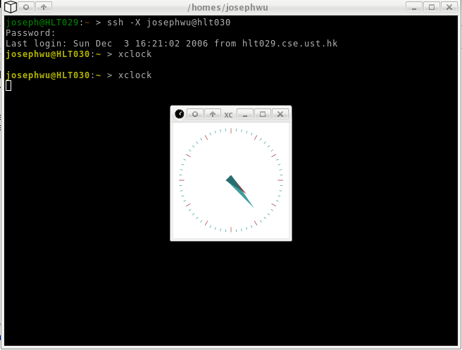
X11 Forwarding

Slide 49
Port Forwarding
SSH port forwarding is a mechanism in SSH for tunneling application ports from the client machine to the server machine, or vice versa.
The application data traffic is directed to flow inside an encrypted SSH connection so that it cannot be eavesdropped or intercepted while it is in transit.
SSH tunneling adds network security to legacy applications that do not natively support encryption.

Slide 50
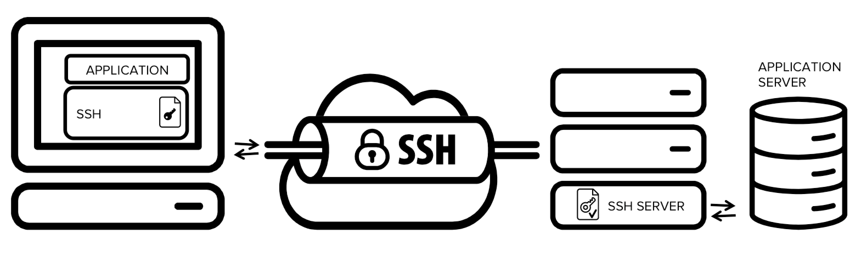
Port Forwarding (Continued)

Slide 51
SCP, and SFTP
SCP: copying files btw. hosts by using SSH for data transfer.
SFTP: Secure FTP over SSH.

Slide 52
SSH Public Key Authentication
Using “ssh-keygen” you can ask SSH to generate an RSA or DSA key pair for you, with protection of your private key from a passphrase:
SSH will then add your public key into the server's “authorized_keys” database. (~/.ssh/authorized_keys)
Later you can connect to the server by authenticating yourself with your public key.

Slide 53
Question for you
* SSH relies heavily on Trust On First Use (TOFU) where public keys are stored in ~/.ssh/known_hosts – what can go wrong?
* If an attacker steals your server's private host key tomorrow, can they decrypt the SSH traffic they recorded yesterday?

Slide 54
References
SSH: The Secure Shell The Definitive Guide 2E
SSH FAQ
OPENSSH Project Official Site
SSH Communications Security
The Secure Shell (SSH) Protocol Architechture https://datatracker.ietf.org/doc/html/rfc4251
The SSH Transport Layer Protocol
https://www.rfc-editor.org/rfc/rfc4253#section-7.1

