Slide 1
CSC 4780 – Email
Susmit Shannigrahi

Slide 2
Why End-to-End Encrypted Email Never Caught On
PEM · RFC 1421 · Feb 1993
PGP/GPG · RFC 2015 · Oct 1996
S/MIME · RFC 2311 · Mar 1998
All 30+ years old. None widely used today.
🔑
Key Discovery
📱
Multi-device
🔒
Password Loss
Hard to find Bob's public key
Private key mgmt across devices
Forget password = lose all mail
🏢
Corporate Block
👥
Network Effect
😐
User Apathy
Companies need plaintext access
Useless if contacts don't support it
Many users simply didn't care

Slide 3
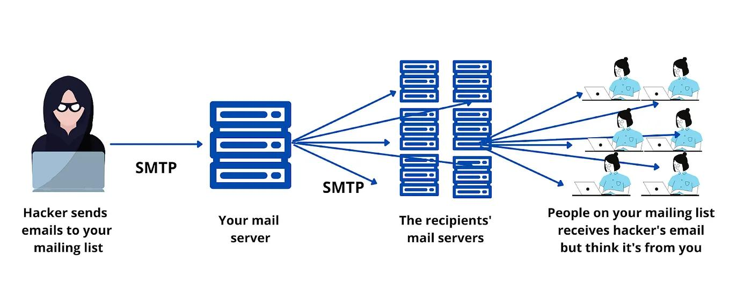
§14.1 Distribution Lists
A distribution list is a name that stands for a set of recipients. Two implementation methods exist:
Remote Exploder (Mail Reflector)
Local Exploder
Sender → Distribution List Site → (copies to each recipient)
Send to a list without knowing its members
One copy over expensive WAN links
Parallelism — lists-within-lists resolved incrementally
Efficient when list > message size
⚠ Nested lists can create infinite loops — the mail system must detect and break cycles.

Slide 4
Distribution Lists
A distribution list is a name that stands for a set of recipients. Two implementation methods exist:
Local Exploder
Sender retrieves list → sends individual copies
Easier to prevent mail forwarding loops
Sender can de-duplicate across lists
Sender knows bandwidth cost in advance
⚠ Nested lists can create infinite loops — the mail system must detect and break cycles.

Slide 5
Store and Forward
Direct device-to-device email is impractical. Message Transfer Agents (MTAs) solve this.
Alice UA
MTA
MTA
MTA
Bob UA
Why can't Alice send directly to Bob?
✗ Both devices must be on simultaneously
✗ Client devices lack stable global IP addresses
✗ NAT prevents inbound connections in different networks
✗ IPv6 alone doesn't help — firewalls block incoming
MTAs also provide: spam filtering · virus checking · DLP scanning · email storage

Slide 6
Disguising Binary as Text
Email was designed for 7-bit ASCII English text. Sending binary data requires encoding.
The Problem: Legacy Infrastructure Mangles Data
⚠ Different line delimiters: <LF>, <CR>, or <CR><LF>
⚠ Platforms add line delimiters if lines are too long
⚠ Trailing whitespace may be stripped
⚠ High-order bit forced to 0 — corrupting 8-bit data
⚠ Digital signatures break if any byte is modified
The Solution: BASE64 Encoding
BASE64
BASE85
UTF-8
Encodes 6 bits → 1 safe ASCII char. Expands data by ~33%. Universal support.
More efficient — 5 chars encode 4 bytes (25% expansion). Less common.
Modern infrastructure supports UTF-8 for international text. Still use BASE64 for binary.

Slide 7
HTML Email and Attachments
HTML-Formatted Email
Attachments
Has full power of a web page — can embed URLs, JavaScript, images
.exe / .cmd
🔴 Always dangerous — runs arbitrary code
Embedded recipient-specific URLs let senders track if/when email is opened
.docm / .pptm
Clicking any link exposes Bob to malicious web content
🔴 Contains macros — treat as dangerous
HTML bugs in email clients exploitable by crafted messages
.docx / .pptx
🟡 Should be safe, but bugs exist
Dilemma: blocking images breaks legitimate email; allowing images enables tracking
PDF
🟡 Generally safe but can exploit reader bugs
MTAs often delete attachments with dangerous extensions (e.g. .exe)

Slide 8
Spam Defenses
Spam: unwanted, unsolicited email sent to huge numbers of recipients for profit or malice.
Why Spammers Do It
Anti-Spam Defenses
Cheap advertising to millions
Deny-list by IP address
⚠ Cloud IP reuse harms innocent tenants
Phishing for personal info / credentials
Keyword / AI filtering
Advance-fee fraud (Nigerian prince etc.)
Spammers adapt quickly once deployed
Malware distribution
Volume detection
Same email to huge recipient lists
How Spammers Find Addresses
Spam folder (not delete)
Harvesting from web pages, mailing lists
Users can review false positives
Purchasing from sign-up sites
Obfuscated addresses
Brute-force guessing (aaaa1@hotmail.com…)
radia at alum dot mit dot edu
Fake 'unsubscribe' links to verify addresses

Slide 9
Malicious Links and Data Loss Prevention
Malicious Links in Email
Data Loss Prevention (DLP)
Clicking a malicious link can install malware — but 'don't click links' is impractical because legitimate mail always contains links.
Preventing confidential company data from leaving the organization via email.
Phishing Protection Service Flow:
MTA scans outbound email for confidential keywords or credit card numbers
1
MTA intercepts all links in inbound email
Can delete, quarantine, or flag for human review
2
Prepends phishingprotection.org/ to each URL
Also checks for 'company confidential' markings
3
User clicks → request goes to the protection service
4
Service scans page for malware or checks deny/allow lists
Limitation: data can also leave via USB, file transfer services

Slide 10
Knowing Bob's Address
Knowing Bob's Email Address
Large companies may have many people with the same name, each with a different email address.
bob@company.com
bob.smith@company.com
robert.q.smith@company.com
bob.smith.2@company.com
Sending to the wrong Bob causes: wasted time for the wrong recipient, potential confidentiality breach, and comedic potential (all seven Bob Smiths fly to Minneapolis for a non-existent meeting).

Slide 11
Self-Destruct
Self-Destruct, Do-Not-Forward
A sender may want a message destroyed after reading, or to prevent forwarding/saving.
✔ Mechanism
✗ Limitation (DRM Problem)
Mark the message with desired behavior; destination email system obeys the instructions.
Software-only enforcement can always be circumvented — modified email client, or simply photograph the screen.

Slide 12
Preventing FROM Field Spoofing
Anyone can put any string in the FROM field. Cryptographic signing is ideal but not widely deployed.
SPF — Sender Policy Framework [RFC 7208]
A domain declares (via DNS/DNSSEC) the limited set of IP addresses authorized to send mail on its behalf. Receiving MTAs refuse mail claiming to be from a domain if the connection doesn't come from a listed IP.
⚠ Limitation: IP spoofing is hard but not impossible. Breaks mail forwarders — forwarded mail arrives from forwarder's IP, not sender's MTA.
DKIM — DomainKeys Identified Mail [RFC 5585]
A domain digitally signs outbound email and announces its public signing keys in DNS. Receiving MTAs verify the signature and refuse mail that doesn't verify.
⚠ Limitation: Mail forwarders often modify messages (e.g., append 'forwarded by' to subject), breaking the DKIM signature.

Slide 13
In-Flight Encryption
Hop-by-hop TLS encryption is often marketed as 'email encryption' — but it is NOT end-to-end.
Alice → MTA (TLS)
MTA → MTA (TLS)
MTA → MTA (TLS)
MTA → Bob (TLS)
⚠ Plaintext visible at every MTA. Requires trusting all MTAs along the path.
STARTTLS · RFC 3207
DANE · RFC 7672
MTA-STS · RFC 8461
MTA tells another MTA it supports TLS during connection setup. Without DANE/MTA-STS, an attacker can strip this announcement.
Announces in DNS (with DNSSEC) that an MTA accepts TLS connections.
Similar to DANE but policy applies domain-wide — all MTAs for that domain must use TLS. Both can be used together.

Slide 14
End-to-End Signed & Encrypted Email (1/2)
Signed Email (Authentication)
Alice signs and sends — Bob verifies. Alice can include her certificate in the message (pessimistic approach) or assume Bob will fetch it. Works for individuals and distribution lists.
Encrypted Email — Alice needs Bob's Public Key. How to find it?
1
2
3
Out-of-band
PKI Lookup
Piggybacking
Alice received Bob's key via a secure offline channel and saved it.
Obtain Bob's certificate through a Public Key Infrastructure.
Bob includes his certificate in emails he sends to Alice. Or Alice emails Bob asking for his cert.
Encrypting for Multiple Recipients
Alice picks random secret key S → encrypts message once with S → encrypts S separately with each recipient's public key → sends {S}Bob, {S}Carol, {S}Ted alongside {message}S

Slide 15
Encrypted Email to Distribution Lists (2/2)
How does Alice encrypt email to a distribution list when she doesn't know the members?
Method 1: Exploder Re-Encrypts S
Method 2: Shared Group Key
Alice encrypts S with the distribution list exploder's public key
Message encrypted with random S; {S}group-key sent alongside
Exploder decrypts S, then re-encrypts S for each recipient
All group members hold group-key and can decrypt S immediately
Forwards the encrypted message {message}S with each personalized {S}recipient
Exploder merely forwards ciphertext — cannot decrypt the message
Exploder can see plaintext of S (and therefore the message) — but need not decrypt body
Alternative: group server authenticates member and releases S on demand
Both methods are largely theoretical — very few email systems implement either today.

Slide 16
Encryption by a Server
Products can encrypt email on behalf of users. The server always retains the ability to decrypt — useful for corporate deployments requiring plaintext access.
1
2
3
Server Key Pairs
Secret Key + Key ID
Identity-Based Encryption
Server creates key pairs for all users. If Bob has no key, server creates one and grants access after authentication.
Service creates a secret key + ID. Alice encrypts with it, puts ID in header. Service decrypts for Bob or sends him the key.
PKG holds domain secret. Alice derives Bob's public key from his name. PKG gives Bob his private key on request.
⚠ Trade-off: The server can always decrypt all email — not truly end-to-end encrypted.

Slide 17
Message Integrity
If Bob receives a message from Alice, how does he know Carol didn't modify it en route?
Solution: Digital Signature — but complications arise:
1
2
3
Forwarding Breaks Signatures
MTA Modifications
What Fields to Sign?
Bob can't forward a subset of Alice's email — any modification invalidates her signature.
MTAs that do DLP scanning, URL rewriting (phishing protection), or credit card scrubbing will modify the message, breaking the signature.
PEM/PGP protect only the body. S/MIME can include a copy of headers inside the envelope.
Dangers of unprotected header fields:
⚠ Subject line leak: 'Our company is getting acquired at twice the market price!' — visible to eavesdroppers even if body is encrypted
⚠ Subject modification attack: Alice forwards Fred's message with 'Fire this Bozo immediately' — attacker changes subject to 'Great idea! Implement this immediately' — message still signed by Alice

Slide 18
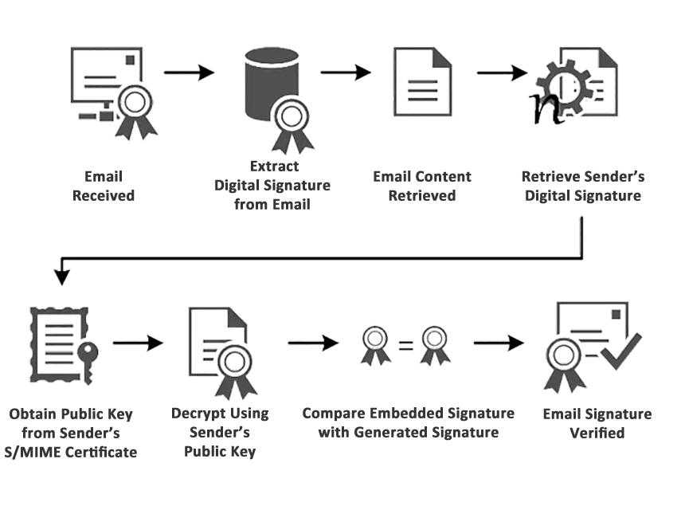
Non-Repudiation
Non-Repudiation
Alice cannot later deny sending a message. Achieved by having Alice sign with her private key — anyone can verify she signed.
⚠ Caveat: Even a private-key signature can be disputed — 'malware signed on my behalf' or 'my key was stolen'. Non-repudiation has no strictly legal meaning.

Slide 19
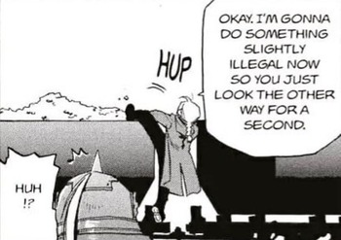
Plausible Deniability
Plausible Deniability
Bob must know the message came from Alice, but must not be able to prove it to anyone else.
1
Alice picks secret key S for this message m
2
Encrypts S with Bob's public key → {S}Bob
3
Signs {S}Bob with her private key → [{S}Bob]Alice
4
Computes MAC of m using S
5
Sends: message m + MAC + [{S}Bob]Alice to Bob
Why deniability holds: Bob received [{S}Bob]Alice — he can construct any message and forge a MAC with S. So he can't prove to a third party that m was Alice's actual message.

Slide 20
Message Flow Confidentiality
Goal: Alice sends Bob a message such that no eavesdropper can tell that Alice communicated with Bob at all.
Simple: Alice → Fred (encrypted) → Fred → Bob
Fred forwards Alice's message to Bob after a random delay. Carol can see Alice contacting Fred but not who Fred is ultimately forwarding to.
Onion Routing — Multi-Hop Layered Encryption (Chaum 1981 → Mixmaster → Tor)
Alice
R1
R5
R2
Bob
R1 knows source (Alice) but not destination
R5 knows neither source nor final destination
R2 knows destination (Bob) but not source
Public-Key Onion
Secret-Key Onion (Tor-style)
Cover Traffic
Each hop decrypts with private key. Message grows per hop. Expensive but stateless.
Connection setup uses public keys; data uses shared secret keys. Fixed message size. Cheaper. Supports return path.
Dummy messages sent at random intervals to prevent traffic-correlation attacks.

Slide 21
Anonymity & Pseudonymity
Anonymity
Pseudonymity
Bob should not be able to tell who sent the message.
Bob can't identify the sender, but can tell that multiple messages came from the same entity.
Simply omitting the FROM field is insufficient — network-layer address may be included
How It Works
Mail transports record the path the message took — available to the recipient
Create a pseudonym + public key pair. Always sign messages with that pseudonym's private key.
Solution: use a third party (Fred) who sends the unsigned message onward
Reply Problem
Bob can't reply via normal DNS lookup. Remailers must retain routing state for each pseudonym.
Fred needs many clients to provide real anonymity (otherwise trivial to correlate)
Traceability
Cover traffic: users send fixed-length dummy messages at random intervals
Only compromising all remailers in the path reveals the true owner of the pseudonym.
Fixed-length messages prevent correlation by size
Anonymous Email
Doesn't allow replies at all — fully one-way communication.

Slide 22
Security Properties: Which Feature Provides What?
Feature
Privacy
Integrity
Auth
Non-Repud.
Anonymity
Flow Conf.
End-to-End Encrypt.
✔
✗
✗
✗
✗
✗
Digital Signature
✗
✔
✔
✔
✗
✗
PGP / S/MIME
✔
✔
✔
✔
✗
✗
Plausible Deniability
✔
✔
✔
✗
✗
✗
Onion Routing
✔
✗
✗
✗
✔
✔
Pseudonymity
✗
✗
Partial
✗
✔
✗
In-flight TLS
Partial
Partial
Partial
✗
✗
✗
✔ = provided ✗ = not provided Partial = depends on configuration

Slide 23
References
Chapter 14
Kaufman

