Slide 1
SSL/TLS
*Slides borrowed from Vitaly Shmatikov

Slide 2
What Is SSL/TLS?
Secure Sockets Layer and Transport Layer Security protocols
Same protocol design, different crypto algorithms
De facto standard for Internet security
“The primary goal of the TLS protocol is to provide privacy and data integrity between two communicating applications”
Deployed in every Web browser; also VoIP, payment systems, distributed systems, etc.

Slide 3
SSL / TLS Guarantees
End-to-end secure communications in the presence of a network attacker
Attacker completely owns the network: controls Wi-Fi, DNS, routers, his own websites, can listen to any packet, modify packets in transit, inject his own packets into the network
Scenario: you are reading your email from an Internet café connected via a r00ted Wi-Fi access point to a dodgy ISP in a hostile authoritarian country

Slide 4
History of the Protocol
SSL 1.0 – internal Netscape design, early 1994?
Lost in the mists of time
SSL 2.0 – Netscape, Nov 1994
Several weaknesses
SSL 3.0 – Netscape and Paul Kocher, Nov 1996
TLS 1.0 – Internet standard, Jan 1999
Based on SSL 3.0, but not interoperable (uses different cryptographic algorithms)
TLS 1.1 – Apr 2006
TLS 1.2 – Aug 2008
TLS 1.3 – Aug 2018

Slide 5
SSL Basics
SSL consists of two protocols
Handshake protocol
Uses public-key cryptography to establish several shared secret keys between the client and the server
Record protocol
Uses the secret keys established in the handshake protocol to protect confidentiality, integrity, and authenticity of data exchange between the client and the server

Slide 6
SSL Handshake Protocol
Runs between a client and a server
For example, client = Web browser, server = website
Negotiate version of the protocol and the set of cryptographic algorithms to be used
Interoperability between different implementations
Authenticate server and client (optional)
Use digital certificates to learn each other’s public keys and verify each other’s identity
Often only the server is authenticated
Use public keys to establish a shared secret

Slide 7
Handshake Protocol Structure
ClientHello
ServerHello, [Certificate], [ServerKeyExchange], [CertificateRequest], ServerHelloDone
C
S
[Certificate], ClientKeyExchange, [CertificateVerify]
switch to negotiated cipher Finished
Record of all sent and received handshake messages
switch to negotiated cipher
Finished

Slide 8
ClientHello
ClientHello
Client announces (in plaintext):
Protocol version he is running
Cryptographic algorithms he supports
Fresh, random number
C
S

Slide 9
ClientHello (RFC)
struct {
ProtocolVersion client_version;
Highest version of the protocol supported by the client
Session id (if the client wants to resume an old session)
Random random; SessionID session_id; CipherSuite cipher_suites;
Set of cryptographic algorithms supported by the client (e.g., RSA or Diffie-Hellman)
CompressionMethod compression_methods;
} ClientHello

Slide 10
ServerHello
C, version_{c}, suites_{c}, N_{c}
ServerHello
Server responds (in plaintext) with:
Highest protocol version supported by both the client and the server
Strongest cryptographic suite selected from those offered by the client
Fresh, random number
C
S

Slide 11
ServerKeyExchange
C, version_{c}, suites_{c}, N_{c}
version_{s}, suite_{s}, N_{s}, ServerKeyExchange
C
S
Server sends his public-key certificate containing either his RSA, or
his Diffie-Hellman public key (depending on chosen crypto suite)

Slide 12
ClientKeyExchange
C, version_{c}, suites_{c}, N_{c}
version_{s}, suite_{s}, N_{s}, certificate, “ServerHelloDone”
C
S
ClientKeyExchange
The client generates secret key material and sends it to the server encrypted with the server’s public key (if using RSA)

Slide 13
ClientKeyExchange (RFC)
struct {
select (KeyExchangeAlgorithm) {
case rsa: EncryptedPreMasterSecret;
case diffie_hellman: ClientDiffieHellmanPublic;
} exchange_keys
} ClientKeyExchange
struct {
Where do random
bits come from?
ProtocolVersion client_version;
opaque random[46];
} PreMasterSecret
Random bits from which symmetric keys will be derived (by hashing them with nonces)

Slide 14

Debian Linux (2006-08)
A line of code commented out from md_rand
MD_Update(&m,buf,j); /* purify complains */
Without this line, the seed for the pseudo-random generator is derived only from process ID
Default maximum on Linux = 32768
Result: all keys generated using Debian-based OpenSSL package in 2006-08 are predictable
“Affected keys include SSH keys, OpenVPN keys, DNSSEC keys, and key material for use in X.509 certificates and session keys used in SSL/TLS connections”

Slide 15
“Core” SSL 3.0 Handshake
C, version_{c}=3.0, suites_{c}, N_{c}
version_{s}=3.0, suite_{s}, N_{s}, certificate for PK_{s}, “ServerHelloDone”
{Secret_{c}}_{PKs}
if using RSA
S
C
C and S share
secret key material (secret_{c}) at this point
switch to keys derived from secret_{c} , N_{c} , N_{s}
switch to keys derived from secret_{c} , N_{c} , N_{s}
Finished
Finished

Slide 16
Version Rollback Attack
C, version_{c}=2.0, suites_{c}, N_{c}
Server is fooled into thinking he is communicating with a client who supports only SSL 2.0
version_{s}=2.0, suite_{s}, N_{s}, certificate for PK_{s}, “ServerHelloDone”
C
S
{Secret_{c}}_{PKs}
C and S end up communicating using SSL 2.0 (weaker earlier version of the protocol that does not include “Finished” messages)

Slide 17
SSL 2.0 Weaknesses (Fixed in 3.0)
Cipher suite preferences are not authenticated
“Cipher suite rollback” attack is possible
Weak MAC construction, MAC hash uses only 40 bits in export mode
SSL 2.0 uses padding when computing MAC in block cipher modes, but padding length field is not authenticated
Attacker can delete bytes from the end of messages
No support for certificate chains or non-RSA algorithms

Slide 18
“Chosen-Protocol” Attacks
Why do people release new versions of security protocols? Because the old version got broken!
New version must be backward-compatible
Not everybody upgrades right away
Attacker can fool someone into using the old, broken version and exploit known vulnerabilities
Similar: fool victim into using weak crypto algorithms
Defense is hard: must authenticate version early
Many protocols had “version rollback” attacks
SSL, SSH, GSM (cell phones)

Slide 19
Version Check in SSL 3.0
C, version_{c}=3.0, suites_{c}, N_{c}
version_{s}=3.0, suite_{s}, N_{s}, certificate for PK_{s}, “ServerHelloDone”
“Embed” version number into secret
C
S
Check that received version is equal to the version in ClientHello
{version_{c}, secret_{c}}_{PKs}
C and S share
secret key material secret_{c} at this point
switch to key derived from secret_{c}, N_{c}, N_{s}
switch to key derived from secret_{c}, N_{c}, N_{s}

Slide 20
Exploiting SSL for Denial of Service
https://www.thc.org/thc-ssl-dos/
2 simple commands in bash:
-----BASH SCRIPT BEGIN-----
thc-ssl-dosit() { while :; do (while :; do echo R; done) | openssl s_client
-connect 127.0.0.1:443 2>/dev/null; done }
for x in `seq 1 100`; do thc-ssl-dosit & done
-----BASH SCRIPT END-------
THC-SSL-DOS is a tool to verify the performance of SSL
Establishing a secure SSL connection requires 15x more processing power on the server than on the client
“THC-SSL-DOS exploits this asymmetric property by overloading the server and knocking it off the Internet”

Slide 21
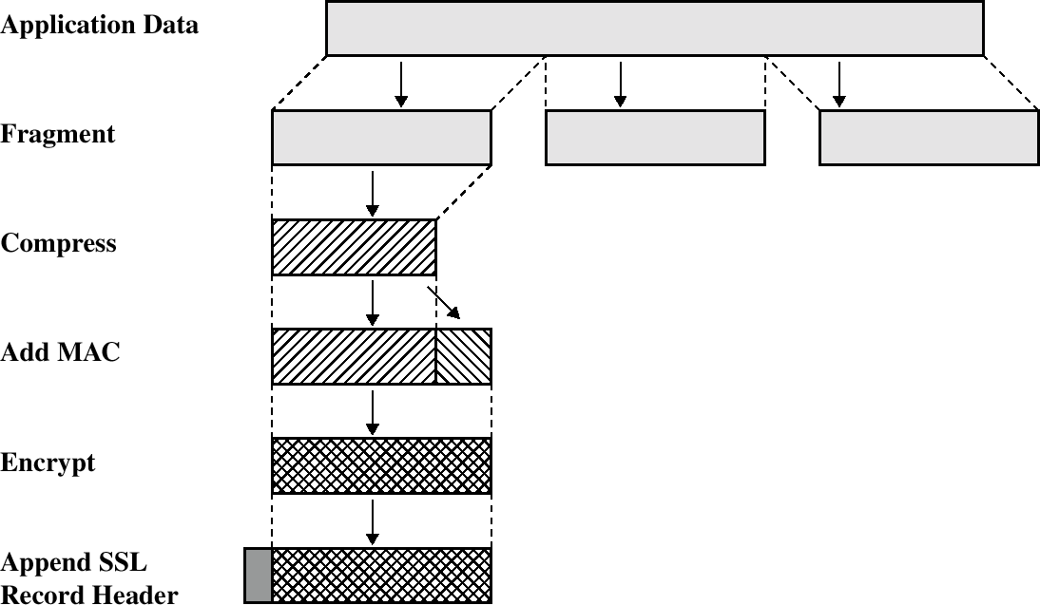
SSL/TLS Record Protection
Use symmetric keys established in the handshake protocol

Slide 22
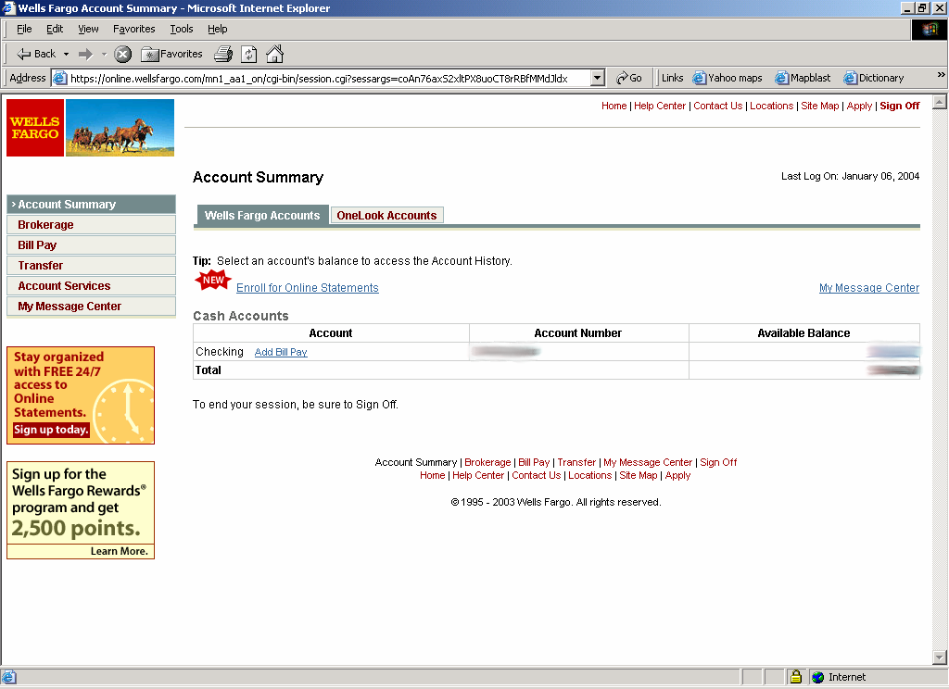
Most Common Use of SSL/TLS

Slide 23


HTTPS and Its Adversary Model
HTTPS: end-to-end secure protocol for Web
Designed to be secure against network attackers, including man-in-the-middle (MITM) attacks
browser
proxy
HTTPS server
Internet
HTTPS tunnel
HTTPS provides encryption, authentication (usually for server only), and integrity checking

Slide 24
The Lock Icon
Goal: identify secure connection
SSL/TLS is being used between client and server to protect against active network attacker
Lock icon should only be shown when the page is secure against network attacker
Semantics subtle and not widely understood by users
Problem in user interface design

Slide 25
HTTPS Security Guarantees
The origin of the page is what it says in the address bar
User must interpret what he sees - remember amazonaccounts.com?
Contents of the page have not been viewed or modified by a network attacker

Slide 26
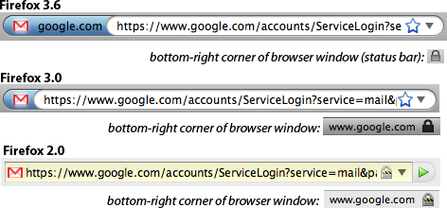
Evolution of the Lock in Firefox
[Schultze]
How about Firefox 4?

Slide 27
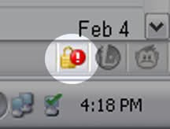
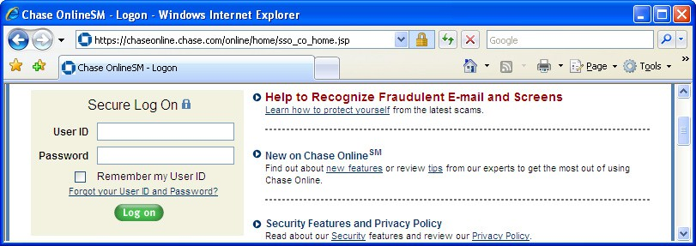
Combining HTTPS and HTTP
Page served over HTTPS but contains HTTP
IE 7: no lock, “mixed content” warning
Firefox: “!” over lock, no warning by default
Safari: does not detect mixed content
Lock icon
Flash file served over HTTP
Flash does not trigger warning in IE7 and FF
Network attacker can now inject scripts, hijack session
Can script
embedding page!

Slide 28
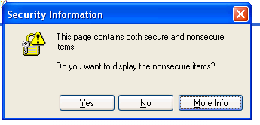
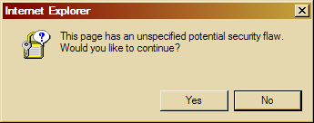
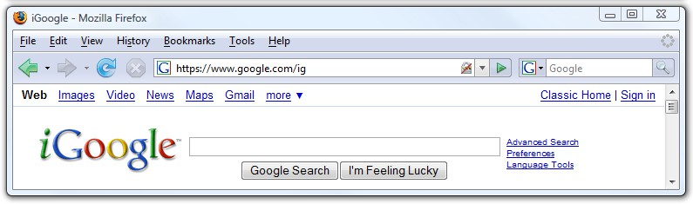
Mixed Content: UI Challenges

Slide 29
Mixed Content and Network Attacks
Banks: after login, all content served over HTTPS
Developer error: somewhere on bank site write
<script src=http://www.site.com/script.js> </script>
Active network attacker can now hijack any session (how?)
Better way to include content:
<script src=//www.site.com/script.js> </script>
Served over the same protocol as embedding page

Slide 30

HTTP → HTTPS and Back
Typical pattern: HTTPS upgrade
Come to site over HTTP, redirect to HTTPS for login
Browse site over HTTP, redirect to HTTPS for checkout
sslstrip: network attacker downgrades connection
HTTP SSL
attacker
Rewrite <a href=https://…> to <a href=http://…>
Redirect Location: https://... to Location: http://...
Rewrite <form action=https://… > to <form action=http://…>
Can the server detect this attack?

Slide 31


Will You Notice?
[Moxie Marlinspike]
⇒
Clever favicon inserted
by network attacker

Slide 32
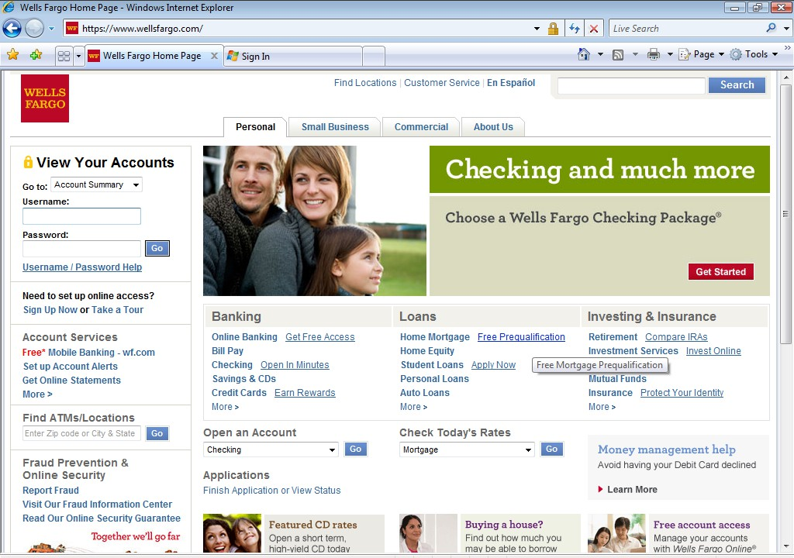

Motivation
https://
Whose public key is used to establish the secure session?

Slide 33








Authenticity of Public Keys
?
private key
Bob
Alice
public key
Problem: How does Alice know that the public key she received is really Bob’s public key?

Slide 34
Distribution of Public Keys
Public announcement or public directory
Risks: forgery and tampering
Public-key certificate
Signed statement specifying the key and identity
– sig_{Alice}(“Bob”, PK_{B})
Common approach: certificate authority (CA)
An agency responsible for certifying public keys
Browsers are pre-configured with 100+ of trusted CAs
A public key for any website in the world will be accepted by the browser if certified by one of these CAs

Slide 35
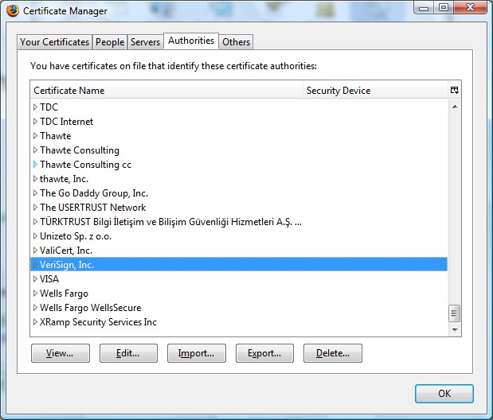
Trusted Certificate Authorities

Slide 36
CA Hierarchy
Browsers, operating systems, etc. have trusted root certificate authorities
Firefox includes certificates of over 100 trusted root CAs
A Root CA signs certificates for intermediate CAs, they sign certificates for lower-level CAs, etc.
Certificate “chain of trust”
– sig_{Verisign}(“UT Austin”, PK_{UT}), sig_{UT}(“Vitaly S.”, PK_{Vitaly})
CA is responsible for verifying the identities of certificate requestors, domain ownership

Slide 37
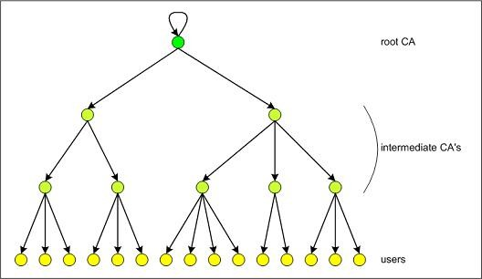
Certificate Hierarchy
What power do they have?
Who trusts their certificates?

Slide 38
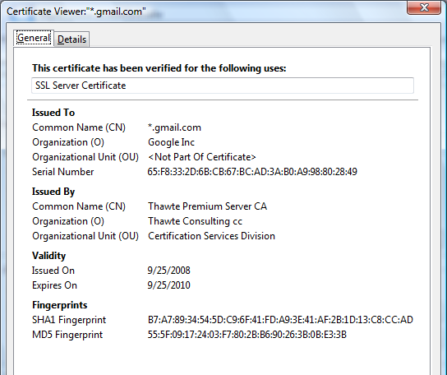
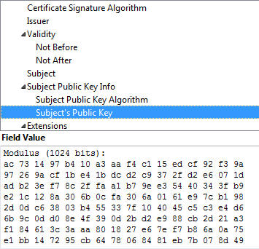
Example of a Certificate
Important fields

Slide 39
Common Name
Explicit name: www.foo.com
Wildcard: *.foo.com or www*.foo.com
Matching rules
Firefox 3: * matches anything
Internet Explorer 7: * must occur in the leftmost component, does not match ‘.’
– *.foo.com matches a.foo.com, but not a.b.foo.com

Slide 40
International Domain Names
Rendered using international character set
Chinese character set contains characters that look like / ? = .
What could go wrong?
Can buy a certificate for *.foo.cn, create any number of domain names that look like
www.bank.com/accounts/login.php?q=me.foo.cn
What does the user see?
*.foo.cn certificate works for all of them!

Slide 41
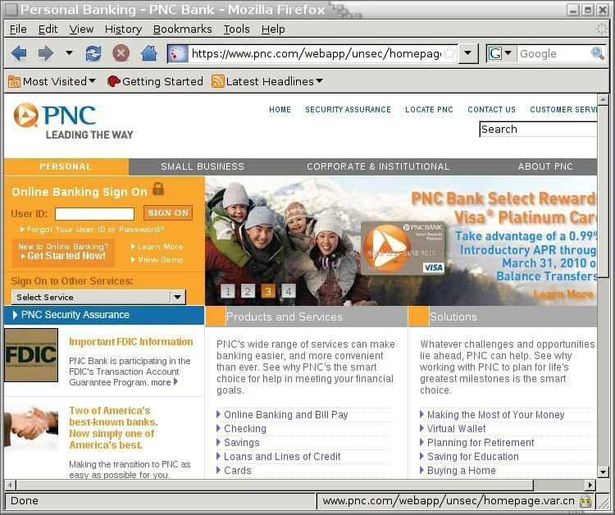
Example
[Moxie Marlinspike]

Slide 42
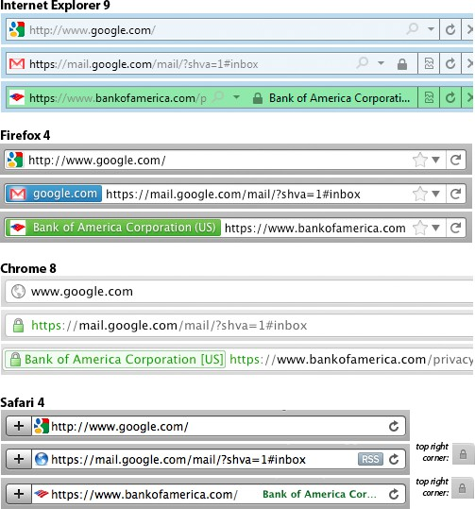
Meaning of Color
[Schultze]
What is the difference?
Domain Validation (DV) certificate
vs.
Extended Validation (EV) certificate
Means what?

Slide 43
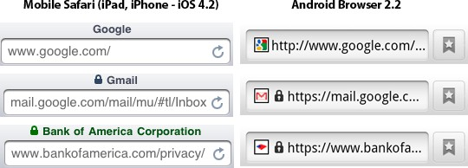
Mobile Browsing
[Schultze]
Same lock for DV and EV
Windows Phone 7: same behavior
… but only when URL bar present
… landscape mode: no URL bar
http://www.freedom-to-tinker.com/blog/sjs/web-browser-security-user-interfaces-hard-get-right-and-increasingly-inconsistent

Slide 44
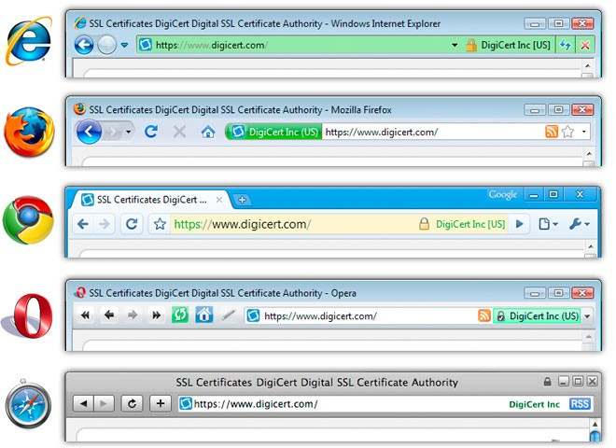
Extended Validation (EV) Certificates
Certificate request must be approved by a human lawyer at the certificate authority

Slide 45
Questions about EV Certificates
What does EV certificate mean?
What is the difference between an HTTPS connection that uses a regular certificate and an HTTPS connection that uses an EV certificate?
If an attacker has somehow obtained a non-EV certificate for bank.com, can he inject a script into https://bank.com content?
What is the origin of the script? Can it access or modify content that arrived from actual bank.com via HTTPS?
What would the browser show – blue or green?

Slide 46
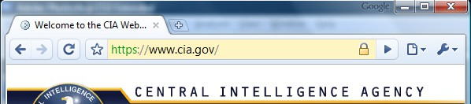
When Should The Lock Be Shown?
All elements on the page fetched using HTTPS For all elements:
HTTPS certificate is issued by a certificate authority (CA) trusted by the browser
HTTPS certificate is valid – means what?
Common Name in the certificate matches domain name in the URL

Slide 47
X.509 Authentication Service
Internet standard (1988-2000)
Specifies certificate format
X.509 certificates are used in IPsec and SSL/TLS
Specifies certificate directory service
For retrieving other users’ CA-certified public keys
Specifies a set of authentication protocols
For proving identity using public-key signatures
Can use with any digital signature scheme and hash function, but must hash before signing
Remember MD5?

Slide 48
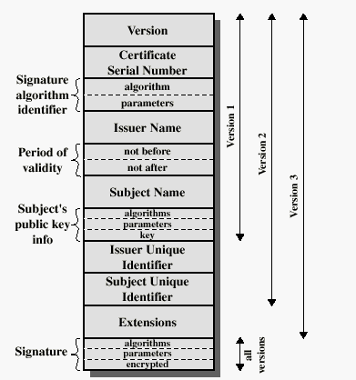
X.509 Certificate
Added in X.509 versions 2 and 3 to address usability and security problems
hash

Slide 49
Back in 2008
[Sotirov et al. “Rogue Certificates”]
Many CAs still used MD5
RapidSSL, FreeSSL, TrustCenter, RSA Data Security, Thawte, verisign.co.jp
Sotirov et al. collected 30,000 website certificates
9,000 of them were signed using MD5 hash
97% of those were issued by RapidSSL

Slide 50
Colliding Certificates
[Sotirov et al. “Rogue Certificates”]
set by the CA
serial number
serial number
validity period
chosen prefix (difference)
validity period
real cert domain name
rogue cert domain name
Hash to the same MD5 value!
real cert RSA key
???
collision bits
Valid for both certificates!
(computed)
X.509 extensions
identical bytes (copied from real cert)
X.509 extensions
signature
signature

Slide 51
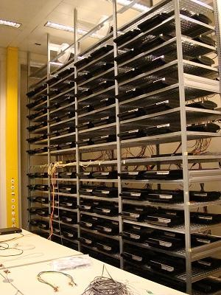
Generating Collisions
[Sotirov et al. “Rogue Certificates”]
1-2 days on a cluster of 200 PlayStation 3’s
Equivalent to 8000 desktop CPU cores or
$20,000 on Amazon EC2

Slide 52
Generating Colliding Certificates
[Sotirov et al. “Rogue Certificates”]
RapidSSL uses a fully automated system
$69 for a certificate, issued in 6 seconds
Sequential serial numbers
Technique for generating colliding certificates
Get a certificate with serial number S
Predict time T when RapidSSL’s counter goes to S+1000
Generate the collision part of the certificate
Shortly before time T buy enough (non-colliding) certificates to increment the counter to S+999
Send colliding request at time T and get serial number S+1000

Slide 53
Creating a Fake Intermediate CA
[Sotirov et al. “Rogue Certificates”]
serial number
validity period
rogue CA cert
chosen prefix (difference)
real cert domain name
rogue CA RSA key
rogue CA X.509
CA bit!
extensions
We are now an
_{Netscape Co} intermediate CA.
real cert RSA key
collision bits (computed)
mment
n
Extensio^{W00T!}
(contents ignored by
X.509 extensions
browsers)
identical bytes (copied from real cert)
signature
signature
slide 54

Slide 54
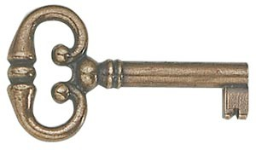
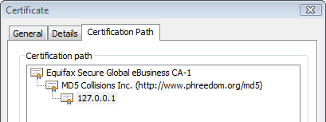
Result: Perfect Man-in-the-Middle
[Sotirov et al. “Rogue Certificates”]
This is a “skeleton key” certificate: it can issue fully trusted certificates for any site (why?)
To take advantage, need a network attack
Insecure wireless, DNS poisoning, proxy auto-discovery, hacked routers, etc.

Slide 55
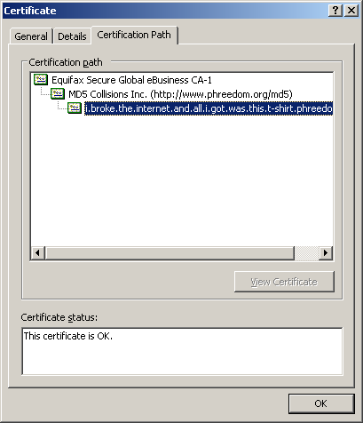
A Rogue Certificate

Slide 56
Remember Flame?
Cyber-espionage virus (2010-2012)
Signed with a fake intermediate CA certificate that appears to be issued by Microsoft and thus accepted by any Windows Update service
Fake intermediate CA certificate was created using an MD5 chosen-prefix collision against an obscure Microsoft Terminal Server Licensing Service certificate that was enabled for code signing and still used MD5
MD5 collision technique possibly pre-dates Sotirov et al.’s work
Evidence of state-level cryptanalysis?

Slide 57

SSL/TLS Handshake
Hello
Here is my certificate
C
S
Validate
the certificate

Slide 58



SSL/TLS Handshake
Hello
I am Chase.com Here is my certificate
Android app
Issued by GoDaddy to AllYourSSLAreBelongTo.us
Ok!

Slide 59


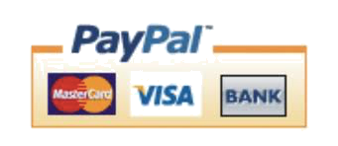


Failing to Check Hostname
“Researchers at the University of Texas at Austin and Stanford University have discovered that poorly designed APIs used in SSL implementations are to blame for vulnerabilities in many critical non-browser software packages. Serious security vulnerabilities were found in programs such as Amazon’s EC2 Java library, Amazon’s and PayPal’s merchant SDKs, Trillian and AIM instant messaging software, popular integrated shopping cart software packages, Chase mobile banking software, and several Android applications and libraries. SSL connections from these programs and many others are vulnerable to a man in the middle attack…”
Major payment processing gateways, client software for cloud computing, integrated e-commerce software, etc.
- Threatpost (Oct 2012)

Slide 60


What Happens After Validation?
Hello
I am PayPal.com
(or whoever you want me to be)
Here is PayPal’s certificate for its RSA signing key
And here is my signed Diffie-Hellman value
Validate the certificate
… then verify the signature on the DH value using the public key from the certificate

Slide 61

Goto Fail
Here is PayPal’s certificate
And here is my signed Diffie-Hellman value
… verify the signature on the DH value using the public key from the certificate
if ((err = SSLHashSHA1.update(&hashCtx, &clientRandom)) != 0) goto fail;
if ((err = SSLHashSHA1.update(&hashCtx, &serverRandom)) != 0) goto fail;
if ((err = SSLHashSHA1.update(&hashCtx, &signedParams)) != 0) goto fail;
goto fail;
???
if ((err = SSLHashSHA1.final(&hashCtx, &hashOut)) != 0)
goto fail; …
err = sslRawVerify(...);
…
fail: … return err …
Signature is verified here
slide 62

Slide 62
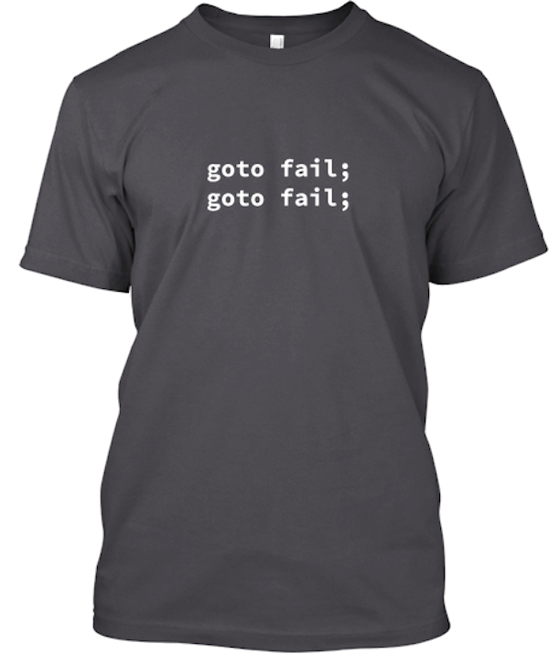
Complete Fail Against MITM
Discovered in February 2014
All OS X and iOS software vulnerable to man-in-the-middle attacks
Broken TLS implementation provides no protection against the very attack it was supposed to prevent
What does this tell you about quality control for security-critical software?

Slide 63
Certificate Revocation
Revocation is very important
Many valid reasons to revoke a certificate
Private key corresponding to the certified public key has been compromised
User stopped paying his certification fee to the CA and the CA no longer wishes to certify him
CA’s certificate has been compromised!
Expiration is a form of revocation, too
Many deployed systems don’t bother with revocation
Re-issuance of certificates is a big revenue source for certificate authorities

Slide 64
Certificate Revocation Mechanisms
Online revocation service
When a certificate is presented, recipient goes to a special online service to verify whether it is still valid
Certificate revocation list (CRL)
CA periodically issues a signed list of revoked certificates
Can issue a “delta CRL” containing only updates
Q: Does revocation protect against forged certificates?

Slide 65
Reading
Kaufman – SSL/TLS

