Slide 1
OpenMP CSC 4760
Dr. Zulkar Nine
Codes: https://www.dropbox.com/scl/fo/jaucq9eo39vwiptg9lsjt/AHanHneKWkec2vlvVIKL2yA?rlkey=pjj99j5zlfpden6rxfvfhssad&st=0ryo9hnx&dl=0

Slide 2
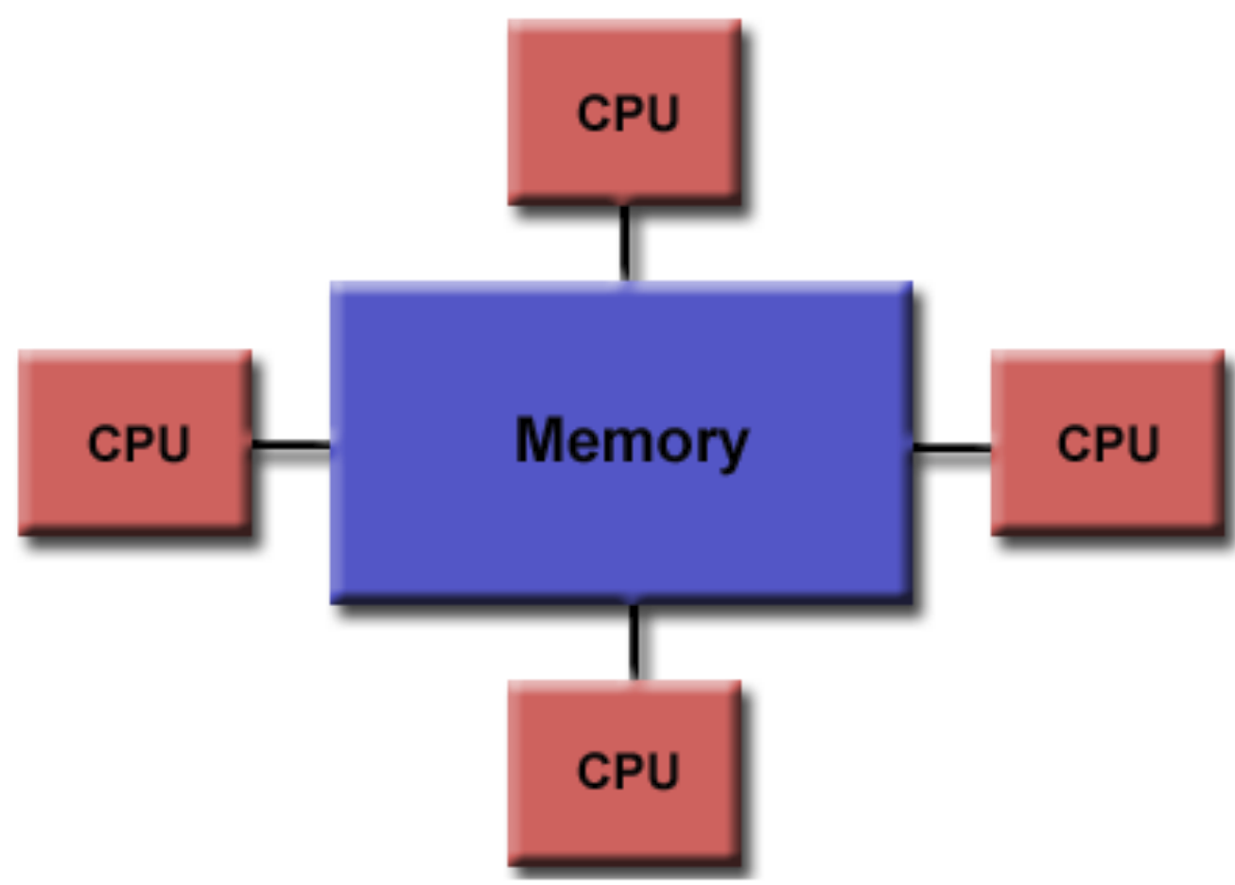
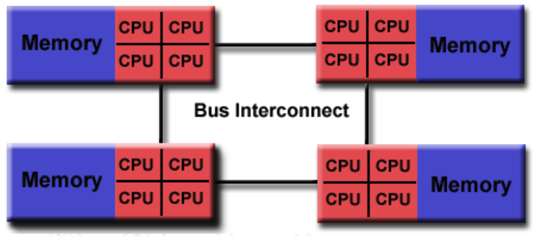
Shared Memory
All processors/cores can access all memory in a single address space
Uniform memory Access
Non-Uniform memory Access (NUMA)

Slide 3
What is OpenMP?
Open Specification for Multi-processing
”Standard” API for defining multi-threaded shared-memory programs
Within Node parallelism

Slide 4
Parallelism
Easy to achieve modest parallelism
Use relax memory model

Slide 5

Relaxed Memory Model
T1
T2
L1
L1
L2
L2
LLC/L3
count = 0
Main Memory

Slide 6
Relaxed Memory Model
Too expensive to update main memory every time value updates.
T1
T2
count = 10
L1
L1
L2
L2
LLC/L3
count = 0
Main Memory

Slide 7
Relaxed Memory Model
T1
T2
count = 10
L1
L1
Temporary view
L2
L2
LLC/L3
count = 0
Main Memory
Shared view

Slide 8
Relaxed Memory Model
Barrier or Flush needed
T1
T2
Temporary view
count = 10
Shared view
L1
L1
L2
L2
Barrier/flush
LLC/L3
count = 10
Main Memory

Slide 9
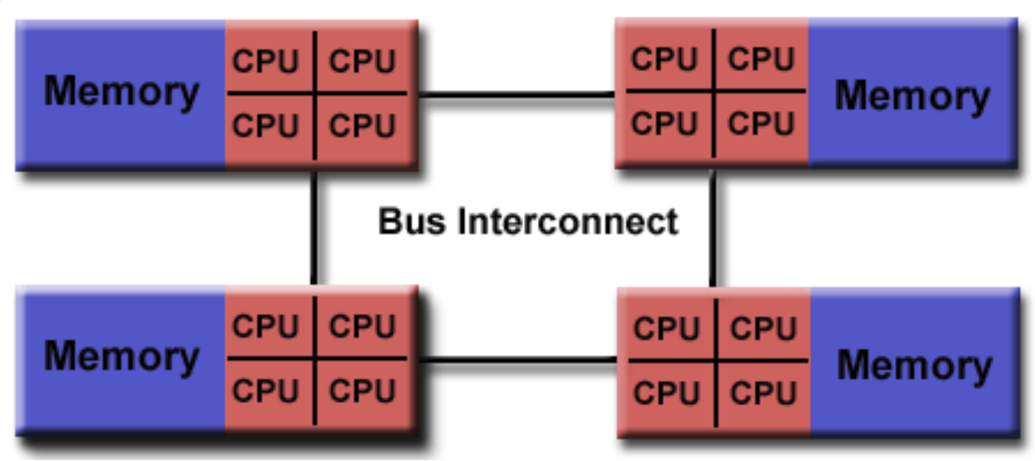
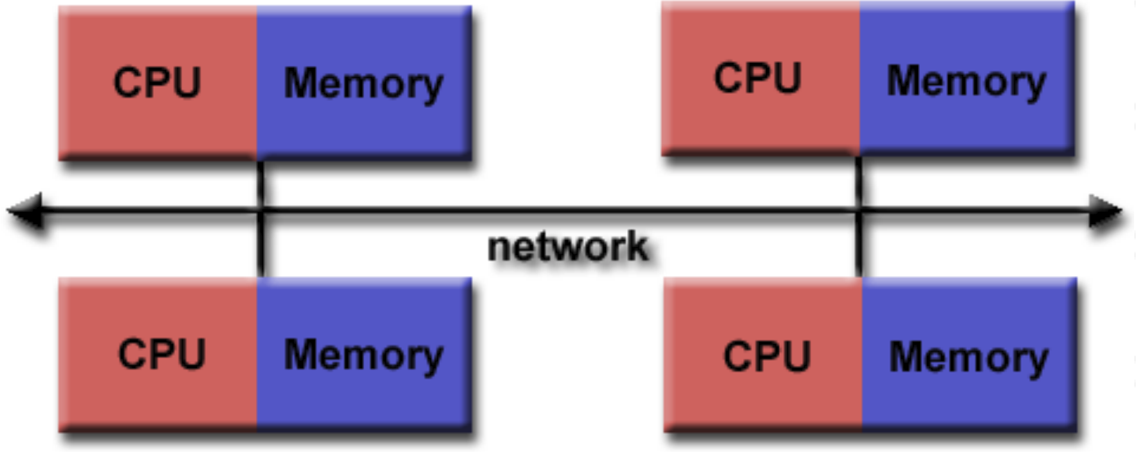
OpenMP scope
Only addresses a single node parallelism
Memory scalability is limited
Parallel Applications with Larger memory requirements
Multi-node distributed Memory architecture
OpenMP needs to be used with Techniques - MPI

Slide 10
OpenMP Programming
OpenMP is a language extension enables parallelizing C/C+/Fortran code.
Programmer uses compiler directives and library routines
Indicate parallel regions
How to parallelize them
Compiler converts code to multi-threaded code
OpenMP uses fork/join model of parallelism

Slide 11
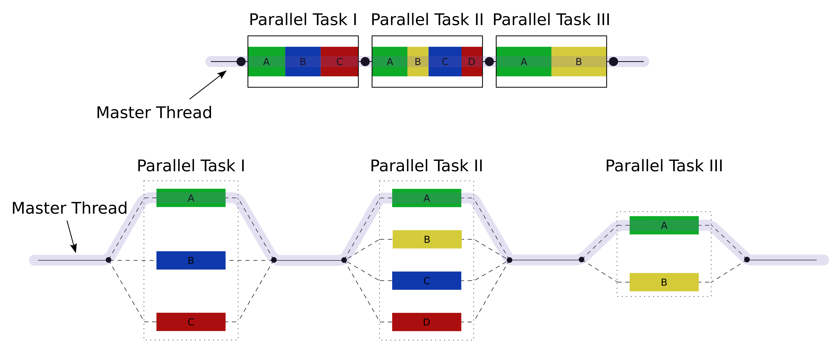
Fork Join Approach
Primary Thread spawn worker threads
Primary Thread
Primary Thread

Slide 12
OpenMP pragmas
Pragma (Greek: πράγμα) – action, deed
Compiler directives
Mechanism to communicate with the compiler
Enable high-level parallelism
Compiler may ignore pragmas
#pragma omp construct [clause [clause] … ]

Slide 13
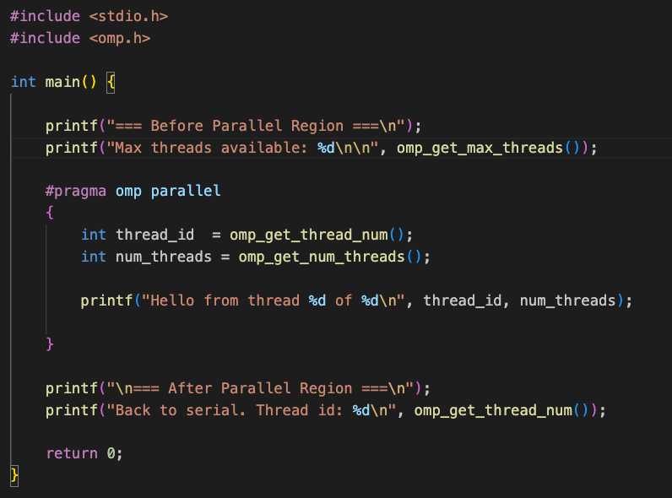
Hello world in OpenMP in C
Thread creation
#pragma omp parallel
Each thread executes a Copy of the code in the structured block
Compile: gcc hello.c –o hello -fopenmp

Slide 14
Thead Creation
Main()
Print(Max thread)
Hello from Th 0
Hello from Th 1
…
Hello from Th n
print(end)

Slide 15
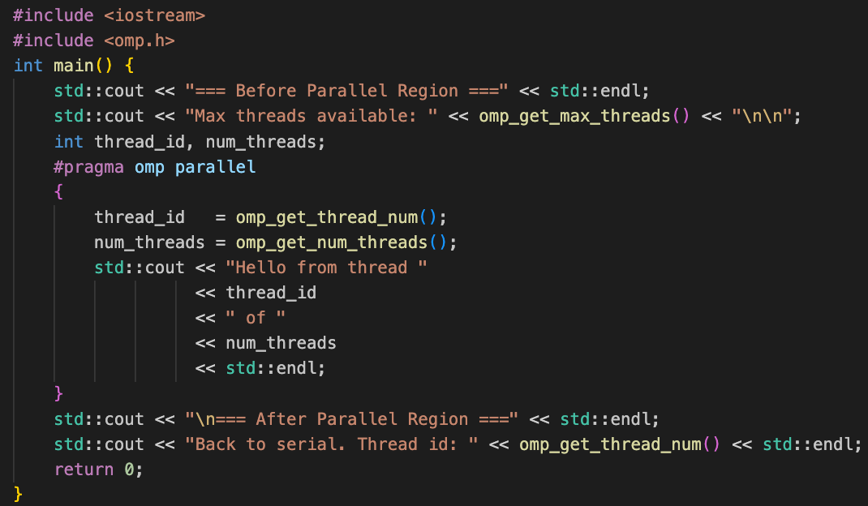
Hello world in OpenMP in C++
Compile: g++ hello.c –o hello -fopenmp

Slide 16
Hello world in OpenMP in C++
Print faces race condition
Compile: g++ hello.c –o hello -fopenmp

Slide 17
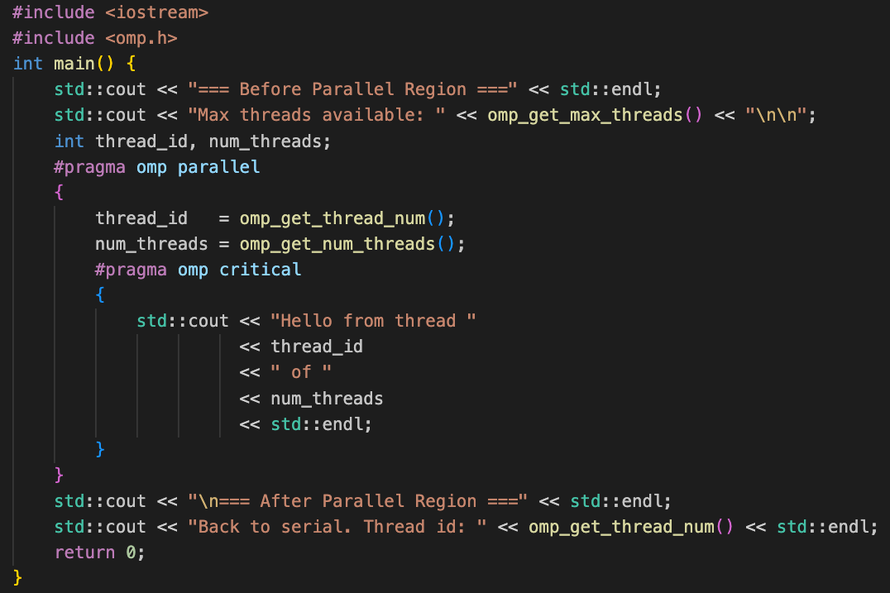
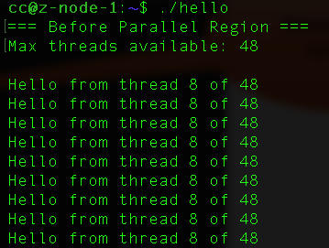
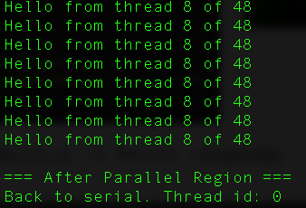
Hello world in OpenMP in C++
All threads showing same id!
Solves race condition
Compile: g++ hello.c –o hello -fopenmp

Slide 18
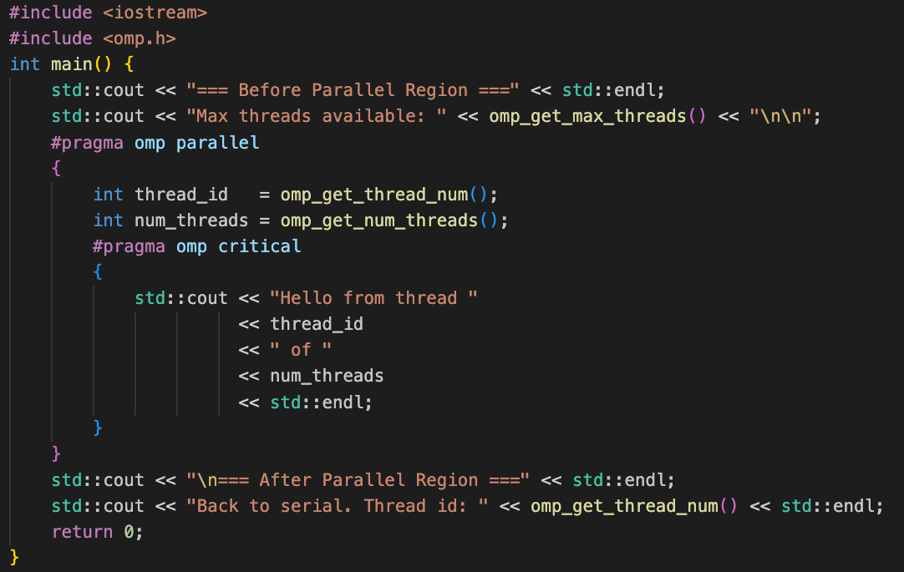
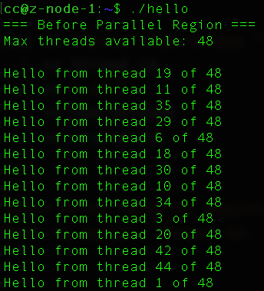
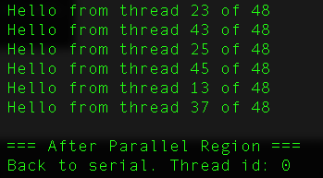
Hello world in OpenMP in C++
Variable scope!
Compile: g++ hello.c –o hello -fopenmp

Slide 19
Parallel for
Direct compiler that immediate for loop should be parallel
Only works on immediate for loop
Not even the nested ones
#pragma omp parallel for [clause [clause] … ]
for (i = init; condition; increment){
// do work
}

Slide 20
Data Sharing defaults
Most variables in an OpenMP program are shared by default
Global variables are shared
Exception: loop index variables are private by default
Exception: Stack variables in function calls from parallel regions are also private to each thread (thread-private)

Slide 21
Parallelizing using OpenMP
Identify compute intensive regions/loops
Make loop iteration independent
Add the appropriate OpenMP directives
saxpy (single precision a*x+y) example:
for (int i = 0; i < n ; i++){
z[i] = a * x[i] + y[i]
}

Slide 22
Parallelizing using OpenMP
Identify compute intensive regions/loops
Make loop iteration independent
Add the appropriate OpenMP directives
saxpy (single precision a*x+y) example:
#pragma omp parallel for
for (int i = 0; i < n ; i++){
z[i] = a * x[i] + y[i]
}

Slide 23
Overriding Defaults using clauses
Specify how data is shared between threads executing a parallel region.
private (list)
shared (list)
default(shared | none)
Reduction(operator: list)
firstprivate(list)
lastprivate(list)

Slide 24
Private clause
Each thread has its own copy of variable
Private variables are uninitialized when thread starts
The value of a private variable is unavailable to primary thread
After parallel region is done.
#pragma omp parallel for private(val)
For( int i = 0 ;i < n; i++){
val = val + 1;
}

Slide 25
What’s wrong with the code?
val = 5;
#pragma omp parallel for private(val)
for( int i = 0 ;i < n; i++){
val = val + 1;
}
cout << val;

Slide 26
What’s wrong with the code?
val = 5;
#pragma omp parallel for private(val)
For( int i = 0 ;i < n; i++){
val = val + 1;
}
cout << val;
The value of val is not available to threads inside the loop

Slide 27
What’s wrong with the code?
val = 5;
#pragma omp parallel for private(val)
For( int i = 0 ;i < n; i++){
val = val + 1;
}
cout << val;
The value of val will not available to primary threads after parallel execution

Slide 28
Default clause
Determines the data sharing attributes for variables inside a parallel region
For variable I didn’t mention – what should OpenMP assume?
#pragma omp parallel default(shared) // All unspecified vars are shared
#pragma omp parallel default(none) // Every var must be explicit
#pragma omp parallel default(private) // Fortran only — not valid in C/C++
#pragma omp parallel default(firstprivate) // OpenMP 5.0+ — C/C++ and Fortran
default(shared) is ?

Slide 29
firstprivate clause
Private – gives each thread it own copy of var, throws away the original value.
Firstprivate – solves this. Each thread gets its own copy of pre-initialized value from (before the parallel region)
val = 5;
#pragma omp parallel for firstprivate(val)
For( int i = 0 ;i < n; i++){
val = val + 1;
}
cout << val;
The value of val is initialized to 5

Slide 30
lastprivate clause
Writes the value belonging to the thread that executes last iteration of the loop to the primary thread’s copy.
val = 5;
#pragma omp parallel for firstprivate(val) lastprivate(val)
For( int i = 0 ;i < n; i++){
val = val + 1;
}
cout << val;

Slide 31
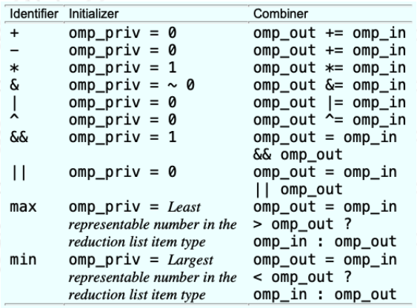
reduction(operator: list) clause
Reduce values across private copies of a variable
Operators: +. -, *, &, |, &&, ||, max, min
#pragma omp parallel for reduction(+:val)
for (int i = 0; i < n ; i++){
val += i;
}
See: reduction.cpp

Slide 32
Loop Scheduling
Scheduling decides
which thread gets which iterations of a parallel loop
when that assignment happens (compile time vs runtime).
Types: static, dynamic, guided, runtime

Slide 33
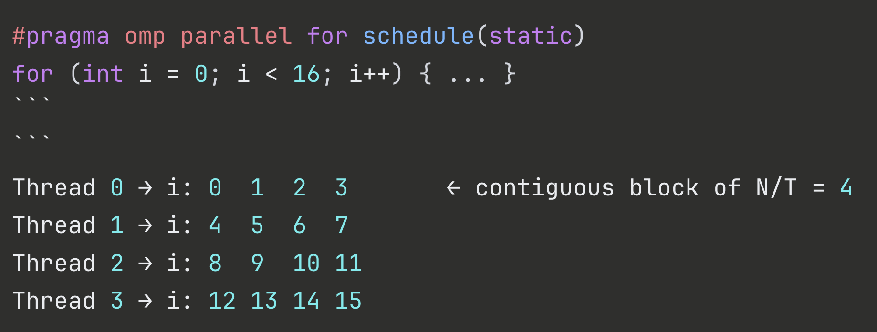
schedule(static) – no chunk
The iteration space is split into
T equal contiguous blocks
Pre-assigned before the loop starts
Zero runtime overhead
Best for uniform workloads.

Slide 34
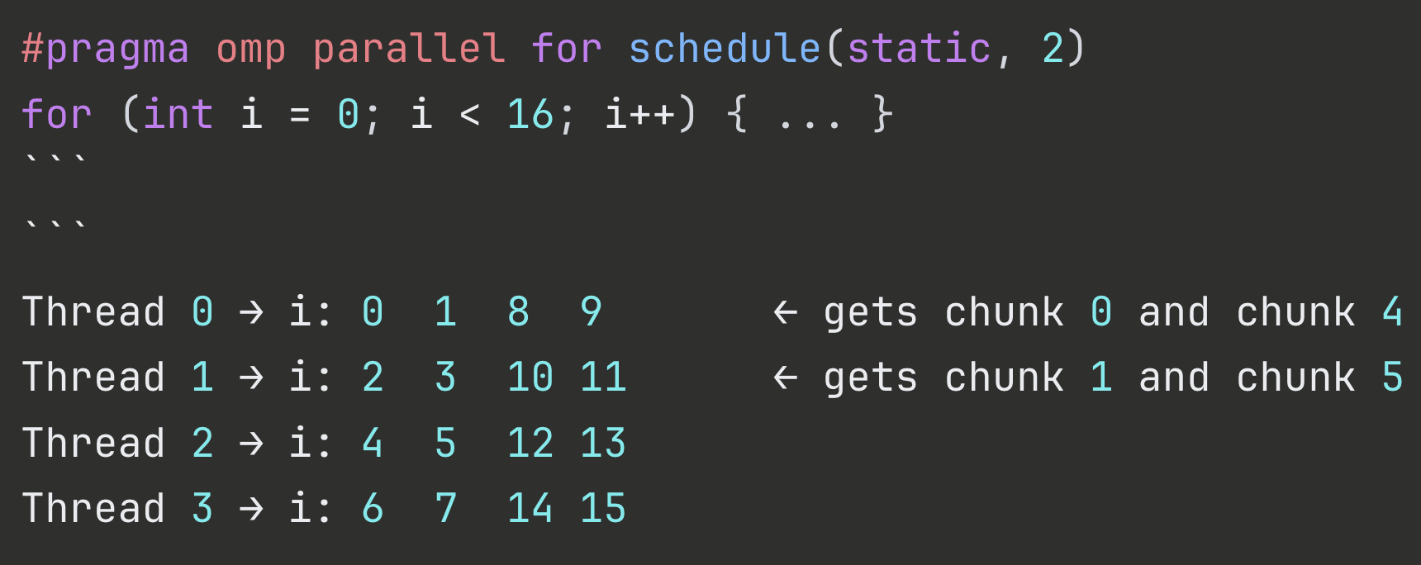
schedule(static) – chunk =2
Chunk of 2 distributed in a round-robin fashion.

Slide 35
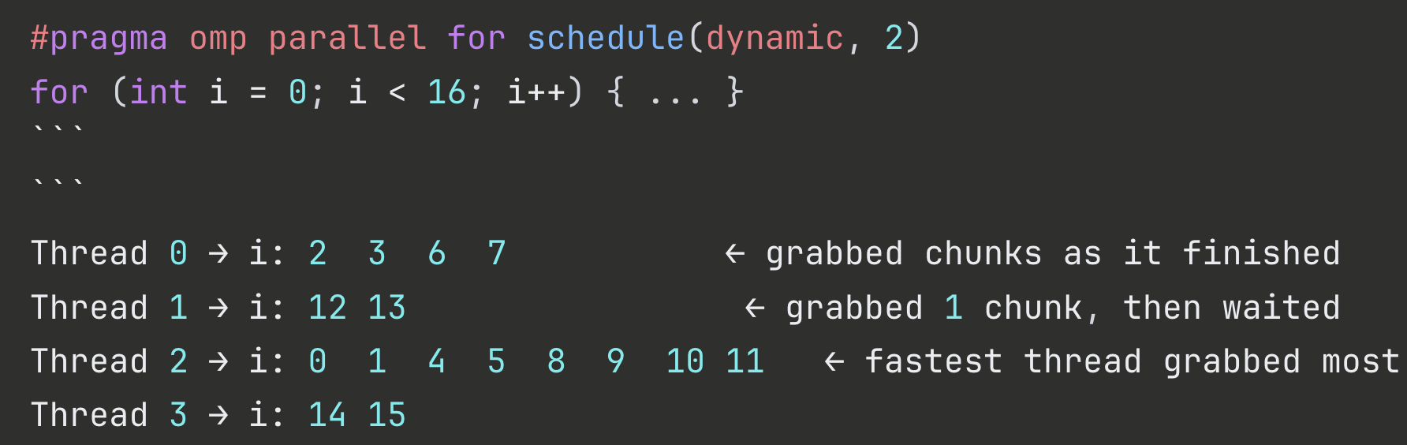
Schedule(dynamic,2)– Dynamic Chunk = 2
No pre-assignment
There is a shared work queue
Each thread grabs a chunk of 2 iterations.
Then comes back for more chunks.
Faster threads get more work.

Slide 36
Schedule(dynamic,2)– Dynamic Chunk = 2
Ideal : for irregular workloads
Cost: High synchronization overhead

Slide 37
Schedule(guided, 2)–Chunk = 2
Similar to dynamic
However, chunks start large and shrinks as loop progresses
See: guided.cpp

Slide 38
schedule (runtime)
Don’t decide schedule at compile time
Read it at runtime from environment or API call.
See: runtime.cpp

Slide 39
Scheduling Decision Guide
All iterations take roughly the same time?
→ schedule(static) - zero overhead, cache-friendly ✅
Iterations have unpredictable, wildly varying cost?
→ schedule(dynamic) best load balance, highest overhead ✅
Imbalanced but you want lower overhead than pure dynamic?
→ schedule(guided) large→small chunks, good middle ground ✅
First-touch / NUMA correctness matters?
→ schedule(static) — MUST match init and compute loops ✅

Slide 40
A complete example :
Vector multiplication and dot product.

