Slide 1

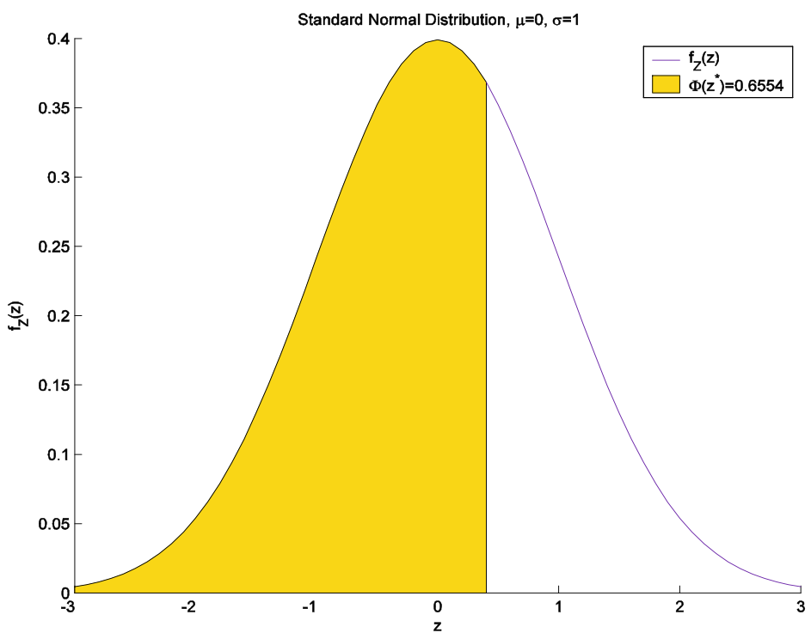

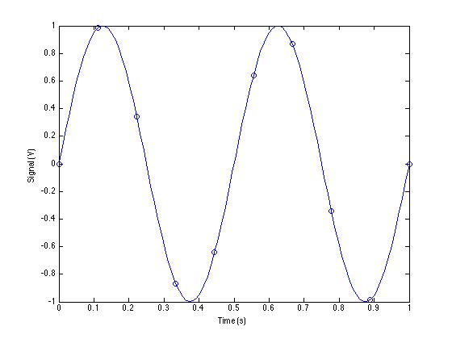
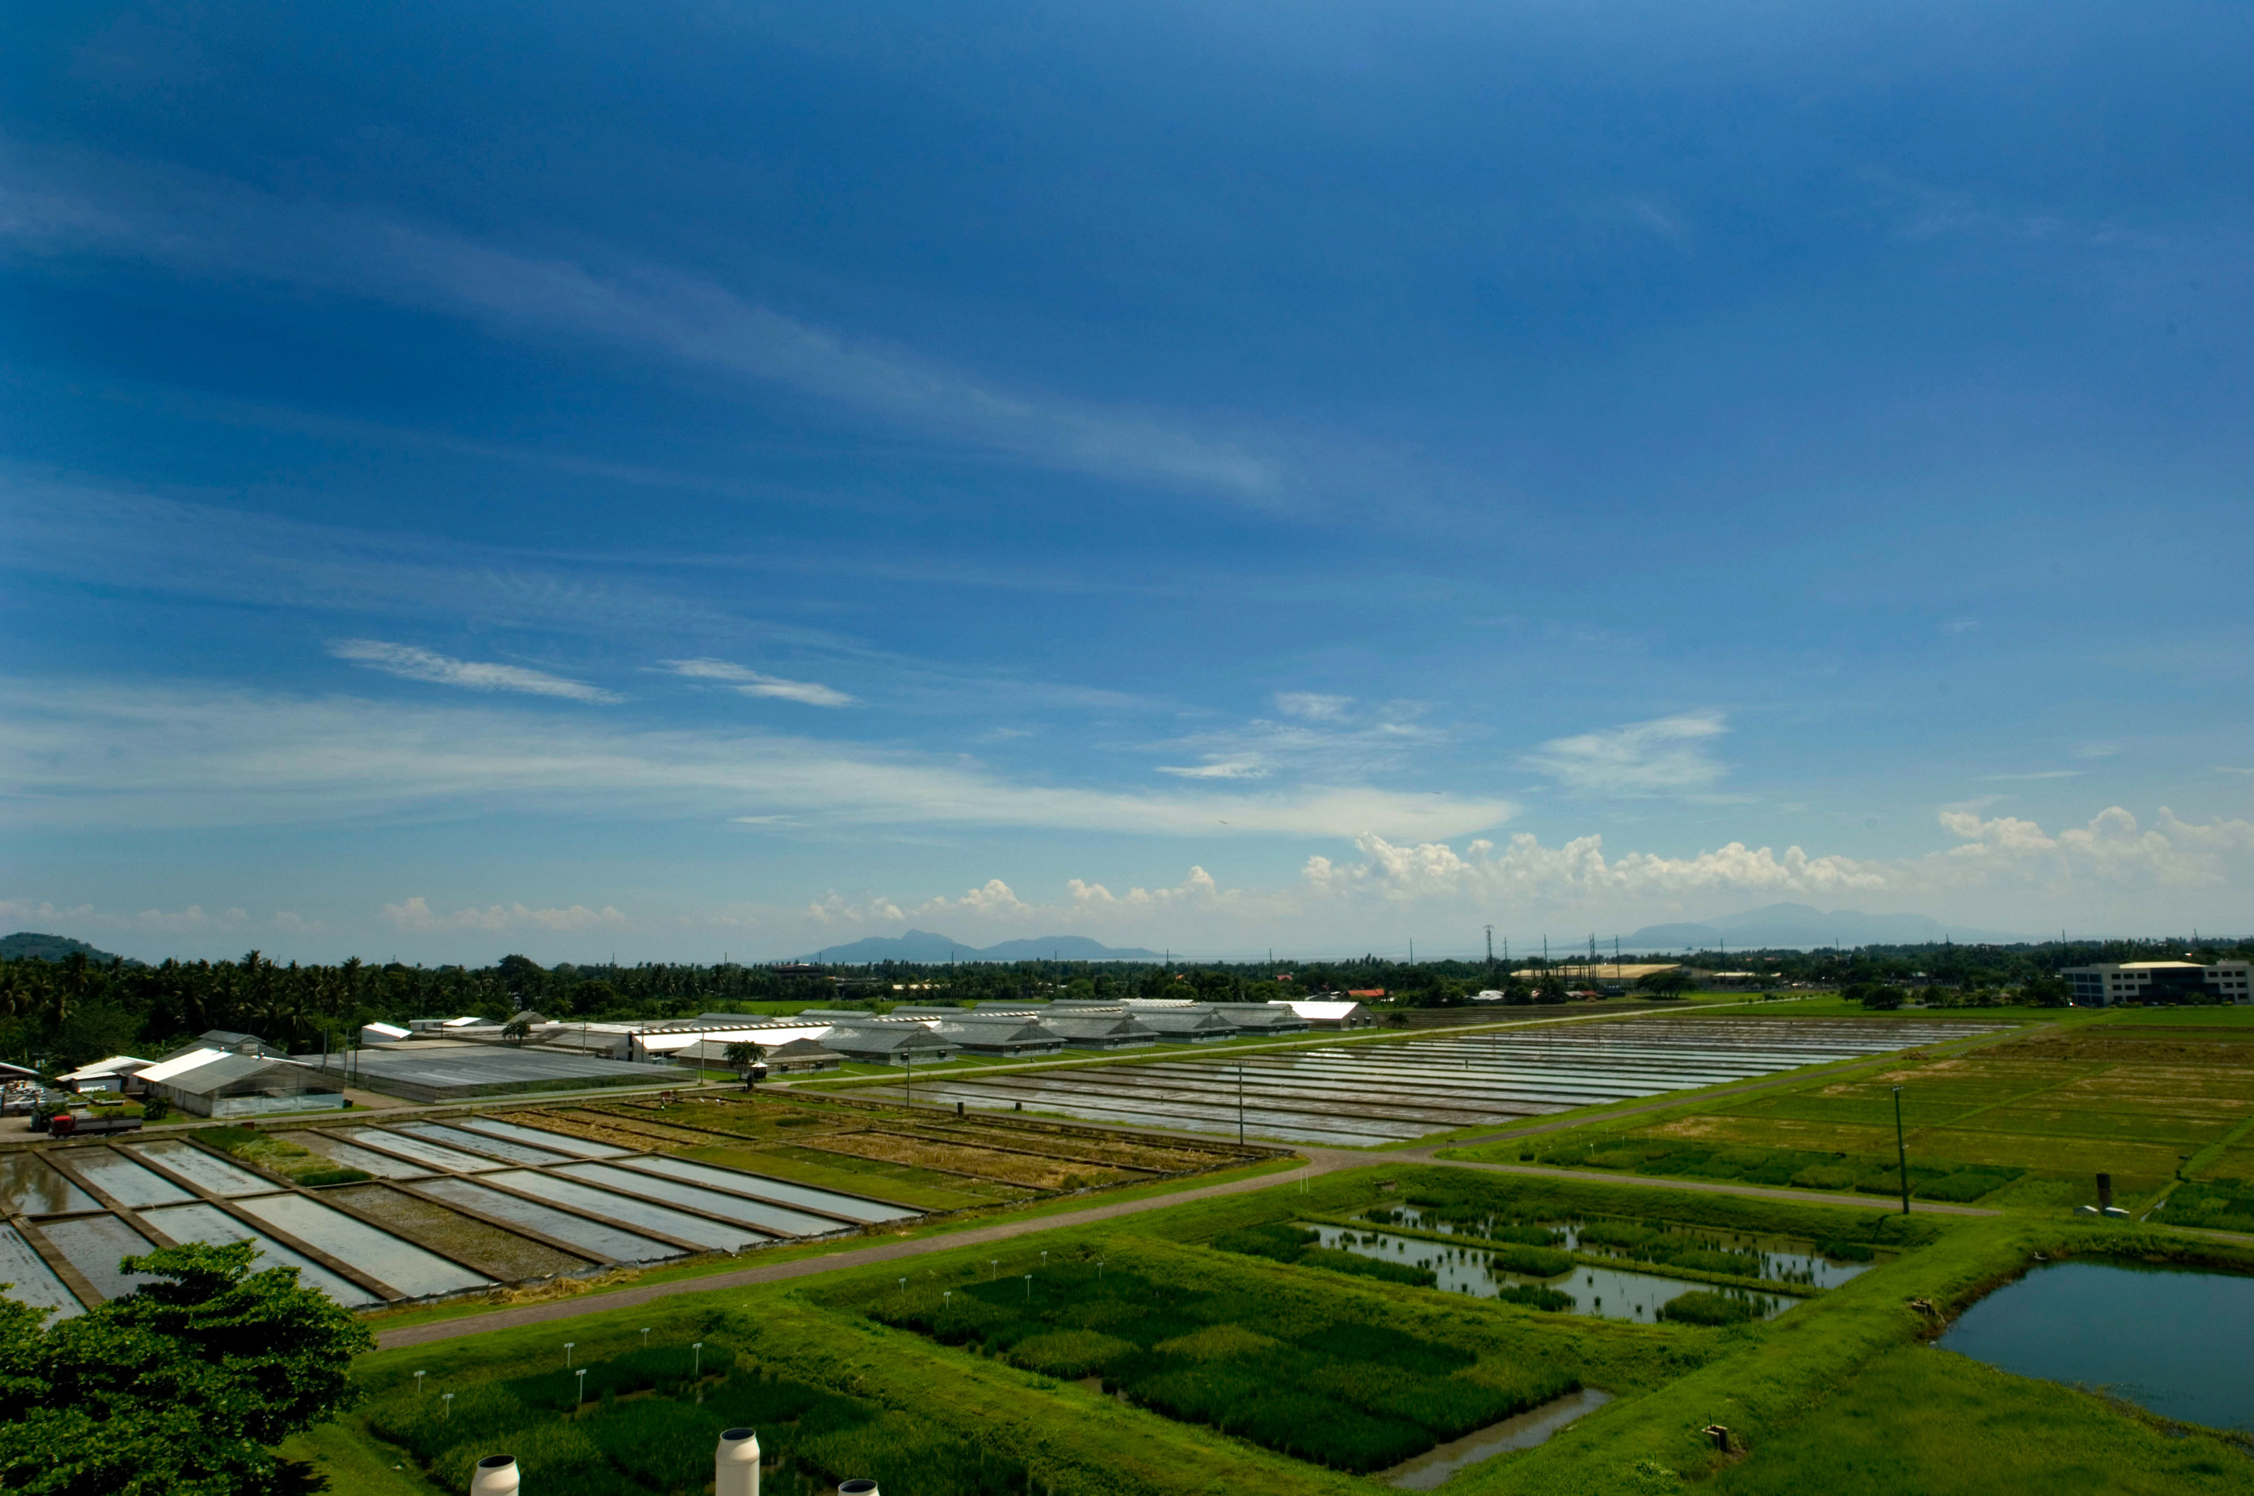
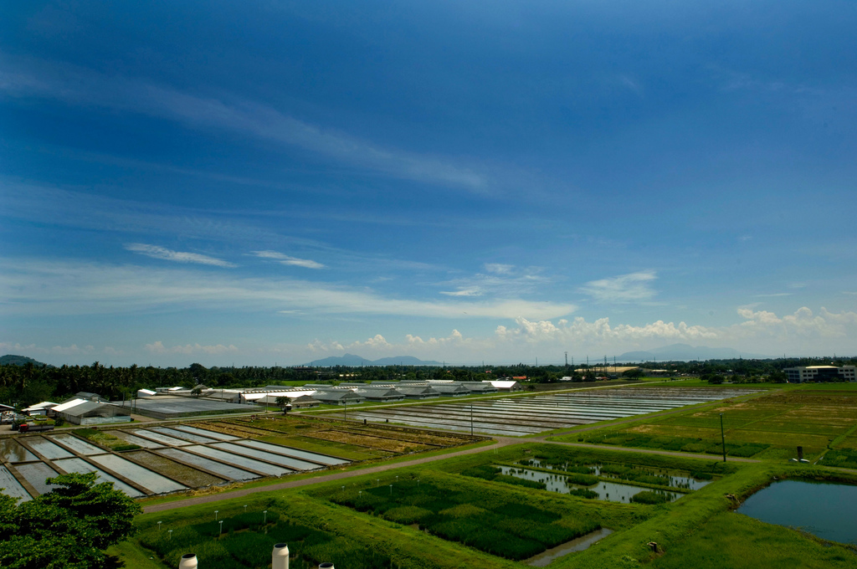
Field Missions of Tennessee: Sustaining and Expanding a Digital Platform for Pop-Up Free Medical Clinics
Design Expo Project | Tennessee Tech | Team: [Add Names] | Advisor: [Add Advisor]
Who We Serve and Why It Matters
Field Missions of Tennessee provides pop-up style free medical clinics across Tennessee, with emphasis on distressed counties.
Many residents face barriers including transportation limits, cost constraints, and reduced access to regular care.
Reliable digital coordination is critical to connect host organizations, volunteers, and participants before, during, and after each clinic.
System Overview
The platform supports clinic planning, participant coordination, and communication between Field Missions and host organizations.
Design emphasis: stability, clarity of workflows, and support for long-term handoff across student teams.
Community and Technical Impact
- Connects mission organizers, host organizations, and participants through clearer digital coordination.
- Supports faster updates for logistics, scheduling, and follow-up communication.
- Strengthens long-term sustainability of a student-supported civic technology project.
Scalability and Future Work
- Add measurable performance indicators for outreach and communication effectiveness.
- Expand support patterns for wider county and partner coverage.
- Continue iterative improvements from real-world stakeholder feedback.
Communication Platform
Enhancements Implemented
- Strengthened operational continuity by refining existing workflows and reducing failure points.
- Improved maintainability for future contributors through cleaner organization and consistent behavior.
- Added a communication platform to enable bi-directional digital communication with individuals using services.
Figure A Placeholder: Platform workflow diagram
Figure B Placeholder: Communication interface screenshot
Figure C Placeholder: Message flow example
Project Origin and Need for Continuity
- This project builds on a student-developed solution originally created by Tennessee Tech students.
- Our team enhanced that foundation to preserve operational continuity across semesters and team transitions.
- We focused on maintainability, reliability, and support for ongoing clinic operations statewide.
Implementation Notes
Poster currently uses text-first placeholders for visuals. Replace Figure A/B/C placeholders with project assets when available.
Recommended assets: system workflow graphic, communication UI screenshot, and message lifecycle diagram.
Operational Continuity Strategy
- Standardized key workflows to reduce handoff friction between student teams.
- Prioritized stable behavior in mission-critical coordination features.
- Kept the platform adaptable for evolving needs of Field Missions and host organizations.
This continuity focus helps ensure the software remains useful beyond a single development cycle.
Bi-Directional Digital Communication
- Field Missions and host organizations can send timely updates to participants.
- Participants can receive and respond with information needed for clinic coordination.
- Communication supports both clinic preparation and post-clinic follow-up.
Expected and Observed Benefits
- Better coordination across organizations and community members.
- Faster information flow for schedule, logistics, and service updates.
- Stronger service continuity across repeated clinic events.
Future Work
- Add outcome metrics dashboards for engagement and communication performance.
- Expand deployment support for additional regions and host partners.
- Continue iterative UX refinements based on stakeholder feedback.
Acknowledgments
Field Missions of Tennessee, partner host organizations, Tennessee Tech faculty mentors, and student contributors.
Optional QR Placeholder: [Repository or Demo Link]

