Slide 1




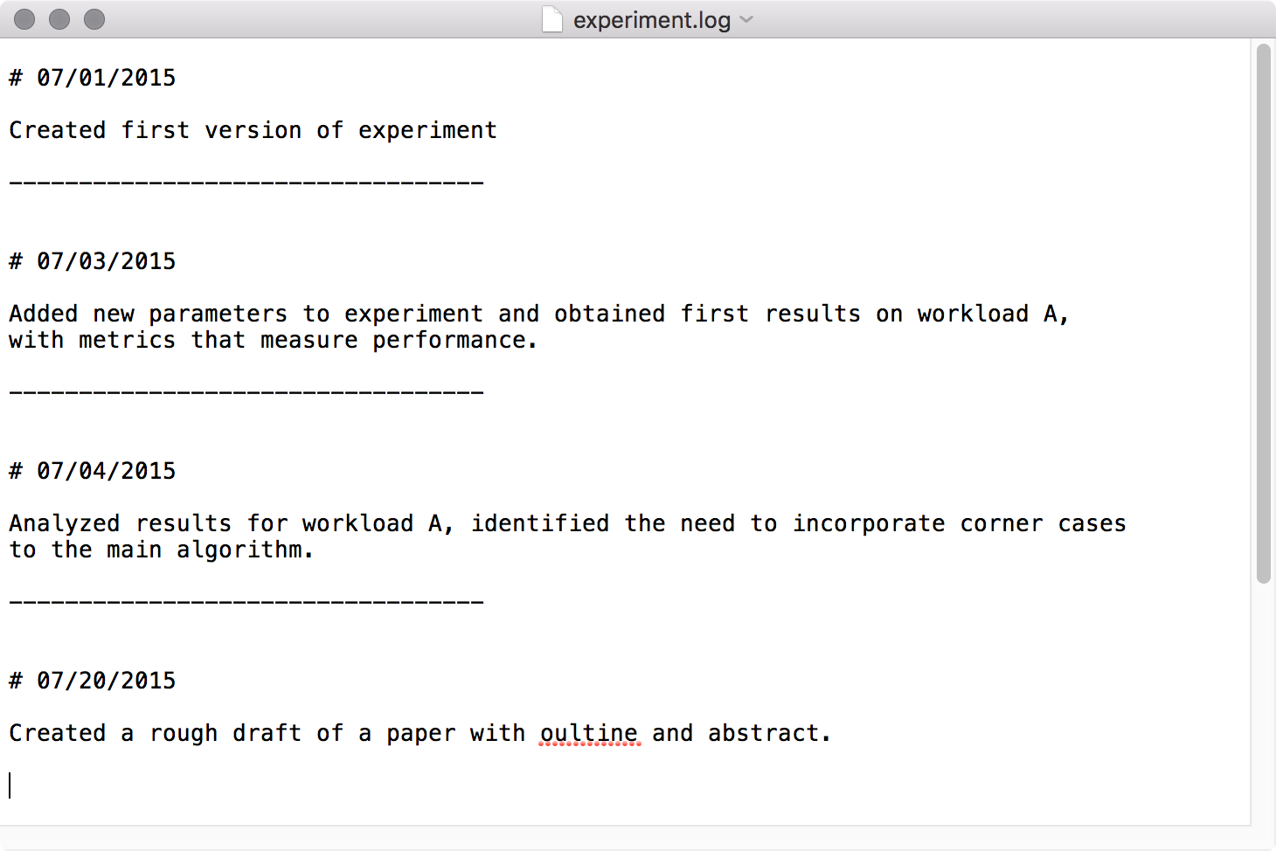
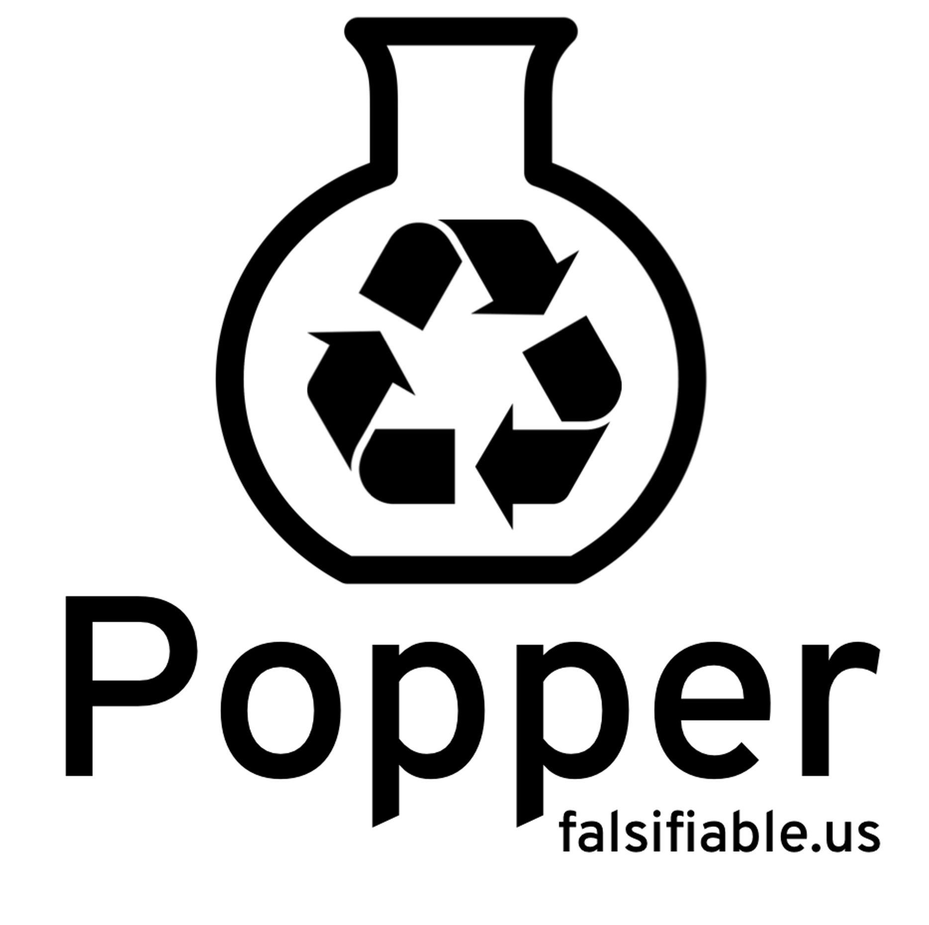
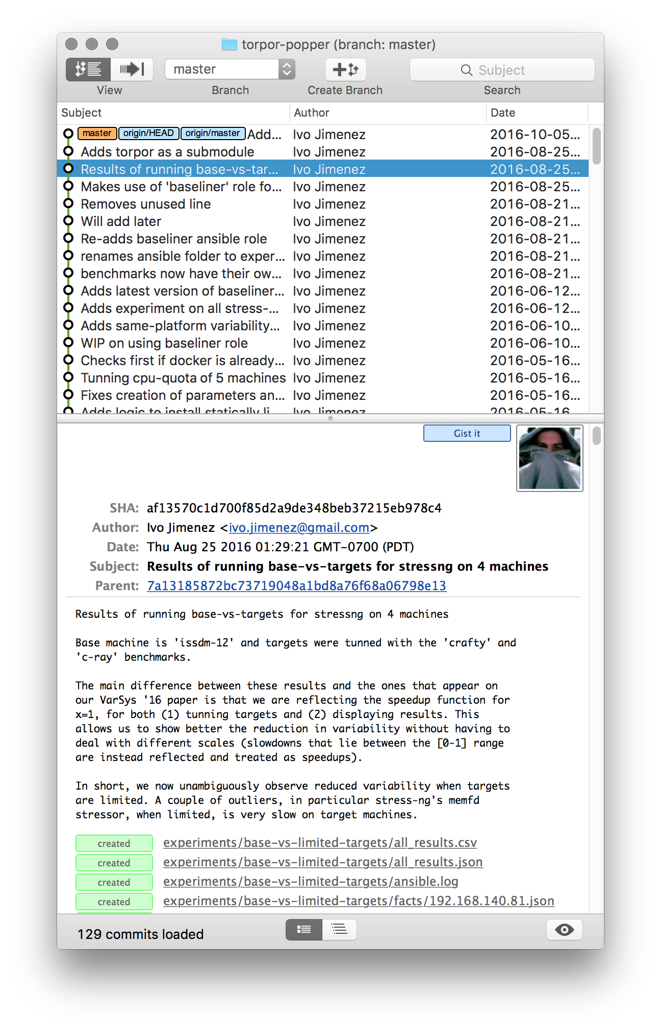









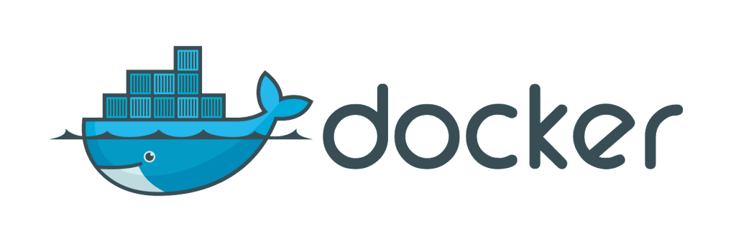




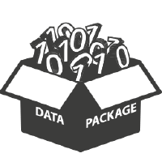








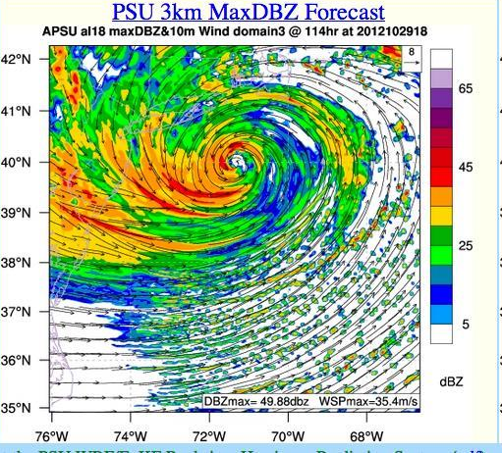
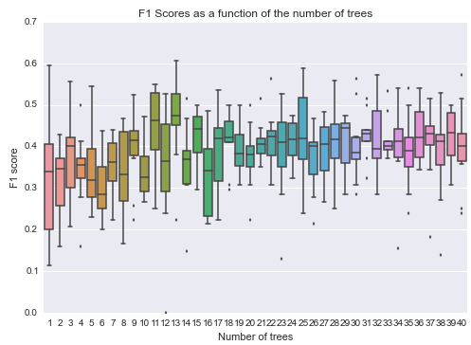

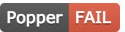


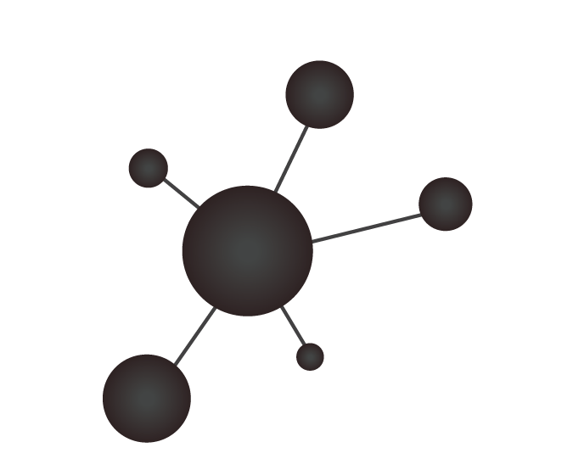









Popper: Practical Reproducible Evaluation of Systems
Ivo Jimenez, Michael Sevilla, Noah Watkins, Carlos Maltzhan, Jay Lofstead,
Kathryn Mohror, Remzi Arpaci-Dusseau, Andrea Arpaci-Dusseau
Reproducibility as a DevOps Problem
Bootstrapping a Popper Project
Project Structure
Independently validating experimental results is challenging.
Recreating experimental setup is often difficult to impossible.
Software engineers deal with reproducibility all the time:
- Bug A can be reproduced in version X on platform Y using input Z.
Shared (cloud) computing and storage services readily available.
Manage an academic article as a software project!
$ cd mypaper-repo
$ popper init
-- Initialized Popper repo mypaper-repo
$ popper experiment list
-- available templates ---------------
ceph-rados proteustm mpi-comm adam sirius comd-openmp
cloverleaf gassyfs zlog bww unum-py cuddn-deeplrn
spark-stand torpor malacology genevo mantle rita-idx
hadoop-yarn kubsched alg-encycl macrob dadvisor obfuscdata
$ popper add gassyfs
-- Added gassyfs experiment to mypaper-repo
mypaper-repo
| README.md
| .git/
| .popper.yml
| experiments
| |-- gassyfs
| | |-- README.md
| | |-- ansible/
| | | |-- setup.yml
| | | |-- vars.yml
| | |-- datasets/
| | | |-- input-data.csv
| | |-- results/
| | | |-- figure.png
| | | |-- postprocess.py
| | | |-- output.csv
| | |-- run.sh
| | -- validate.sh
| paper
| |-- build.sh
| |-- figures/
| |-- paper.tex
| -- references.bib
Our Approach
Communities Following Popper
Code
Package
Computer Systems Research (UCSC; UW Madison).
High Performance Computing (Sandia, LLNL, LANL).
Games and Playable Media (UCSC).
Genomics (UCSC).
Numeric Weather Prediction (Big Weather Web).
Execute
Data and
Metrics
Analyze/
Visualize
Manuscript
Input Data
Automated Validation
Popper: Take a common generic experimentation workflow (above) and apply a DevOps practice used in the development of open source software (OSS) projects (below).
Codified Validations:
WHEN NOT network_saturated AND num_nodes=*
EXPECT
system_throughput >= (baseline_throughput * 0.9)
The Convention:
Trigger execution
3
Run multi-node experiment on one of supported backends
Pick a DevOps tool for each stage of the scientific experimentation workflow.
Put all associated scripts (experiment and manuscript) in version control, in order to provide a self-contained repository.
Document changes as experiment evolves, in the form of version control commits.
2
Code
Package
1
Commit change to experiment
PopperCI
5
Validate experiment results by testing codified assertions on output
Experiment generates output datasets or runtime metrics
4
Execute
Data and
Metrics
Analyze/
Visualize
Manuscript
6
Keep track of execution and associated status to the corresponding commit
Input Data
Benefits and Challenges
Popper Compliance
Pros:
Experiments can be falsifiable with minimal re-execution effort.
Facilitates collaboration by following the OSS model for sharing.
Investing time in DevOps skills quickly pays off.
The convention complements many existing efforts
Challenges:
Steep learning curve of DevOps practices and tools/frameworks.
Big cultural change; new experimentation paradigm.
Tools: Generate referenceable assets (associate unique IDs to binaries, data, configuration and infrastructure state); usable from scripts/CLI and capable of acting upon IDs.
Experiment: Provide all necessary assets in a single repository (self-contained), including experiment code, orchestration logic, data dependencies, results and validation criteria.
Article: Provide full text and figures of article, as well as all popper-compliant experiments.
Notes:
Add the bootstrapping listing example
Make room by using smaller text
Include a list of collaborations projects
Intro can be specified as “reproducibility as a DevOps problem”

