Slide 1



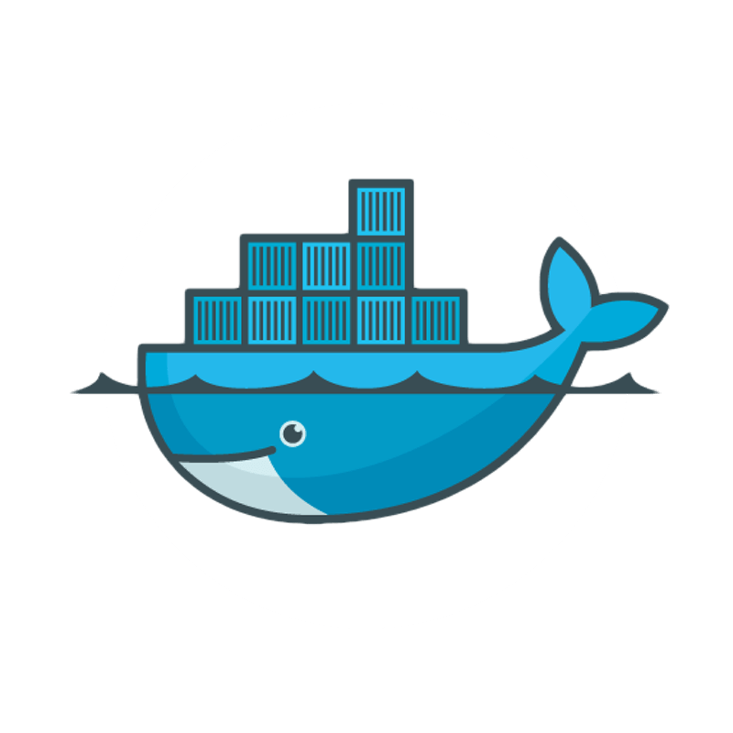
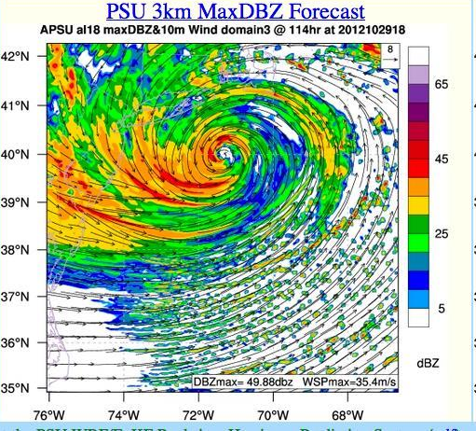
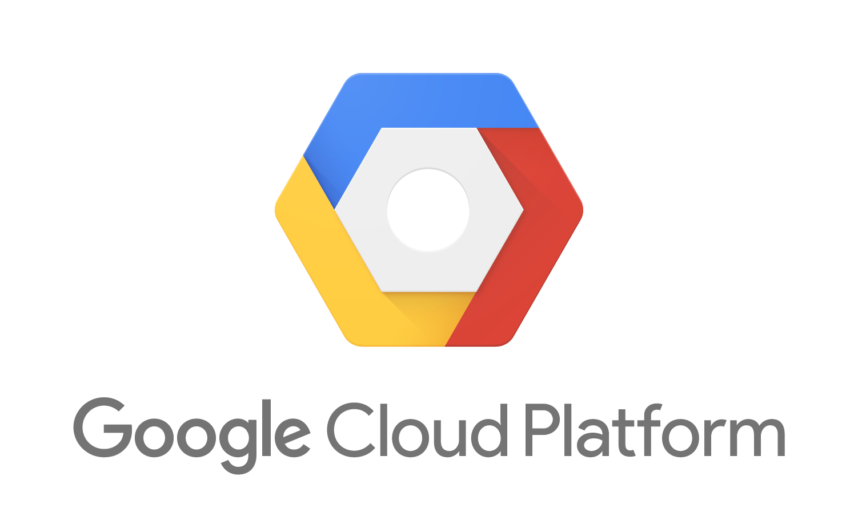
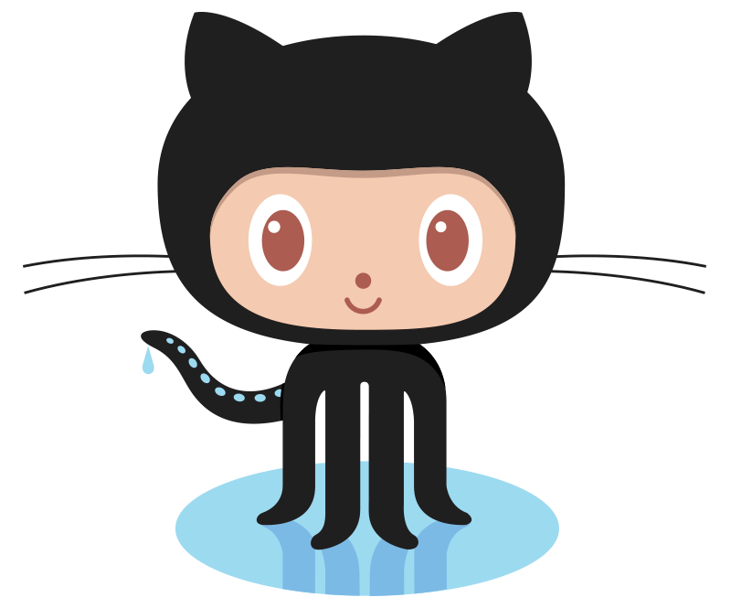





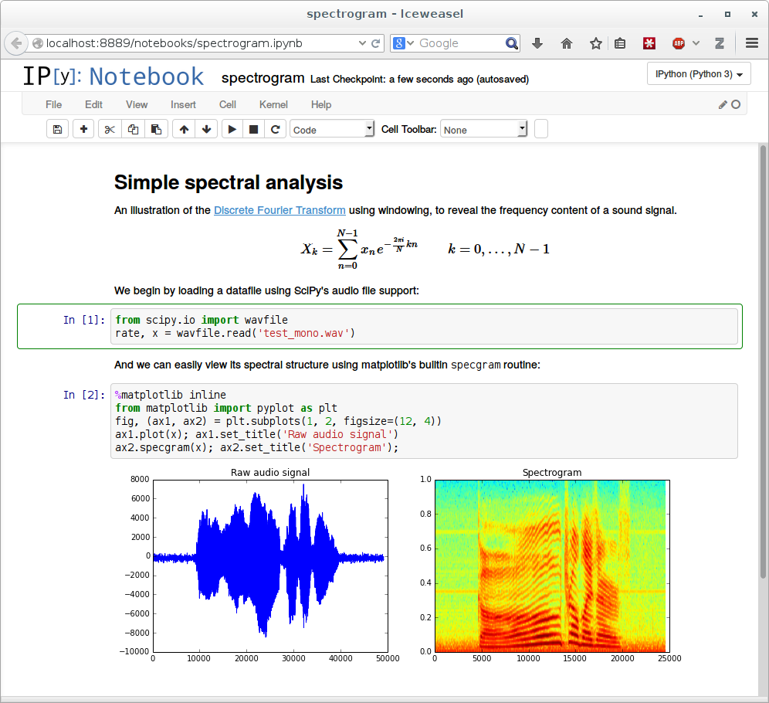
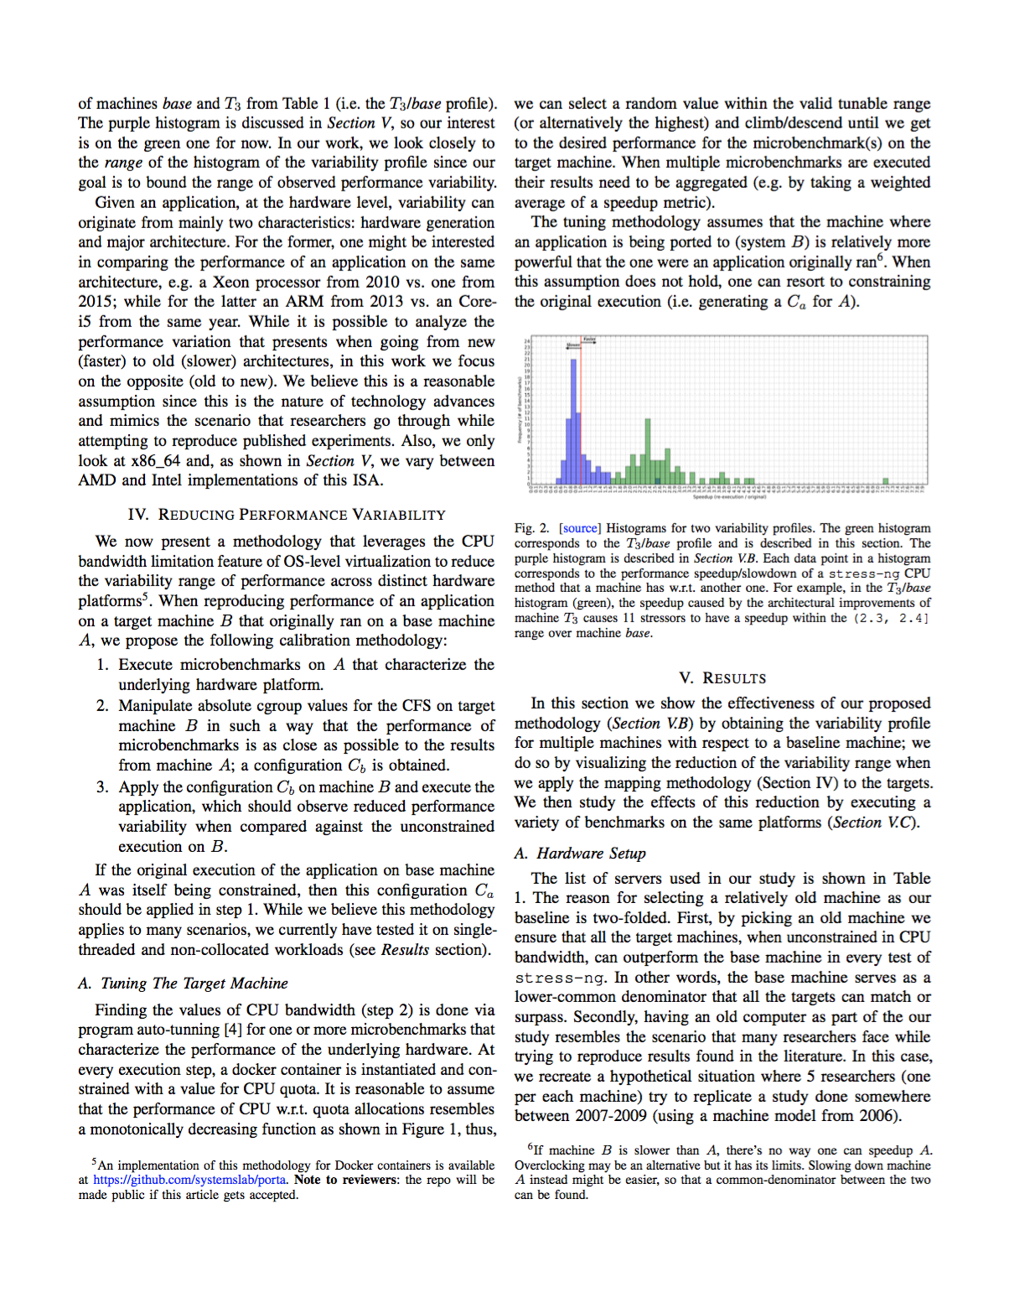




3
4
Experiment or simulation produces output.
5
Triggered by execute command Ansible pulls images, datasets from cloud storage, and deploys an experiment on cluster and configues it.
Cluster configuration management, orchestration, and deployment
Result stored in the cloud (access public or restricted).
Cloud storage
Immutable & versioned inputs and output results containing all information to re-execute it.
System images and code versions
PRObE
1
6
User pulls or pushes code versions and system images to
access / adapt / improve community artifacts (applications, workflows, jupyter notebooks, and Ansible playbook roles)
2
Users refers to data sets, results, and stores and shares analysis.
User executes experiment or simulation using Ansible playbooks that are available in github.
7
Publications contain links to jupyter notebooks and results so that reviewers and readers can re-execute them.
8
Publications contain links to:
Source code in git
Images in docker
Datasets in cloud storage
Experiments can be re-executed:
Ansible playbooks contain orchestration logic of containers.
Output can be compared with previous results.
Jupyter notebooks contain analysis recipe with links to result.
Notes:
“links” are url+version like github.com/bww/wrf#v2.0 or hub.docker.com/bww/wrf:2.0
the execution of the experiment can also be done in the local machine, doesn’t necessarily need to be in the cloud
similarly, the output can be stored locally and backed in the cloud (when simulation runs in user’s laptop)
the output can be analyzed locally or remotely using notebooks or other visualization containers

Slide 2
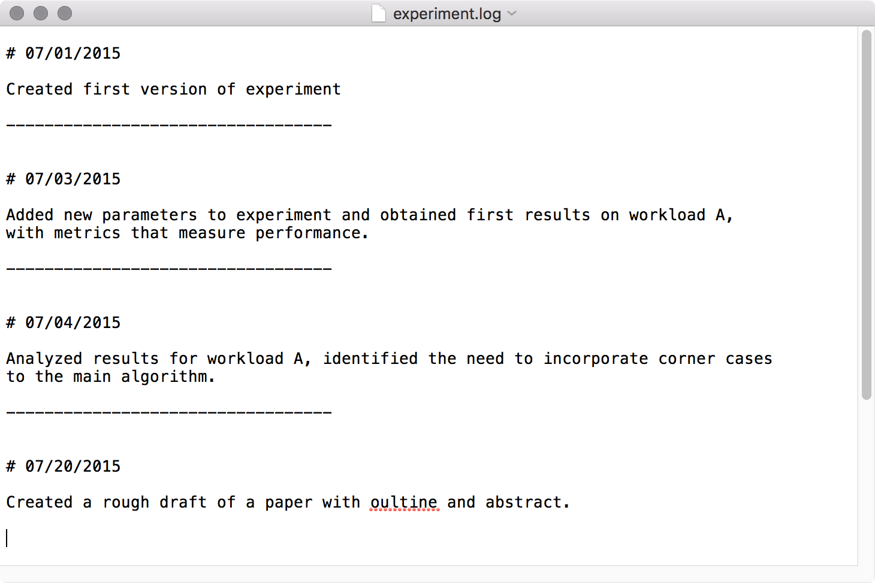
Code
Package
Execute
Data and
Metrics
Analyze/
Visualize
Manuscript
Input Data

Slide 3




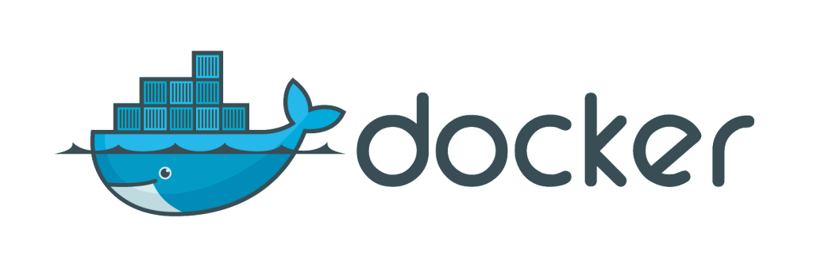






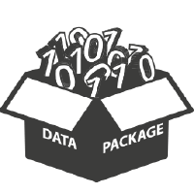





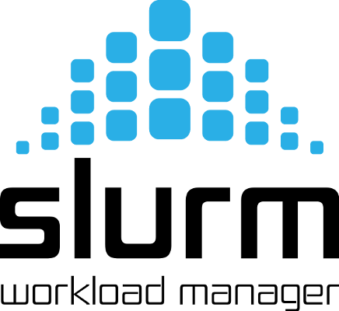
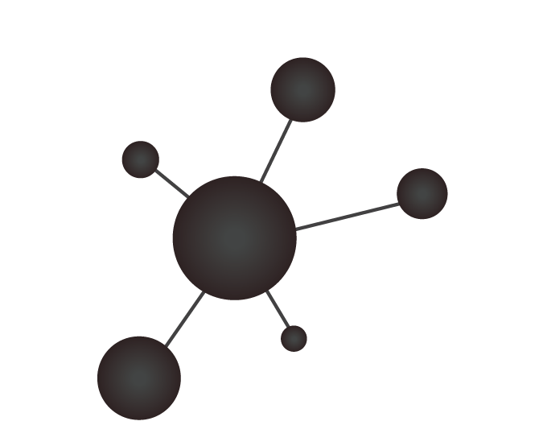





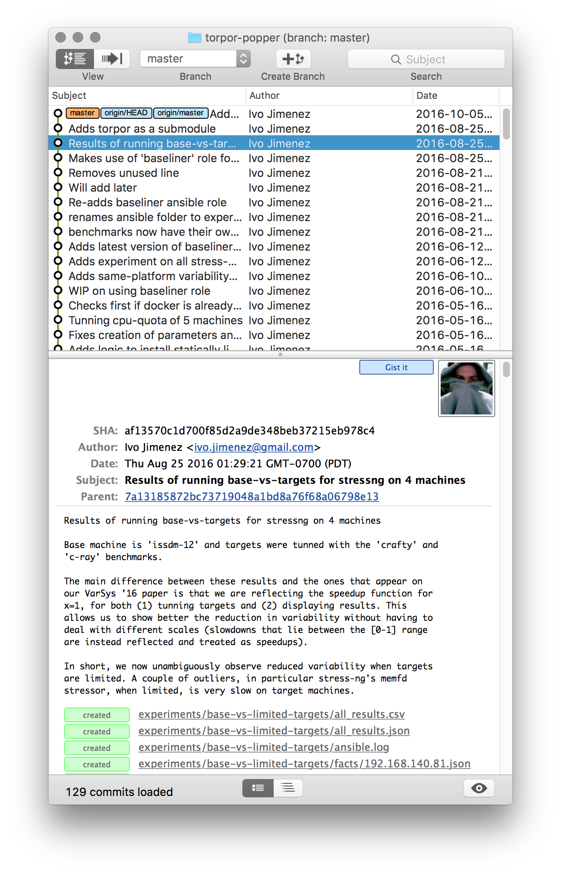


Code
Package
Execute
Data and
Metrics
Analyze/
Visualize
Manuscript
Input Data

