Slide 1







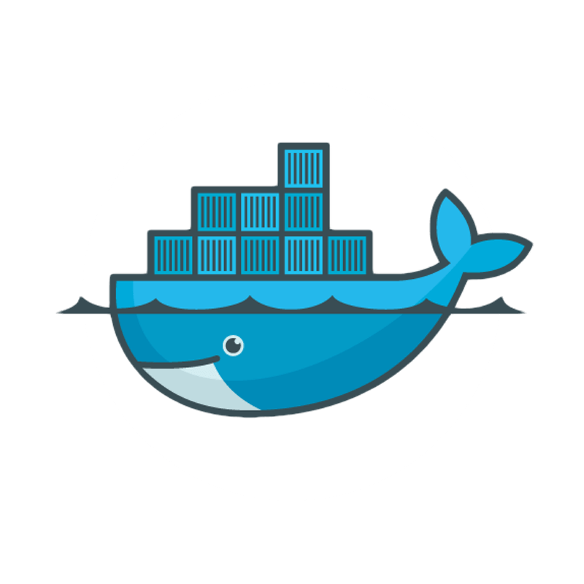


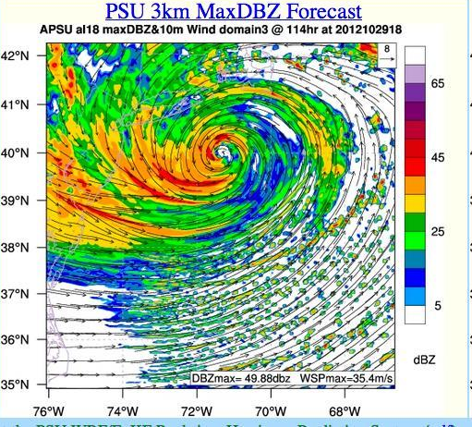
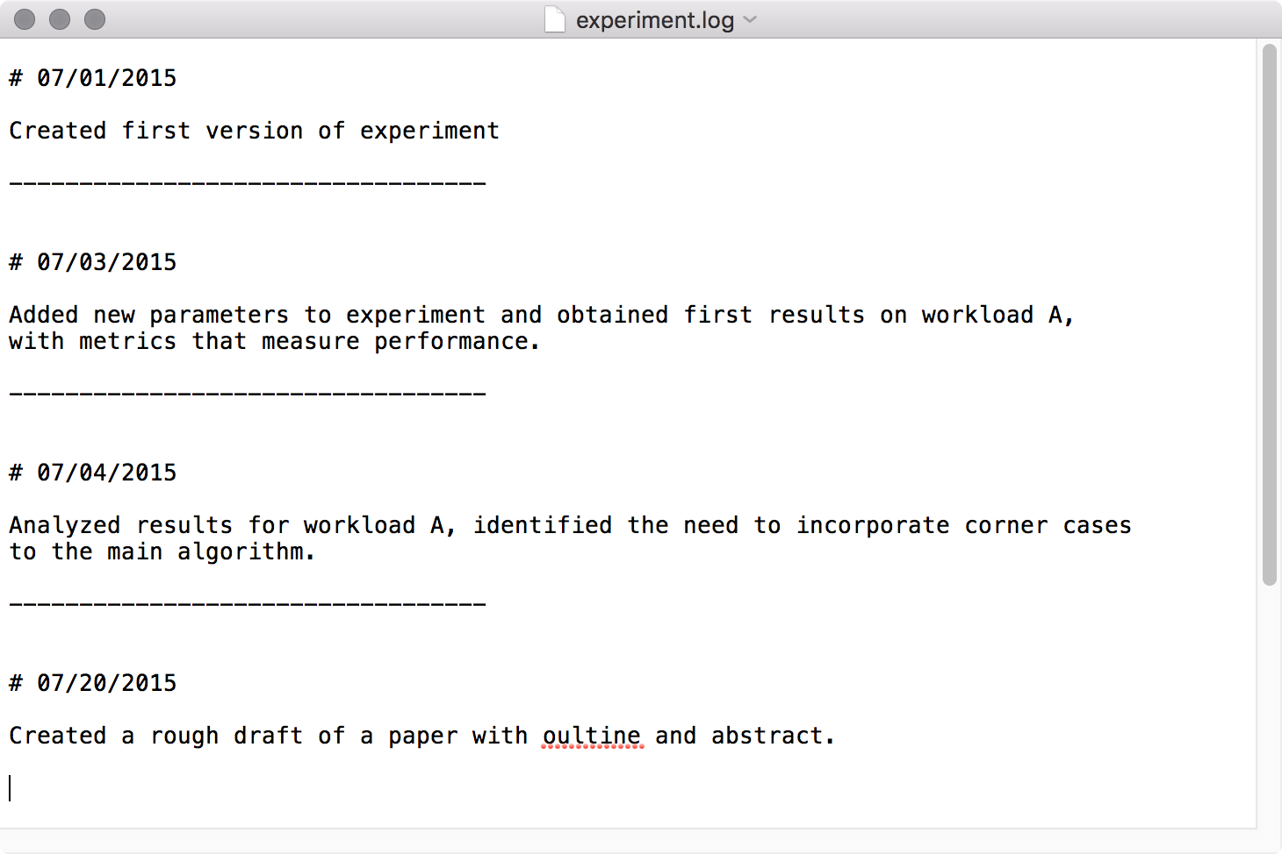



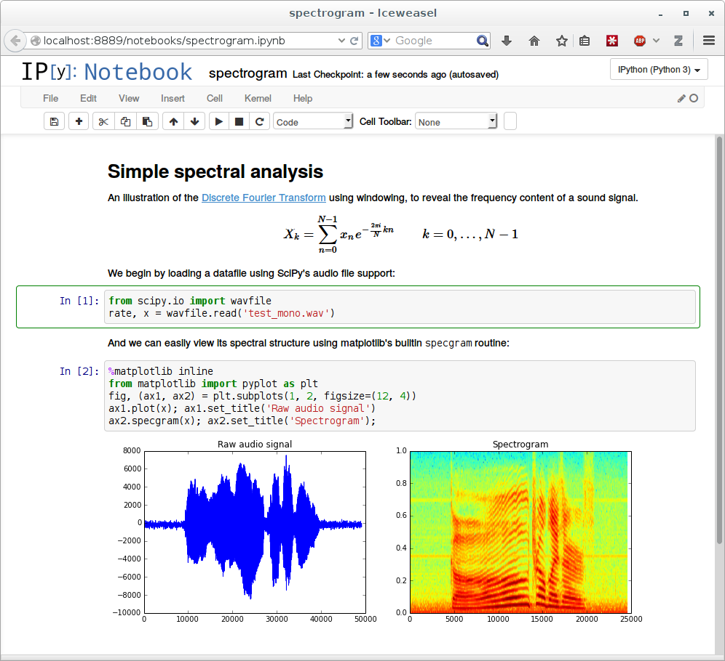
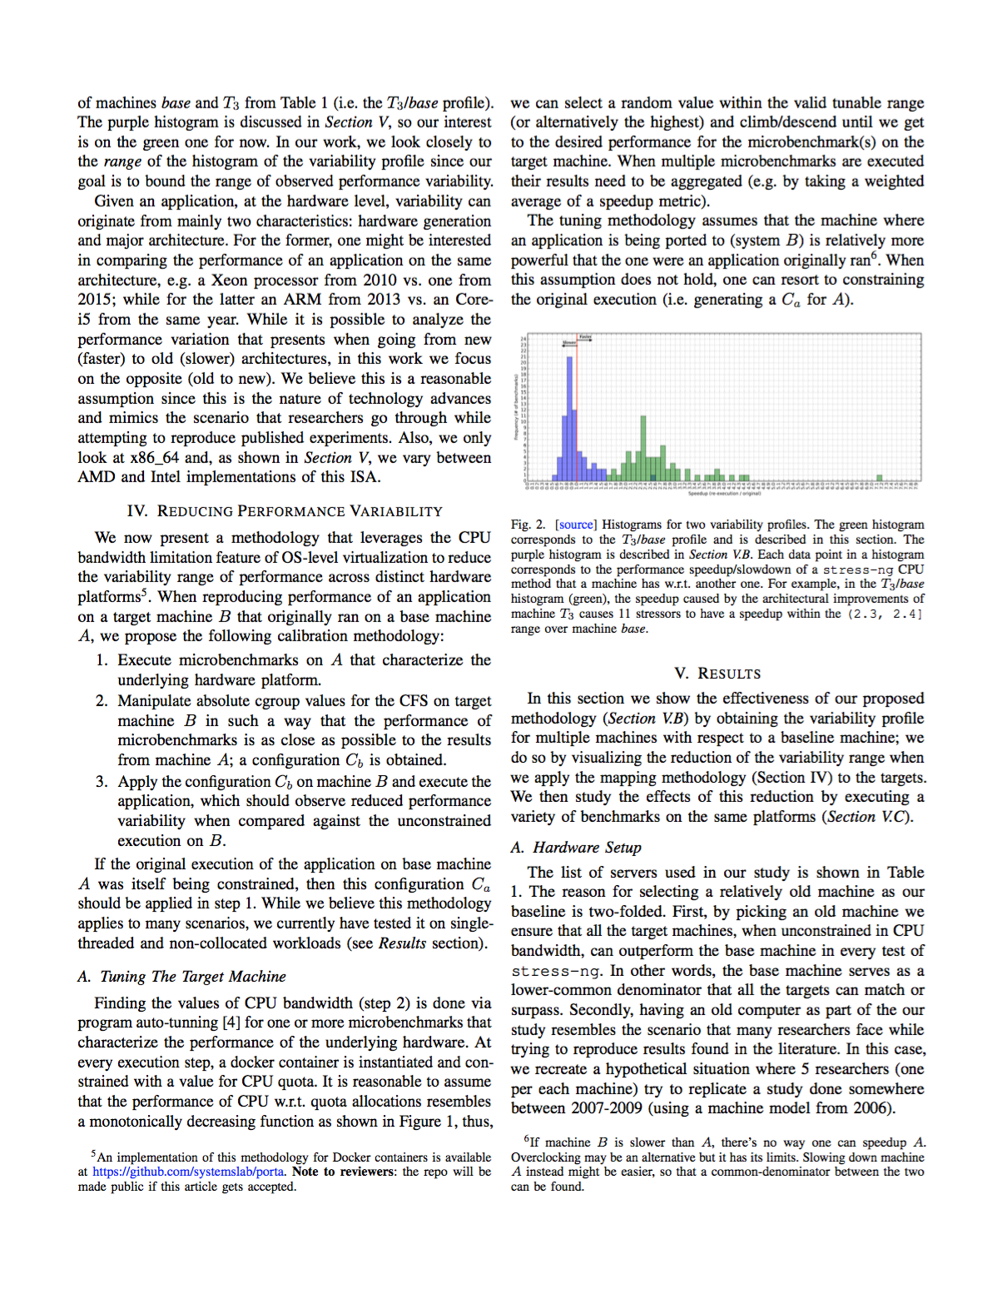
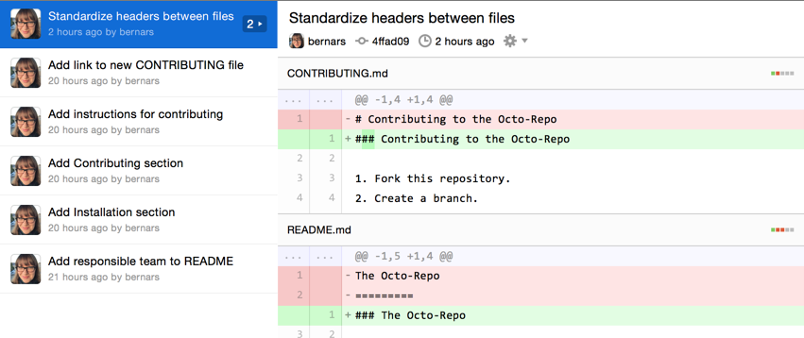






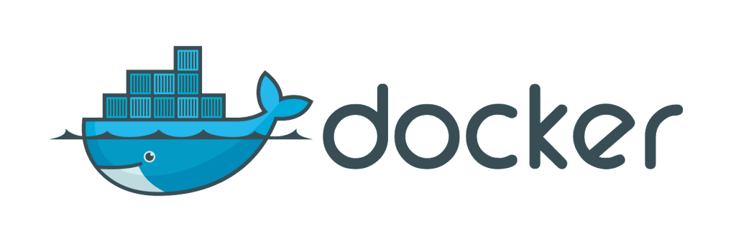









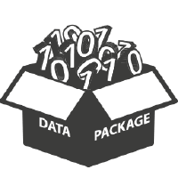





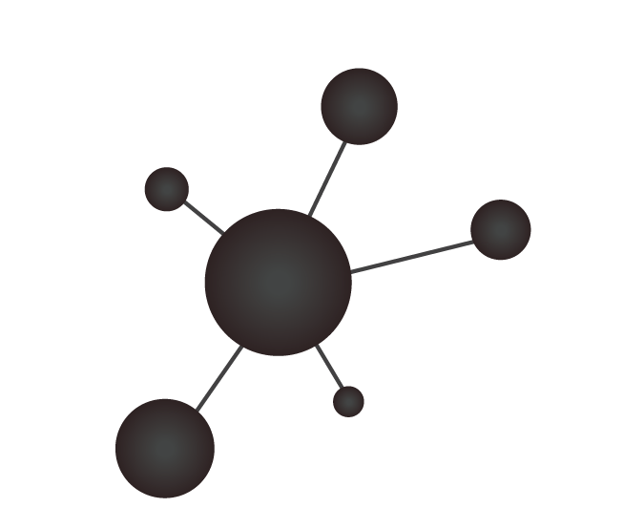









Popper: Practical Reproducible Evaluation of Systems
Ivo Jimenez, Michael Sevilla, Noah Watkins, Carlos Maltzhan, Jay Lofstead,
Kathryn Mohror, Remzi Arpaci-Dusseau, Andrea Arpaci-Dusseau
Reproducibility as a DevOps Problem
4
5
Result stored in the cloud (access public or restricted).
Independently validating experimental results is challenging.
Recreating experimental setup is often difficult to impossible.
Software engineers deal with reproducibility all the time:
- Bug A can be reproduced in version X on platform Y using input Z.
Shared (cloud) computing and storage services readily available.
Manage an academic article as a software project!
3
Cluster configuration management, orchestration, and deployment
Experiment or simulation produces output.
Cloud storage
Triggered by execute command Ansible pulls images, datasets from cloud storage, and deploys an experiment on cluster and configues it.
Immutable & versioned inputs and output results containing all information to re-execute it.
System images and code versions
PRObE
Our Approach
6
1
Users refers to data sets, results, and stores and shares analysis.
User pulls or pushes code versions and system images to
access / adapt / improve community artifacts (applications, workflows, jupyter notebooks, and Ansible playbook roles)
2
User executes experiment or simulation using Ansible playbooks that are available in github.
Code
Package
Execute
Data and
Metrics
Analyze/
Visualize
Manuscript
7
8
Publications contain links to:
Source code in git
Images in docker
Datasets in cloud storage
Experiments can be re-executed:
Ansible playbooks contain orchestration logic of containers.
Output can be compared with previous results.
Jupyter notebooks contain analysis recipe with links to result.
Publications contain links to jupyter notebooks and results so that reviewers and readers can re-execute them.
Input Data
Popper: Take a common generic experimentation workflow (above) and apply a DevOps practice used in the development of open source software (OSS) projects (below).
Bootstrapping a Popper Project
Project Structure
Design Goals:
Clearly benefit individual researcher by improving productivity.
Usable in many research domains.
Abstract underlying technologies.
$ cd mypaper-repo
$ popper init
-- Initialized Popper repo mypaper-repo
$ popper experiment list
-- available templates ---------------
ceph-rados proteustm mpi-comm adam sirius comd-openmp
cloverleaf gassyfs zlog bww unum-py cuddn-deeplrn
spark-stand torpor malacology genevo mantle rita-idx
hadoop-yarn kubsched alg-encycl macrob dadvisor obfuscdata
$ popper add gassyfs
-- Added gassyfs experiment to mypaper-repo
mypaper-repo
| README.md
| .git/
| .popper.yml
| .travis.yml
| experiments
| |-- gassyfs
| | |-- datasets/
| | |-- input-data.csv
| | |-- figure.png
| | |-- process-result.py
| | |-- setup.yml
| | |-- results.csv
| | |-- run.sh
| | |-- validations.aver
| | -- vars.yml
| paper
| |-- build.sh
| |-- figures/
| |-- paper.tex
| -- references.bib
Code
Package
Execute
Data and
Metrics
Analyze/
Visualize
Manuscript
Input Data
Popper Compliance
Communities Following Popper
Tools: generate referenceable assets (associate unique IDs to binaries, data, configuration and infrastructure state); usable from scripts/CLI and capable of acting upon IDs.
Experiment: Provide all necessary assets in a single repository (self-contained), including experiment code, orchestration logic, data dependencies, results and validation criteria.
Article: Provide full text and figures of article, as well as all popper-compliant experiments.
Computer Systems Research (UCSC; UW Madison).
High Performance Computing (Sandia, LLNL, LANL).
Games and Playable Media (UCSC).
Genomics (UCSC).
Numeric Weather Prediction (Big Weather Web).
Contact
Ivo Jimenez
email: ivo@cs.ucsc.edu
web: http://falsify.us
Popper
Notes:
Add the bootstrapping listing example
Make room by using smaller text
Include a list of collaborations projects
Intro can be specified as “reproducibility as a DevOps problem”

