Slide 1
Malacology: A Programmable Storage Framework
Noah Watkins, Michael Sevilla, Ivo Jimenez, Carlos Maltzahn, Ike Nassi, Scott Brandt, Sage Weil, Greg Farnum, Sam Fineberg
February 19, 2016

Slide 2
Malacology: A Programmable Storage System
Traditonal Storage Offerings
Programmable Storage Offerings
OBJECT
BLOCK
FILE
Mantle
ZLog
Map
Reduce
LIB
RADOS
MALA
COLOGY
Ceph: robust, production quality distributed system
M
Lua
M
M
Notes:
Ceph Provides storage

Slide 3
Traditional Storage Offerings
Programmable Storage
OBJECT
BLOCK
FILE
LIB
Mantle
ZLog
MALA
COLOGY
storage
daemon
monitor
daemon
M
other
daemons
M
M

Slide 4
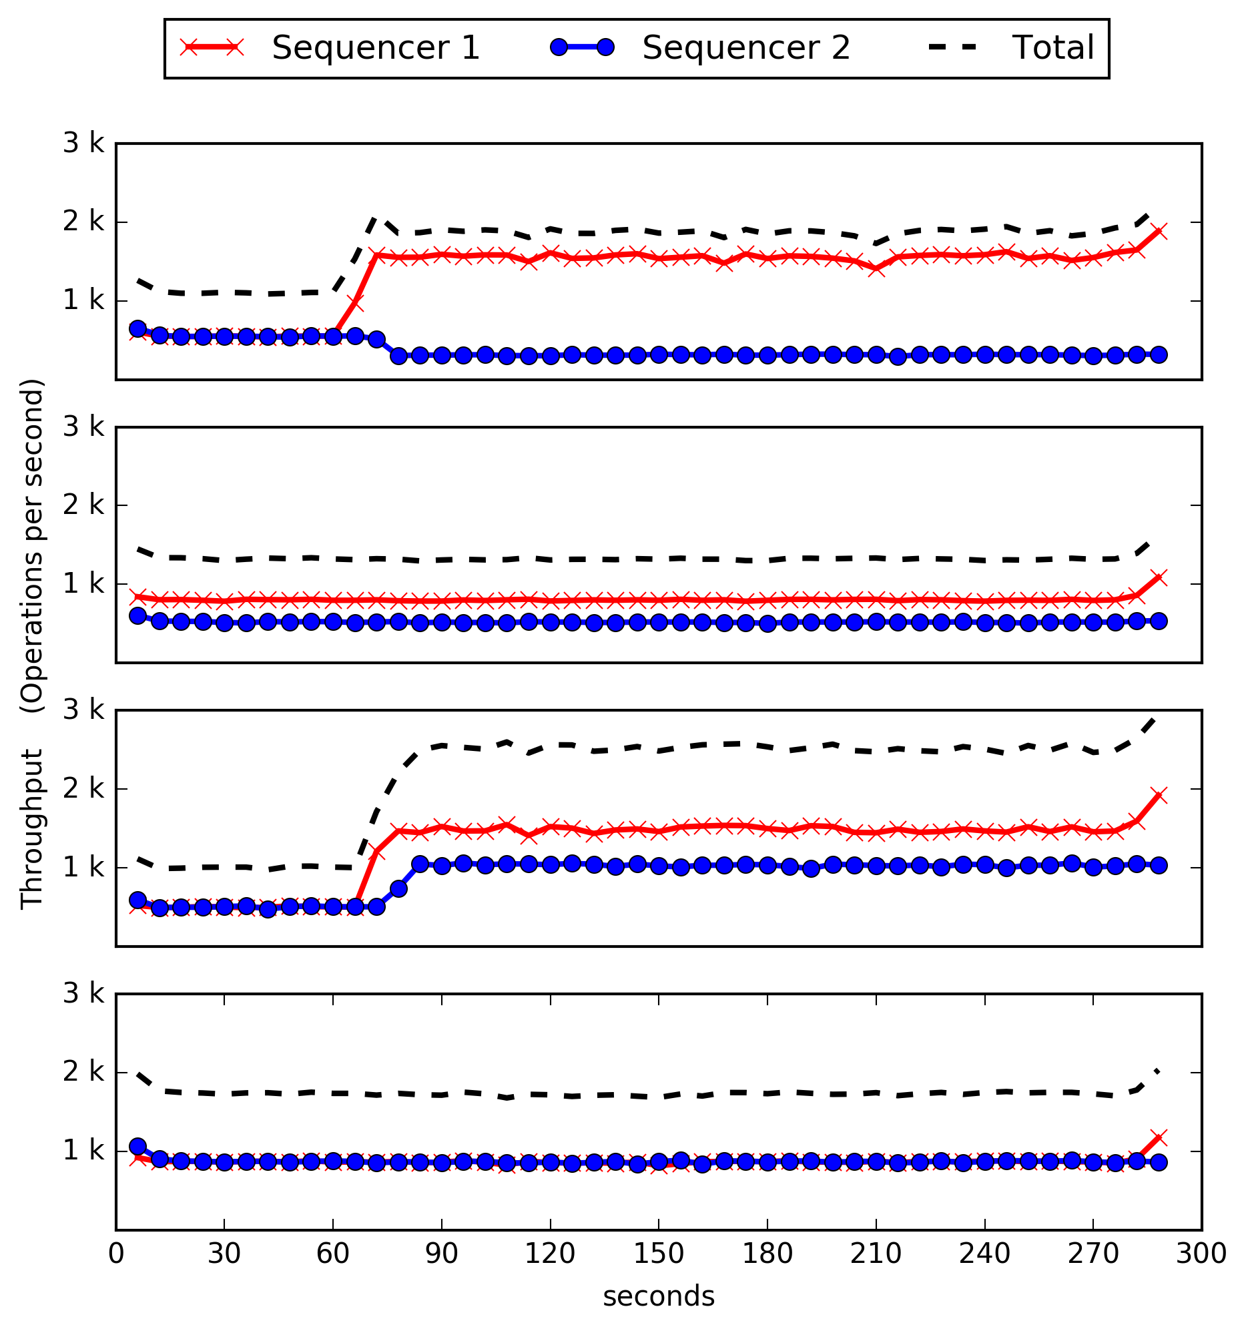
 | Proxy Mode
 | Seq. Mode
 | Proxy Mode
 | Seq. Mode
MDS1
MDS1
MDS1
MDS1
MDS1

Slide 5
1
Sequencer | Client | Request | Response
1
No Balancing
Proxy Mode
(Half)
Server A
Server B
Server A
Server B
1
2
1
2
Client
Mode
Proxy Mode
(Full)
Server A
Server B
Server A
Server B
1
2
1
2

Slide 6
1
Sequencer | Client | Request | Response
1
No Balancing
Proxy Mode
(Half)
Client
Mode
Server A
Server B
Server A
Server B
Server A
Server B
1
2
1
2
1
2

Slide 7
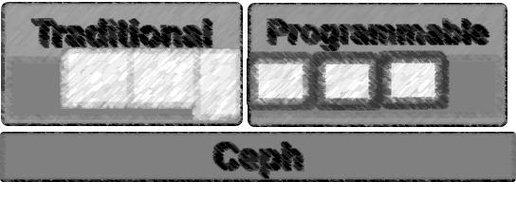
Outline
Background: What’s already there
What we implemented
What we plan to evaluate

Slide 8
Background: what’s already there

Slide 9
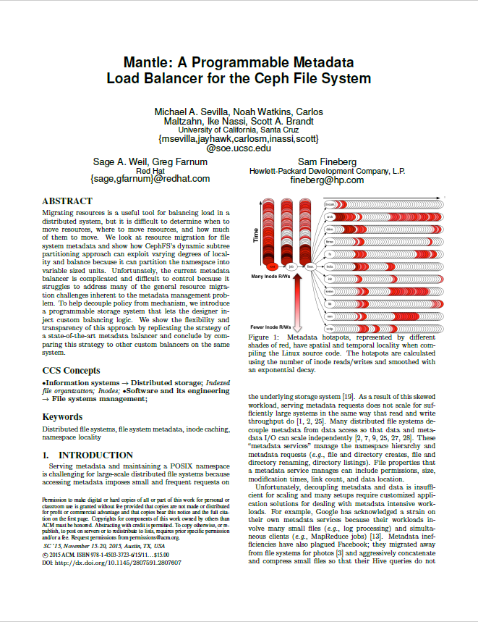
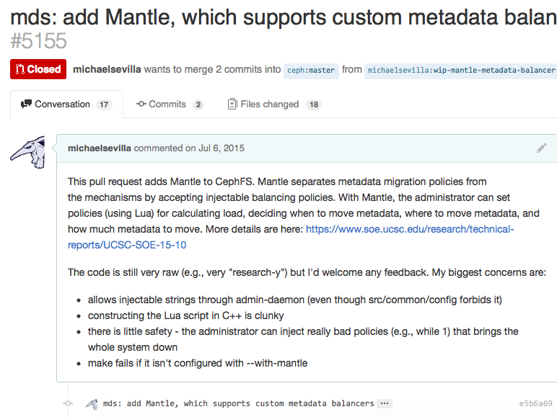
A Quick Story…
Research Code ≠ Production quality
Distributing work
Dynamically load balancers?
Safety and security?
Durability
Store balancers?
Versioning
Current balancer?

Slide 10
Ceph = Production Quality Distributed System
OSDs provide active storage ✔ distribute work
Scenario: capitalize chararcters in an object
Naïve Approach
send data over network
Active Storage (Object Interface)
inject functionality into OSD, send upper()
read(obj)
upper(obj)
upper
.so
upper(obj)
OSD
OSD
write(obj)
Notes:
Scenario: capitalize all letters in an object

Slide 11
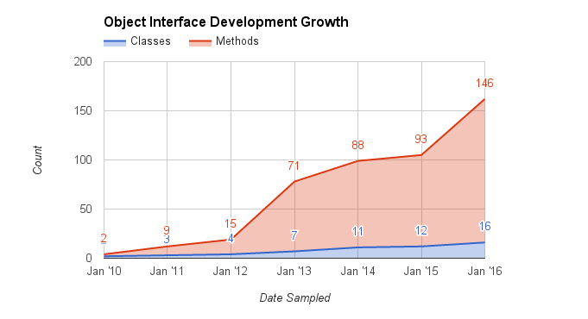
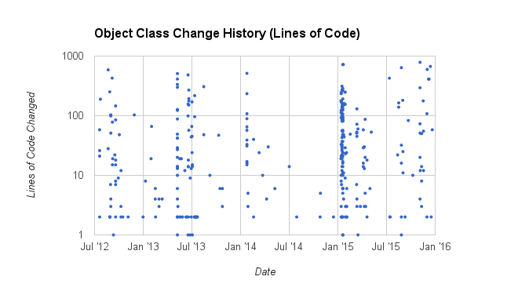
People use Object Interfaces!

Slide 12
Ceph = Production Quality Distributed System
OSDs provide active storage ✔ distribute work
RADOS reliably stores data ✔ durability
Autonomous, Self-Healing, Adaptive
Striped, Replicated, Erasure Coded

Slide 13

Ceph = Production Quality Distributed System
OSDs provide active storage ✔ distribute work
RADOS reliability stores data ✔ durability
MONs exchange state with PAXOS ✔ versioning
Authentication
Logging
Cluster Maps (PG, MDS, MON)
M
M
M
M
M

Slide 14
Design & Implementation

Slide 15
Malacology Design
Safely Load Dynamic Object/Balancer Interfaces ✔ distr. work
Store Interfaces in RADOS ✔ durability
Specify Current Interface in MDS/PG Map ✔ versioning

Slide 16
1. Safely Load Dynamic Object/Balancer Interfaces
Lua: scripting language designed to be “embeddable”
Safe
Dynamic
Portable
Small
Fast

Slide 17
1. Safely Load Dynamic Object/Balancer Interfaces
exec(obj, up)
“up”
object interface
OSD

Slide 18
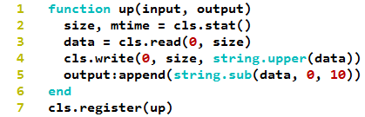
1. Safely Load Dynamic Object/Balancer Interfaces
Ship functions
“up”
object interface
“LuaVM”
object interface
exec(obj, script, up)
OSD

Slide 19
1. Safely Load Dynamic Object/Balancer Interfaces
Ship functions
Use in OSD and MDS
LuaVM
Balancer
Interface
LuaVM
Object Interface
1
init(“lua”)
++clslua_getxattr()
++clslua_write()
++clslua_map_get_keys()
…
init(“lua”)
2
oid, fxn
output
Lua
Core
Lua
OSD
input
Notes:
Lua VM + fxns for manipulating objects
lua_core.so: VM

Slide 20
LuaVM
Object Interface
LuaVM
Balancer
Interface
1
Lua
Core
2
oid, fxn
output
Lua
OSD
input
Notes:
Lua VM + fxns for manipulating objects
lua_core.so: VM

Slide 21
1. Safely Load Dynamic Object/Balancer Interfaces
Object Interface
Object Interface vX.Y
LuaVM
(OSD API)
M
OSD
MDS
Balancer
Policy
Balancer
Policy
vX.Y
LuaVM
(MDS API)
vX.Y
Balancer
Version
v
Notes:
Lua VM + fxns for manipulating objects
lua_core.so: VM

Slide 22
1. Safely Load Dynamic Object/Balancer Interfaces
Object Interface
LuaVM
Core
OSD
1
Balancer
Interface
2
M
Balancer
Version
M
M
3
M
M
Notes:
Lua VM + fxns for manipulating objects
lua_core.so: VM

Slide 23
Malacology Design
Safely Load Dynamic Object/Balancer Interfaces ✔ distr. work
Store Interfaces in RADOS ✔ durability
Specify Current Interface in MDS/PG Map ✔ versioning

Slide 24
2. Store Interfaces in RADOS
Durability: erasure coded, replicated, balanced
37 lines of code
Lua
We can do this because Lua is portable!
Notes:
A result of Lua being portable

Slide 25
3. Specify Current Interface in MDS/PG Map
mon set-class mypool script
M
M
“LuaVM”
object interface
M
M
17 lines of code
MDSMap
M

Slide 26
Recap: Re-used Ceph Components!
Dynamic Obj./Balancer Interfaces ✔ distr. work
Lua is designed as embeddable language
Lua can be shipped with the data
Store Interfaces into RADOS ✔ durability
Lua is not dependent on host architecture
Communicate Current Interface in MDS/PG Map ✔ versioning
636 lines of code (61a441f), 37 l.o.c (43f2541), 17 l.o.c (0870dc2)

Slide 27
Systems on Malacology

Slide 28
Mantle: Programmable Metadata Load Balancer
Interested Parties
Michael
Ishani
Ike
rebalance
migrate?
recv HB
partition
cluster
Reused
Safety/Robustness of loading dynamic code
Ease of state transfer
Transparency of balancer
Easier to test/integrate w/ correctness suites
ClassHandler, ClassData
partition
namespace
fragment
migrate

Slide 29
Zlog: Distributed Shared Commit Log
Interested Parties
Noah
Neha
Sequ-encer
read
read
read
read
read
read
read
append
1
2
3
-
-
-
Expose CORFU optimized interface
Striping Strategy
Log positions → objects

Slide 30
MapReduce: Distributed Computation Framework
Interested Parties
Trivrikram
= Lua code
M
= map
M
M
M
M
M
M
M
M
M
M
M
M
RADOS obj
Reduce

Slide 31
Programmability Evaluation
Dynamic Obj./Balancer Interfaces
636 lines of code (61a441f)
Store Interfaces in RADOS
37 l.o.c (43f2541)
Communicate Current Interface in MDS/PG Map
17 l.o.c (0870dc2)

Slide 32
Need your input ?
How do we evaluate this thing?
Lines of code? Performance? Already done in Mantle SC’15 paper… User feedback? How many people are using it?
How do we make Malacology a good citizen in reproducible research?
Stakeholders: Ivo
What should we implement next?
Apache Drill?
HDFS re-implementation?
Statistics at the OSDs for databases?
Stakeholders: Trivrikram
Notes:
Noah: don’t have to compare raw performance
Emphasize that the MR framework is useful
Carlos: What’s the message?
Not just scriptability – there’s a niche that needs a solution
Observation: breakdown of communication between database and fs… need to own the entire stack
Message: we are redoing a lot of work
We allow users to tailor the storage system without using tunables, magic numbers, alignment or middleware
Make stacks more powerful so we can leapfrog crusty storage systems
Shell: statistics gathering should be trivial but may be application specific
Drill example: can we implement this?
Abstract join cardinality
Database update statistics take a long time (scan the data)
Learning optimizer

Slide 33
Motivation: CROSS
Mantle code not ready to be merged
Ceph already halfway there

Slide 34
Malacology
Studied of soft bodied creatures

Slide 35
Lua
Fast
Portable
Secure

Slide 36
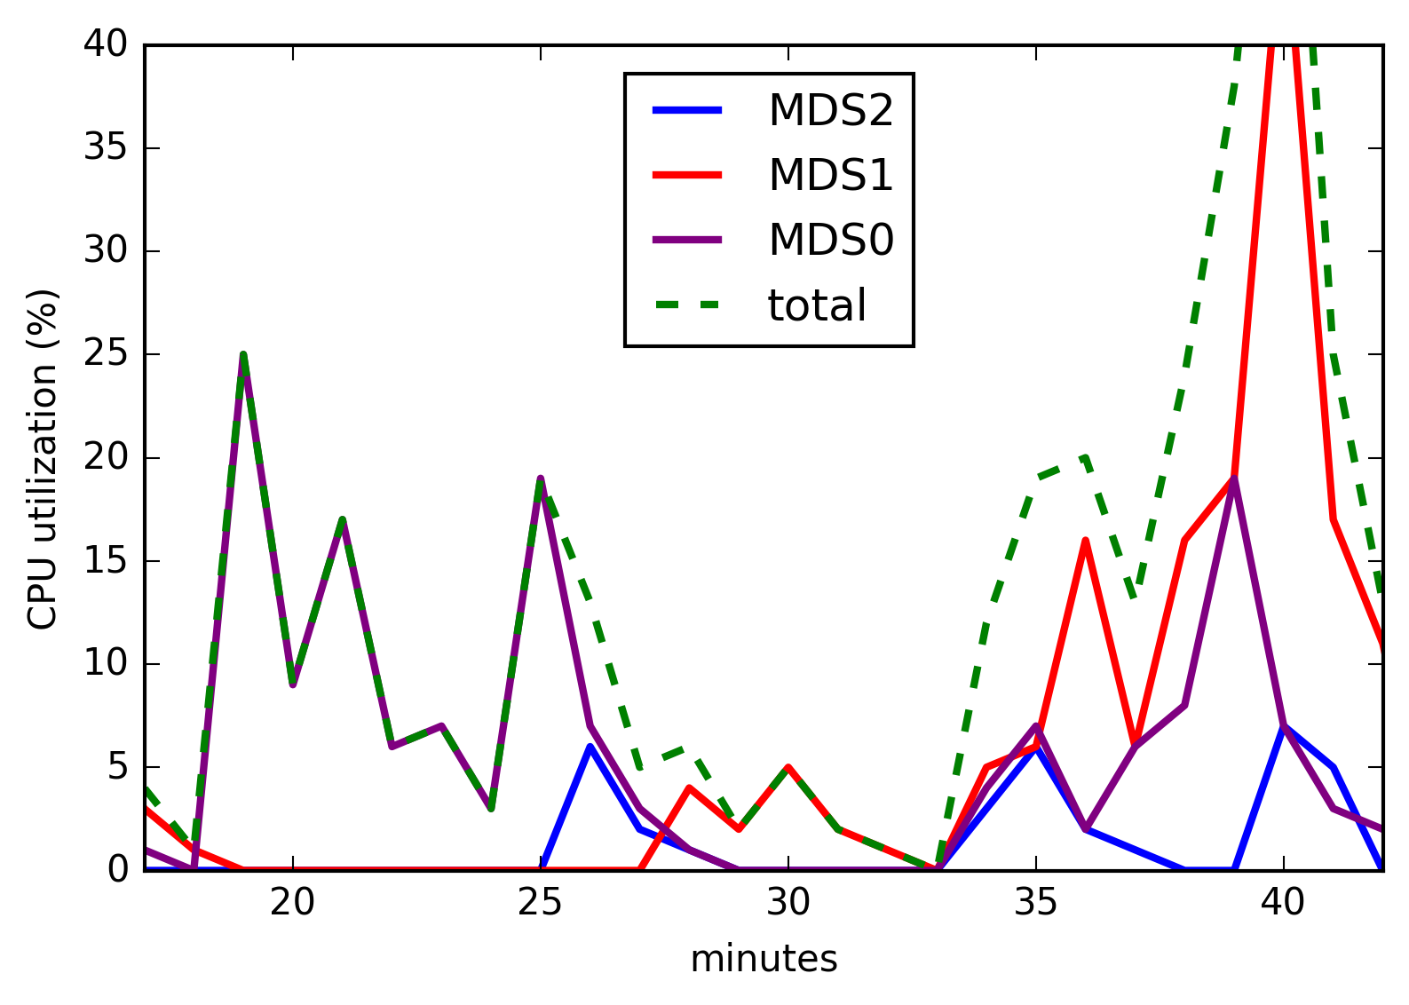
One MDS
Add MDSs
3 MDSs

Slide 37
Extra

Slide 38
Traditional Storage
Programmable
Ceph

