Slide 1
Malacology: A Programmable Storage Framework
Noah Watkins, Michael Sevilla, Ivo Jimenez, Carlos Maltzahn, Ike Nassi, Scott Brandt, Sage Weil, Greg Farnum, Sam Fineberg
February 19, 2016

Slide 2
Malacology: A Programmable Storage System
Traditonal Storage Offerings
Programmable Storage Offerings
OBJECT
BLOCK
FILE
Mantle
ZLog
Map
Reduce
LIB
RADOS
MALA
COLOGY
Ceph: robust, production quality distributed system
M
Lua
M
M
Notes:
Ceph Provides storage

Slide 3
Clients
Shared Resource Interface
Ceph Module: Client, Library
handle_capabilities()
M
Service Metadata
Ceph Module: Maps
MDSMap.cc, MONMap.cc
M
M
MON Nodes
Load Balancing Interface
Ceph Module: Metadata Balancer
rebalance()
MDS Nodes
Data/IO Interface
Ceph Module: Class Handler
cls.cc
Durability Interface
Ceph Module: Objecter
localize()
OSD
Nodes

Slide 4
Clients
Shared Resource Interface
Ceph Module: Client, Library
M
Service Metadata
Ceph Module: Maps
M
M
MON Nodes
Load Balancing Interface
Ceph Module: Metadata Balancer
MDS Nodes
Data/IO Interface
Ceph Module: Class Handler
Durability Interface
Ceph Module: Objecter
OSD
Nodes

Slide 5
POSIX Client
Object Server
ZLog
Shared Resource
Client, Library
CLS Object Classes
ZLog
Data I/O
Monitor Server
Mantle
M
Server Cluster Maps
Metadata Server
Service Metadata
ZLog
Objecter
Durability
Mantle
Mantle
Load Balancing
Metadata Balancer
Legend
Malacology Interface
Ceph Daemon/Module
Higher-Level Service
ZLog
Inode Structures
ZLog
File Type

Slide 6
Higher-Level
Services
(Section §5)
Mantle
ZLog
Malacology Interfaces
(Section §4
& Table 2)
Shared Resource
Data
I/O
Service Metadata
File
Type
Load Balancing
Dura-
bility
Client
Object Server
Monitor Server
Metadata Server
libcephfs
Object Classes
Cluster Maps
Inode Structs
RADOS API
Existing Internal Subsystems
Metadata Balancer
Existing Daemons

Slide 7
Higher-Level
Services
Mantle
ZLog
Shared Resource
Data
I/O
Service Metadata
File
Type
Load Balancing
Dura-
bility
Malacology Interfaces
Existing Subsystems
Client
Object Server
Monitor Server
Metadata Server
libcephfs
Object Classes
Cluster Maps
Inode Structs
RADOS API
Existing Daemons
Metadata Balancer

Slide 8
Traditional Storage Offerings
Programmable Storage
OBJECT
BLOCK
FILE
LIB
Mantle
ZLog
MALA
COLOGY
storage
daemon
monitor
daemon
M
other
daemons
M
M

Slide 9
1
Sequencer | Client | Request | Response
1
No Balancing
Proxy Mode
(Half)
Server A
Server B
Server A
Server B
1
2
1
2
Client
Mode
Proxy Mode
(Full)
Server A
Server B
Server A
Server B
1
2
1
2

Slide 10
1
Sequencer | Client | Request | Response
1
No Balancing
Proxy Mode
(Half)
Client
Mode
Server A
Server B
Server A
Server B
Server A
Server B
1
2
1
2
1
2

Slide 11
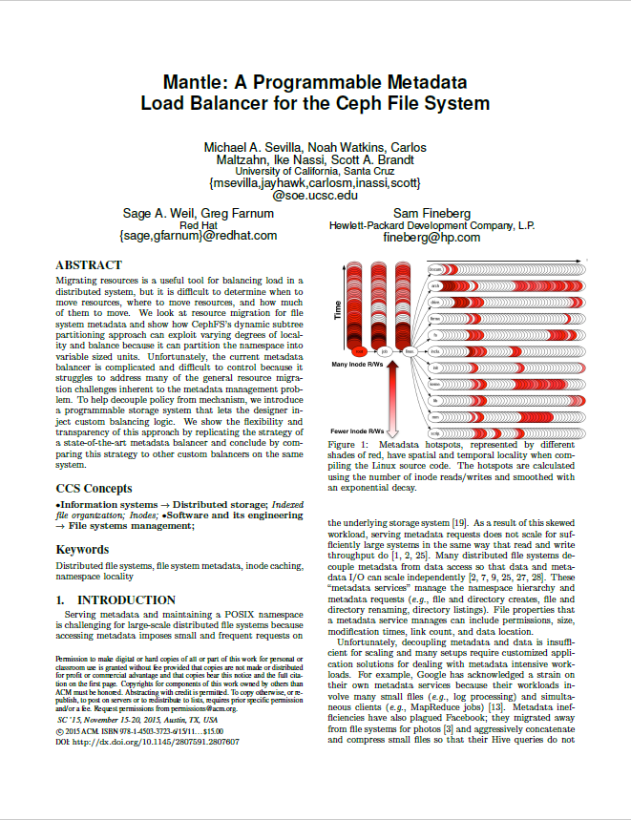
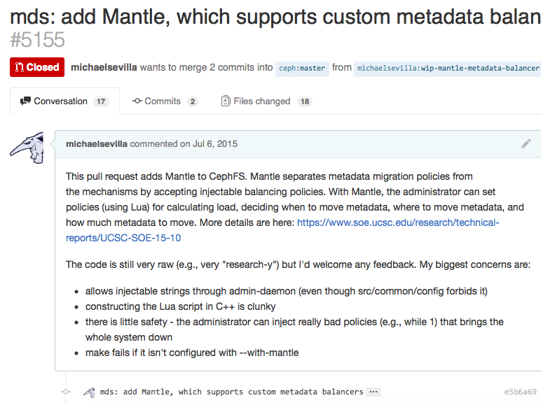
A Quick Story…
Research Code ≠ Production quality
Distributing work
Dynamically load balancers?
Safety and security?
Durability
Store balancers?
Versioning
Current balancer?

Slide 12
Ceph = Production Quality Distributed System
OSDs provide active storage ✔ distribute work
Scenario: capitalize chararcters in an object
Naïve Approach
send data over network
Active Storage (Object Interface)
inject functionality into OSD, send upper()
read(obj)
upper(obj)
upper
.so
upper(obj)
OSD
OSD
write(obj)
Notes:
Scenario: capitalize all letters in an object

Slide 13
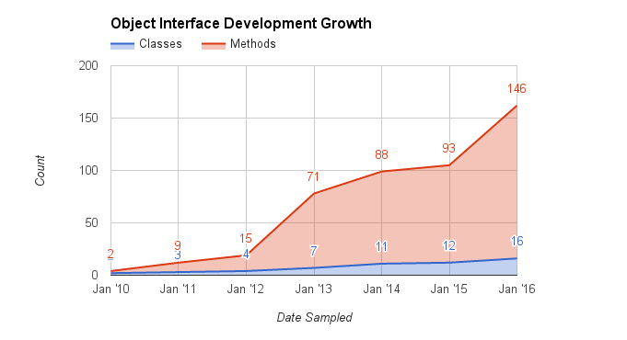
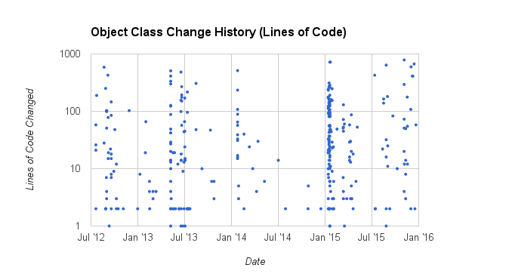
People use Object Interfaces!

Slide 14
Ceph = Production Quality Distributed System
OSDs provide active storage ✔ distribute work
RADOS reliably stores data ✔ durability
Autonomous, Self-Healing, Adaptive
Striped, Replicated, Erasure Coded

Slide 15
1. Safely Load Dynamic Object/Balancer Interfaces
Object Interface
Object Interface vX.Y
LuaVM
(OSD API)
M
OSD
MDS
Balancer
Policy
Balancer
Policy
vX.Y
LuaVM
(MDS API)
vX.Y
Balancer
Version
v
Notes:
Lua VM + fxns for manipulating objects
lua_core.so: VM

