Slide 1
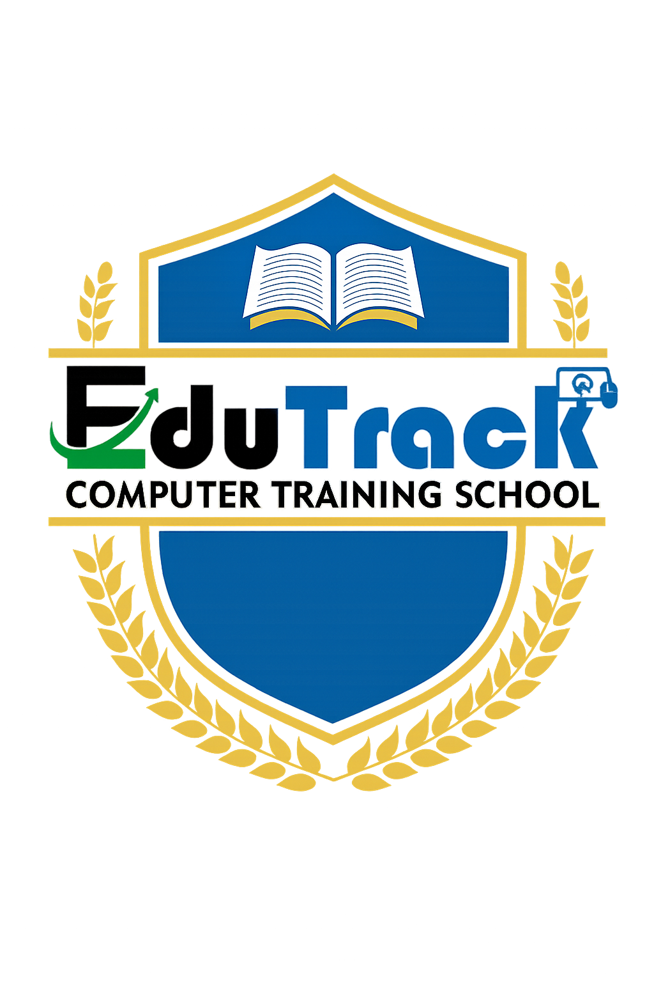
Topic 1: Computer Fundamentals
Foundations of Computing and Mathematics | Cybersecurity Certificate Program
Notes:
Welcome to Topic 1: Computer Fundamentals. This topic establishes the physical and logical building blocks of computing. Every cybersecurity professional must understand how computers process information because every cyberattack ultimately targets hardware, software, or data at some stage. We will examine the Input-Processing-Output-Storage (IPOS) cycle, core hardware components, system architecture, and different types of computing devices. All abbreviations will be defined on first use.

Slide 2
Why Computer Fundamentals Matter in Cybersecurity
You cannot protect what you do not understand.
Attackers exploit weaknesses at every level: physical hardware, operating systems, applications, and user behavior.
Understanding hardware helps incident responders find where malware hides and how data is stolen.
In Zambia, banks like Zambia National Commercial Bank (Zanaco), mobile network operators like Mobile Telecommunications Network (MTN), and utility companies like Zambia Electricity Supply Corporation (ZESCO) all rely on these same computing principles.
Job roles that require this knowledge: Security Operations Center (SOC) Analyst, Network Security Technician, Digital Forensics Investigator, and Incident Responder.
Notes:
INSTRUCTOR NOTES - Detailed Explanation:
This slide sets the context for the entire topic. Emphasize that cybersecurity is not just about firewalls and antivirus software. It begins with understanding the machines themselves.
Key point: The 2021 Colonial Pipeline ransomware attack in the United States began with a compromised Virtual Private Network (VPN) account, but the attackers then moved through the organization's computer systems, exploiting basic understanding of how Windows servers, user accounts, and network connections work. If the defenders had stronger foundational knowledge, the attack might have been contained earlier.
In Zambia, the Information and Communication Technology (ICT) sector is growing rapidly. ZICTA (Zambia Information and Communications Technology Authority) regulates this space, and organizations across the country need people who understand both the technology and how to secure it.
Abbreviations defined:
- IPOS = Input, Processing, Output, Storage
- VPN = Virtual Private Network
- SOC = Security Operations Center
- MTN = Mobile Telecommunications Network
- ZESCO = Zambia Electricity Supply Corporation
- ZICTA = Zambia Information and Communications Technology Authority

Slide 3
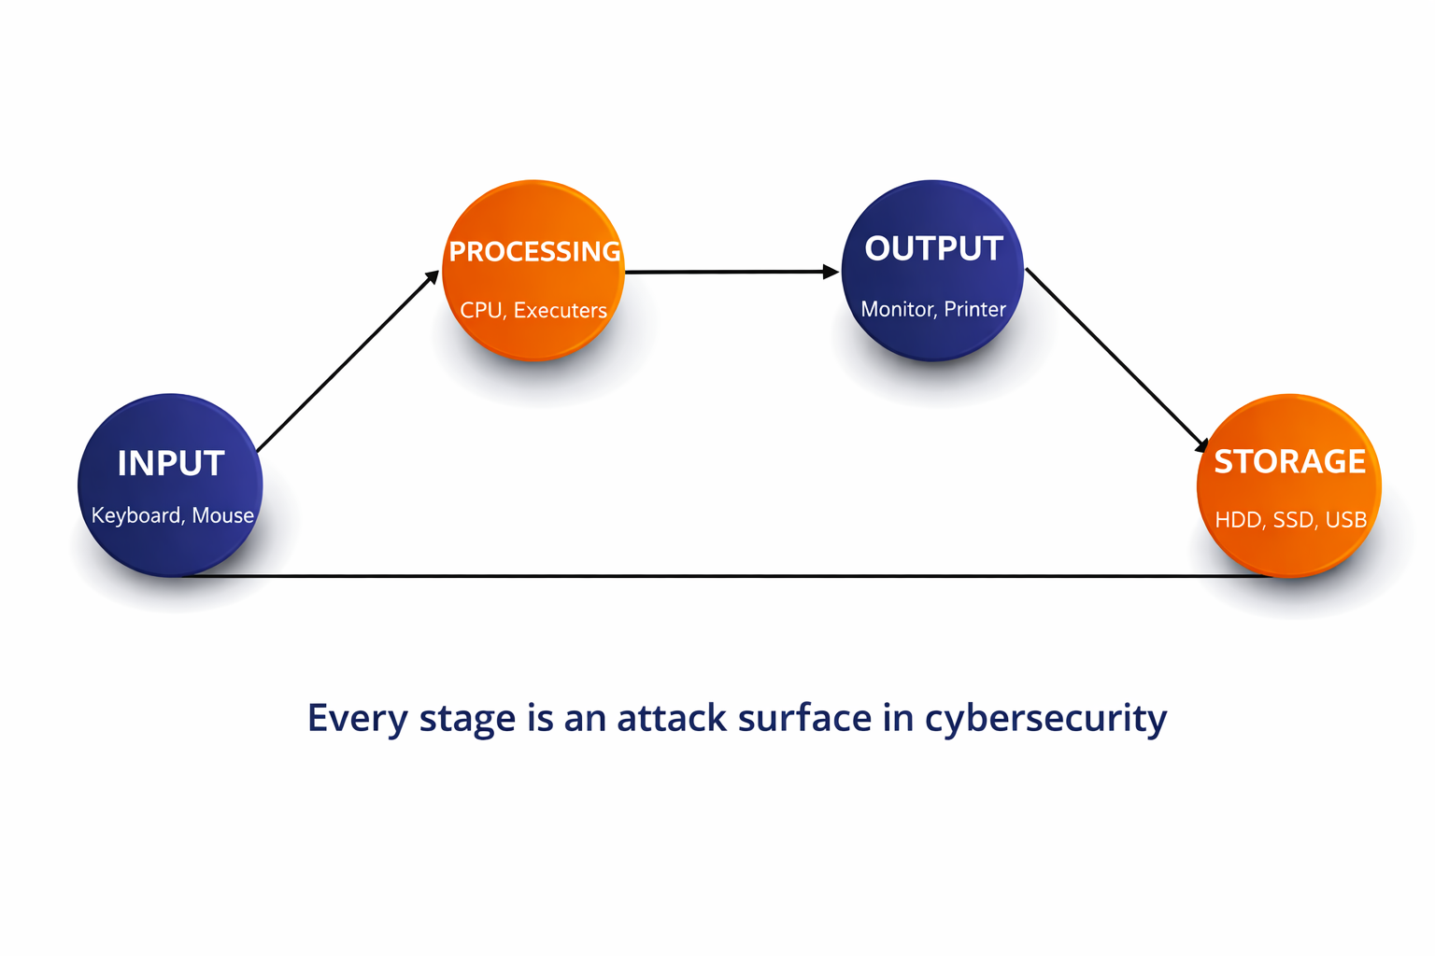
What is a Computer? The IPOS Model
A computer is an electronic device that accepts data, processes it according to instructions, stores the results, and produces output.
The IPOS Model stands for Input, Processing, Output, and Storage.
Input: Data enters the system through devices like a keyboard, mouse, touchscreen, biometric scanner, or card reader.
Processing: The Central Processing Unit (CPU) performs calculations and logical operations on the input data.
Output: The results are displayed to the user through a monitor, printer, or speakers.
Storage: Data and instructions are saved for future use on devices like Hard Disk Drives (HDD), Solid State Drives (SSD), or Universal Serial Bus (USB) flash drives.
Notes:
INSTRUCTOR NOTES - Detailed Explanation:
The IPOS model is fundamental because it breaks down every computing action into four stages. Each stage represents a potential attack surface.
Input Stage: Attackers can intercept input before it reaches the processor. Examples include keyloggers (software or hardware devices that record every keystroke), fake biometric scanners that steal fingerprint data, and card skimmers placed on Automated Teller Machines (ATMs).
Processing Stage: The CPU is where all computation happens. Modern CPUs use speculative execution (performing calculations before they are confirmed as needed) to speed up performance. The Spectre and Meltdown vulnerabilities, discovered in 2018, showed that this feature could leak sensitive information between programs. Over 90 percent of processors worldwide were affected.
Output Stage: Shoulder surfing is when an attacker physically watches a user's screen or keyboard in public places like internet cafes in Lusaka. Screen privacy filters are a physical security control that limits viewing angles.
Storage Stage: Data at rest (data stored on a device) must be protected. If a laptop is stolen from a government office or non-governmental organization (NGO) in Zambia and the drive is not encrypted, the thief can access all files. Full Disk Encryption (FDE) using BitLocker on Windows or Linux Unified Key Setup (LUKS) on Linux prevents this.
Abbreviations defined:
- CPU = Central Processing Unit
- HDD = Hard Disk Drive
- SSD = Solid State Drive
- USB = Universal Serial Bus
- ATM = Automated Teller Machine
- NGO = Non-Governmental Organization
- FDE = Full Disk Encryption
- LUKS = Linux Unified Key Setup

Slide 4
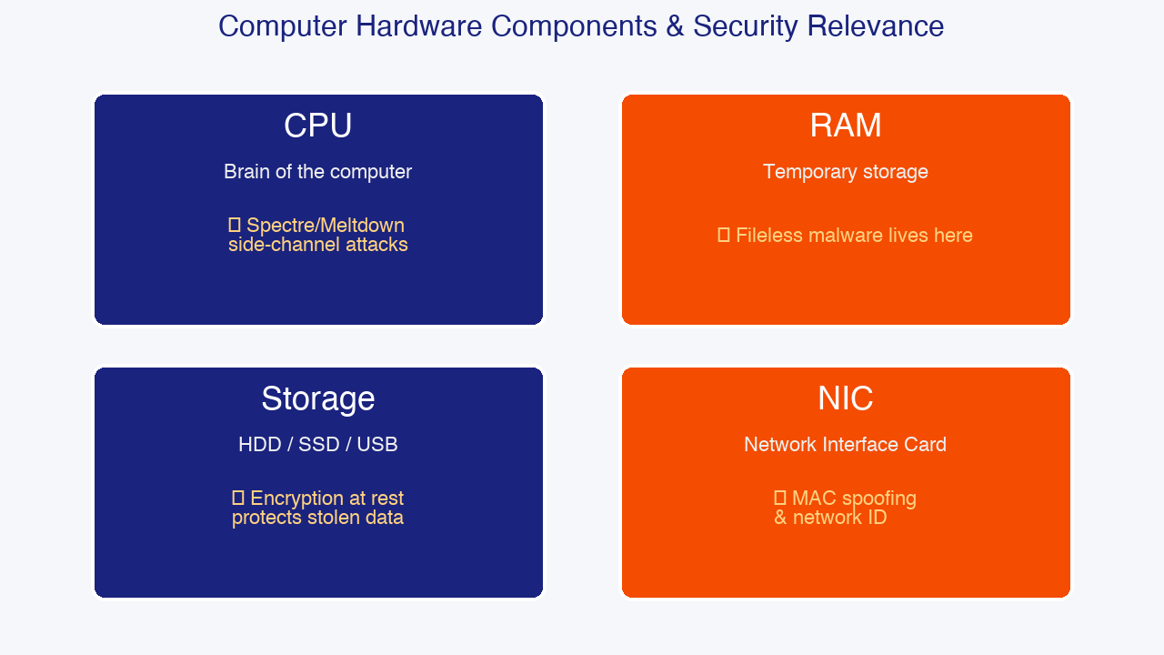
Hardware Components and Their Security Relevance
Central Processing Unit (CPU): Often called the brain of the computer. It executes program instructions and performs arithmetic and logical operations. Speed is measured in gigahertz (GHz). Modern CPUs have multiple cores, allowing them to perform multiple tasks simultaneously.
Security relevance: CPUs handle cryptographic operations like encrypting and decrypting data. Vulnerabilities such as Spectre and Meltdown are side-channel attacks that exploit how the CPU processes data to leak secrets across programs.
Random Access Memory (RAM): Temporary, high-speed memory that the CPU uses while the computer is running. It is volatile, meaning all data is lost when power is turned off.
-Security relevance: Fileless malware operates entirely in RAM to avoid being detected by traditional antivirus software that scans files on the hard drive. Incident responders use memory forensics tools like Volatility to detect such threats.
Notes:
INSTRUCTOR NOTES - Detailed Explanation:
Central Processing Unit (CPU): The CPU contains two main parts: the Arithmetic Logic Unit (ALU), which performs mathematical calculations and logical comparisons, and the Control Unit (CU), which fetches instructions from memory and directs operations. Multi-core processors (dual-core, quad-core, etc.) allow parallel processing. In cybersecurity, the CPU is responsible for encrypting data using algorithms like the Advanced Encryption Standard (AES). However, researchers discovered that speculative execution - a performance optimization where the CPU guesses which instructions it will need next - could be exploited. The Spectre and Meltdown attacks allowed malicious programs to read memory that should have been protected, including passwords and encryption keys. Over 90 percent of processors worldwide were affected.
Random Access Memory (RAM): RAM is much faster than storage but temporary. When you open a document, it is loaded from storage into RAM so the CPU can work with it quickly. Because RAM does not retain data after power loss, some attackers perform cold boot attacks: they quickly restart a computer from a special device and dump the RAM contents before the data fades. Fileless malware (also called living-off-the-land attacks) resides only in RAM, using legitimate system tools like PowerShell to avoid writing any files to disk. This makes it invisible to signature-based antivirus. Memory forensics is the practice of analyzing RAM dumps to find such threats. Tools like Volatility and Rekall are industry standards for this work.
Abbreviations defined:
- ALU = Arithmetic Logic Unit
- CU = Control Unit
- AES = Advanced Encryption Standard
- RAM = Random Access Memory

Slide 5
More Hardware Components: Storage and Network Interface
Storage Devices: Hard Disk Drives (HDD) use spinning magnetic platters. Solid State Drives (SSD) use flash memory with no moving parts, making them faster and more durable. USB flash drives provide portable storage.
Security relevance: Stolen storage devices are a major data breach vector. Encryption at rest ensures that even if a device is physically stolen, the data remains unreadable without the decryption key. Forensic investigators also examine storage for deleted files and hidden data.
Network Interface Card (NIC): This hardware component connects the computer to a network, either through an Ethernet cable or wirelessly via WiFi.
Every NIC has a unique Media Access Control (MAC) address burned into it by the manufacturer, such as 00:1A:2B:3C:4D:5E.
Security relevance: MAC addresses identify devices on a local network. Attackers can use MAC spoofing (changing their MAC address to impersonate another device) to bypass Network Access Control (NAC) systems or frame innocent users.
Notes:
INSTRUCTOR NOTES - Detailed Explanation:
Storage Devices: Hard Disk Drives (HDD) store data magnetically on spinning platters. They are slower but offer large capacities at low cost. Solid State Drives (SSD) store data in flash memory chips. They are faster, quieter, and more shock-resistant but typically more expensive per gigabyte. USB (Universal Serial Bus) flash drives are convenient for transferring files but are easily lost or stolen. In 2022, the United Kingdom's Information Commissioner's Office (ICO) fined multiple organizations millions of pounds after unencrypted USB drives containing personal data were lost.
Encryption at rest means that data is encrypted while stored on the device. Even if the physical device is stolen, the thief cannot read the data without the encryption key. Windows includes BitLocker for this purpose. Linux includes LUKS (Linux Unified Key Setup). Both require a password or recovery key to decrypt the drive.
Network Interface Card (NIC): Every device that connects to a network has a NIC. Wired NICs use Ethernet cables. Wireless NICs use WiFi. Each NIC has a unique 48-bit identifier called the Media Access Control (MAC) address. The first 24 bits (three pairs of hex digits) identify the manufacturer. The last 24 bits identify the specific device.
MAC spoofing is when an attacker changes their device's MAC address to match another device's address. This can be used to bypass Network Access Control (NAC), which restricts network access to known devices. It can also be used to impersonate another user on a network. Tools like macchanger on Linux make MAC spoofing easy. However, MAC addresses only work on the local network; they are not sent over the internet. Internet routing uses Internet Protocol (IP) addresses instead.
Abbreviations defined:
- HDD = Hard Disk Drive
- SSD = Solid State Drive
- USB = Universal Serial Bus
- ICO = Information Commissioner's Office
- NIC = Network Interface Card
- MAC = Media Access Control
- NAC = Network Access Control
- IP = Internet Protocol

Slide 6
System Architecture: 32-bit versus 64-bit
A 32-bit system can address a maximum of 4 gigabytes (GB) of Random Access Memory (RAM).
A 64-bit system can theoretically address 16 exabytes of RAM - far more than any current computer needs.
Most modern computers, smartphones, and servers use 64-bit architecture.
Security relevance: 64-bit operating systems support stronger security features including Address Space Layout Randomization (ASLR) and Data Execution Prevention (DEP), also known as the No-eXecute (NX) bit.
ASLR randomizes where programs load in memory, making it harder for attackers to predict memory addresses during exploits.
DEP marks certain memory regions as non-executable, preventing buffer overflow attacks from running injected malicious code.
Notes:
INSTRUCTOR NOTES - Detailed Explanation:
The terms 32-bit and 64-bit refer to how much data the processor can handle in one operation and how much memory it can access. A 32-bit processor uses 32 binary digits (bits) to represent memory addresses. Because 2 raised to the power of 32 equals approximately 4.29 billion, a 32-bit system can only use about 4 gigabytes (GB) of RAM. This was sufficient in the 1990s but is a serious limitation today.
A 64-bit processor uses 64 bits for memory addressing. While no computer today uses anywhere near the theoretical maximum of 16 exabytes (1 exabyte = 1 billion gigabytes), the larger address space allows systems to use hundreds of gigabytes of RAM, which is essential for running modern security tools like Security Information and Event Management (SIEM) systems.
From a cybersecurity perspective, the move to 64-bit is about more than just memory capacity. 64-bit operating systems can implement stronger versions of Address Space Layout Randomization (ASLR). ASLR is a security technique that randomly arranges the memory positions of key data areas, including the base of the executable and the positions of the stack, heap, and libraries. This makes it much harder for an attacker to predict where to redirect execution during a buffer overflow or other memory corruption attack.
Data Execution Prevention (DEP) is another critical defense. Also called the NX (No-eXecute) bit on AMD processors or XD (eXecute Disable) bit on Intel processors, DEP marks certain areas of memory as non-executable. In a buffer overflow attack, the attacker typically injects malicious code into a memory area that should only contain data (like the stack). With DEP enabled, the processor will refuse to execute code from that region, causing the attack to fail.
Abbreviations defined:
- GB = Gigabyte
- RAM = Random Access Memory
- ASLR = Address Space Layout Randomization
- DEP = Data Execution Prevention
- NX = No-eXecute
- SIEM = Security Information and Event Management

Slide 7
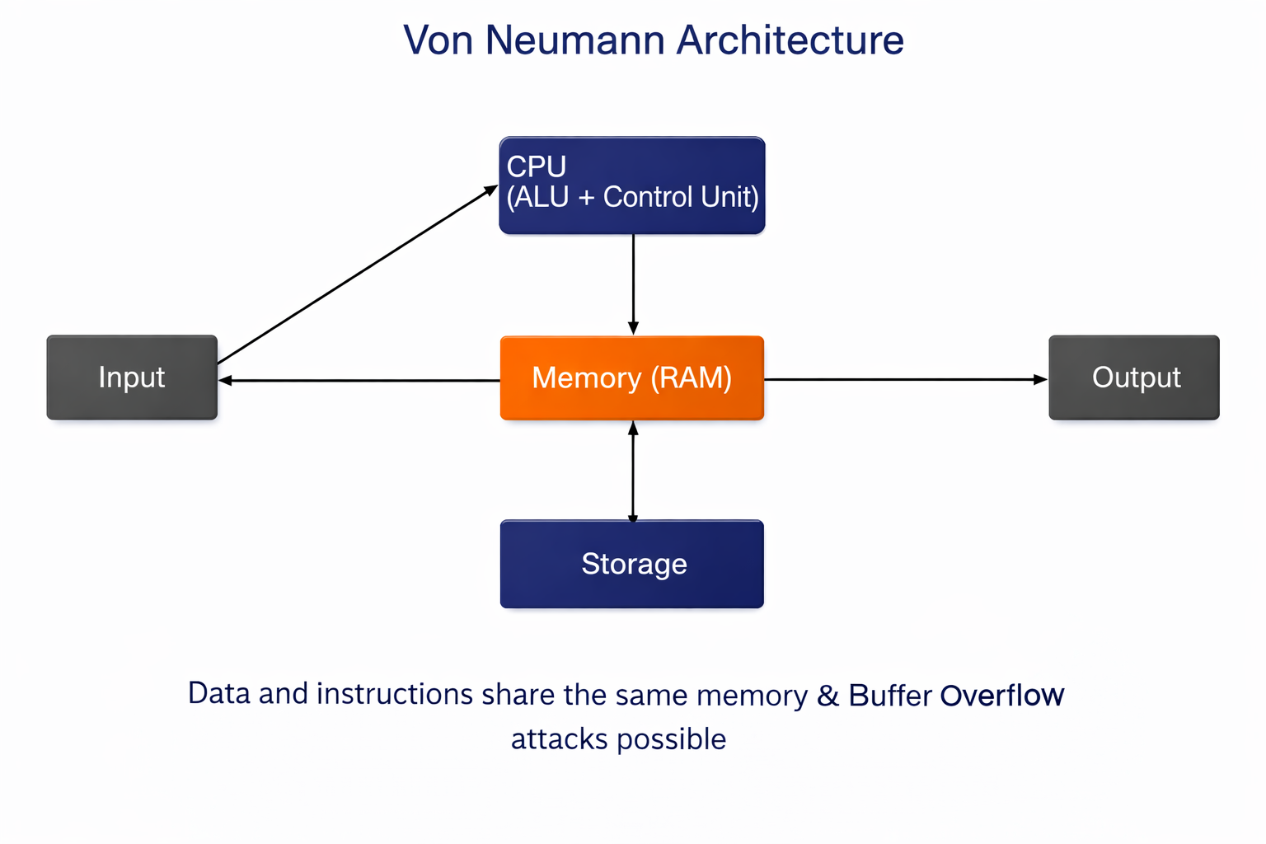
Von Neumann Architecture and Security Implications
The Von Neumann architecture, developed by mathematician John von Neumann in 1945, is the design model used by almost all modern computers.
It consists of five main parts: Input devices, the Central Processing Unit (CPU) containing the Arithmetic Logic Unit (ALU) and Control Unit (CU), Memory (RAM), Storage, and Output devices.
The defining characteristic is that both data and program instructions are stored in the same memory space.
Security implication: Because data and instructions share memory, a buffer overflow attack can overwrite program instructions with malicious code, causing the computer to execute attacker-controlled commands.
Modern defenses include DEP/NX bit, ASLR, and stack canaries (special values placed before return addresses to detect overflows).
Notes:
INSTRUCTOR NOTES - Detailed Explanation:
John von Neumann was a Hungarian-American mathematician who, in 1945, published a paper describing a computer design where the program (instructions) and data are both stored in the same memory. Before this, computers were programmed by physically rewiring circuits or using punch cards that were separate from the data. The stored-program concept revolutionized computing and is still used today.
The five components are:
1. Input: Devices that bring data into the computer (keyboard, mouse, scanner, microphone).
2. CPU (Central Processing Unit): The brain containing the ALU (Arithmetic Logic Unit) for math and the Control Unit (CU) for directing operations.
3. Memory (RAM): Fast temporary storage for both data and instructions currently in use.
4. Storage: Long-term retention of programs and files when the computer is off.
5. Output: Devices that present results to the user (monitor, printer, speakers).
The security problem: Because instructions and data live in the same memory, there is no hard boundary preventing a program from accidentally or maliciously treating data as instructions. This is the root cause of buffer overflow attacks. When a program receives more input than expected and fails to check the size, the excess input can spill over into adjacent memory that contains return addresses or executable instructions. An attacker can craft input that includes malicious machine code and overwrite a return address to point to that code. When the function returns, the CPU executes the attacker's code.
Defenses evolved to mitigate this architectural weakness:
- Stack canaries: A secret value placed on the stack before the return address. If a buffer overflow occurs, the canary is overwritten first. Before returning, the program checks if the canary has changed. If so, it terminates immediately.
- DEP/NX bit: Marks data regions (stack, heap) as non-executable.
- ASLR: Randomizes memory locations so attackers cannot predict where to jump.
The 2017 WannaCry ransomware exploited EternalBlue, a buffer overflow in the Windows Server Message Block (SMB) protocol, to spread automatically across networks. Understanding Von Neumann architecture helps students understand WHY such vulnerabilities are possible.

Slide 8
Types of Computers and Their Security Posture
Personal Computer (PC): Includes desktop and laptop computers used by individuals. Security focus is on endpoint protection, including antivirus software, Endpoint Detection and Response (EDR), and user awareness training.
Server: A powerful computer that provides services to many users simultaneously, such as hosting websites, managing databases, or handling email. Servers are high-value targets and require hardening (securing the configuration), continuous monitoring, and regular patching.
Embedded System: A computer built into another device, such as an ATM, traffic light, or medical equipment. These often run outdated software that cannot be easily patched, making them vulnerable.
Internet of Things (IoT) Device: Smart devices connected to the internet, such as security cameras, smart meters, and home assistants. These devices often ship with default passwords and lack security updates, creating a massive attack surface.
Notes:
INSTRUCTOR NOTES - Detailed Explanation:
Different categories of computers face different threats and require different security strategies.
Personal Computers (PCs): In Zambia, most office workers at banks, schools, and government offices use Windows PCs. The primary security controls for PCs are endpoint security solutions. Antivirus software detects known malware signatures. Endpoint Detection and Response (EDR) goes further by monitoring behavior in real time, detecting fileless malware, and allowing remote investigation. User awareness training teaches employees to recognize phishing emails, which are the most common attack vector against endpoints.
Servers: A single compromised web server can expose thousands or millions of customer records. In 2017, Equifax - one of the largest credit reporting agencies in the world - suffered a breach exposing 147 million records. The cause was an unpatched Apache Struts web server. In Zambia, servers at MTN, Airtel, Zanaco, and government data centers predominantly run Linux. This makes Linux security skills highly employable. Server hardening includes disabling unnecessary services, applying security patches promptly, using strong authentication, and maintaining detailed logs.
Embedded Systems: Unlike PCs and servers, embedded systems are often physically difficult to access and are designed to run for years without intervention. This means they frequently run old operating systems with known vulnerabilities that were never patched. An ATM running Windows XP (which Microsoft stopped supporting in 2014) is vulnerable to attacks that have been public knowledge for years.
Internet of Things (IoT): The number of IoT devices worldwide is in the tens of billions. In Zambia, smart electricity meters, cheap Closed-Circuit Television (CCTV) cameras, and smart home devices are increasingly common. Many of these devices ship with default usernames and passwords like admin/admin or root/root. The 2016 Mirai botnet infected over 600,000 IoT devices with default credentials and used them to launch record-breaking Distributed Denial of Service (DDoS) attacks. The first security step for any IoT device is changing the default password and isolating it on a separate network segment.
Abbreviations defined:
- PC = Personal Computer
- EDR = Endpoint Detection and Response
- IoT = Internet of Things
- CCTV = Closed-Circuit Television
- DDoS = Distributed Denial of Service

Slide 9
Topic 1 Summary: Key Takeaways
The IPOS Model (Input, Processing, Output, Storage) describes how computers handle data. Every stage represents an attack surface.
The Central Processing Unit (CPU) executes instructions and handles encryption. Side-channel attacks like Spectre and Meltdown target the CPU.
Random Access Memory (RAM) is temporary and volatile. Fileless malware hides in RAM to avoid disk-based antivirus detection.
Storage devices (HDD, SSD, USB) hold data permanently. Encryption at rest protects against theft and unauthorized access.
The Network Interface Card (NIC) connects devices to networks using a unique Media Access Control (MAC) address. MAC spoofing is a common attack technique.
The Von Neumann architecture stores data and instructions in the same memory, which enables buffer overflow attacks. Modern defenses include ASLR, DEP/NX bit, and stack canaries.
Different computer types (PC, server, embedded, IoT) require different security strategies.
Notes:
INSTRUCTOR NOTES - Detailed Explanation:
This summary slide recaps the foundational concepts of Topic 1. Emphasize the connections between hardware and security.
The IPOS model is not just theory - it maps to real attack vectors. Input = keyloggers and skimmers. Processing = CPU side-channel attacks. Output = shoulder surfing and screen capture malware. Storage = data theft from unencrypted devices.
The CPU and RAM are primary targets for advanced attackers. While traditional antivirus scans files on the hard drive, sophisticated threats live in memory. This is why memory forensics and behavior-based detection (EDR) are essential skills for modern cybersecurity professionals.
The Von Neumann architecture is a historical design decision with lasting security consequences. Buffer overflows have existed for decades and remain one of the most dangerous vulnerability classes. Every major operating system invests heavily in mitigations like ASLR and DEP.
Finally, the growth of IoT devices has massively expanded the attack surface. In Zambia and globally, organizations struggle to inventory and secure these devices. Students who understand how to segment networks and harden embedded systems will be valuable assets.

