Slide 1


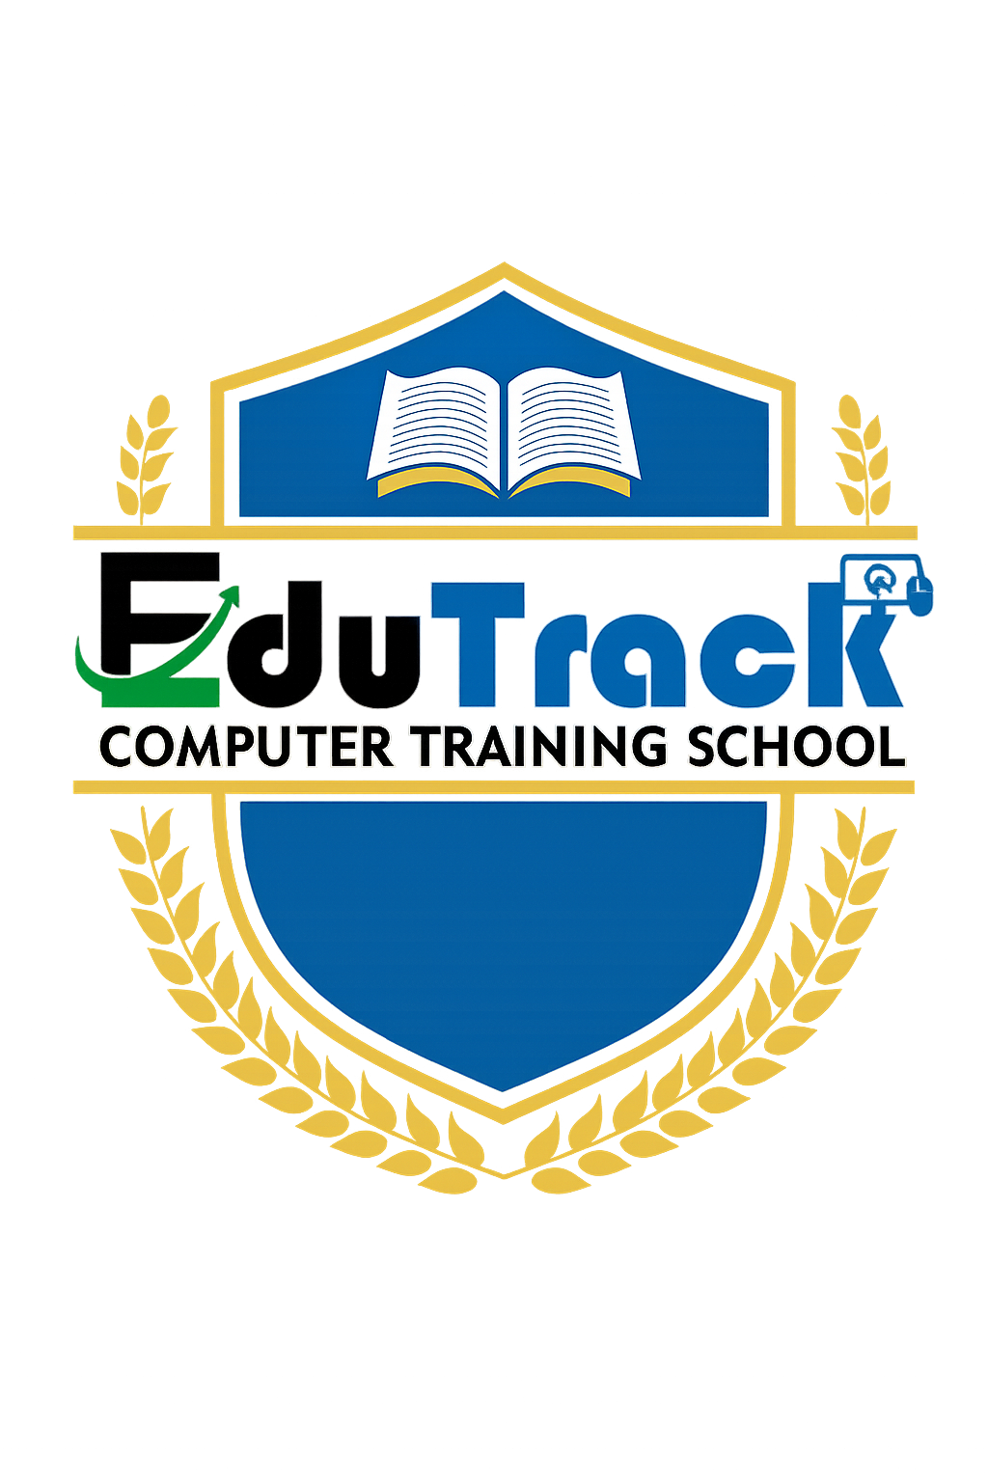
Topic 2: Operating Systems
Windows and Linux Fundamentals for Cybersecurity
Notes:
Welcome to Topic 2: Operating Systems. An Operating System (OS) is the software that manages computer hardware and provides services for applications. It sits between the user and the hardware, making it the ultimate security gatekeeper. Every file you open, every network connection you make, and every password you type passes through the OS. If the OS is compromised, nothing running on it can be trusted. This topic covers Windows and Linux, the two most important operating systems for cybersecurity professionals.

Slide 2
What is an Operating System?
- An Operating System (OS) is system software that manages hardware resources and provides common services for computer programs.
- It acts as an intermediary between the user, applications, and the physical hardware.
- Key functions of an OS include:
+ Process management: Creating, scheduling, and terminating running programs.
+ Memory management: Allocating and protecting Random Access Memory (RAM).
+ File system management: Organizing, reading, and writing files on storage devices.
+ Security and access control: Managing user accounts, passwords, and permissions.
+ Device management: Communicating with hardware through drivers.
Notes:
INSTRUCTOR NOTES - Detailed Explanation:
The Operating System (OS) is the most critical piece of software on any computer. Without an OS, the hardware cannot be used. The OS is responsible for making sure that multiple programs can run simultaneously without interfering with each other.
Process Management: Every running program is called a process. The OS decides which process gets to use the CPU and for how long. Attackers often try to hide malicious processes by giving them names that look like legitimate system processes. For example, malware might name itself svch0st.exe (with a zero) instead of svchost.exe (with the letter o), hoping that a busy administrator will not notice the difference.
Memory Management: The OS ensures that each process only accesses its own allocated memory. If a program tries to read or write memory belonging to another program, the OS should stop it. However, vulnerabilities in the OS or applications can bypass these protections, leading to attacks like buffer overflows and heap spraying.
File System Management: The OS controls how files are created, named, stored, and retrieved. It also enforces permissions - who can read, write, or delete files. Poorly configured file permissions are a common cause of data breaches.
Security and Access Control: The OS verifies who you are (authentication) and what you are allowed to do (authorization). Windows uses Active Directory in corporate environments. Linux uses the Pluggable Authentication Modules (PAM) system.
Device Management: The OS communicates with hardware devices through drivers. Because drivers run with kernel-level privileges (the highest level of system access), a vulnerability in a printer driver, graphics card driver, or network driver can give an attacker complete control of the computer. The 2021 PrintNightmare vulnerability in Windows was a driver flaw that allowed remote code execution.
Abbreviations defined:
- OS = Operating System
- RAM = Random Access Memory
- CPU = Central Processing Unit
- PAM = Pluggable Authentication Modules

Slide 3
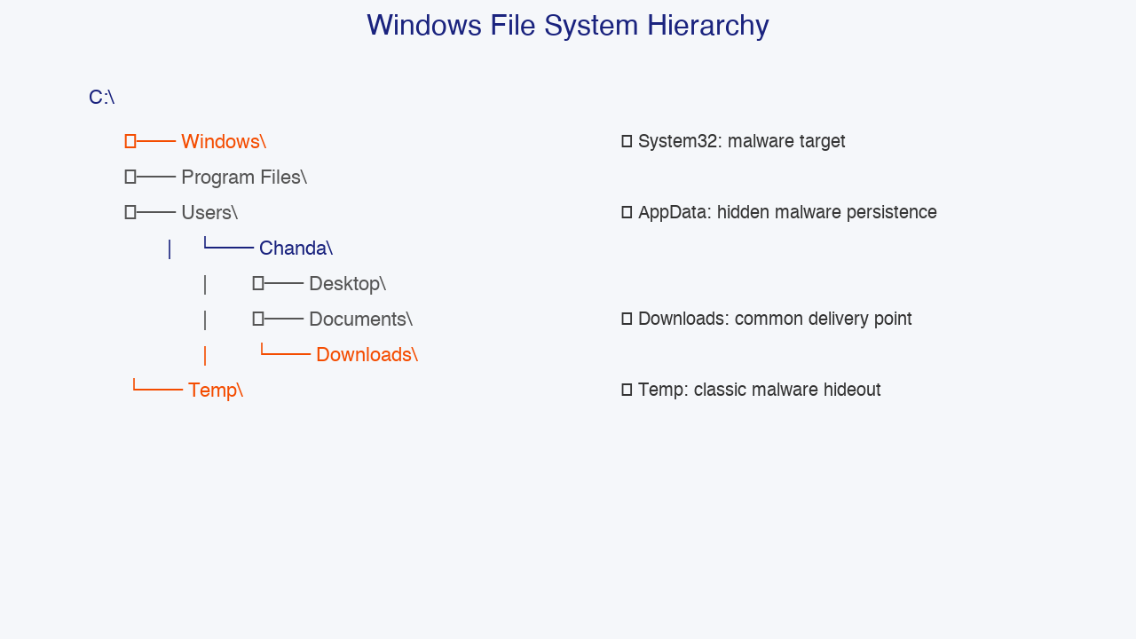
Windows Operating System: File System Basics
- Windows is the most widely used desktop operating system globally and in Zambia.
- The file system is organized in a tree structure starting from drive letters like C:\.
- C:\Windows\System32 contains core operating system files, Dynamic Link Libraries (DLLs), and executables. This is a frequent target for malware.
- C:\Users\[Username]\AppData is a hidden directory that stores application data. Malware frequently uses this location for persistence because it is writable by standard users.
- C:\Temp and C:\Windows\Temp store temporary files. Incident responders check these directories for recently dropped malware.
- C:\Program Files and C:\Program Files (x86) contain installed applications. Unauthorized software here may indicate a security breach.
Notes:
INSTRUCTOR NOTES - Detailed Explanation:
Microsoft Windows dominates the personal computer market, with approximately 70 percent market share worldwide. In Zambian businesses, schools, and government offices, Windows is the standard desktop operating system. Because of this dominance, cybersecurity professionals spend a large portion of their time investigating, securing, and managing Windows systems.
C:\Windows\System32: This directory is the heart of the Windows operating system. It contains hundreds of Dynamic Link Libraries (DLLs) - shared code libraries used by multiple programs - and essential executables like cmd.exe (the Command Prompt) and svchost.exe (which hosts Windows services). Malware frequently targets System32 through a technique called DLL hijacking. In this attack, a malicious DLL with the same name as a legitimate one is placed in a directory where Windows will load it before the real version. When a program runs, it unknowingly loads the malicious DLL and executes attacker code.
AppData: This directory is hidden by default, meaning users do not see it unless they enable 'Show hidden files' in File Explorer. It has three subfolders: Local, LocalLow, and Roaming. Malware loves AppData because standard users can write to it without administrator privileges, and some antivirus programs exclude it from scanning to avoid breaking legitimate applications. Ransomware families like Ryuk and TrickBot commonly store configuration files and secondary payloads in AppData. To view it, open File Explorer, click the View tab, and check 'Hidden items.' Alternatively, in Command Prompt, use: dir /a C:\Users\[username]\AppData
Temp Directories: The %TEMP% environment variable points to a temporary folder, usually C:\Users\[username]\AppData\Local\Temp. Any user can write here, making it an ideal place for malware to extract and execute files. During an incident response investigation, one of the first commands an analyst runs is dir /o-d %TEMP% (the /o-d flag sorts by date, newest first). Recently created executable files in Temp are highly suspicious.
Program Files: This is where most installed applications live. During security audits, analysts check for unauthorized or outdated software. Old versions of web browsers, PDF readers, or media players often contain known vulnerabilities that attackers can exploit.
Abbreviations defined:
- DLL = Dynamic Link Library
- cmd.exe = Command Prompt executable

Slide 4
Windows Command Prompt: Essential Security Commands
- ipconfig: Displays Internet Protocol (IP) configuration, including the computer's IP address, subnet mask, and default gateway. Using ipconfig /all shows additional details including the Media Access Control (MAC) address and Domain Name System (DNS) servers.
- netstat -an: Displays all active network connections and listening ports. Analysts use this to spot suspicious connections to unknown remote addresses.
- tasklist: Lists all running processes. Using tasklist /svc shows which Windows services each process is hosting, helping identify injected or rogue processes.
- systeminfo: Displays detailed system information including the operating system version, installed hotfixes (security patches), and hardware details.
- net user: Lists local user accounts. Attackers often create hidden backdoor accounts with innocent-sounding names.
- dir /a: Lists all files in a directory, including hidden and system files.
Notes:
INSTRUCTOR NOTES - Detailed Explanation:
The Windows Command Prompt (cmd.exe) and its more powerful successor, PowerShell, are essential tools for system administration and incident response. While PowerShell has largely replaced Command Prompt for advanced tasks, these basic commands are guaranteed to work on every Windows system and are excellent starting points for beginners.
ipconfig: This command reveals the computer's network identity. The output includes the IPv4 address (the local network address), subnet mask (which defines the network boundary), default gateway (the router that connects to other networks), and MAC address. The command ipconfig /displaydns shows the DNS resolver cache - a record of recently resolved domain names. If you see entries for suspicious domains, it may indicate malware communication. Unexpected DNS server addresses can also be a sign of DNS hijacking.
netstat -an: This is one of the most important commands for network investigation. The -a flag shows all connections and listening ports. The -n flag displays addresses and port numbers in numerical form, which is faster than resolving names. If you see a connection to an unusual foreign IP address on port 4444 (the default port for the Metasploit penetration testing framework) or port 3389 (Remote Desktop Protocol), it may indicate that the computer has been compromised. For more detail, the command netstat -anb (requires administrator privileges) shows which executable file owns each connection.
tasklist: This lists all running processes. A process is a running instance of a program. The basic tasklist command shows the process name and Process Identifier (PID). Adding the /svc flag shows which Windows services are running inside each svchost.exe process. Malware frequently injects itself into legitimate processes or creates processes with names that mimic legitimate ones. Comparing tasklist output against a known-good baseline helps spot anomalies.
systeminfo: This command outputs a comprehensive system profile, including the operating system name and version, installation date, registered owner, processor type, and total physical memory. Most importantly for security, it lists installed hotfixes (security patches). An unpatched system is a vulnerable system. For example, if the hotfix for EternalBlue (MS17-010) is missing, the computer is vulnerable to WannaCry and similar ransomware.
net user: This command lists all local user accounts on the computer. Attackers who gain access often create backdoor accounts with names like 'helpdesk,' 'backup,' or 'support' to maintain access. The command net localgroup administrators shows which accounts have administrator privileges. Any unexpected account in this list is a critical red flag.
dir /a: The /a flag shows all files, including hidden files (which have the Hidden attribute) and system files. Malware often marks itself as hidden to avoid detection.
Abbreviations defined:
- IP = Internet Protocol
- MAC = Media Access Control
- DNS = Domain Name System
- PID = Process Identifier
- MS17-010 = Microsoft Security Bulletin 2017-010 (EternalBlue patch)

Slide 5
Windows User Accounts and the Principle of Least Privilege
- Administrator Account: Has full control over the system. Can install software, modify all files, and change security settings. Should be used only when necessary.
- Standard User Account: Has limited privileges. Cannot install software system-wide or modify protected operating system files. This is the recommended account type for daily use.
- Guest Account: Has very limited access and cannot make persistent changes to the system.
- The Principle of Least Privilege means giving users only the minimum level of access they need to perform their job.
- Security impact: If a standard user account is compromised by malware, the malware's ability to damage the system is limited. If an administrator account is compromised, the attacker gains full control.
Notes:
INSTRUCTOR NOTES - Detailed Explanation:
User account management is a fundamental security control in Windows. Microsoft designed the User Account Control (UAC) system to reduce the damage caused by malware running under administrator accounts. When UAC is enabled, even administrators run with standard privileges by default, and Windows prompts for confirmation before performing administrative tasks.
However, many users and even some organizations disable UAC or give everyone administrator accounts for convenience. This is a dangerous practice. If an attacker tricks an administrator into running malware - for example, through a phishing email with a malicious attachment - the malware immediately has full system access. It can disable antivirus, create hidden accounts, install persistent backdoors, and encrypt files (ransomware).
In contrast, if the same malware runs on a standard user account, its capabilities are restricted. It cannot modify system directories, install drivers, or change security settings. While it can still steal the user's personal files, it cannot easily spread across the network or deeply compromise the system. This is why the Principle of Least Privilege is one of the most effective and least expensive security controls.
In enterprise environments, Windows uses Active Directory (AD) to centrally manage thousands of user accounts. Group Policy allows administrators to enforce least privilege across the entire organization. For example, Group Policy can prevent standard users from running executable files from USB drives, disable guest accounts, or enforce password complexity requirements.
Abbreviations defined:
- UAC = User Account Control
- AD = Active Directory

Slide 6
Linux Operating System: Why It Matters in Cybersecurity
- Linux is an open-source operating system based on Unix. The source code is freely available, and anyone can inspect, modify, and distribute it.
- Linux powers the majority of web servers, cloud infrastructure, and supercomputers worldwide. Over 80 percent of web servers run Linux.
- In Zambia, core infrastructure at banks, mobile network operators, and government institutions runs on Linux servers.
- Kali Linux is a specialized Linux distribution designed for cybersecurity professionals. It comes pre-installed with hundreds of penetration testing and forensics tools.
- Because Linux is free, highly configurable, and stable, it is the platform of choice for most security tools and research.
Notes:
INSTRUCTOR NOTES - Detailed Explanation:
Linux was created in 1991 by Linus Torvalds, a Finnish computer science student. Unlike Windows, which is developed by Microsoft as proprietary software, Linux is open-source. This means its source code is publicly available, and a global community of developers contributes to it. There are many different versions of Linux called distributions (or distros), including Ubuntu, Debian, Fedora, CentOS, and Red Hat Enterprise Linux.
The dominance of Linux in the server market cannot be overstated. According to W3Techs, over 80 percent of all web servers run Linux. Major websites like Google, Facebook, Amazon, and Wikipedia all rely heavily on Linux infrastructure. In the cloud computing market, Amazon Web Services (AWS), Microsoft Azure, and Google Cloud Platform all run Linux virtual machines as their primary compute offering.
For cybersecurity professionals, Linux proficiency is non-negotiable. The vast majority of security tools - including Nmap (network scanner), Wireshark (packet analyzer), Metasploit (penetration testing framework), and Volatility (memory forensics) - were originally developed for Linux. Kali Linux, maintained by Offensive Security, is a Debian-based distribution that includes over 600 pre-installed security tools. It is the standard operating system used in ethical hacking courses and professional penetration testing.
In Zambia, Linux skills are directly employable. MTN Zambia, Airtel Zambia, Zanaco, ZESCO, and ZICTA all maintain Linux-based servers for web hosting, databases, and network infrastructure. Students who learn Linux command-line navigation, file permissions, and basic scripting will have a significant advantage when applying for technical roles.
Abbreviations defined:
- AWS = Amazon Web Services
- ZICTA = Zambia Information and Communications Technology Authority

Slide 7
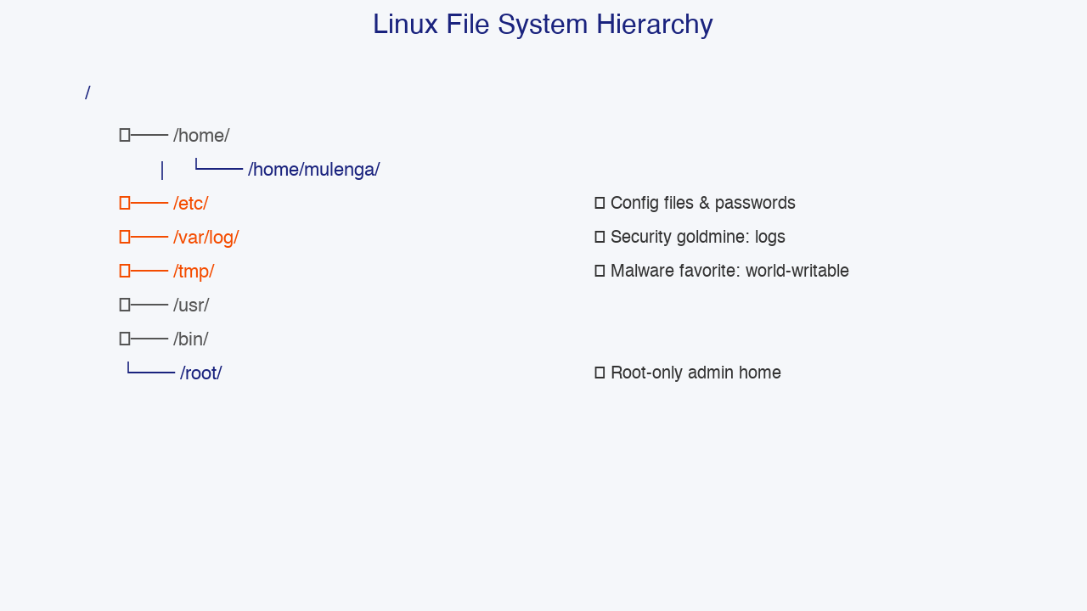
Linux File System Hierarchy
- The Linux file system is organized as a single tree starting from the root directory, represented by a forward slash (/).
- /bin/ contains essential system commands available to all users, such as ls (list files), cat (display file contents), and chmod (change file permissions).
- /etc/ contains system-wide configuration files. Critical security files here include /etc/passwd (user account information), /etc/shadow (encrypted password hashes), and /etc/hosts (local hostname mappings).
- /home/ contains personal directories for each user. For example, /home/mulenga/ belongs to the user named mulenga.
- /var/log/ contains system log files. This is where authentication attempts, system errors, and application activity are recorded.
- /tmp/ is a temporary directory that any user can write to. Malware frequently drops files here.
- /root/ is the home directory of the root user - the Linux equivalent of the Windows Administrator account.
Notes:
INSTRUCTOR NOTES - Detailed Explanation:
Unlike Windows, which uses drive letters like C:\ and D:\, Linux treats all storage as part of a single directory tree starting at the root (/). This includes hard drives, USB drives, network shares, and even special system information.
/bin/ (binaries): This directory contains essential command-line programs that all users need. The name 'bin' comes from 'binary,' which is the machine-readable format of compiled programs. Important commands here include ls (list directory contents), cp (copy files), mv (move files), rm (remove files), and chmod (change permissions). Because these programs are essential for system recovery, /bin/ is kept separate from other directories and is available even when the system is in rescue mode.
/etc/ (et cetera): This directory contains system-wide configuration files. It is one of the most important directories for security professionals. Key files include:
- /etc/passwd: Contains a list of all user accounts on the system, along with their user ID numbers, home directories, and default shells. By design, this file is readable by all users, but it does NOT contain the actual passwords.
- /etc/shadow: Contains the encrypted (hashed) passwords for all users. This file should be readable ONLY by the root user. If an attacker gains read access to /etc/shadow, they can attempt to crack the passwords offline using tools like John the Ripper or Hashcat.
- /etc/hosts: Maps hostnames to IP addresses locally. Attackers sometimes modify this file to redirect traffic from legitimate websites (like banking sites) to malicious servers controlled by the attacker. This is called hosts file poisoning.
- /etc/crontab and /etc/cron.d/: Define scheduled tasks. Attackers often add malicious cron jobs to maintain persistence - ensuring their malware runs again after a reboot.
/var/log/ (variable logs): This is the security goldmine. Linux logs almost everything that happens on the system. The most important log files for security include:
- /var/log/auth.log (on Debian/Ubuntu systems) or /var/log/secure (on Red Hat/CentOS systems): Records every authentication attempt, including successful logins, failed logins, and sudo usage. Multiple failed login attempts from the same IP address indicate a brute-force attack.
- /var/log/syslog: General system messages.
- /var/log/apache2/access.log or /var/log/httpd/access_log: Web server access logs. These show every request made to a website, including the source IP address, requested file, and response code.
- /var/log/audit/audit.log: Detailed audit logs, especially on systems running Security-Enhanced Linux (SELinux).
/tmp/ (temporary): This directory is world-writable, meaning any user can create, modify, or delete files here. Because of this, it is a favorite drop zone for malware. Many modern Linux distributions mitigate this risk by mounting /tmp with special flags like noexec (which prevents execution of files in /tmp) and nodev (which prevents device files).
/root/: This is the home directory of the root user, who has unlimited privileges on the system. Unlike regular users whose home directories are under /home/, root's home is separate for security reasons. Regular users should never be using the root account for daily tasks. Instead, they should use the sudo (superuser do) command to temporarily elevate privileges when needed.
Abbreviations defined:
- IP = Internet Protocol
- SELinux = Security-Enhanced Linux
- sudo = superuser do

Slide 8
Essential Linux Commands for Security Professionals
- ls -la: Lists files in long format, showing permissions, owner, size, and modification date. The -a flag includes hidden files (files starting with a dot).
- cat /etc/passwd: Displays the contents of the /etc/passwd file, which lists all user accounts on the system.
- grep 'Failed' /var/log/auth.log: Searches the authentication log for lines containing the word 'Failed.' This helps identify brute-force login attempts.
- ps aux: Displays all running processes on the system, including those started by other users and system services.
- sudo chmod 600 file.txt: Changes file permissions so that only the owner can read and write the file. The group and others have no permissions.
- whoami: Displays the username of the currently logged-in user.
- history: Shows the command history for the current session. Attackers may delete or modify this to hide their tracks.
Notes:
INSTRUCTOR NOTES - Detailed Explanation:
Linux command-line proficiency is essential for anyone pursuing a career in cybersecurity. The command line provides direct, low-level access to the system that is often faster and more powerful than graphical tools.
ls -la: The ls command lists directory contents. The -l flag uses the 'long' format, showing permissions, number of links, owner name, group name, file size, modification date, and filename. The -a flag shows all files, including hidden files that start with a dot (.). Hidden files are not displayed by default. Attackers frequently hide configuration files, SSH keys, and backdoors as hidden files. For example, .bashrc is a hidden file in the user's home directory that executes every time a terminal is opened. An attacker who modifies .bashrc can achieve persistence - their malicious code will run automatically whenever the user opens a terminal.
cat: Short for 'concatenate,' the cat command displays the contents of a file. It is commonly used to quickly view configuration files, log files, or scripts. For large files, commands like less or more are better because they allow scrolling.
grep: This is one of the most powerful text-searching tools in Linux. It searches files for lines matching a given pattern. Examples for security analysis:
- grep 'Failed password' /var/log/auth.log | wc -l (counts failed login attempts)
- grep -i 'error|warning' /var/log/syslog (finds lines containing either 'error' or 'warning,' case-insensitive)
- grep '192.168.1.50' /var/log/apache2/access.log (finds all web requests from a specific IP address)
ps aux: The ps command shows running processes. The a flag shows processes for all users. The u flag displays the user who owns each process. The x flag includes processes not attached to a terminal (background services). Security analysts use ps aux to identify suspicious processes, unusually high CPU usage, or processes running from unexpected locations like /tmp/.
sudo chmod 600 file.txt: The chmod command changes file permissions. The numeric mode 600 means: owner has read and write permissions (4+2=6), group has no permissions (0), and others have no permissions (0). This is the recommended permission for sensitive files like SSH private keys (~/.ssh/id_rsa). If an SSH private key has permissions like 644 (readable by everyone), anyone with access to the system can copy it and use it to impersonate the owner on remote servers.
whoami: A simple but useful command that prints the current username. When performing security tasks, it is important to verify whether you are running as a regular user or as root.
history: Bash (the default Linux shell) keeps a history of commands entered by the user. The history command displays this list. Attackers often try to clear the history using commands like history -c or rm ~/.bash_history to cover their tracks. A missing or unusually short history file can itself be a sign of compromise.
Abbreviations defined:
- SSH = Secure Shell
- Bash = Bourne Again Shell
- CPU = Central Processing Unit

Slide 9
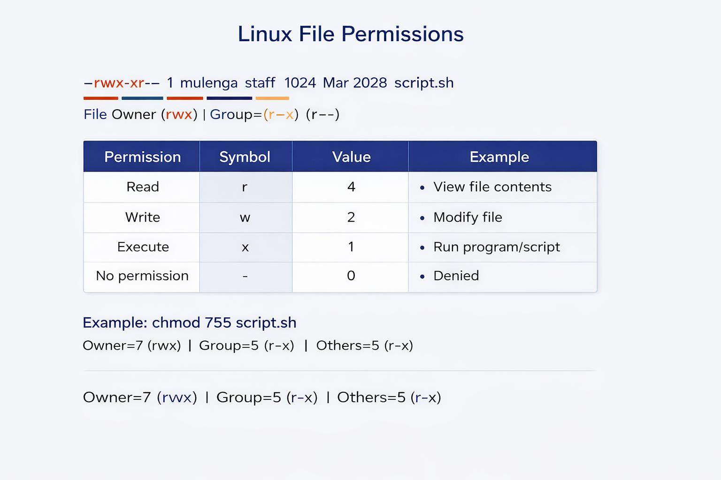
Understanding Linux File Permissions
- Every file and directory in Linux has three sets of permissions: one for the owner, one for the group, and one for all other users.
- The three permission types are: Read (r), Write (w), and Execute (x).
- Read (r) allows viewing the contents of a file or listing the contents of a directory.
- Write (w) allows modifying a file or adding and removing files from a directory.
- Execute (x) allows running a file as a program or script. For directories, it allows entering the directory.
- Permissions can be represented numerically: Read = 4, Write = 2, Execute = 1. The values are added together for each category.
- Example: chmod 755 script.sh means the owner has read, write, and execute (7 = 4+2+1), while the group and others have read and execute only (5 = 4+0+1).
Notes:
INSTRUCTOR NOTES - Detailed Explanation:
Linux file permissions are the foundation of the operating system's security model. Understanding how to read and modify permissions is essential for both system administration and cybersecurity.
When you run ls -l in a directory, the output looks like this:
-rwxr-xr-- 1 mulenga staff 1024 Mar 10 10:30 script.sh
Let's break down every character:
- The first character indicates the file type. A dash (-) means a regular file. The letter d means a directory. The letter l means a symbolic link (similar to a shortcut in Windows).
- Characters 2-4 (rwx) show the owner's permissions. In this example, the owner (mulenga) can read, write, and execute the file.
- Characters 5-7 (r-x) show the group's permissions. The group (staff) can read and execute but cannot write (the dash means no permission).
- Characters 8-10 (r--) show permissions for everyone else. Other users can only read the file; they cannot modify it or run it.
Numeric representation: Each permission is assigned a number. Read (r) = 4. Write (w) = 2. Execute (x) = 1. No permission (-) = 0. To get the numeric value for a category, add the numbers together.
- rwx = 4 + 2 + 1 = 7
- r-x = 4 + 0 + 1 = 5
- r-- = 4 + 0 + 0 = 4
So -rwxr-xr-- is equivalent to 754 in numeric notation.
Security-critical permission examples:
- chmod 600 ~/.ssh/id_rsa: SSH private keys should NEVER be readable by anyone except the owner. 600 means only the owner has read and write access.
- chmod 700 /home/username: A user's home directory should be private. 700 gives the owner full access and denies everyone else.
- chmod 644 /etc/passwd: This file is designed to be world-readable (644 = owner read/write, group read, others read).
- chmod 640 /etc/shadow: This file should be readable ONLY by root and the shadow group. 640 = owner read/write, group read, others no access.
Privilege escalation through misconfigured permissions: If a script is owned by root but writable by everyone (chmod 777), any user can modify it to run malicious commands. When root runs that script - perhaps as part of a scheduled task - the attacker's code executes with root privileges. Tools like LinPEAS (Linux Privilege Escalation Awesome Script) automate the search for such misconfigurations.
Special permissions: Beyond rwx, Linux has three special permission bits:
- Set User ID (SUID): When set on an executable file, it runs with the privileges of the file owner rather than the user who executed it. Attackers hunt for misconfigured SUID binaries to escalate privileges.
- Set Group ID (SGID): Similar to SUID but applies to the group.
- Sticky Bit: When set on a directory, users can only delete their own files, even if the directory is world-writable. This is used on /tmp/.
Abbreviations defined:
- SUID = Set User ID
- SGID = Set Group ID
- SSH = Secure Shell

Slide 10
Topic 2 Summary: Key Takeaways
- The Operating System (OS) is the ultimate security gatekeeper. It manages processes, memory, files, devices, and user access.
- Windows is the dominant desktop OS. Critical directories for security include System32, AppData, and Temp.
- Windows Command Prompt commands like ipconfig, netstat, tasklist, systeminfo, and net user are essential for investigation.
- The Principle of Least Privilege means users should have only the minimum access needed. Administrator accounts should be used sparingly.
- Linux dominates servers and cybersecurity tools. Key directories include /etc/ (configuration), /var/log/ (logs), /tmp/ (temporary files), and /home/ (user directories).
- Essential Linux commands include ls -la, cat, grep, ps aux, chmod, whoami, and history.
- Linux file permissions use read (r=4), write (w=2), and execute (x=1) for owner, group, and others. Misconfigured permissions are a common attack vector.
Notes:
INSTRUCTOR NOTES - Detailed Explanation:
This summary ties together the Windows and Linux content. The key message is that both operating systems are essential for cybersecurity professionals to understand. Windows dominates the endpoint (desktop) world, while Linux dominates the server and security tools world.
Students should leave this topic with practical skills: they should be able to open Command Prompt on Windows and run basic investigation commands. They should be able to open a Linux terminal and navigate the file system, check permissions, read logs, and understand what different permission strings mean.
The Principle of Least Privilege applies equally to Windows and Linux. In both systems, running with excessive privileges increases the damage that malware can cause. Organizations that enforce least privilege and regularly audit user accounts and permissions dramatically reduce their attack surface.
For the practical assessment, students should be comfortable with both Windows CMD and Linux terminal navigation, file permission interpretation, and identifying security-critical directories on both platforms.

