Slide 1
Topic 5: Networking Essentials
How Data Travels and How Attackers Intercept It
Notes:
Welcome to Topic 5: Networking Essentials. Computer networks are the highways of the digital world. Every email, website visit, bank transaction, and video call depends on networks. For cybersecurity professionals, understanding how data moves across a network is not optional - it is essential. You cannot defend what you do not understand. This topic covers network types, the OSI and TCP/IP models, IP addressing, protocols, ports, common network devices, and the security threats that target each layer.

Slide 2
Types of Networks
- Local Area Network (LAN): A network that covers a small geographic area, such as a home, office, school, or building. LANs are fast and privately controlled.
- Wide Area Network (WAN): A network that spans a large geographic area, such as a city, country, or the entire world. The internet is the largest WAN.
- Personal Area Network (PAN): A very small network centered around a single person, typically using Bluetooth or USB connections. Examples include wireless earphones and fitness trackers.
- Wireless Local Area Network (WLAN): A LAN that uses Wi-Fi instead of physical cables.
- Metropolitan Area Network (MAN): A network that covers a city or large campus, such as a cable television network or municipal fiber network.
Notes:
INSTRUCTOR NOTES - Detailed Explanation:
Understanding network types helps cybersecurity professionals assess the scope of their responsibility and the nature of threats they face.
Local Area Network (LAN): A LAN connects devices in a limited area, typically using Ethernet cables or Wi-Fi. In an office environment, all employee computers, printers, and servers are on the same LAN. Because LANs are controlled by the organization, administrators can enforce security policies like firewalls, network segmentation, and intrusion detection systems. However, if an attacker gains access to the LAN - for example, by plugging into an open network jack or compromising an employee's laptop - they can move laterally, scanning and attacking other devices on the same network. This is why internal network security is just as important as perimeter security.
Wide Area Network (WAN): WANs connect multiple LANs across large distances. A Zambian bank with branches in Lusaka, Kitwe, and Livingstone uses a WAN to connect those branch LANs. WANs are typically leased from telecommunications providers like MTN Zambia or Airtel Zambia. Because data travels over third-party infrastructure, WAN traffic is often encrypted using Virtual Private Network (VPN) tunnels to prevent interception. The internet itself is a massive, global WAN composed of millions of interconnected networks.
Personal Area Network (PAN): PANs are the smallest type of network. They connect personal devices like smartphones, wireless keyboards, Bluetooth speakers, and smartwatches. Because PANs often use wireless protocols like Bluetooth, they are vulnerable to attacks like Bluejacking (sending unsolicited messages) and Bluesnarfing (stealing data over Bluetooth). Users should disable Bluetooth when not in use and avoid pairing with unknown devices.
Wireless Local Area Network (WLAN): WLANs use radio waves instead of cables. The most common WLAN technology is Wi-Fi (based on the IEEE 802.11 standards). WLANs are convenient but introduce unique security challenges. Wireless signals pass through walls, meaning an attacker with a laptop and antenna can sit in a parking lot and attempt to access the network. Securing WLANs requires strong encryption (WPA3 is the current standard, replacing WPA2), hidden Service Set Identifiers (SSIDs) if desired (though this is not a strong security measure), and MAC address filtering.
Metropolitan Area Network (MAN): MANs cover a city or large campus. Examples include municipal Wi-Fi projects and cable TV distribution networks. From a cybersecurity perspective, MANs are less commonly managed by individual organizations but are relevant for understanding internet service provider (ISP) infrastructure.
Abbreviations defined:
- LAN = Local Area Network
- WAN = Wide Area Network
- PAN = Personal Area Network
- WLAN = Wireless Local Area Network
- Wi-Fi = Wireless Fidelity (based on IEEE 802.11 standards)
- VPN = Virtual Private Network
- WPA3 = Wi-Fi Protected Access 3
- WPA2 = Wi-Fi Protected Access 2
- SSID = Service Set Identifier
- MAC = Media Access Control
- ISP = Internet Service Provider
- IEEE = Institute of Electrical and Electronics Engineers

Slide 3
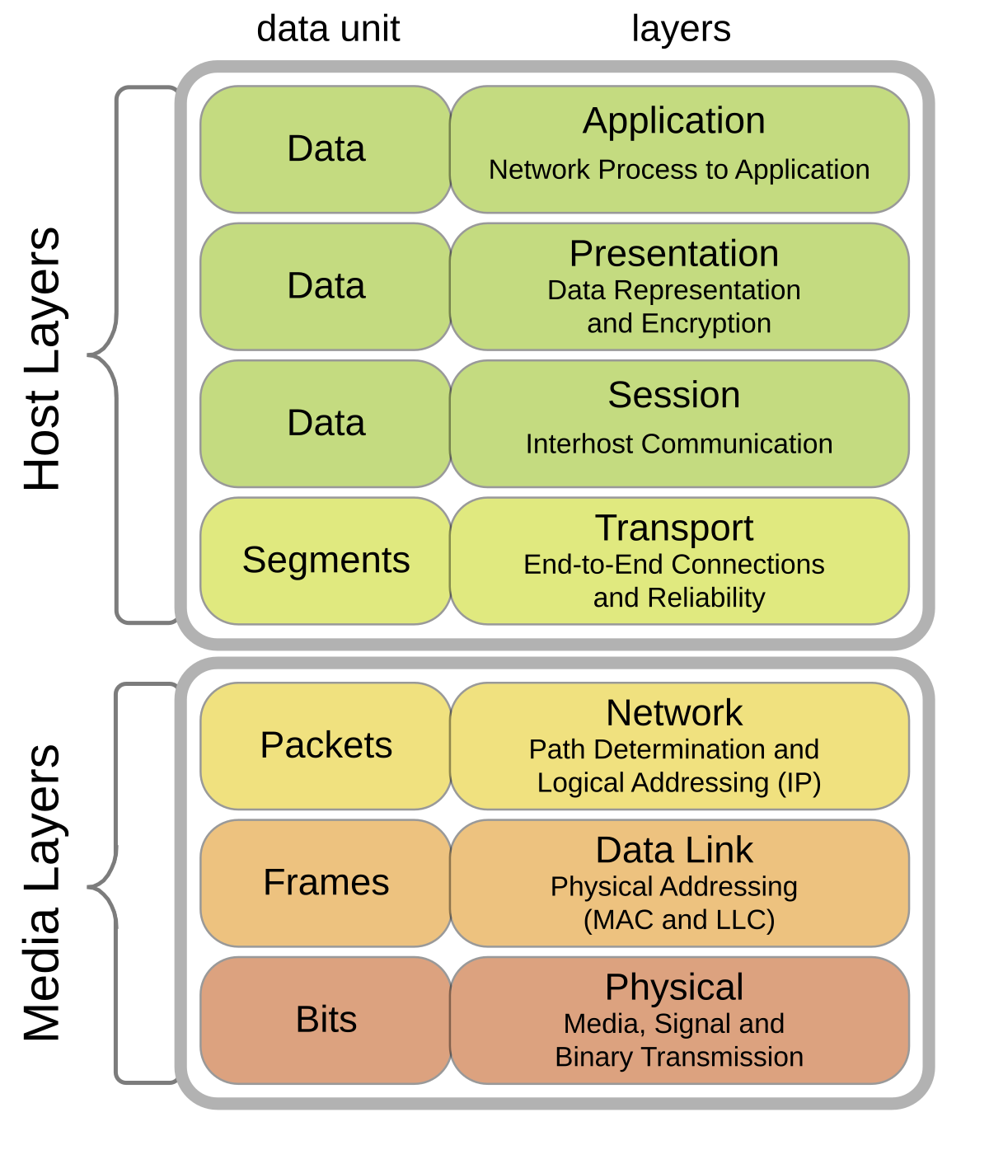
The OSI Model: Seven Layers of Networking
- The Open Systems Interconnection (OSI) model is a conceptual framework that divides network communication into seven distinct layers.
- Each layer has a specific function and communicates with the layers directly above and below it.
- The seven layers are:
7. Application (user-facing software like web browsers and email clients)
6. Presentation (data formatting, encryption, and compression)
5. Session (establishing, managing, and terminating connections)
4. Transport (reliable data delivery, error checking)
3. Network (logical addressing and routing)
2. Data Link (physical addressing and local network access)
1. Physical (raw electrical, optical, or radio signals)
Notes:
INSTRUCTOR NOTES - Detailed Explanation:
The OSI model was developed by the International Organization for Standardization (ISO) in 1984 as a universal reference model for networking. While modern networks do not perfectly map to OSI, it remains the standard teaching framework and the language that network engineers and cybersecurity professionals use to describe where problems and attacks occur.
The model is often remembered using mnemonics. One popular version from top to bottom is: All People Seem To Need Data Processing (Application, Presentation, Session, Transport, Network, Data Link, Physical). Another from bottom to top is: Please Do Not Throw Sausage Pizza Away (Physical, Data Link, Network, Transport, Session, Presentation, Application). Instructors can encourage students to create their own memorable phrases.
Detailed layer descriptions:
- Layer 7 - Application: This is the layer closest to the end user. It includes web browsers, email clients, file transfer programs, and Application Programming Interfaces (APIs). Protocols at this layer include HyperText Transfer Protocol (HTTP), HyperText Transfer Protocol Secure (HTTPS), File Transfer Protocol (FTP), Simple Mail Transfer Protocol (SMTP), and Post Office Protocol version 3 (POP3). Attacks at this layer include SQL injection, cross-site scripting (XSS), and malware delivered through email attachments.
- Layer 6 - Presentation: This layer is responsible for translating data between the application layer and the network. It handles data formatting (for example, converting Extended Binary Coded Decimal Interchange Code (EBCDIC) to ASCII), encryption and decryption, and compression. Transport Layer Security (TLS) and Secure Sockets Layer (SSL) operate here. If encryption fails or certificates are invalid, the presentation layer is where the error manifests.
- Layer 5 - Session: This layer manages sessions - sustained interactions between applications. It establishes, maintains, and terminates connections. For example, when you log into a website, the session layer helps maintain your login state. Session hijacking is an attack where an attacker steals a session token (like a cookie) and impersonates the legitimate user.
- Layer 4 - Transport: This layer ensures reliable end-to-end data delivery. The two most important protocols here are Transmission Control Protocol (TCP) and User Datagram Protocol (UDP). TCP provides reliable, ordered delivery with error checking. UDP provides fast, connectionless delivery without guarantees. Attacks at this layer include SYN flood (a type of Denial of Service, or DoS) and TCP session hijacking.
- Layer 3 - Network: This layer handles logical addressing and routing. The Internet Protocol (IP) operates here. It is responsible for getting packets from source to destination across multiple networks. Devices at this layer are routers. Attacks include IP spoofing (sending packets with a fake source address) and routing table poisoning.
- Layer 2 - Data Link: This layer handles physical addressing using Media Access Control (MAC) addresses, and it manages access to the physical network medium. Devices at this layer are switches and network interface cards (NICs). Attacks include ARP (Address Resolution Protocol) spoofing and MAC flooding.
- Layer 1 - Physical: This is the hardware layer. It includes cables, fiber optics, radio waves, hubs, and repeaters. Attacks include wiretapping, cutting cables, and jamming wireless signals.
Abbreviations defined:
- OSI = Open Systems Interconnection
- ISO = International Organization for Standardization
- API = Application Programming Interface
- HTTP = HyperText Transfer Protocol
- HTTPS = HyperText Transfer Protocol Secure
- FTP = File Transfer Protocol
- SMTP = Simple Mail Transfer Protocol
- POP3 = Post Office Protocol version 3
- SQL = Structured Query Language
- XSS = Cross-Site Scripting
- EBCDIC = Extended Binary Coded Decimal Interchange Code
- ASCII = American Standard Code for Information Interchange
- TLS = Transport Layer Security
- SSL = Secure Sockets Layer
- TCP = Transmission Control Protocol
- UDP = User Datagram Protocol
- DoS = Denial of Service
- IP = Internet Protocol
- MAC = Media Access Control
- NIC = Network Interface Card
- ARP = Address Resolution Protocol

Slide 4
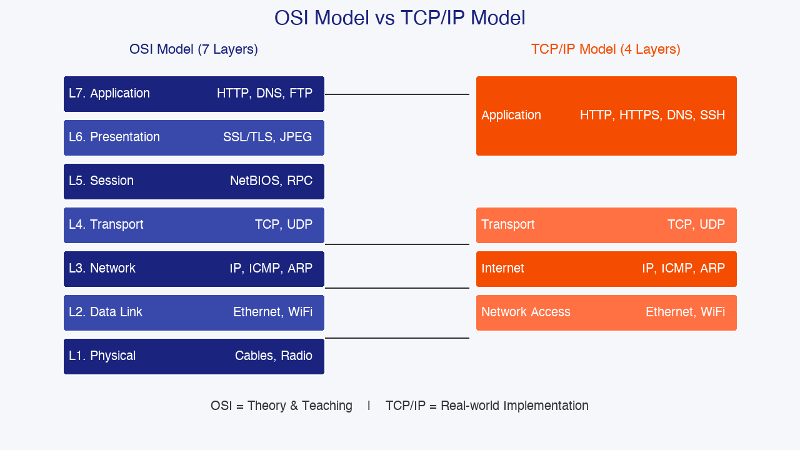
The TCP/IP Model
- The TCP/IP model is the practical framework used by the internet and most modern networks.
- It combines some OSI layers into four layers:
4. Application (combines OSI Application, Presentation, and Session)
3. Transport (same as OSI Transport - TCP and UDP)
2. Internet (same as OSI Network - IP addressing and routing)
1. Network Access (combines OSI Data Link and Physical)
- TCP/IP was developed by the United States Department of Defense and is the foundation of the internet.
- While OSI is a teaching model, TCP/IP is the implementation model.
Notes:
INSTRUCTOR NOTES - Detailed Explanation:
The TCP/IP model predates the OSI model. It was developed in the 1970s by the United States Department of Defense (DoD) Advanced Research Projects Agency (DARPA) as part of the ARPANET project - the precursor to the modern internet. Because TCP/IP was built for real-world use rather than theoretical perfection, it is simpler and more practical than OSI.
Layer 4 - Application: In the TCP/IP model, this single layer covers everything that the OSI model splits into Application, Presentation, and Session. Protocols like HTTP, HTTPS, FTP, SMTP, and Domain Name System (DNS) all live here. When a web browser requests a page, it uses HTTP at the application layer. When an email client sends a message, it uses SMTP. When you type a domain name like google.com into your browser, DNS resolves it to an IP address at this layer.
Layer 3 - Transport: This layer is nearly identical to OSI Layer 4. TCP is the workhorse of the internet. It breaks data into segments, numbers them, sends them across the network, and reassembles them in the correct order at the destination. It also handles error checking and retransmission of lost segments. UDP is a simpler, faster alternative used by applications that prioritize speed over reliability, such as online gaming, live video streaming, and DNS queries.
Layer 2 - Internet: This layer corresponds to OSI Layer 3 (Network). The Internet Protocol (IP) is responsible for logical addressing and routing. Every device on a TCP/IP network has an IP address. IPv4 addresses are 32 bits long and are written in dotted-decimal notation (for example, 192.168.1.50). IPv6 addresses are 128 bits long and are written in hexadecimal (for example, 2001:0DB8:85A3::8A2E:0370:7334). Routing protocols like Open Shortest Path First (OSPF) and Border Gateway Protocol (BGP) operate at this layer, determining the best path for packets to travel across the internet.
Layer 1 - Network Access: This layer combines OSI Layers 1 and 2. It handles everything related to putting data onto the physical medium - whether that is an Ethernet cable, a fiber optic line, or a Wi-Fi radio signal. Ethernet frames, MAC addresses, and physical signaling all belong here.
OSI vs TCP/IP in practice: Network engineers and cybersecurity professionals use both models. OSI provides a more detailed conceptual framework, which is excellent for learning and troubleshooting. TCP/IP reflects how the internet actually works. When analyzing a network problem, you might ask: 'Is this a Layer 2 issue (Data Link), a Layer 3 issue (Network), or a Layer 7 issue (Application)?' This layered language is universal in the industry.
Abbreviations defined:
- DoD = Department of Defense
- DARPA = Defense Advanced Research Projects Agency
- ARPANET = Advanced Research Projects Agency Network
- HTTP = HyperText Transfer Protocol
- HTTPS = HyperText Transfer Protocol Secure
- FTP = File Transfer Protocol
- SMTP = Simple Mail Transfer Protocol
- DNS = Domain Name System
- TCP = Transmission Control Protocol
- UDP = User Datagram Protocol
- IP = Internet Protocol
- IPv4 = Internet Protocol version 4
- IPv6 = Internet Protocol version 6
- OSPF = Open Shortest Path First
- BGP = Border Gateway Protocol
- MAC = Media Access Control

Slide 5
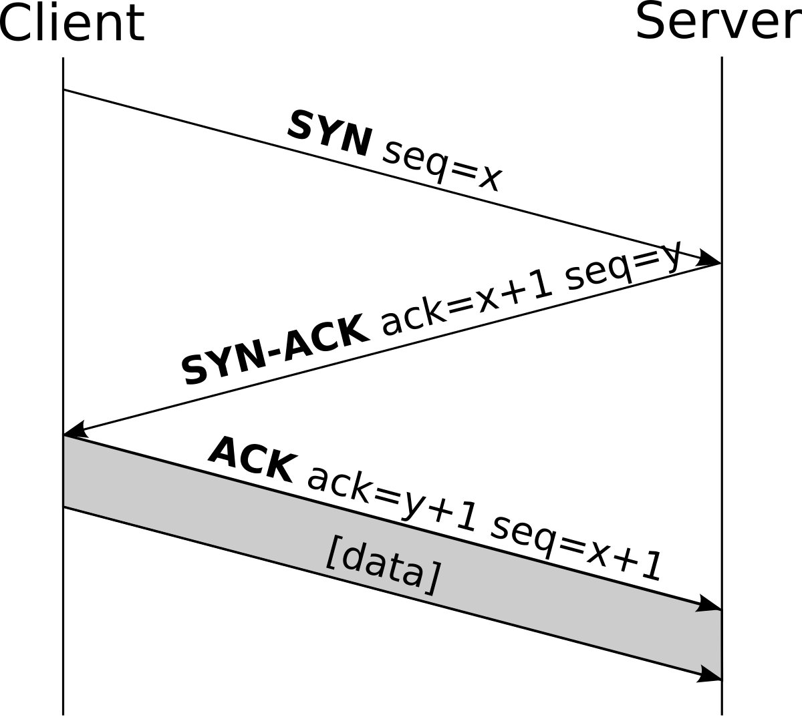
How TCP Works: The Three-Way Handshake
- TCP is a connection-oriented protocol. Before data is sent, the sender and receiver must establish a connection using a three-way handshake.
- Step 1 - SYN (Synchronize): The client sends a SYN packet to the server, requesting to open a connection.
- Step 2 - SYN-ACK (Synchronize-Acknowledge): The server responds with a SYN-ACK packet, acknowledging the request and sending its own synchronization message.
- Step 3 - ACK (Acknowledge): The client sends an ACK packet back to the server. The connection is now established, and data transfer can begin.
- This handshake ensures both sides are ready to communicate and agree on initial sequence numbers.
Notes:
INSTRUCTOR NOTES - Detailed Explanation:
The TCP three-way handshake is one of the most important concepts in networking. It is the foundation of reliable internet communication, and it is also the target of one of the most common network attacks: the SYN flood.
Why a handshake is needed: Unlike UDP, which simply sends data without checking whether the recipient is ready, TCP ensures that both the client and server are alive, reachable, and ready to exchange data. The handshake also synchronizes sequence numbers - unique numbers assigned to each byte of data so the receiver can reassemble packets in the correct order and detect missing segments.
Detailed handshake walkthrough:
1. SYN: The client chooses a random initial sequence number (let's call it 1000) and sends a TCP packet with the SYN flag set to the server's IP address and port. This says, 'I want to start a conversation, and my starting number is 1000.'
2. SYN-ACK: The server receives the SYN, allocates resources for the connection (creating a data structure in memory called a Transmission Control Block), chooses its own random initial sequence number (let's say 5000), and sends back a packet with both the SYN and ACK flags set. The acknowledgment number is 1001, which means 'I received your SYN, and I expect your next packet to start at 1001.'
3. ACK: The client receives the SYN-ACK, sends an ACK packet with acknowledgment number 5001 (acknowledging the server's SYN), and the connection is officially established. Now both sides can send data.
TCP flags: TCP packets contain several flags that control the connection state. The key flags are:
- SYN (Synchronize): Initiates a connection.
- ACK (Acknowledge): Confirms receipt of data.
- FIN (Finish): Gracefully terminates a connection.
- RST (Reset): Abruptly terminates a connection, often used when a port is closed or something goes wrong.
- PSH (Push): Asks the receiver to pass data to the application immediately.
- URG (Urgent): Indicates that the data should be processed urgently.
The SYN flood attack: An attacker sends a flood of SYN packets to a server, often using spoofed (fake) source IP addresses. The server responds with SYN-ACK packets and allocates resources for each half-open connection. However, because the source addresses are fake, the final ACK packets never arrive. The server's connection table fills up with half-open connections, leaving no room for legitimate users. This is a classic Denial of Service (DoS) attack. Defenses include SYN cookies (a technique where the server avoids allocating resources until the handshake is complete) and rate limiting.
Abbreviations defined:
- TCP = Transmission Control Protocol
- UDP = User Datagram Protocol
- SYN = Synchronize
- ACK = Acknowledge
- FIN = Finish
- RST = Reset
- PSH = Push
- URG = Urgent
- IP = Internet Protocol
- DoS = Denial of Service

Slide 6
IP Addressing and Subnetting
- An IP address is a unique identifier assigned to every device on a network.
- IPv4 addresses are 32 bits long, divided into four octets (bytes) separated by dots. Example: 192.168.1.50.
- IPv6 addresses are 128 bits long, written in hexadecimal. Example: 2001:0DB8:85A3::8A2E:0370:7334.
- Private IP ranges (used inside organizations) include:
+ 10.0.0.0 to 10.255.255.255
+ 172.16.0.0 to 172.31.255.255
+ 192.168.0.0 to 192.168.255.255
- A subnet mask defines which part of an IP address is the network portion and which part is the host portion.
- The Classless Inter-Domain Routing (CIDR) notation, such as /24, indicates how many bits are used for the network portion.
Notes:
INSTRUCTOR NOTES - Detailed Explanation:
IP addressing is the foundation of routing. Without unique addresses, devices would not know where to send data.
IPv4 structure: An IPv4 address is a 32-bit number. Because humans struggle to read long binary strings, it is written in dotted-decimal notation - four numbers between 0 and 255 separated by dots. Each number represents one byte (8 bits). For example, 192.168.1.50 in binary is 11000000.10101000.00000001.00110010.
IPv6: Because the world was running out of IPv4 addresses (there are only about 4.3 billion possible IPv4 addresses), IPv6 was developed with 128-bit addresses, providing approximately 340 undecillion (3.4 x 10^38) unique addresses. IPv6 addresses are written in hexadecimal, grouped into eight blocks of four hex digits separated by colons. Leading zeros in each block can be omitted, and consecutive blocks of zeros can be replaced with a double colon (::) once per address. For example, 2001:0DB8:0000:0000:0000:0000:1428:57AB can be shortened to 2001:DB8::1428:57AB.
Private IP addresses: Not every device on the internet needs a globally unique IP address. Private IP ranges are reserved for use inside organizations, and Network Address Translation (NAT) allows many private devices to share a single public IP address. The three private IPv4 ranges are:
- 10.0.0.0 /8 (10.0.0.0 to 10.255.255.255)
- 172.16.0.0 /12 (172.16.0.0 to 172.31.255.255)
- 192.168.0.0 /16 (192.168.0.0 to 192.168.255.255)
If you check the IP address of your home router or office computer, it will almost certainly be in one of these ranges.
Subnetting: A subnet mask separates the network portion of an IP address from the host portion. For example, a subnet mask of 255.255.255.0 means the first three octets identify the network, and the last octet identifies the specific host. In CIDR notation, this is written as /24 because the first 24 bits are the network portion. A /24 network can have up to 256 IP addresses (0 to 255), but two are reserved: the network address (x.x.x.0) and the broadcast address (x.x.x.255). So a /24 provides 254 usable host addresses.
Security implications of subnetting: Network segmentation is a critical security practice. By dividing a large network into smaller subnets, organizations can isolate sensitive systems. For example, the finance department might be on subnet 192.168.10.0/24, while guest Wi-Fi users are on 192.168.50.0/24. Firewalls can enforce rules that prevent guest users from accessing the finance subnet. This limits the 'blast radius' if one part of the network is compromised.
Abbreviations defined:
- IP = Internet Protocol
- IPv4 = Internet Protocol version 4
- IPv6 = Internet Protocol version 6
- CIDR = Classless Inter-Domain Routing
- NAT = Network Address Translation

Slide 7
Network Devices and Their Security Roles
- Network Interface Card (NIC): A hardware component that connects a computer to a network. Every NIC has a unique Media Access Control (MAC) address burned into it at the factory.
- Switch: A Layer 2 device that forwards data frames to specific devices within a LAN based on MAC addresses. A managed switch supports security features like Virtual LANs (VLANs) and port security.
- Router: A Layer 3 device that forwards packets between different networks based on IP addresses. Routers use routing tables and protocols to determine the best path.
- Firewall: A security device that monitors and controls incoming and outgoing network traffic based on predefined rules. It can operate at multiple OSI layers.
- Access Point (AP): A device that allows wireless devices to connect to a wired network.
Notes:
INSTRUCTOR NOTES - Detailed Explanation:
Understanding network devices is essential for both designing secure networks and investigating incidents. Each device has specific capabilities and vulnerabilities.
Network Interface Card (NIC): Every networked computer, smartphone, printer, and IoT device has at least one NIC. Each NIC has a globally unique MAC address assigned by the manufacturer. The MAC address is 48 bits long and is typically written as six pairs of hex digits separated by colons or hyphens, like 00:1A:2B:3C:4D:5E. The first three pairs (the Organizationally Unique Identifier, or OUI) identify the manufacturer. For example, addresses starting with 00:50:56 belong to VMware. MAC addresses are used for communication within a local network (Layer 2). MAC spoofing is an attack where a device changes its MAC address to impersonate another device, often to bypass MAC filtering or to hide the attacker's identity.
Switch: A switch is smarter than an older network device called a hub. A hub broadcasts all incoming data to every connected device, which creates a major security risk - any computer on the hub can see all traffic. A switch, by contrast, learns which MAC addresses are connected to which ports and forwards frames only to the intended recipient. This is much more secure, but it is not perfect. Attackers can use ARP spoofing to trick the switch into sending traffic to the wrong port. Managed switches offer advanced security features like VLANs (which create separate logical networks on the same physical switch) and port security (which limits which MAC addresses can connect to each port).
Router: Routers are the traffic directors of the internet. They examine the destination IP address of each packet and forward it toward its destination using routing tables. Routers can connect different types of networks (for example, a LAN to a WAN, or Ethernet to Wi-Fi). Home routers combine multiple functions: routing, Network Address Translation (NAT), Dynamic Host Configuration Protocol (DHCP), and sometimes firewalling. A misconfigured router - for example, one with default passwords still in place - is a common entry point for attackers. The 2016 Mirai botnet infected hundreds of thousands of routers and IoT devices by trying a short list of default passwords.
Firewall: Firewalls are the primary perimeter defense for networks. They inspect traffic and allow or block it based on rules. Traditional firewalls operate at Layers 3 and 4, filtering by IP address and port number. Next-Generation Firewalls (NGFWs) can inspect traffic at the application layer (Layer 7), detecting malware hidden inside allowed protocols. Firewalls can be hardware appliances or software programs (like the built-in Windows Firewall or Linux iptables). A poorly configured firewall - one with overly permissive rules - provides a false sense of security.
Access Point (AP): An AP bridges wireless clients to a wired LAN. Modern enterprise APs support strong encryption (WPA2/WPA3), multiple SSIDs (network names), and client isolation (preventing wireless clients from communicating directly with each other). Rogue access points - unauthorized APs placed on a network by attackers or careless employees - are a serious security threat because they can provide an unmonitored backdoor into the LAN.
Abbreviations defined:
- NIC = Network Interface Card
- MAC = Media Access Control
- IoT = Internet of Things
- OUI = Organizationally Unique Identifier
- ARP = Address Resolution Protocol
- VLAN = Virtual Local Area Network
- NAT = Network Address Translation
- DHCP = Dynamic Host Configuration Protocol
- NGFW = Next-Generation Firewall
- WPA2 = Wi-Fi Protected Access 2
- WPA3 = Wi-Fi Protected Access 3
- SSID = Service Set Identifier
- LAN = Local Area Network
- IoT = Internet of Things

Slide 8
Network Protocols and Port Numbers
- A protocol is a set of rules that define how devices communicate.
- A port number is a 16-bit identifier that tells the operating system which application should receive incoming data.
- Well-known ports (0 to 1023) are reserved for standard services and require administrator privileges on most systems.
- Common well-known ports include:
+ Port 20/21: File Transfer Protocol (FTP)
+ Port 22: Secure Shell (SSH)
+ Port 25: Simple Mail Transfer Protocol (SMTP)
+ Port 53: Domain Name System (DNS)
+ Port 80: HyperText Transfer Protocol (HTTP)
+ Port 110: Post Office Protocol version 3 (POP3)
+ Port 143: Internet Message Access Protocol (IMAP)
+ Port 443: HyperText Transfer Protocol Secure (HTTPS)
+ Port 3389: Remote Desktop Protocol (RDP)
Notes:
INSTRUCTOR NOTES - Detailed Explanation:
Protocols and ports are the vocabulary of network communication. Every service running on a server listens on a specific port, waiting for incoming connections. Understanding which ports are used by which services is essential for configuring firewalls, diagnosing connectivity issues, and identifying malicious activity.
How ports work: When a client wants to connect to a server, it sends a packet to the server's IP address and port number. The operating system on the server checks the port number and delivers the data to the correct application. For example, when you visit a website, your browser sends a request to the web server's IP address on port 80 (for HTTP) or port 443 (for HTTPS). The web server software (like Apache, Nginx, or Microsoft Internet Information Services) is listening on that port and responds with the requested web page.
Port ranges:
- Well-known ports: 0 to 1023. Reserved by the Internet Assigned Numbers Authority (IANA) for standard services. On Linux and Unix systems, only the root user can open a well-known port.
- Registered ports: 1024 to 49151. Used by vendors for proprietary applications. Examples include port 3306 (MySQL database), port 5432 (PostgreSQL), and port 8080 (alternate HTTP).
- Dynamic/Private ports: 49152 to 65535. Used temporarily by client applications for outbound connections. When your browser connects to a web server, it uses a high-numbered dynamic port on your computer as the source port.
Detailed protocol and port descriptions:
- FTP (Ports 20 and 21): File Transfer Protocol is used for transferring files between computers. Port 21 is for control commands, and port 20 is for data transfer. FTP sends passwords in plain text, making it insecure. Secure alternatives include SFTP (SSH File Transfer Protocol) and FTPS (FTP over SSL/TLS).
- SSH (Port 22): Secure Shell provides encrypted remote access to servers and network devices. It is the standard remote management protocol for Linux and Unix systems. Attackers constantly scan the internet for open port 22 and attempt brute-force password attacks. Best practices include disabling password authentication in favor of SSH key pairs, changing the default port, and using fail2ban to block repeated failed attempts.
- SMTP (Port 25): Simple Mail Transfer Protocol is used for sending email between mail servers. It is also used by email clients to send outgoing mail. Like FTP, traditional SMTP does not encrypt traffic. Modern implementations use STARTTLS to upgrade to encrypted connections.
- DNS (Port 53): The Domain Name System translates human-readable domain names (like google.com) into IP addresses. It uses UDP for most queries and TCP for zone transfers. DNS is a frequent attack target. DNS spoofing (also called DNS cache poisoning) redirects users to malicious websites. DNS tunneling encodes data in DNS queries to bypass firewalls.
- HTTP (Port 80): HyperText Transfer Protocol is the foundation of the World Wide Web. It is unencrypted, meaning anyone who intercepts the traffic can read the contents. For this reason, modern websites redirect HTTP traffic to HTTPS.
- POP3 (Port 110): Post Office Protocol version 3 is used by email clients to download messages from a mail server. It typically downloads emails to the local device and deletes them from the server. POP3S (POP3 Secure) uses port 995 and encrypts the connection with SSL/TLS.
- IMAP (Port 143): Internet Message Access Protocol is another email retrieval protocol. Unlike POP3, IMAP leaves messages on the server and synchronizes them across multiple devices. IMAPS (IMAP Secure) uses port 993.
- HTTPS (Port 443): HyperText Transfer Protocol Secure is the encrypted version of HTTP. It uses Transport Layer Security (TLS) to encrypt data between the browser and the web server. HTTPS is essential for protecting passwords, credit card numbers, and personal information. Modern browsers warn users if a website does not use HTTPS.
- RDP (Port 3389): Remote Desktop Protocol is Microsoft's protocol for remote graphical access to Windows computers. Like SSH, it is a common target for brute-force attacks. The 2017 WannaCry ransomware spread partly by exploiting a vulnerability in the Server Message Block (SMB) protocol, but RDP is also frequently attacked directly. Best practices include placing RDP behind a VPN, using Network Level Authentication (NLA), and restricting access by IP address.
Abbreviations defined:
- IANA = Internet Assigned Numbers Authority
- HTTP = HyperText Transfer Protocol
- HTTPS = HyperText Transfer Protocol Secure
- FTP = File Transfer Protocol
- SSH = Secure Shell
- SMTP = Simple Mail Transfer Protocol
- DNS = Domain Name System
- POP3 = Post Office Protocol version 3
- IMAP = Internet Message Access Protocol
- TLS = Transport Layer Security
- SSL = Secure Sockets Layer
- RDP = Remote Desktop Protocol
- SMB = Server Message Block
- NLA = Network Level Authentication
- VPN = Virtual Private Network
- SQL = Structured Query Language
- UDP = User Datagram Protocol
- TCP = Transmission Control Protocol

Slide 9
Network Security Threats by OSI Layer
- Network attacks can target any layer of the OSI model. Defenders must understand each layer's vulnerabilities.
Layer 1 (Physical): Wiretapping, cable cutting, electromagnetic interference, device theft.
Layer 2 (Data Link): ARP spoofing, MAC flooding, unauthorized switch access.
Layer 3 (Network): IP spoofing, ICMP (Internet Control Message Protocol) redirection, routing attacks.
Layer 4 (Transport): SYN flood, TCP reset attacks, session hijacking.
Layer 5 (Session): Session hijacking and fixation.
Layer 6 (Presentation): Weak or misconfigured encryption (SSL stripping).
Layer 7 (Application): SQL injection, cross-site scripting (XSS), malware, phishing.
Notes:
INSTRUCTOR NOTES - Detailed Explanation:
Understanding attacks by OSI layer is a core skill for cybersecurity professionals. It helps defenders choose the right countermeasures and speak the common language of the industry.
Layer 1 - Physical attacks: These are often overlooked because they seem low-tech, but they can be devastating. Wiretapping involves physically connecting to a network cable to intercept data. Although modern networks use switches rather than hubs, specialized tools can still extract useful information from cables. Cable cutting is a Denial of Service (DoS) attack that physically disrupts connectivity. Electromagnetic interference can disrupt wireless signals. Finally, device theft - stealing a laptop, server, or backup tape - gives an attacker direct access to the data stored on it. This is why full disk encryption and physical security controls (locks, guards, surveillance cameras) are essential.
Layer 2 - Data Link attacks:
- ARP Spoofing (ARP Poisoning): The attacker sends fake Address Resolution Protocol (ARP) messages onto the LAN, associating their own MAC address with the IP address of another device (like the default gateway). Other devices on the network then send traffic intended for the gateway to the attacker instead. The attacker can intercept, inspect, or modify the traffic before forwarding it. This is a man-in-the-middle (MitM) attack.
- MAC Flooding: The attacker sends a massive number of frames with fake source MAC addresses to a network switch. The switch's MAC address table overflows, causing it to fail open and broadcast all traffic to every port - effectively turning the switch into a hub. The attacker can then capture traffic from all devices on the switch. Defenses include enabling port security on managed switches, which limits the number of MAC addresses per port.
Layer 3 - Network attacks:
- IP Spoofing: The attacker crafts packets with a false source IP address. This is commonly used in Denial of Service attacks to hide the attacker's identity and to bypass IP-based access controls.
- ICMP Redirection: An attacker sends fake Internet Control Message Protocol (ICMP) redirect messages to a host, telling it to send traffic through a router controlled by the attacker.
- Routing Attacks: Attackers compromise routers or manipulate routing protocols to redirect traffic through their systems. Border Gateway Protocol (BGP) hijacking is a sophisticated attack where an attacker advertises false IP address ranges, causing internet traffic to be routed through their network.
Layer 4 - Transport attacks:
- SYN Flood: As described earlier, the attacker overwhelms a server with half-open TCP connections, exhausting resources.
- TCP Reset Attack: An attacker injects forged TCP RST (reset) packets into a connection, causing it to terminate abruptly. This was used by some internet service providers to block peer-to-peer file sharing.
- Session Hijacking: After a TCP connection is established, an attacker guesses or steals sequence numbers and injects malicious packets into the session, impersonating one of the parties.
Layer 5 - Session attacks: Session hijacking and session fixation are attacks against the session management mechanisms of web applications. In session hijacking, the attacker steals a session cookie or token and uses it to impersonate the user. In session fixation, the attacker tricks the user into using a session ID that the attacker already knows.
Layer 6 - Presentation attacks: Weak encryption or misconfigured Transport Layer Security (TLS) settings allow attackers to intercept and decrypt traffic. SSL stripping is an attack where an attacker downgrades an HTTPS connection to HTTP, removing encryption. Tools like SSLstrip automate this process on open Wi-Fi networks.
Layer 7 - Application attacks: This is where the majority of cyberattacks occur because applications are complex and often poorly coded. Common attacks include:
- SQL Injection: Inserting malicious SQL commands into input fields to steal or manipulate database contents.
- Cross-Site Scripting (XSS): Injecting malicious scripts into web pages viewed by other users.
- Malware Delivery: Trick users into downloading and executing malicious files.
- Phishing: Deceptive emails or websites designed to steal credentials.
Abbreviations defined:
- OSI = Open Systems Interconnection
- ARP = Address Resolution Protocol
- MAC = Media Access Control
- IP = Internet Protocol
- ICMP = Internet Control Message Protocol
- BGP = Border Gateway Protocol
- TCP = Transmission Control Protocol
- RST = Reset
- TLS = Transport Layer Security
- SSL = Secure Sockets Layer
- HTTPS = HyperText Transfer Protocol Secure
- HTTP = HyperText Transfer Protocol
- SQL = Structured Query Language
- XSS = Cross-Site Scripting
- MitM = Man-in-the-Middle
- DoS = Denial of Service
- LAN = Local Area Network

Slide 10
Topic 5 Summary: Key Takeaways
- Networks connect devices over distances ranging from personal space (PAN) to the entire world (WAN / internet).
- The OSI model divides networking into seven conceptual layers. The TCP/IP model compresses these into four practical layers.
- TCP uses a three-way handshake (SYN, SYN-ACK, ACK) to establish reliable connections. This handshake is the target of SYN flood attacks.
- IP addresses uniquely identify devices. IPv4 uses 32-bit dotted-decimal notation. IPv6 uses 128-bit hexadecimal notation.
- Network devices include NICs, switches, routers, firewalls, and access points. Each has specific security capabilities and vulnerabilities.
- Protocols use port numbers to deliver data to the correct application. Well-known ports include 22 (SSH), 80 (HTTP), and 443 (HTTPS).
- Attackers target every OSI layer, from physical wiretapping to application-layer SQL injection. Defense requires layered security.
Notes:
INSTRUCTOR NOTES - Detailed Explanation:
Topic 5 provides the networking foundation that every cybersecurity professional needs. Without understanding how packets move, how addresses work, and where attacks occur, it is impossible to design effective defenses or investigate incidents.
The concept of 'defense in depth' is directly tied to the OSI model. No single security control can protect against all threats. A secure network uses multiple layers of defense:
- Physical security (locks, cameras) protects Layer 1.
- Port security and VLANs protect Layer 2.
- Firewalls and intrusion detection systems protect Layers 3 and 4.
- Encryption (TLS, VPNs) protects Layers 5 and 6.
- Web application firewalls, secure coding, and user awareness protect Layer 7.
For the practical assessment, students should be able to identify common network devices, explain the TCP three-way handshake, convert simple binary and decimal numbers, list well-known ports and their services, and describe at least one attack for each of the lower OSI layers (1-4). A hands-on lab using Wireshark to capture and inspect network packets is an excellent complement to this topic.

