Slide 1
The use of McIntosh Sunspot Classifications for Solar Flare Prediction
Craig M. Lennon
Data Science Final Project
General Assembly, Washington, DC
3/16/2015

Slide 2
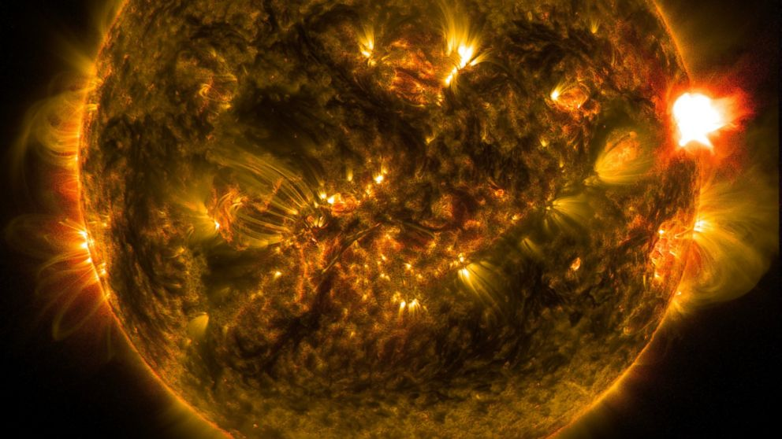
Solar Flares
Solar flares are powerful bursts of radiation from the sun, which release potentially harmful radiation.
Emit radiation across the spectrum.
Ionizing radiation can disrupt radio communication.
Can be associated with coronal mass ejections (CME).
CMEs lead to geomagnetic storms.
Currents induced in high voltage transmission lines and overland pipelines.
The March 1989 blackout.
Is there a feature on the sun that could be used to predict flares?
M Class observed by the NASA Solar Dynamics Observatory on Jan. 12, 2015.
Classification | Peak Flux Range at 0.1-0.8 nm (W/m²)
A | < 10⁻⁷
B | 10⁻⁷ - 10⁻⁶
C | 10⁻⁶ - 10⁻⁵
M | 10⁻⁵ - 10⁻⁴
X | 10⁻⁴ - 10⁻³

Slide 3
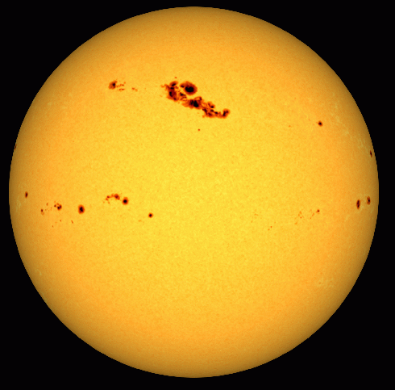
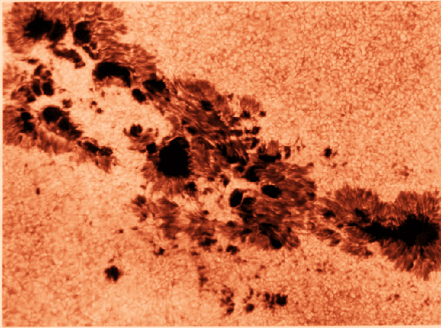
Sunspots
“Cold” regions on the sun’s photosphere.
Intense magnetic fields cool sunspot regions.
Sunspot activity and solar flare events follow a (roughly) 11 year solar cycle.
Referred to by an active region number assigned by NOAA.

Slide 4
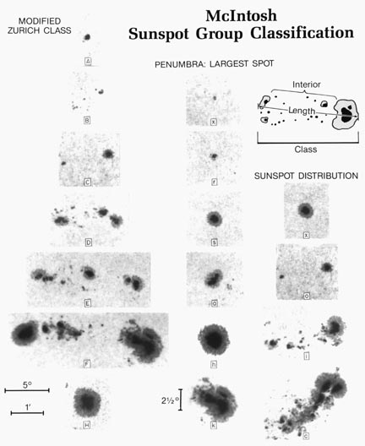
Sunspot Classification
A
Group Type | Penumbra of Largest Spot | Spot Compactness | Number of Types
A | x | x | 1
B | x | o, i | 2
C | r, s, a, h, k | o, i | 10
D, E, F | r | o, i | 6
D, E, F | s, a, h, k | o, i, c | 36
H | r, s, a, h, k | x | 5
B
x
C
r
D
s
x
The sixty allowed types of McIntosh Classifications.
o
E
o
F
h
l
Classifications are assigned manually! Thanks, grad students.
H
c
k
P.S. McIntosh, Sol. Phys. 125, 251 (1990)

Slide 5
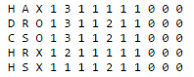
The Data
NOAA active region observations from 8/19/1978 to 12/23/1978 provided by the UCI machine learning repository.
N = 1066, p = 13
Predictor Information:
Code for class (modified Zurich class) (A,B,C,D,E,F,H)
Code for largest spot size (X,R,S,A,H,K)
Code for spot distribution (X,O,I,C)
Activity (1 = reduced, 2 = unchanged)
Evolution (1 = decay, 2 = no growth, 3 = growth)
Previous 24 hour flare activity code (1 = nothing as big as an M1, 2 = one M1, 3 = more activity than one M1)
Historically-complex (1 = Yes, 2 = No)
Did region become historically complex (1 = yes, 2 = no) on this pass across the sun's disk
Area (1 = small, 2 = large) 10.
Area of the largest spot (1 = <=5, 2 = >5) 11.
C-class flares production by this region Number in the following 24 hours (common flares) 12.
M-class flares production by this region Number in the following 24 hours (moderate flares) 13.
X-class flares production by this region Number in the following 24 hours (severe flares)
https://archive.ics.uci.edu/ml/machine-learning-databases/solar-flare/

Slide 6
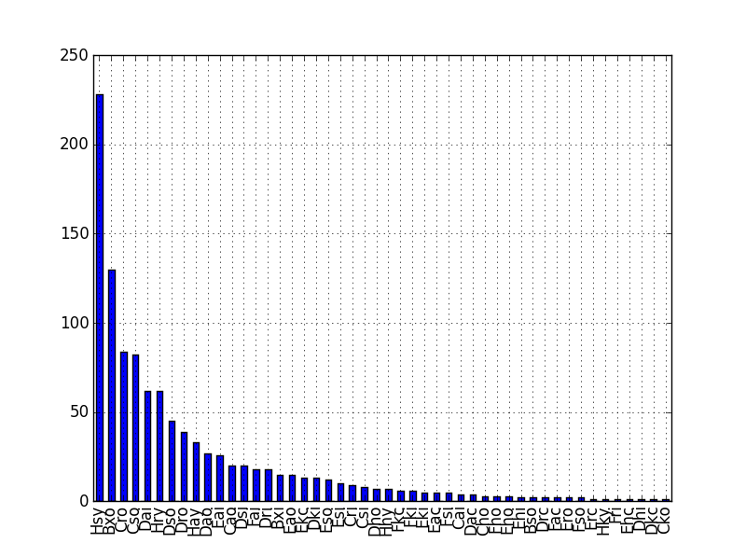
The Data
Most sunspots were benign.
Hsy spots were observed 226 times and only 16 flares were found to be associated.

Slide 7
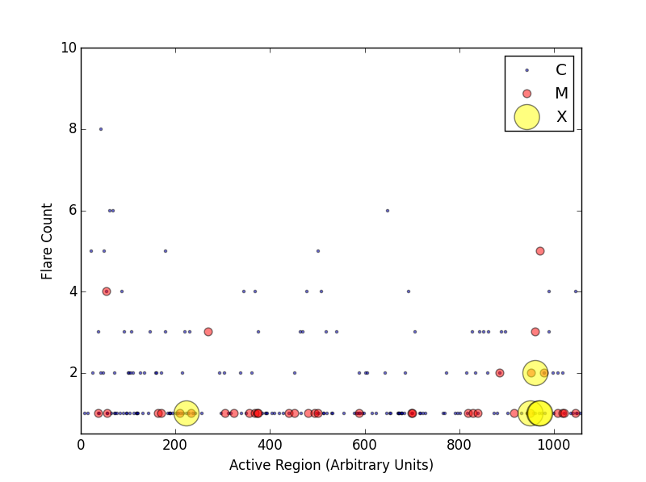
The Data
1066 active regions were observed.
Only 18.85 % of active regions have flares.
The majority of flares were class C.
Only 5 class X flares were recorded.

Slide 8
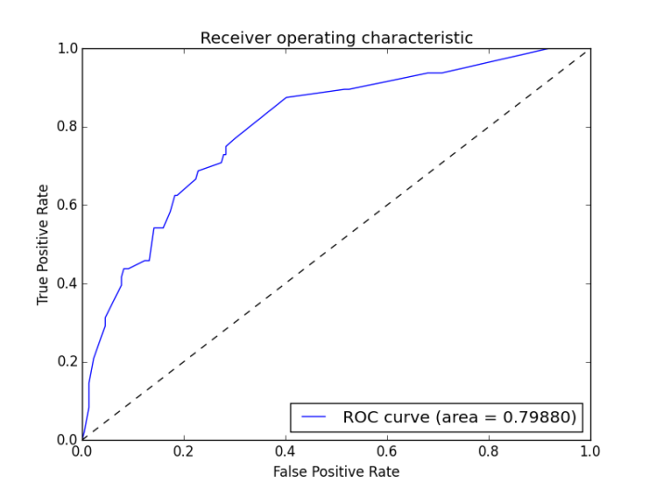
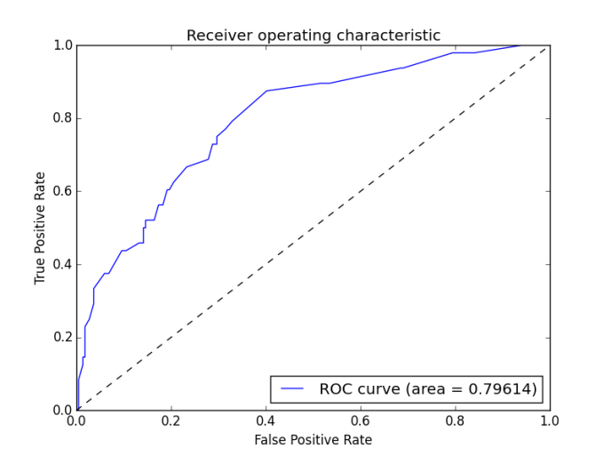
Logistic Regression
Can this data predict if any type of flare will occur?
Created a binary response for each instance (0 = no flare, 1 = at least 1 flare).
Created dummy variables for the McIntosh sunspot classifications. This added 13 feature columns.
Used 10 fold cross validation with ROC AUC and recall (sensitivity) as scoring metrics.
A sensitivity of 0.2799 was achieved using Zpc dummy variables, Activity, Previous 24 hour activity, and historic complexity.
I’m only predicting if a flare will occur correctly 28% of the time! Sorry, Northern latitudes.
Only Zpc dummy variables.
Zpc dummy variables, features 4,6,7

Slide 9
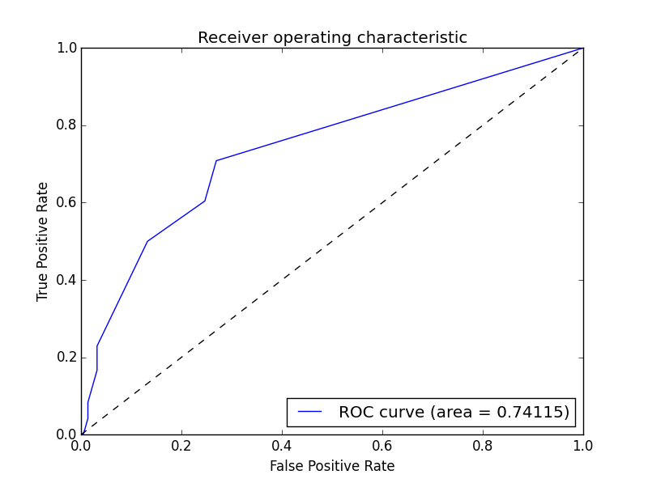
Decision Trees
Due to the binary nature of the response a classification tree model was attempted.
Use 13 dummy variables again.
Tuned the model using tree depth.
4 was “optimal”
Used 10 fold cross validation with ROC AUC and recall (sensitivity) as scoring metrics.
A sensitivity of 0.215 was achieved using the “best” logistic regression predictors.
Flares are only predicted correctly ~22% of the time.
Decision trees were quickly abandoned.
 | No Flare Predicted | Flare Predicted
No Flare Occurred | 216 | 3
Flare Occurred | 45 | 3
Example confusion matrix following a preliminary train test split.

Slide 10
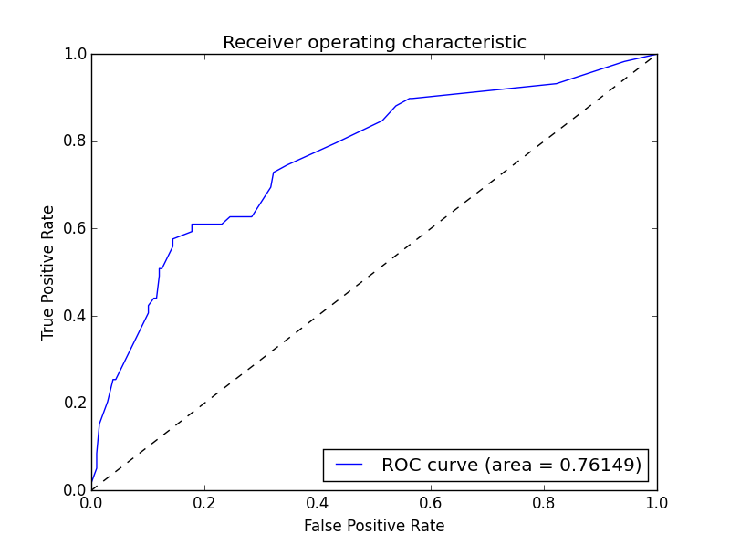
Naïve Bayes
The Naïve Bayes classifier also works well for binary classification.
Ignored all dummy variables.
Created a McIntosh classification column by concatenating Zurich, penumbra, and compactness columns (i.e. Dao).
The McIntosh classifications were used to generated a document term matrix to be used as a predictor.
Used 10 fold cross validation with ROC AUC and recall (sensitivity) as scoring metrics.
False positives increase, but so does sensitivity.
Predicting flares correctly 51.3% of the time. That’s better than a coin flip!
 | No Flare Predicted | Flare Predicted
No Flare Occurred | 83 | 25
Flare Occurred | 29 | 30
Example confusion matrix following a preliminary train test split.

Slide 11
Conclusions and Future Work
Using McIntosh classifications as the sole predictor is probably not the best approach.
The manual assignment of McIntosh classifications leads to inherently flawed models.
Include quantitative predictors in future models.

