Slide 1
I. Quick intro Ii. approach II. challenges iii. Next steps III. Q&A
agenda

Slide 2
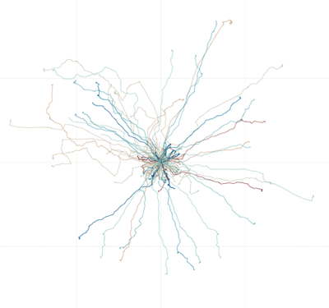


0. Quick intro I. my approach II. My challenges iii. Next steps III. Q&A
agenda
QUICK INTRO
$30,000 prize
1,568 teams
Driver Telematics Analysis
Sponsor: AXA is a French investment banking firm interested in predicting driving characteristics
Competition Basics: Use GPS driving data to model a driver signature for 3000+ drivers, then use signatures to identify fake drives inserted for each driver

Slide 3

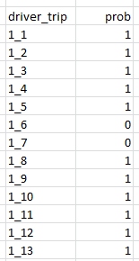

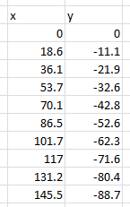
0. Quick intro I. my approach II. My challenges iii. Next steps III. Q&A
agenda
QUICK INTRO (CONT)
Data
Submission
X and Y coordinates every second
Drivers
Drives
Model
Drive
?
3612
total
200
each
Is this actually Driver 2?
~1000
each

Slide 4

0. Quick intro I. my approach II. My challenges iii. Next steps III. Q&A
agenda
Approach
Picking a Model
I have:
Unlabeled data (K-means?)
Large-scale, divided data (something simpler?)
I need:
‘0’ - ‘1’ predictions (Logistic Reg. or Decision Trees?)
Can I force labels?

Slide 5
0. Quick intro I. my approach II. My challenges iii. Next steps III. Q&A
agenda
Approach (CONT)
Creating Features for the Data
Trip Length
Average Trip Speed
Max Trip Speed
Number of turns
Degree of turns
Acceleration
More advanced features…
Running the Model
Loop through each folder to compile features for each driver
Loop through each n+1 driver to grab their features to combine with above driver features
Run logistic regression on train-test split data for that driver to get preds
Run for all drivers to get preds
Combine all driver preds (565k) into one file
Submit file to get AUC accuracy ranking
Adjust model as necessary, resubmit

Slide 6
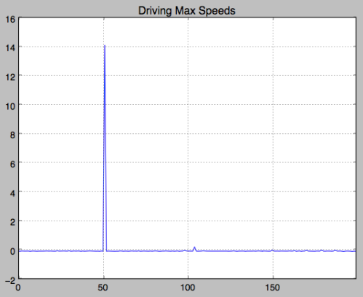
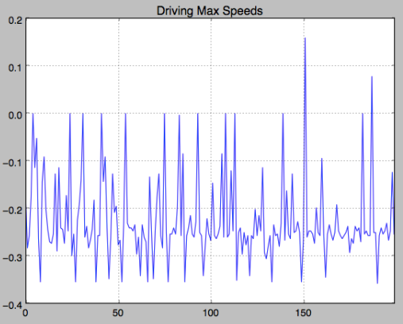
0. Quick intro I. my approach II. My challenges iii. Next steps III. Q&A
agenda
CHALLENGES
Do I want to include outliers?
Or Not?

Slide 7
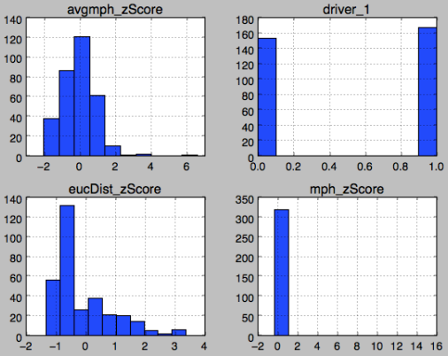
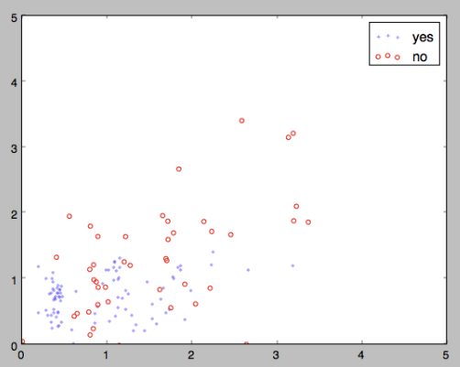
0. Quick intro I. my approach II. My challenges iii. Next steps III. Q&A
agenda
CHALLENGES (CONT)
Features Overview
Overview of Combined Training Set
Is this Driver 1?
Distance Z-Score
Max Speed Z-Score

Slide 8
0. Quick intro I. my approach II. My challenges iii. Next steps III. Q&A
agenda
CHALLENGES (CONT)
Data Structure and Size
Creating looping structures for folders and files was complicated
Running my basic model initially took 20 hours
Introducing more modeling increased this to 30 hours
Competition submissions required exactly 547,201 rows, mine were always coming up short, not easy to figure out why

Slide 9
0. Quick intro I. my approach II. My challenges iii. Next steps III. Q&A
agenda
Next steps
Complete initial entry form and submit
Review the forums after competition is closed to see winning strategies
Keep competing in Kaggle competitions

Slide 10
0. Quick intro I. my approach II. My challenges iii. Next steps III. Q&A
agenda
Q&A

