Slide 1


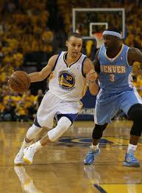
Predicting NBA achievement from inaugural performance
By: Nick Smirnov
August 26th, 2015
GA Data Science 2015

Slide 2
Problem Statement
Can we measure initial performance of a NBA player and use that performance to determine his success and the accent to being an elite NBA player?
My Hypothesis
A player’s performance early in his career will determine his success later in his career. A player who exhibits success within his first 3 seasons is likely to continue his progress into becoming an elite player.

Slide 3
Description of your data set
My data set consist of conventional box-score & advanced NBA player metrics from players since 1978.
Number of players: 2,454
Number of total seasons: 13,849

Slide 4
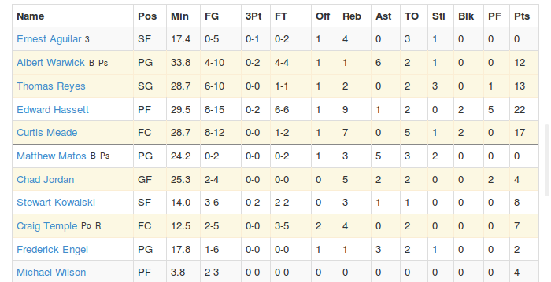
Conventional Statistics:
i.e. Counting Stats

Slide 5

Advanced Statistics:
Stats which can’t be measured easily on the floor

Slide 6
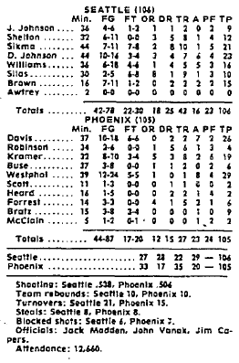
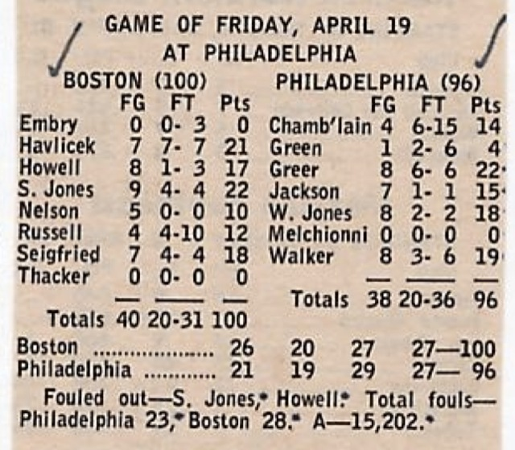
Why 1978?

Slide 7
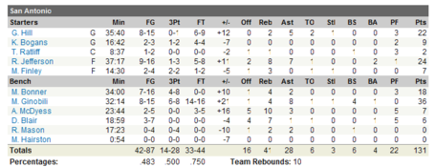
A modern box score

Slide 8

How my data was obtained
Basketball-reference stores data from the every NBA/ABA season (since 1946).
Beautiful Soup was utilized to extract data from each HTML page.
I extracted Debut, Traditional Per Game, and Advanced individual basketball statistics from Basketball-reference.

Slide 9
My Feature Selection choice
I needed to have some kind of singular value for my dependent variable to evaluate player performance.
I decided to use the following two metrics:
WinShares (WS)₁
PER (Player Efficiency Rating)
1: http://www.basketball-reference.com/about/ws.html

Slide 10

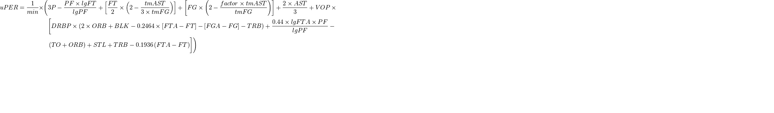



PER: Player Efficiency Rating
PER strives to measure a player’s per-minute performance, while adjust for pace of play₂.
Here’s the formulate to calculate uPER (unweighted PER):
Here’s the formulate to calculate PER after determining uPER:
2: Wikipedia: https://en.wikipedia.org/wiki/Player_efficiency_rating

Slide 11
PER: Player Efficiency Rating
What do the ratings correspond to?
PER | Category
35.0+ | A Year for the Ages
30.0 | Runaway MVP Candidate
27.5 | Strong MVP Candidate
25.0 | Weak MVP Candidate
22.5 | Bona fide All-Star
20.0 | Borderline All-Star
18.0 | Solid 2nd option
16.5 | 3rd Banana
15.0 | Average
13.0 | In Rotation

Slide 12
WS: Win Shares₃
WS = Offensive WS + Defensive WS
Offensive WS = Points produced - 0.92 * (1) * (Offensive possessions)
Defensive WS = (player minutes played / team minutes played) * (team defensive possessions) * (1.08 * (league points per possession) - ((Defensive Rating) / 100))
3: Basketball-reference: http://www.basketball-reference.com/about/ws.html

Slide 13


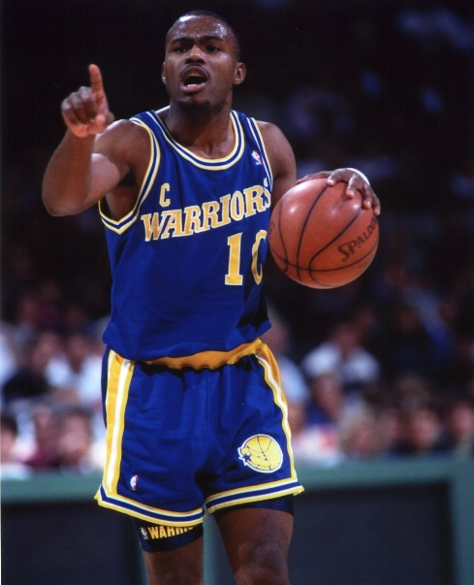

Pre-processing before Analysis
Removing Nulls
Integrating players across multiple seasons
Resolving when different players have the same name
Calculating Experience, Mean PER, and Mean WS

Slide 14
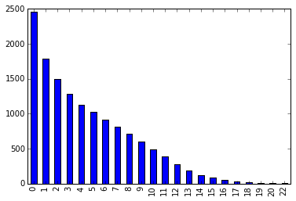
Playing Professional Basketball is hard!!!!
Number of players
Seasons of Experience

Slide 15
My Original Hypothesis
A player’s performance early in his career will determine his success later in his career. A player who exhibits success within his first 3 seasons is likely to continue his progress into becoming an elite player.
My revised Hypothesis
A player’s performance early in his career will determine his success later in his career. A player who exhibits success within his first season is likely to continue his progress into becoming an elite player.

Slide 16
Model selection
The best models that I could think to use are:
Linear regression
Logarithmic regression
Decision Tree
Naïve Bayes

Slide 17
Dimension | Coef
TS% | 24.72
EFG% | 19.61
FGA | 3.10
TRB | 1.43
FT% | 1.40
PTS | 1.23
TRB% | 1.18
Dimension | Pvalues
MP | 6.15E-132
AGE | 6.39E-124
AST | 4.59E-109
PF | 2.91E-47
FT% | 1.52E-45
BLK | 1.52E-38
STL | 7.90E-36
Linear
PER:
MAE | RMSE
2.372 | 3.458
Feature analysis:
Dimension | Coef
FG% | 2.325
x3P | 0.705
STL | 0.668
x2P | 0.641
TRB | 0.610
TRB | 0.517
Dimension | Pvalues
age | 0.00E+00
ast | 1.52E-163
tov | 3.94E-74
stl | 3.71E-47
pf | 1.04E-41
blk | 1.37E-39
WS:
MAE | RMSE
1.001 | 1.363
Feature analysis:

Slide 18
Logistic
 | Predicted: No | Predicted: Yes
Actual: No | 598 | 1
Actual: Yes | 12 | 3
PER:
2.8% of population qualified
WS:
3.3% of population qualified
 | Predicted: No | Predicted: Yes
Actual: No | 592 | 5
Actual: Yes | 12 | 5

Slide 19
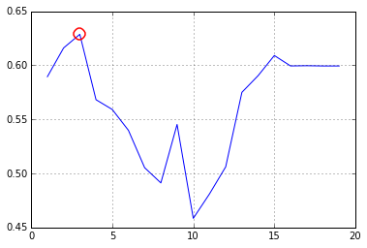
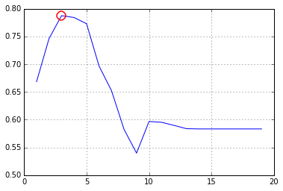
Decision Tree
Dimension | Coef
FT | 0.492
TS% | 0.268
BLK% | 0.239
PER:
WS:
Dimension | Coef
G | 0.138
MP | 0.264
TRB | 0. 598

Slide 20
Model Cross Validation
Model | Accuracy | ROC_AUC | Specific* | Sensitive*
Log | 97.6% | 0.90 | 99.8% | 20%
Decision Tree | 96.6% | 0.62 | 97.5 | 0
Naïve Bayes | 86.8% | 0.77 | N/A | N/A
KNN | 97.2% | 0.67 | N/A | N/A
PER:
Model | Accuracy | ROC_AUC | Specific* | Sensitive*
Log | 96.7% | 0.92 | 99.1% | 29.4%
Decision Tree | 96.6% | 0.73 | 97.5 | 25%
Modified Tree | 96.3% | 0.86 | N/A | N/A
Naïve Bayes | 82.1% | 0.88 | N/A | N/A
KNN | 96.5 | 0.73 | N/A | N/A
WS:

Slide 21
Challenges:
Reduced group of players
Dealing with similarly named players
Calculating PER, mean WS, and mean PER
Extremely Low Success Rate
Successes:
Finding strong feature correlations
Create my own NBA RDBS

Slide 22


