Slide 1
Distance Geometry Problem
Carlile Lavor
Universidade de Campinas
Michael Souza
Universidade Federal do Ceará

Slide 2

Distance Geometry Problem (DGP)
Find $x_{1},x_{2},…,x_{n}∈ℝ^{3}$ such that
$l_{ij}≤\left\|x_{i}−x_{j}\right\|≤u_{ij}, ∀(i,j)∈E$.
The bounds $l_{ij}$ and $u_{ij}$ represent the available (NMR) data.

Slide 3
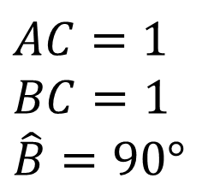
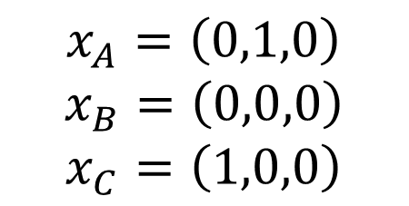
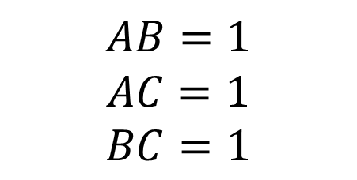
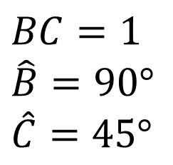
Representation
A
$$AB=1$$
$$AC=1$$
$$BC=1$$
$$x_{A}=\left(0,1,0\right)$$
$$x_{B}=\left(0,0,0\right)$$
$$x_{C}=\left(1,0,0\right)$$
$$AC=1$$
$$BC=1$$
$$\hat{B}=90°$$
$$BC=1$$
$$\hat{B}=90°$$
$$\hat{C}=45°$$
B
C

Slide 4
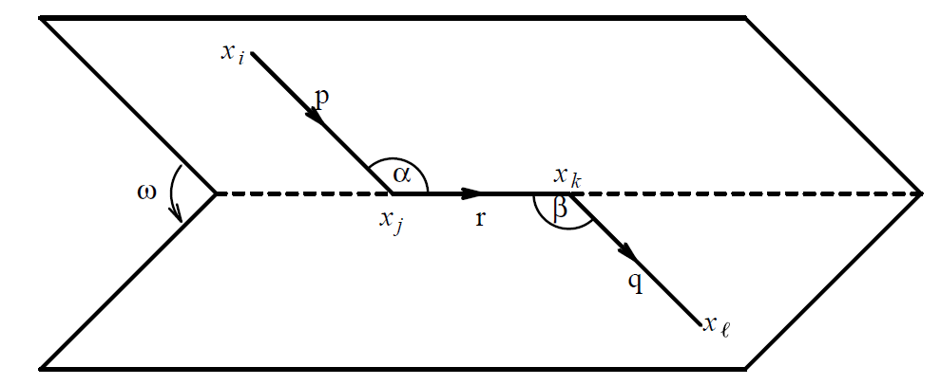
Representation

Slide 5
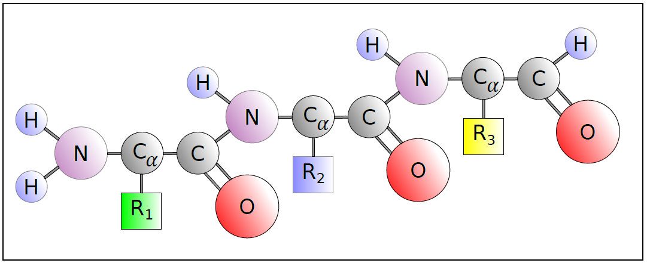
Creating instances

