Slide 1


Slide 2
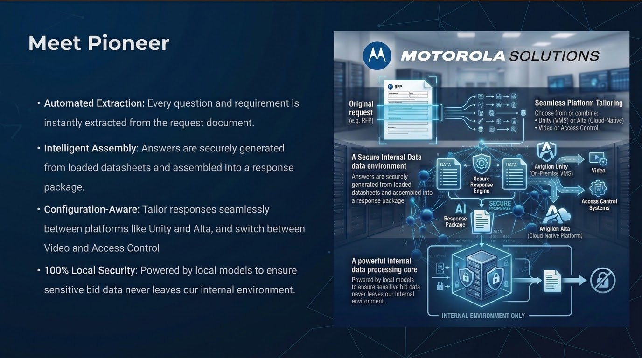

Slide 3
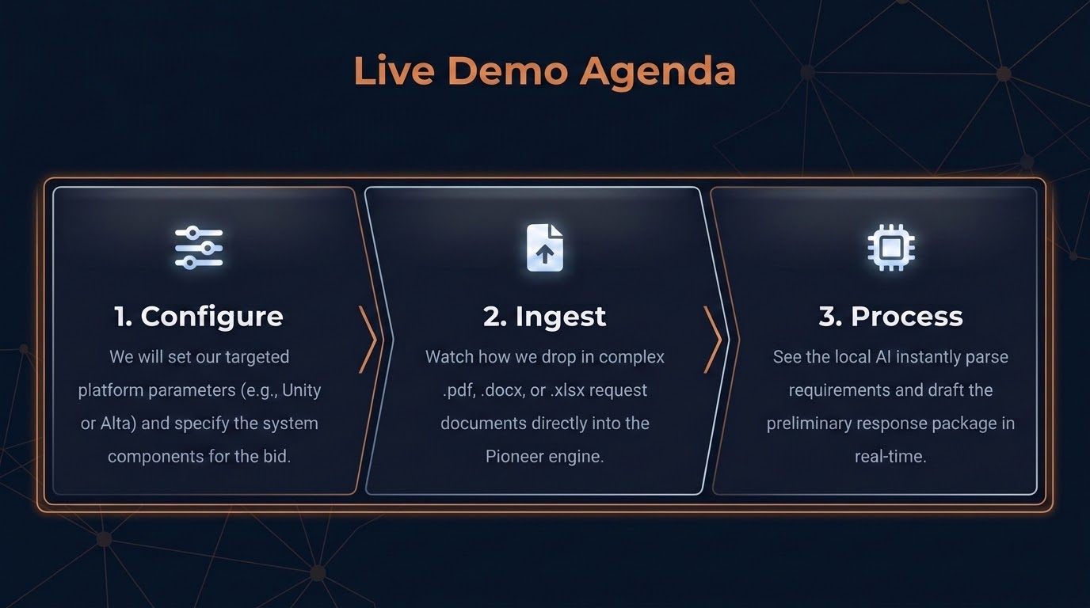

Slide 4



Questions & Answers
Pioneer RFP Engine — Support & Resource Directory
Pioneer RFP Engine Download
Download the desktop application, manage configurations, and run automated extractions.
download
Pioneer RFP Engine Release Page
View the latest release notes, product updates, and version documentation.
new_releases
Pioneer NotebookLM Workspace
Interact with synthesized resources, reference materials, and interactive Q&A.
assignment
Notes:
git hub repo: https://github.com/michaelsuppan-dot/Pioneer-D/releases/tag/Pioneer_v1.2.2
github download page: https://michaelsuppan-dot.github.io/Pioneer-D/
notebook LM: https://notebooklm.google.com/notebook/771bea3f-631a-43ad-b3cd-49c18919e5d6

