Slide 1
Determining Diabetes Diagnosis Through Machine Learning
Brandon Osvold
Sarah Preese
Theon Masters
Omar M Abdel-Kerem
Michael J Tiede

Slide 2
Brief Background on Diabetes
Diabetes affects 37.3 million Americans, which is about 1 in 10 people.
1 in 5 people with diabetes do not even know that they have it.
The CDC estimates that 96 million American adults have prediabetes, which represents more than 1 in 3 adults in the US.
Centers for Disease Control and Prevention. (2022, January 24). The facts, stats, and impacts of diabetes. Accessed December 3rd, 2022
Notes:
Centers for Disease Control and Prevention. (2022, January 24). The facts, stats, and impacts of diabetes. Centers for Disease Control and Prevention. Retrieved December 3, 2022, from https://www.cdc.gov/diabetes/library/spotlights/diabetes-facts-stats.html

Slide 3
Dataset Background
Data Source: Kaggle
9 Columns
8 Predictors
1 Target
768 total records

Slide 4
Predictors
Pregnancies: # of pregnancies
BloodPressure: the diastolic blood pressure (mmHg).
Age: age in years.
Glucose: the plasma glucose concentration (mg/dL) during an oral glucose tolerance test.
SkinThickness: the skin fold thickness (mm) of the triceps.
Insulin: serum insulin (mu U/mL) measured in 2 hours.
BMI: body mass index
DiabetesPedigreeFunction: the likelihood of diabetes based on family history.

Slide 5
Target
Outcome:
1 indicates diabetes
0 indicates no diabetes

Slide 6
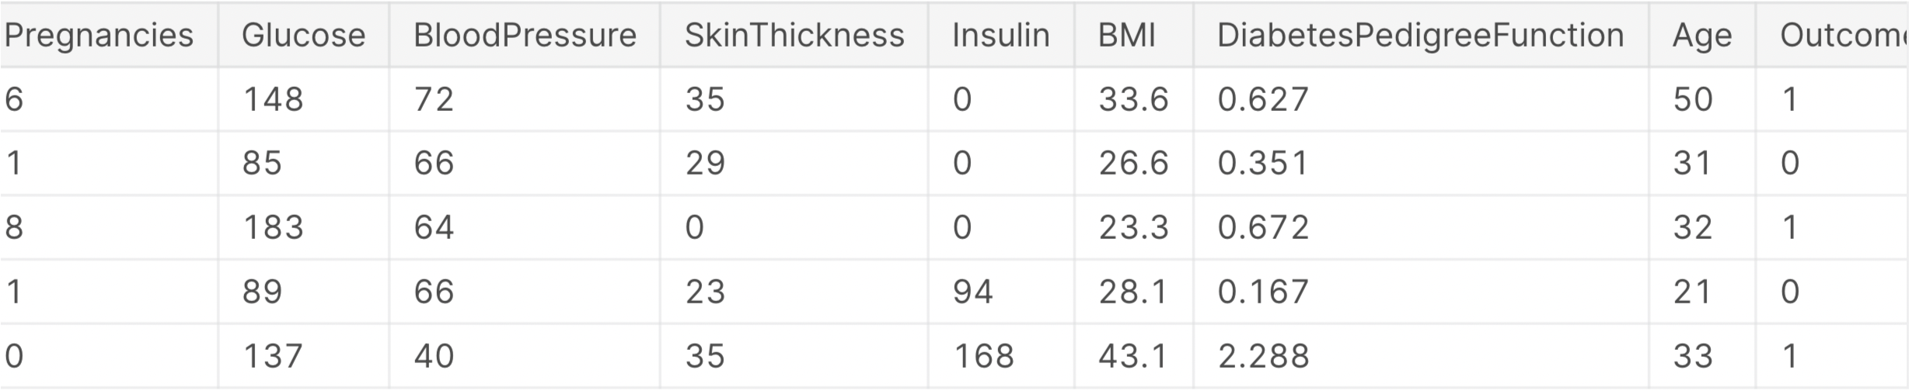
Snippet of Dataset

Slide 7
Why?
This dataset could give insight into the health predictors, such as weight, BMI, and family history, that are highly associated with whether a person might develop diabetes in the future.
By understanding which predictors are important for the diagnosis of diabetes, we can use predictive analysis to determine someone's possible future diagnosis.
Centers for Disease Control and Prevention. (2022, January 24). The facts, stats, and impacts of diabetes. Accessed December 3rd, 2022
Notes:
Centers for Disease Control and Prevention. (2022, January 24). The facts, stats, and impacts of diabetes. Centers for Disease Control and Prevention. Retrieved December 3, 2022, from https://www.cdc.gov/diabetes/library/spotlights/diabetes-facts-stats.html
Given the staggering statistics, this dataset could give insight into the health predictors, such as weight, BMI, and family history, that may be highly associated with whether a person might develop diabetes in the future.

Slide 8
Why?
By detecting the onset of diabetes early, this will promote the overall health and wellbeing of individuals who are more susceptible to diabetes due to genetics as well as lifestyle factors.
Early detection and diagnosis may potentially lower the possibility of health issues due to undiagnosed diabetes, such as, increased rate of infections, neuropathy, or vision loss.
Centers for Disease Control and Prevention. (2022, January 24). The facts, stats, and impacts of diabetes. Accessed December 3rd, 2022
Notes:
Centers for Disease Control and Prevention. (2022, January 24). The facts, stats, and impacts of diabetes. Centers for Disease Control and Prevention. Retrieved December 3, 2022, from https://www.cdc.gov/diabetes/library/spotlights/diabetes-facts-stats.html

Slide 9
Tools & Methods
Data cleaning
Z score standardization
Python libraries: pandas, numpy, sk learn, matplotlib
Support Vector Machine
Regularization

Slide 10
Python Libraries
Numpy
Pandas
Matplotlib
Visualization
Sklearn
Predictive analysis (SVM)

Slide 11
Data Cleaning
The dataset did not contain any null fields.
However, many fields contained 0.
Values that were deemed as missing were substituted with column means.
For example, having zero insulin in the blood, is extremely rare, even in fasting, untreated, type 1 diabetic patients
Outcome ratios in the dataset:
Non-diabetic (Class 0)—500 instances
Diabetic (Class 1)—268 instances

Slide 12
Adjustments to Reduce Noise
Variables | Number of Zeros | % of Zeros | Substituted Zeros w/Mean
Pregnancies | - | 0% | N
Glucose | 5 | 1% | Y
Blood Pressure | 35 | 5% | Y
Skin Thickness | 227 | 30% | Y
Insulin | 374 | 49% | Y
BMI | 11 | 1% | Y
Diabetes Pedigree Function | - | 0% | N
Age | - | 0% | N
Notes:
There are 8 predictors and 768 instances, there are 8*768 = 6144 fields. Overall, 652 fields in total were substituted with the column mean, that would represent 10.6% (computed using 652/6144) of all fields within the dataset.

Slide 13
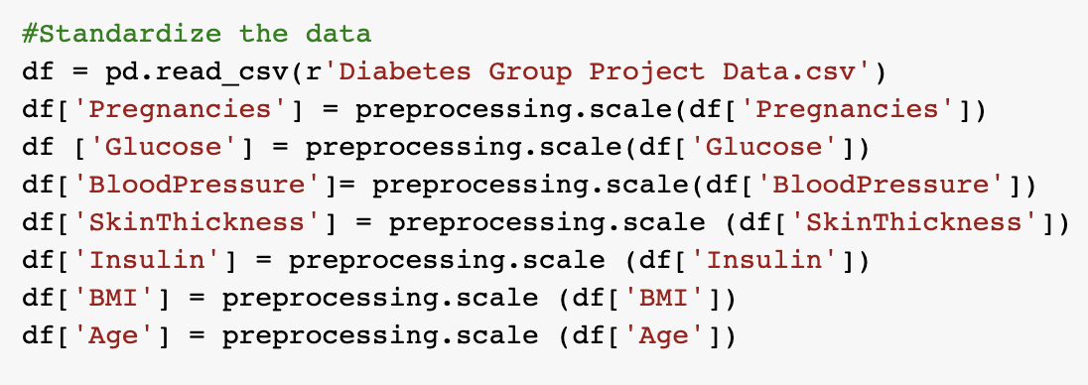
Z-Score Standardization

Slide 14
Regularization
Various gamma values ranging from 0.05 to 3 were tested
Similarly, various values ranging from 0.001 to 5.0 were tested for C (Regularization parameter)
Important Predictors
Glucose | 0.941
Diabetes Pedigree Function | 0.677
BMI | 0.542
Least Important Predictors
Insulin | -0.055
Age | 0.0925
Skin Thickness | -0.118

Slide 15
Support Vector Machine
A SVM RBF model was used to analyze the dataset
Optimal model fit was achieved using the following parameters:
Gamma: 0.8
C: 1.0

Slide 16

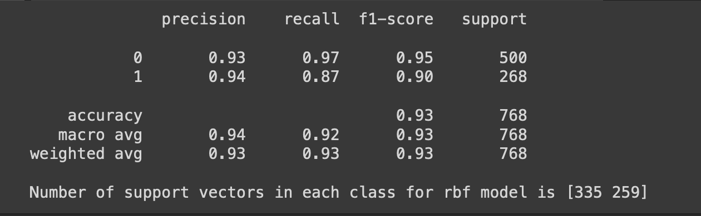
Model Quality
Precision, Recall, F-score

Slide 17
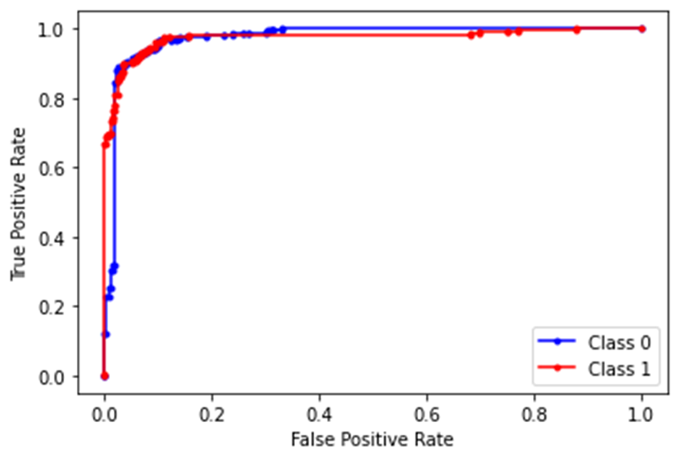
ROC Curve
Class 0 –No Diabetes
Class 1—Diabetes

Slide 18
Discussion
The model results indicate that the important predictors in diagnosing diabetes are glucose, diabetes pedigree function, and BMI respectively.
Predictors such as insulin, age, and skin thickness were found to not be good candidates for predicting whether someone has diabetes.

Slide 19
Pitfalls
652 fields in total were substituted with the column mean, which represents ~10.6% of the total fields in the data set.
It should be taken with a grain of salt that insulin was found to be not a reliable predictor for classifying whether individuals have diabetes or not, as insulin values were substituted for ~49% of instances with column means.
Unbalanced data set?

Slide 20
References
Rahul. (2019, September 20). Machine learning for diabetes with python. Kaggle. Retrieved November 27, 2022, from https://www.kaggle.com/datasets/rahulsah06/machine-learning-for-diabetes-with-python
Centers for Disease Control and Prevention. (2022, January 24). The facts, stats, and impacts of diabetes. Centers for Disease Control and Prevention. Retrieved December 3, 2022, from https://www.cdc.gov/diabetes/library/spotlights/diabetes-facts-stats.html

