Slide 1
Image Geometric Transformation
Group name: MMfsn (A2)
Date: nov 20th

Slide 2
names
1. Michael Tran
2. Matthew Lai
3. He Feng
4. Raga Shalini Koka
5. Navya Doddapaneni

Slide 3
Topics and Objectives
1. Scaling
2. Translation
3. Rotation
4. Affine Transformation(Shear)
5. Polar, log-polar co-ordinate transformation
6. Interpolation Techniques

Slide 4
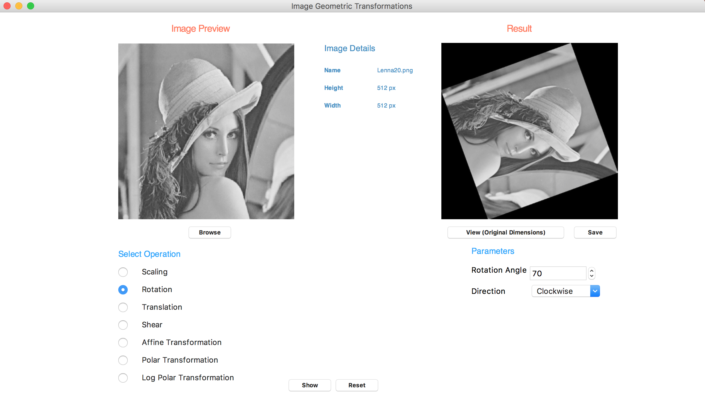
GUI

Slide 5
What is Geometric Transformation?
A spatial transformation of an image is a Geometric Transformation.
Changes the spatial positions but not the gray levels.
Uses Spatial Mapping and Interpolation to transform.

Slide 6
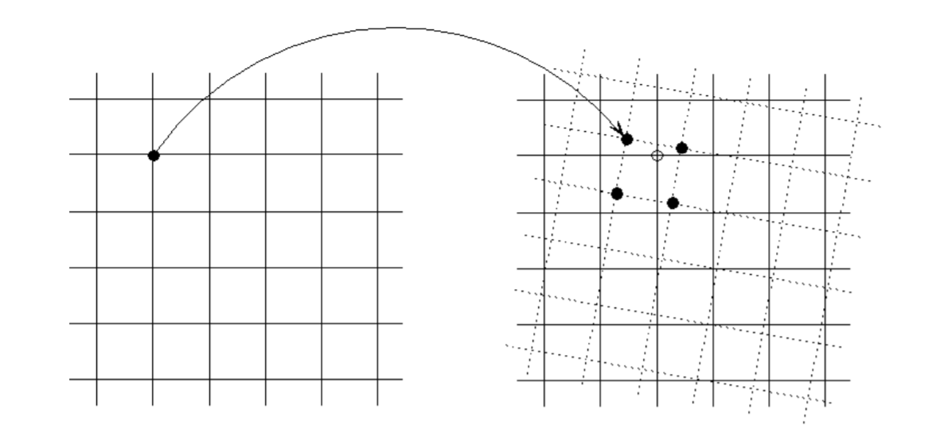
Spatial Mapping - Each point (x, y) of image is mapped to a point (u, v) in a new coordinate system.
u = f1(x, y)
v = f2(x, y)
Interpolation - A process of estimating unknown values using known values.
https://www.cis.rit.edu/class/simg782/lectures/lecture_02/lec782_05_02.pdf

Slide 7
Applications
Align images that were taken at different times or with different sensors
Correct images for lens distortion
Correct effects of camera orientation
Image morphing or other special effects

Slide 8
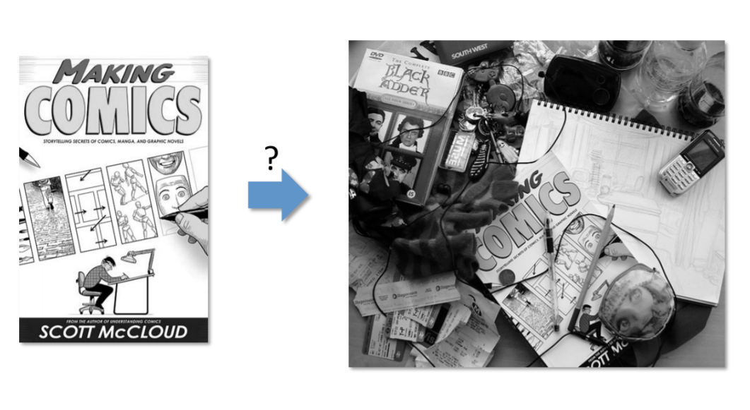
Applications
Align images that were taken at different times or with different sensors
The image on the left requires translation, rotation and scaling to fit into the image on the right
https://www.cs.toronto.edu/~urtasun/courses/CV/lecture05.pdf

Slide 9
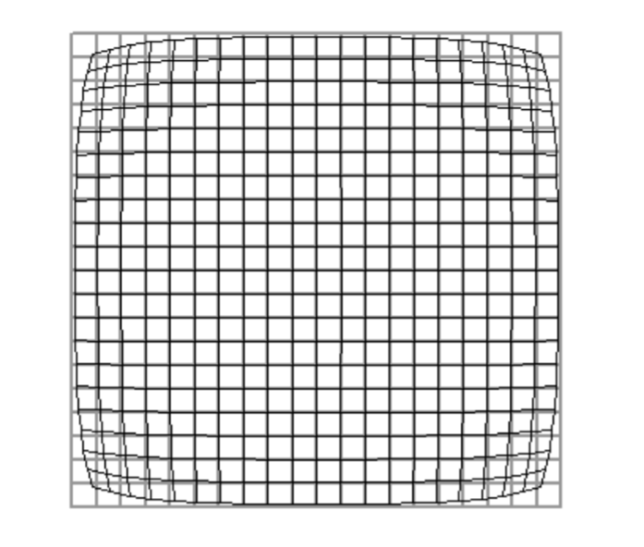
Applications
Correct images for lens distortion
Correct effects of camera orientation
https://www.cis.rit.edu/class/simg782/lectures/lecture_02/lec782_05_02.pdf

Slide 10
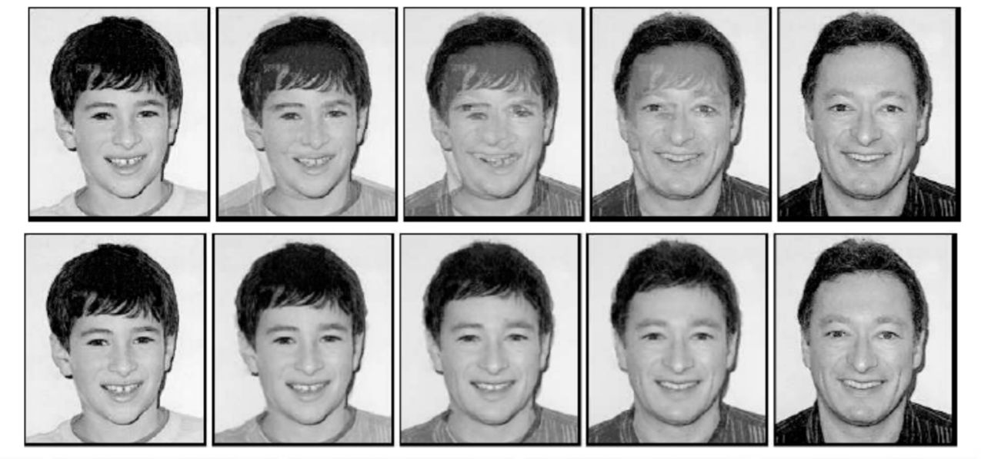
Applications
Image morphing or other special effects
http://eeweb.poly.edu/~yao/EL5123/lecture12_ImageWarping.pdf

Slide 11
Scaling
Resizing the image by changing no. of pixels.
Can be Zooming or Shrinking the image
Zooming images makes the details more clear and visible
Shrinking can be used to generate thumbnails

Slide 12
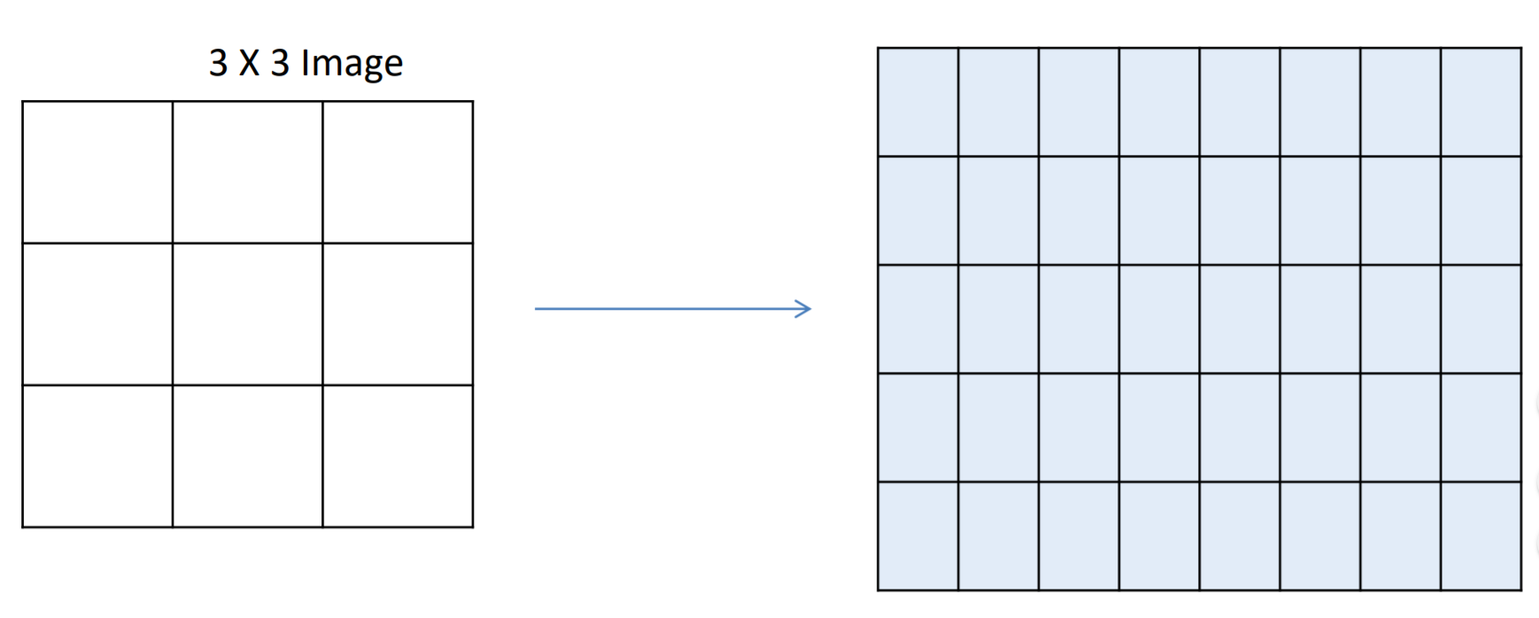
Scaling - Implementation
5 X 8
Create a grid of required size.
http://qil.uh.edu/dip/media/cosc6380/Lecture_-_4.pdf

Slide 13
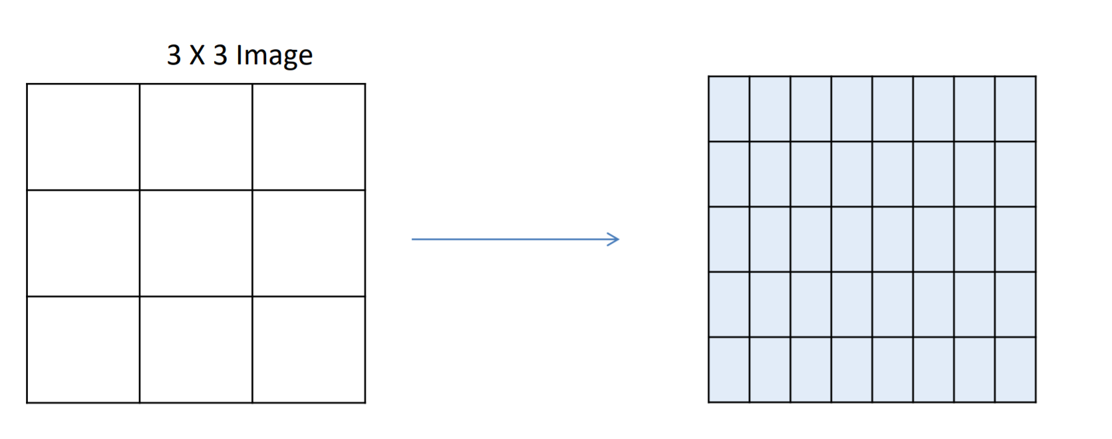
Shrink the image.
http://qil.uh.edu/dip/media/cosc6380/Lecture_-_4.pdf

Slide 14
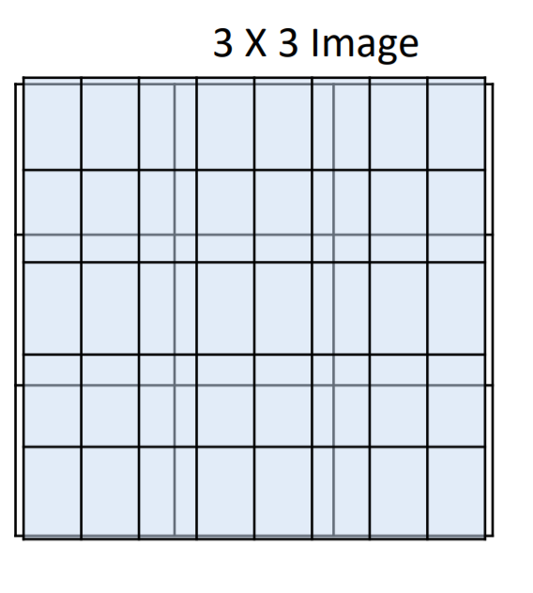
Scaling
Overlap the new grid on the image and fill the values using interpolation.
Resize the image to required dimensions.
http://qil.uh.edu/dip/media/cosc6380/Lecture_-_4.pdf

Slide 15
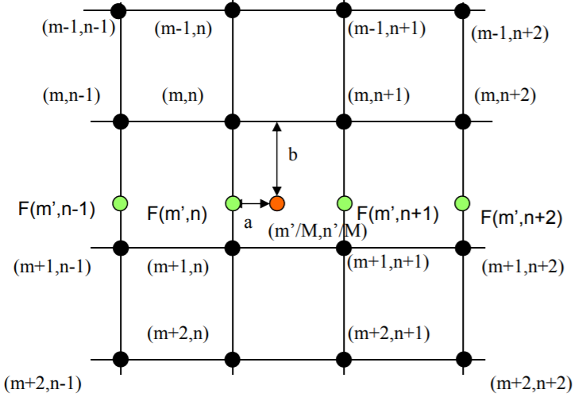
Bi Cubic Interpolation
O(m’, n’) is interpolated from 16 samples nearest to (m ’/M , n’/M) in original image. Where M is the scaling factor.
Interpolate along each row y: I[m , n]->F[m’ , n] (from 4 samples) for all 4 rows.
Interpolate along the row x’: F[m’ , n]-> O[m ’, n’] (from 4 samples)
http://eeweb.poly.edu/~yao/EL5123/lecture8_sampling.pdf

Slide 16
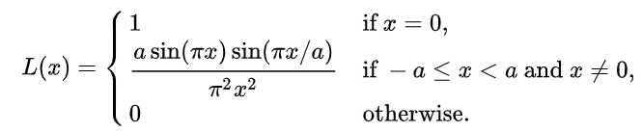
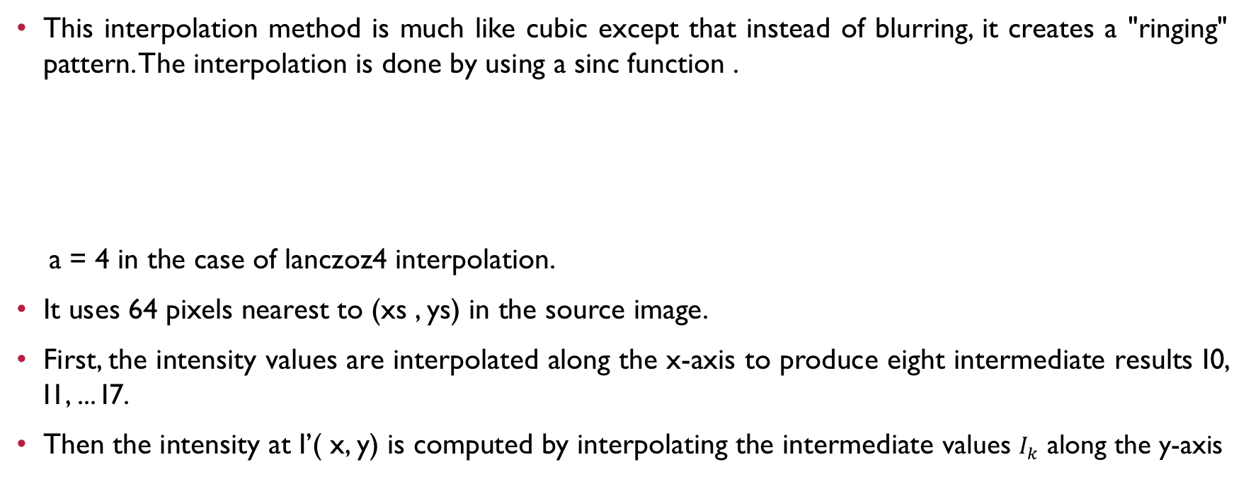
Lanczoz4 Interpolation
This interpolation method is much like cubic except that instead of blurring, it creates a "ringing" pattern. The interpolation is done by using a sinc function .
a = 4 in the case of lanczoz4 interpolation.
It uses 64 pixels nearest to (xs , ys) in the source image.
First, the intensity values are interpolated along the x-axis to produce eight intermediate results I0, I1, ... I7.
Then the intensity at I’( x, y) is computed by interpolating the intermediate values $I_{k}$ along the y-axis
https://en.wikipedia.org/wiki/Lanczos_resampling

Slide 17
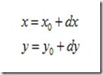

image translation
Translation basically means that we are shifting the image by adding/subtracting the X and Y coordinates.
There are two methods can perform the image translation.
https://images0.cnblogs.com/blog/439761/201410/202228276056387.png
https://images0.cnblogs.com/blog/439761/201410/202228283554758.png

Slide 18
image translation
To perform this, we can create a new image by using Numpy (np.zeros).
The formula I used is:
Then insert the image pixel to the new image.
https://images0.cnblogs.com/blog/439761/201410/202228283554758.png

Slide 19
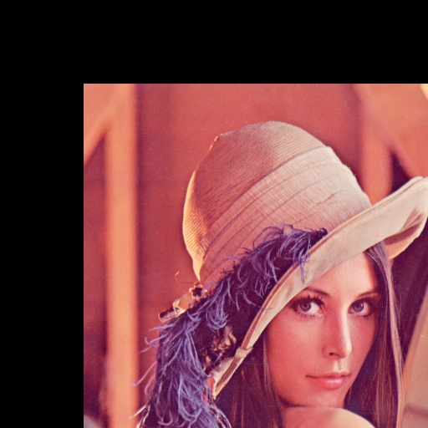
image translation - Example
We want to shift the image down right, and the vector value for x and y is 100.
Result[100, 100] = Image[0, 0]

Slide 20
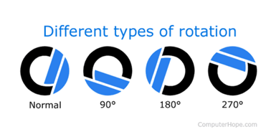
Image Rotation
Rotation is most commonly used to improve the visual appearance of the image. When referring to an image or image editor, rotation is a feature that allows you to turn an image like a clockwise or counterclockwise direction. On the right is an example of the Computer Hope logo and what it would look like rotated at 90,180, and 270-degrees clockwise.
https://www.computerhope.com/jargon/r/rotate.htm

Slide 21


Rotation - Implementation and approach
Rotation performs a geometric transform which maps the position (x, y) of the a picture element in an input image onto a position(x1, y1) in an output image by rotating it through a user-specified angle θ about an origin O(center of the input image)
http://www.uh.edu/

Slide 22
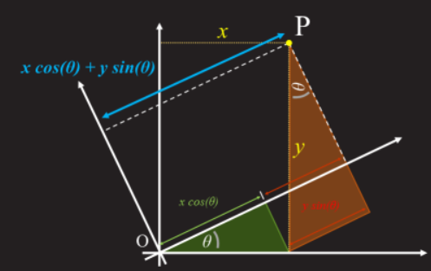
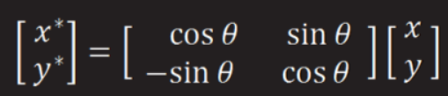
Rotation - Implementation and approach
Firstly, find the four corner coordinates of the original image
Secondly, find the four corner coordinates of the new image and calculate the size of the new image. Using some geometry we can work out the relationship between the source coordinates (x, y) and the destination coordinate (x1,y1)
Formula:x1=x* cosθ+ y* sinθ , y1=-x* sinθ + y* cosθ
Finally, calculate each coordinate of the new image and use bilinear interpolation to get each coordinate’s pixel
http://datagenetics.com/blog/august32013/index.html

Slide 23
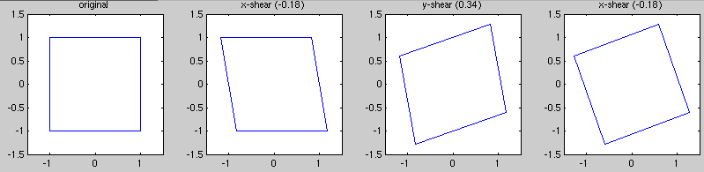
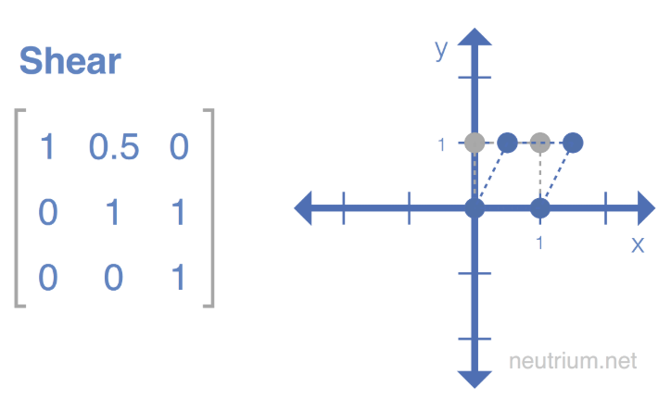
Shear Transformation
Shearing displaces points along the axis (x/y) by an amount proportional to their signed distance along the axis of shear.
Lines that are parallel to the axis of shear will shift their position, but maintain their length.
Complex shears are achieved by applying shear along multiple axis.
Area preserving properties.
https://neutrium.net/mathematics/basics-of-affine-transformation/

Slide 24
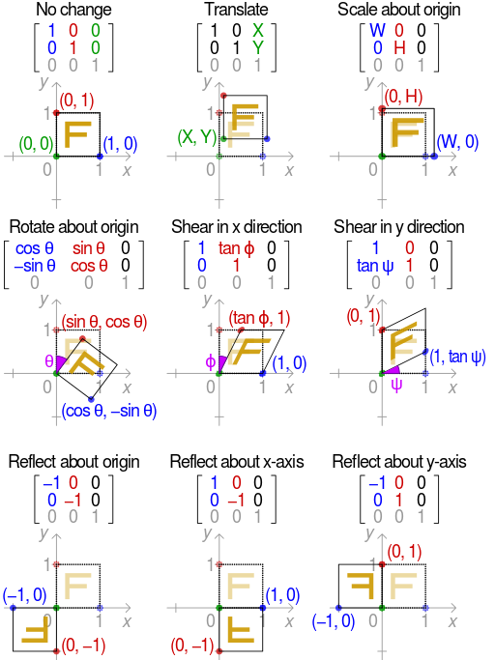
Transformation Matrices
Allows arbitrary linear transformations to be displayed in a consistent format, suitable for computation.
https://en.wikipedia.org/wiki/Transformation_matrix

Slide 25
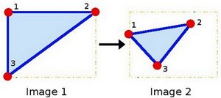

Affine Transformation
Applies the transformation matrices onto images to yield the resultant image.
Affine Transformations can do Translations, Scaling, Rotations, Shearing, Reflections all in one step.
To generate transformation matrices on the fly in 2D, we take 2 triangles and try to fit one triangle into another triangle. Therefore 6 points are required.
Applying Linear Algebra and solving for the unknowns, we generate a Transformation Matrix. E.g:
https://docs.opencv.org/3.4/d4/d61/tutorial_warp_affine.html

Slide 26

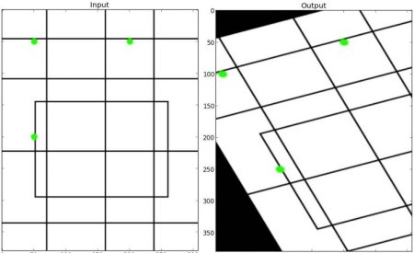
Affine Transformation
Using our obtained Transformation Matrix, we apply it to the formula:
The result will look something similar to:
https://homepages.inf.ed.ac.uk/rbf/HIPR2/affine.htm
https://docs.opencv.org/3.1.0/da/d6e/tutorial_py_geometric_transformations.html

Slide 27
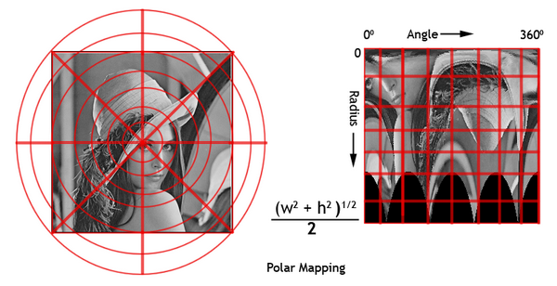



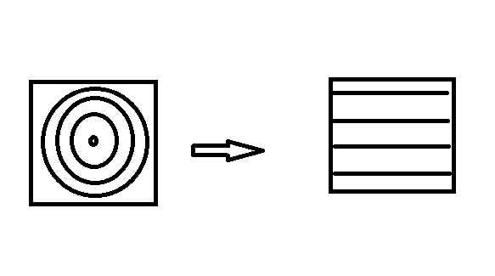
Polar Coordinates
The polar coordinate system is a two-dimensional coordinate system in which each point on an image (x, y) is determined by distance from a reference point and an angle from a reference direction (r, φ).
We essentially remap an image to polar space.
https://www.codeproject.com/Articles/33648/Polar-View-of-an-Image
https://en.wikipedia.org/wiki/Polar_coordinate_system

Slide 28


Log Polar Coordinates
Similar to Polar Coordinates, we remap an image to log-polar space.
Instead of using the distance to a certain point, we use the logarithm of the distance to a certain point.
Polar coordinates are usually used to describe domains in the plane with some rotational symmetry.
In areas like harmonic and complex analysis, log-polar coordinates are more useful than polar coordinates.
https://en.wikipedia.org/wiki/Log-polar_coordinates

Slide 29
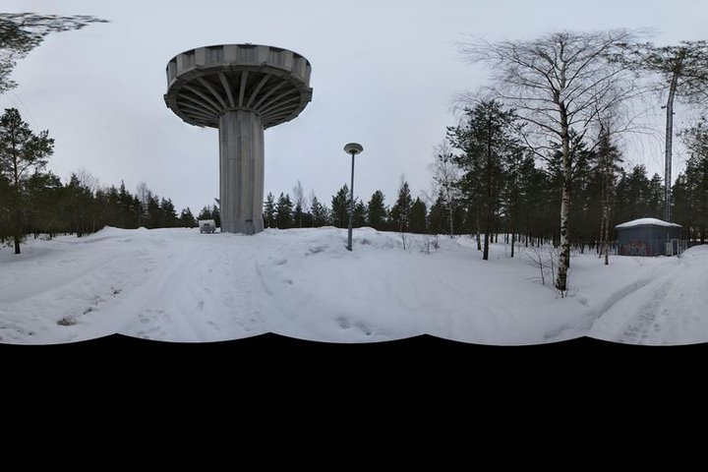
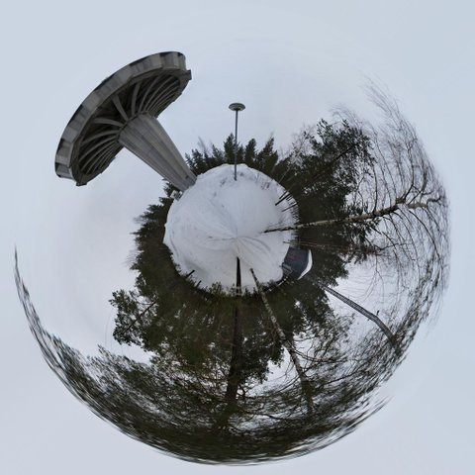
Polar/Log Polar Uses
One of the cool uses of Polar Coordinates are creating Polar Panorama Photos
https://www.instructables.com/id/How-to-make-360-degree-flashpolar-panoramas/

Slide 30
References
https://neutrium.net/mathematics/basics-of-affine-transformation/
https://docs.opencv.org/3.1.0/da/d6e/tutorial_py_geometric_transformations.html
https://homepages.inf.ed.ac.uk/rbf/HIPR2/affine.htm
https://docs.opencv.org/3.4/d4/d61/tutorial_warp_affine.html
https://www.codeproject.com/Articles/33648/Polar-View-of-an-Image

Slide 31
Demo:

Slide 32
Q&a

Slide 33
Thank you

