Slide 1
Amazon Product Review Project
Capstone II Project
Michael Trent

Slide 2
Problem Statement

Slide 3
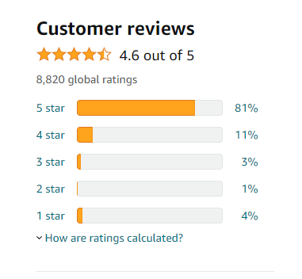
Problem Statement

Slide 4
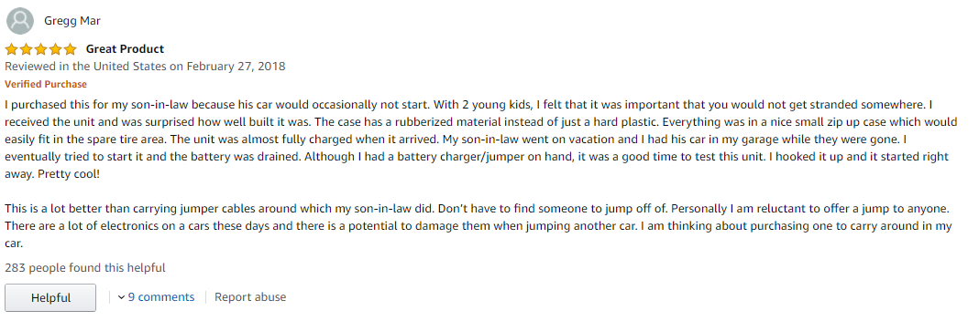
Problem Statement

Slide 5
Problem Statement

Slide 6
Problem Statement
?

Slide 7


Slide 8
How well will your new product sell based on reviews and ratings?

Slide 9
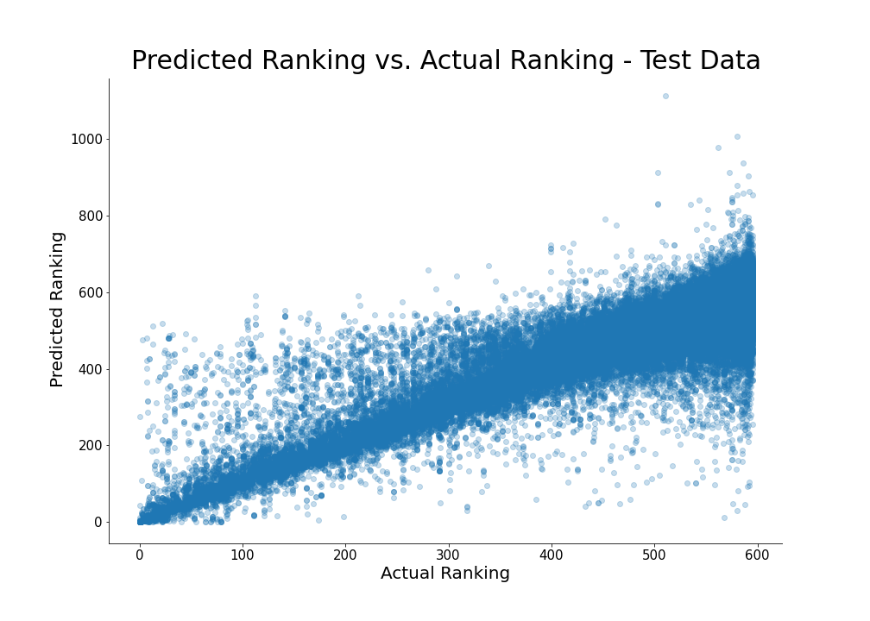
How well will your new product sell based on reviews and ratings?

Slide 10
How well will your new product sell based on reviews and ratings?
Our model predicts ~93% of the variability in the data

Slide 11
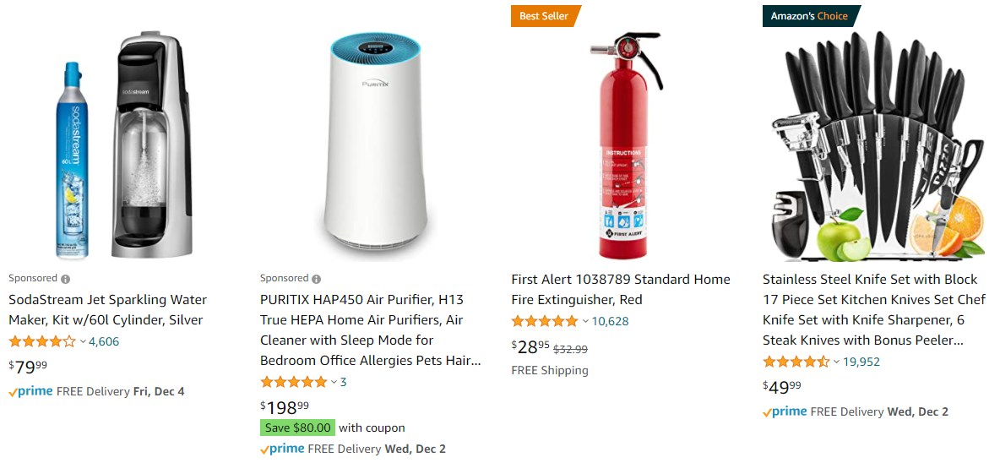
Data
~ 7 million reviews
~ 1.5 million products

Slide 12
Data
~ 7 million reviews
~ 1.2 million products
Citation:
Justifying recommendations using distantly-labeled reviews and fined-grained aspects. Jianmo Ni, Jiacheng Li, Julian McAuley. Empirical Methods in Natural Language Processing (EMNLP), 2019.

Slide 13
Data Wrangling
Determining Sales Ranking

Slide 14
Data Wrangling
Determining Sales Ranking
['>#9,714 in Kitchen & Dining (See Top 100 in Kitchen & Dining)', '>#29 in Kitchen & Dining > Bakeware > Baking Tools & Accessories > Baking Cups', '>#3,224 in Kitchen & Dining > Kitchen Utensils & Gadgets’]

Slide 15
Data Wrangling
Determining Sales Ranking
The overall ranking within Kitchen & Dining is meaningless.
['>#9,714 in Kitchen & Dining (See Top 100 in Kitchen & Dining)', '>#29 in Kitchen & Dining > Bakeware > Baking Tools & Accessories > Baking Cups', '>#3,224 in Kitchen & Dining > Kitchen Utensils & Gadgets’]

Slide 16
Data Wrangling
Determining Sales Ranking
The overall ranking within Kitchen & Dining is meaningless.
We want the ranking within the primary (main) category.
['>#9,714 in Kitchen & Dining (See Top 100 in Kitchen & Dining)', '>#29 in Kitchen & Dining > Bakeware > Baking Tools & Accessories > Baking Cups', '>#3,224 in Kitchen & Dining > Kitchen Utensils & Gadgets’]

Slide 17
Data Wrangling
Determining Sales Ranking
The overall ranking within Kitchen & Dining is meaningless.
We want the ranking within the primary (main) category.
['>#9,714 in Kitchen & Dining (See Top 100 in Kitchen & Dining)', '>#29 in Kitchen & Dining > Bakeware > Baking Tools & Accessories > Baking Cups', '>#3,224 in Kitchen & Dining > Kitchen Utensils & Gadgets’]

Slide 18
Data Wrangling
Determining Sales Ranking
Identify similar products

Slide 19
Data Wrangling
Determining Sales Ranking
Identify similar products
Identical products may have different names and product IDs

Slide 20
Data Wrangling
Determining Sales Ranking
Identify similar products
Use fuzzy logic
Identical products may have different names and product IDs

Slide 21

Data Wrangling
Determining Sales Ranking
Identify similar products
Use fuzzy logic
Identical products may have different names and product IDs
Fuzzy Wuzzy

Slide 22
Data Wrangling
Determining Sales Ranking
Identify similar products
Use fuzzy logic
> 85% set ratio & > 85% sort ratio
→ Same product
Identical products may have different names and product IDs
Fuzzy Wuzzy

Slide 23
Data Wrangling
Determining Sales Ranking
Identify similar products
Use fuzzy logic
> 85% set ratio & > 85% sort ratio
→ Same product
Identical products may have different names and product IDs
Fuzzy Wuzzy
['Hamilton Beach 31103A Countertop Oven with Convection and Rotisserie',
'Hamilton Beach Countertop Oven with Convection and Rotisserie', 100, 95]

Slide 24
Data Wrangling
Determining Sales Ranking
Identify similar products
Use fuzzy logic
> 85% set ratio & > 85% sort ratio
→ Same product
Identical products may have different names and product IDs
Fuzzy Wuzzy
['Hamilton Beach 31103A Countertop Oven with Convection and Rotisserie',
'Hamilton Beach Countertop Oven with Convection and Rotisserie', 100, 95]

Slide 25
Data Wrangling
Determining Sales Ranking
Identify similar products
Drop unknowable missing values

Slide 26
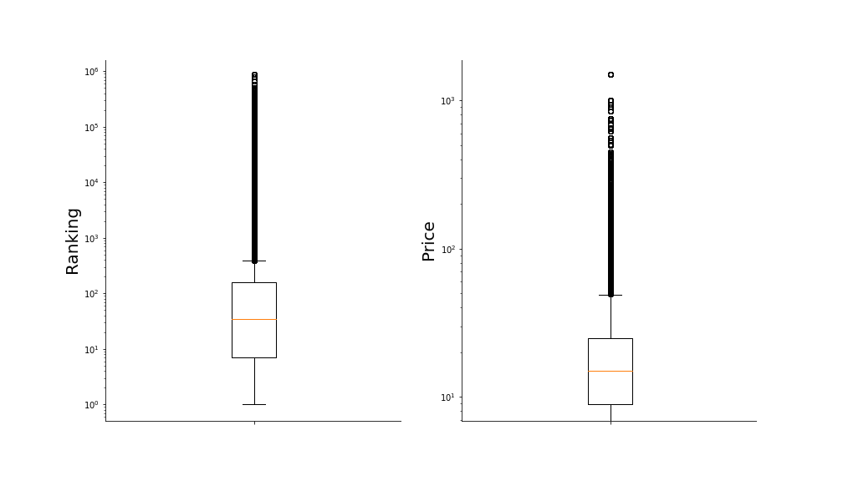
EDA
Determining Sales Ranking
Identify similar products
Drop unknowable missing values
Drop outliers

Slide 27
EDA
Determining Sales Ranking
Identify similar products
Drop unknowable missing values
Drop outliers
> 4*IQR or < 4*IQR

Slide 28
Feature Engineering
Determining Sales Ranking
Identify similar products
Drop unknowable missing values
Drop outliers
Binning categories and brands
Infrequent categories (< 500 reviews)
Infrequent brands (< 300 reviews)
→ Miscellaneous

Slide 29

Feature Engineering
Determining Sales Ranking
Identify similar products
Drop unknowable missing values
Drop outliers
Binning categories and brands
Sentiment Analysis
Nltk VADER

Slide 30
Feature Engineering
Determining Sales Ranking
Identify similar products
Drop unknowable missing values
Drop outliers
Binning categories and brands
Sentiment Analysis
Nltk VADER
Compound polarity score
[-1, 1]

Slide 31
Feature Engineering
Determining Sales Ranking
Identify similar products
Drop unknowable missing values
Drop outliers
Binning categories and brands
Sentiment Analysis
Nltk VADER
Compound polarity score
[-1, 1]
Calculate score for each sentence

Slide 32
Feature Engineering
Determining Sales Ranking
Identify similar products
Drop unknowable missing values
Drop outliers
Binning categories and brands
Sentiment Analysis
Nltk VADER
Compound polarity score
[-1, 1]
Calculate score for each sentence
Average scores across review

Slide 33
Feature Engineering
Determining Sales Ranking
Identify similar products
Drop unknowable missing values
Drop outliers
Binning categories and brands
Sentiment Analysis
Nltk VADER
Compound polarity score
[-1, 1]
Calculate score for each sentence
Average scores across review
Blank reviews scored as 0

Slide 34
Feature Engineering
Determining Sales Ranking
Identify similar products
Drop unknowable missing values
Drop outliers
Binning categories and brands
Sentiment Analysis
Nltk VADER
Compound polarity score
[-1, 1]
Calculate score for each sentence
Average scores across review
Blank reviews scored as 0
Numerical score for modeling!

Slide 35
Feature Engineering
Determining Sales Ranking
Identify similar products
Drop unknowable missing values
Drop outliers
Binning categories and brands
Sentiment Analysis
Nltk VADER
Compound polarity score
[-1, 1]
Calculate score for each sentence
Average scores across review
Blank reviews scored as 0
Numerical score for modeling!
Duplicate process for summaries

Slide 36
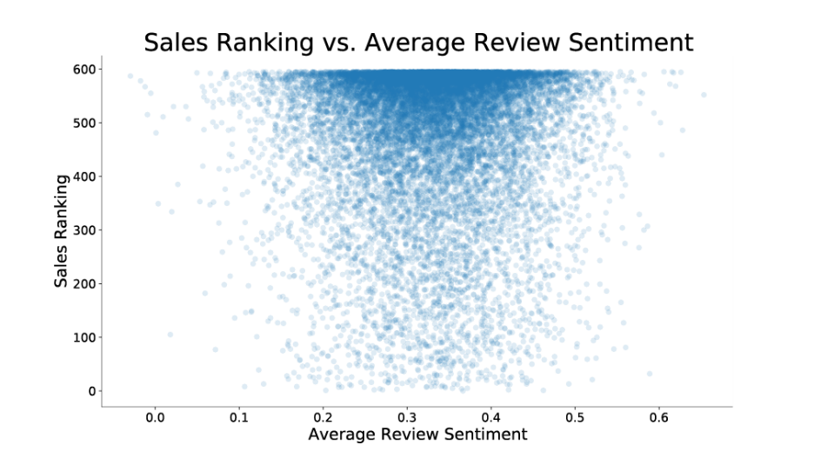
Feature Engineering
Determining Sales Ranking
Identify similar products
Drop unknowable missing values
Drop outliers
Binning categories and brands
Sentiment Analysis
Non-linear relationship with ranking…

Slide 37
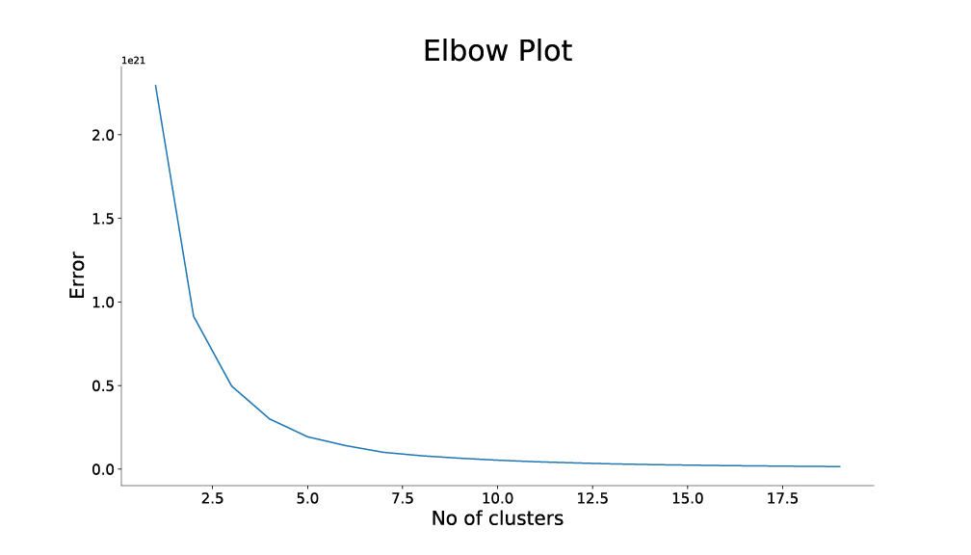
Feature Engineering
Determining Sales Ranking
Identify similar products
Drop unknowable missing values
Drop outliers
Binning categories and brands
Sentiment Analysis
Kmeans and PCA

Slide 38
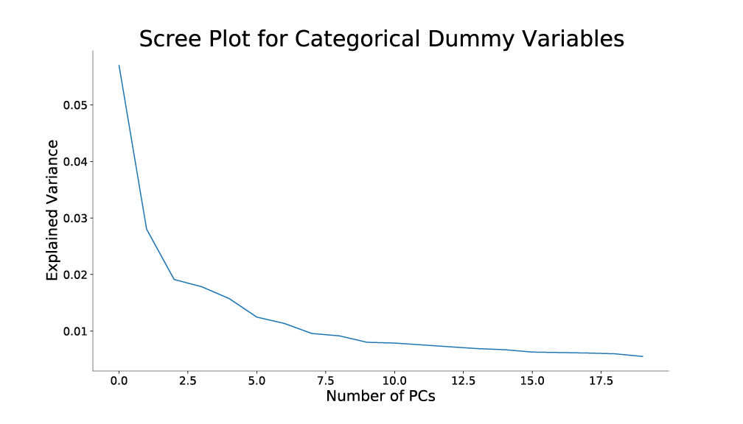
Feature Engineering
Determining Sales Ranking
Identify similar products
Drop unknowable missing values
Drop outliers
Binning categories and brands
Sentiment Analysis
Kmeans and PCA

Slide 39
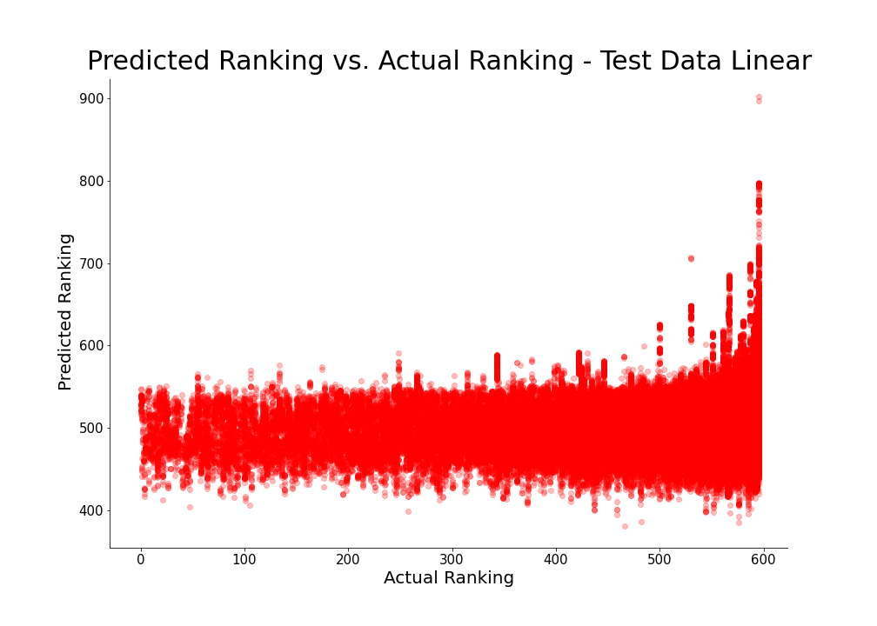
Modeling
Determining Sales Ranking
Identify similar products
Drop unknowable missing values
Drop outliers
Binning categories and brands
Sentiment Analysis
Kmeans and PCA
Linear Modeling
R2 = 5.8%

Slide 40
Modeling
Determining Sales Ranking
Identify similar products
Drop unknowable missing values
Drop outliers
Binning categories and brands
Sentiment Analysis
Kmeans and PCA
Linear Modeling
XGBoost
Bayesian Optimization for hyperparameter tuning

Slide 41
Modeling
Determining Sales Ranking
Identify similar products
Drop unknowable missing values
Drop outliers
Binning categories and brands
Sentiment Analysis
Kmeans and PCA
Linear Modeling
XGBoost
R2 = 92.745%
Bayesian Optimization for hyperparameter tuning

Slide 42
Modeling
Determining Sales Ranking
Identify similar products
Drop unknowable missing values
Drop outliers
Binning categories and brands
Sentiment Analysis
Kmeans and PCA
Linear Modeling
XGBoost
R2 = 92.745% - Thanks optimizer!
Bayesian Optimization for hyperparameter tuning

Slide 43
Results

Slide 44
Results
Feature Importance

Slide 45
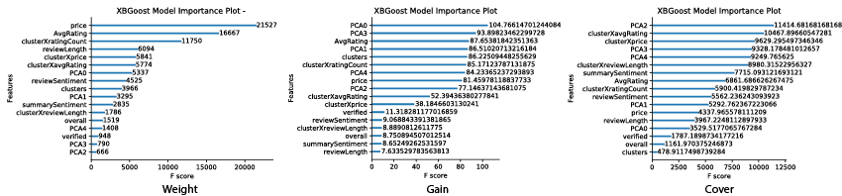
Results
Feature Importance - XGBoost

Slide 46
Results
Feature Importance - Shap

Slide 47
Results
Feature Importance – Shap
Uses the Shapley value to calculate each features contribution to the model

Slide 48
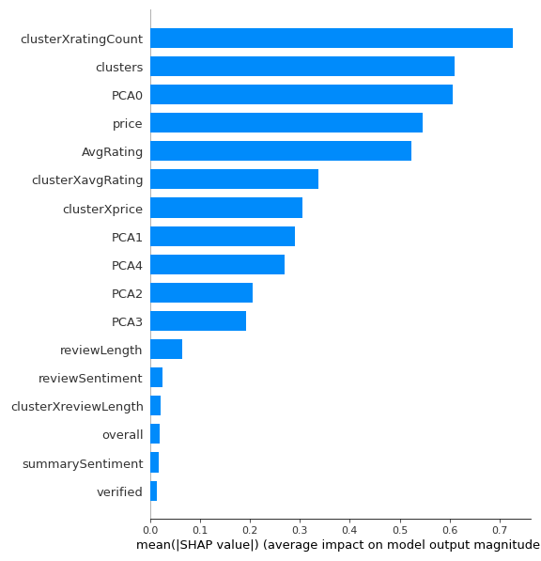
Results
Feature Importance – Shap
Price and average rating are important interpretable features
Review length and sentiment are not as important

Slide 49
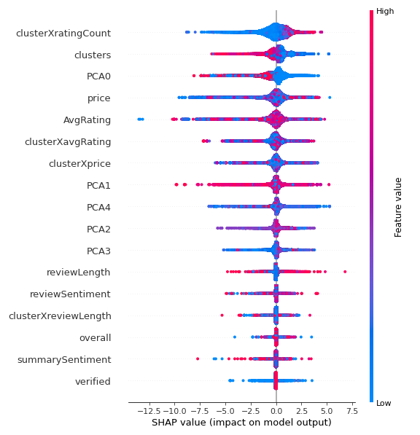
Results
Feature Importance – Shap

Slide 50
Results
Feature Importance – Shap
Possible correlation between price and Shap value
Possible correlation between average rating and Shap value

Slide 51
Future directions

Slide 52
Future directions
Larger data set

Slide 53
Future directions
Larger data set
More categories

Slide 54
Future directions
Larger data set
More categories
Mixed categories

