Slide 1
GA Data Science Project Idea 01 Proposal
Michael Lin

Slide 2
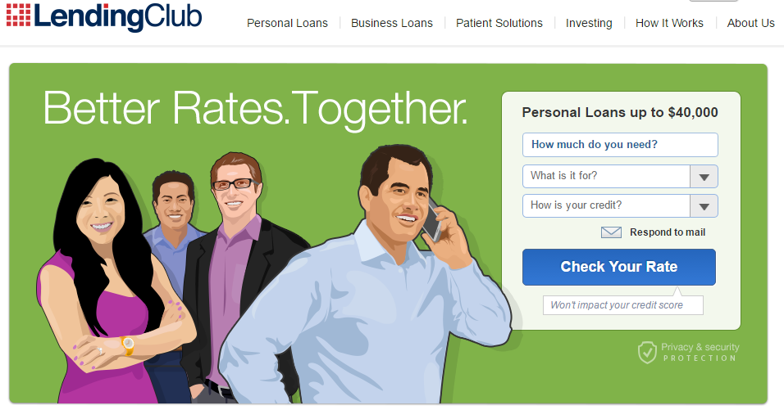



Slide 3

Objective

Slide 4
Specific
Using 3-yr issued loan data provided by Lending Tree, zip-code based income data by University of Michigan, and urban/rural data from ERS; we would like to find interaction or subset of the loan pool that would produce better ROI for investors who wishes to invest in P2P loans.
Measurable
Return on Investment (ROI) – which is the average interest rate of the good loans within the prediction.
Attainable
Data is obtained and preliminary analysis was done.
Relevant
Time-Based
Who doesn’t like to make more money from their investment??!
Loan data is span from 2007 to 2013
Income data is surveyed and estimated from 2006-2010
Urban Influence data is from 2013
Benchmarking against the avg int rate from the loan population.

Slide 5
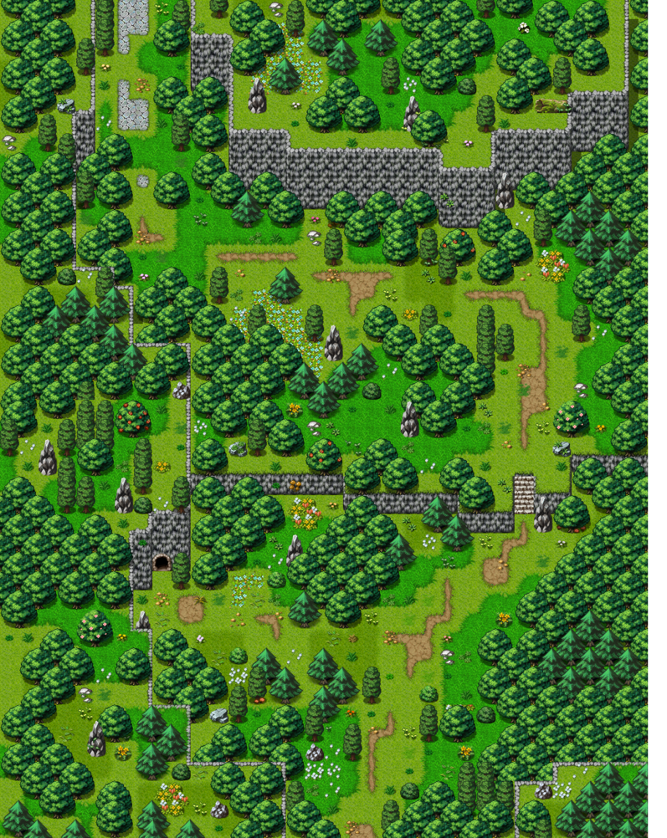

What was done

Slide 6
The Results

Slide 7

What’s Next…

Slide 8


And…

Slide 9

Feedback?!

Slide 10
Backup Slides

