Slide 1

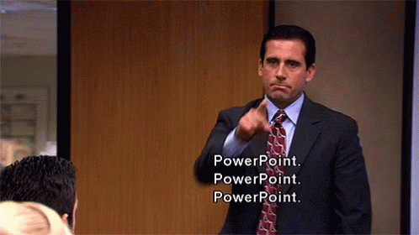
Officer, Plz Help With PPT!
A quick intro to the Officer package for PowerPoint

Slide 2

Way back in 2020….

Slide 3

Way back in 2020….

Slide 4

Way back in 2020….

Slide 5




Way back in 2020….

Slide 6

What is officer?
The officer package lets you manipulate Word and PowerPoint documents through R.
You can add text, tables, picture files, and more!
https://ardata-fr.github.io/officeverse/
It shines when automating reporting in business required software/constraints.

Slide 7
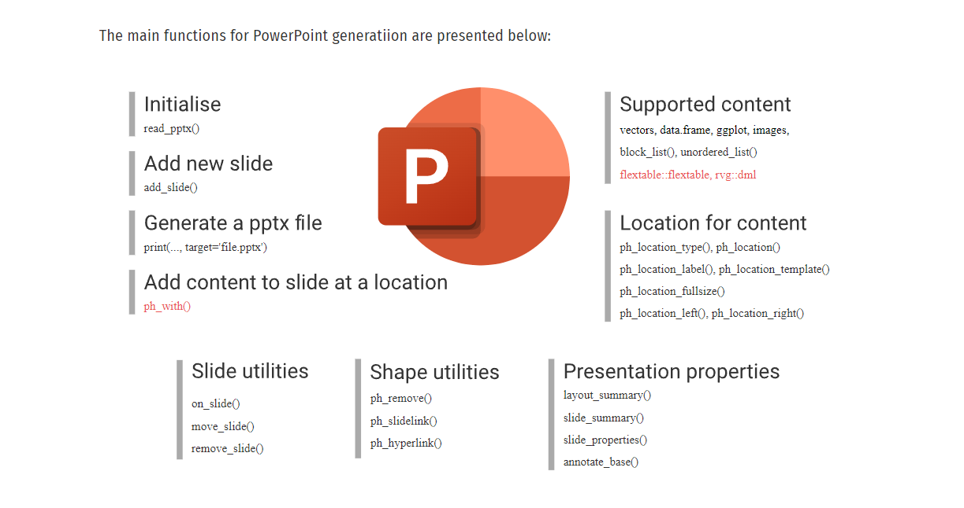
Working with PPTs
Notes:
Stolen from the Bookdown: https://ardata-fr.github.io/officeverse/officer-for-powerpoint.html

