Slide 1

Ansible: Operations for Developers

Slide 2

The evening
17:00-17:30 – Introduction/setting up
17:30-18:00 – Dinner
18:00-end – Handson exercises
Introduction
<number>

Slide 3

Setting up VMs
Hopefully each of you has installed Vagrant and Virtualbox, if not do so right now
Make sure to have Hyper-V disabled if you are on Windows
Download the repository:
https://github.com/michaelvangastel/ansible-automation
Run vagrant up in the ansible_tutorial directory
This will download and setup a CentOS 7 VM
Setting up
<number>

Slide 4

Introduction
Michael van Gastel
Former developer (C++) and teacher at Leiden University
At AMIS since 2017
0 experience with Operations when I started at AMIS
Along came project CIS…
Introduction
<number>

Slide 5
Introduction: project CIS
Oracle Cloud Infrastructure
“On Premise in the Cloud”
Many environments (Dev, Test, Pilot, Demo, Acc, Prod)
Many VMs per environment (10+)
VMs and network managed through Terraform
How do we manage the software and applications?
Introduction
<number>

Slide 6
Why Ansible?
Specific need: configuration management and automatic deployments
Ansible is agentless (requires Python to be installed on the client)
Very scalable
Easy to setup
Manages configuration
Automates deployments
Introduction
<number>

Slide 7
Ansible in the bigger picture
Evolution of software platform
Bare metal servers
Virtualization
Containers
Serverless
Ansible is most useful for 1. and 2.
Introduction
<number>

Slide 8
What does Ansible do?
Ansible generates Python command files and copies them to the target server with SSH
Allows you to automate anything you can do using SSH
Practical uses:
Configuration management
Automatic deployments
Orchestration
Introduction
<number>

Slide 9
What does Ansible not do?
Create VMs
Configure networks
Use tools like Vagrant or Terraform for this!
What Ansible can but should not do:
Provision Docker containers
There are better tools for this (think Kubernetes, Nomad)
Introduction
<number>

Slide 10
Ansible and idempotence
Idempotent:
: relating to or being a mathematical quantity which when applied to itself under a given binary operation (such as multiplication) equals itself
also : relating to or being an operation under which a mathematical quantity is idempotent
(from Merriam-Webster dictionary)
In IT: an operation that always has the same result, no matter the starting state
Introduction
<number>

Slide 11
Ansible and idempotence
Ansible does not tell a server, “Do X and Y”
Ansible tells a server “Make sure X and Y are done”
Example: install Apache webserver
Ansible does not just yum install httpd
Ansible checks if httpd is installed and if not, yum install httpd
The Big take-away from tonight:
Ansible makes sure a server is in a required state
Introduction
<number>

Slide 12
How did we use Ansible in project CIS?
Ansible Playbook and Jenkinsfile in Git repository
Jenkins runs Playbook in pipeline, receives information from pipeline
Targeted hosts receive Playbook commands
Introduction
<number>

Slide 13
Setting up

Slide 14
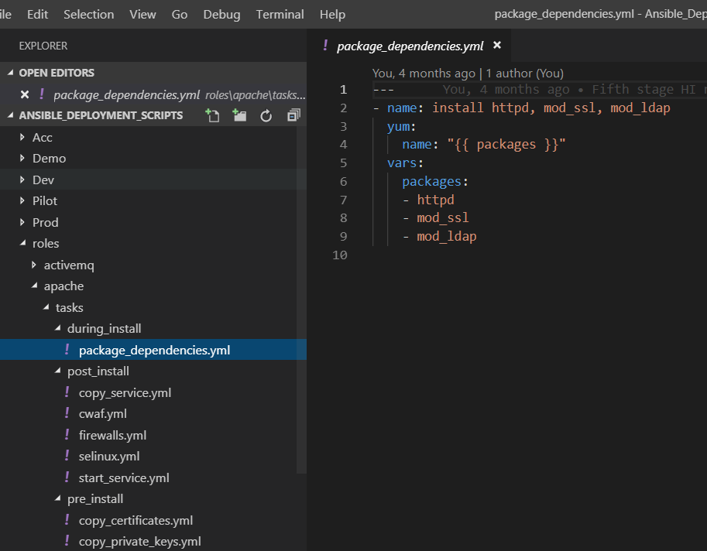
Editor
Anything that writes text will suffice
I highly recommend Visual Studio Code with Ansible Extension
Ansible uses YAML
Ansible Extension will check syntax and indentation (it matters in YAML)
Introduction
<number>

Slide 15
Setting up Vagrant and Ansible
Ansible is not natively supported on Windows
We will use a VM created by Vagrant to host Ansible
We will create other VMs as “target machines”
Let us all download and install Vagrant now, the presentation will continue once it has been set up
Setting up
<number>

Slide 16
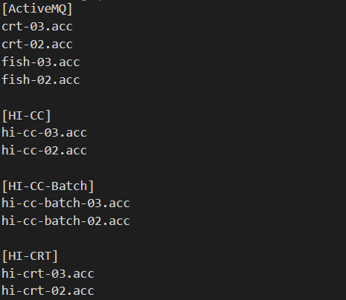
Ansible Hosts file
Contains information about hosts (“target servers”)
Hosts can be grouped
Hostnames and groupnames are magic variables in Ansible and are implicitly set
Setting up
<number>

Slide 17

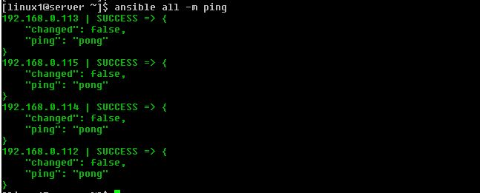
Ansible ad-hoc commands
Ad hoc command: a command sent directly from the command line to (a) server(s)
Ad hoc commands to multiple servers?
Setting up
<number>

Slide 18

Ansible Playbook
Running ad hoc commands is useful but time consuming (you have to manually execute them)
Playbooks automate these commands
Setting up
<number>

Slide 19
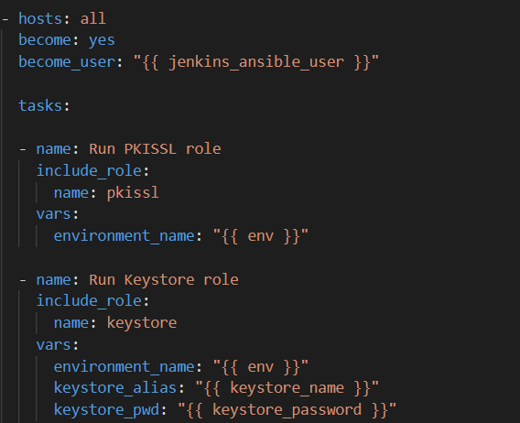
Ansible Playbook syntax
Ansible Playbooks are written in YAML or JSON
YAML is the preferred way for Ansible
Indentation matters!
Takes some getting used to but I prefer it over JSON
See also https://docs.ansible.com/ansible/latest/reference_appendices/YAMLSyntax.html when in trouble
Setting up
<number>

Slide 20
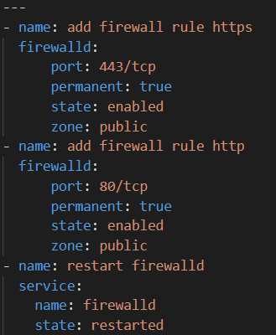
Ansible Modules
Ansible uses modules
Ansible can also run linux commands without modules
Why use modules?
Idempotency!
Setting up
<number>

Slide 21
Ansible, adding servers
How would you go about adding servers to the deployment?
Setting up
<number>

Slide 22
Ansible inventory
Until now: each time you want to change or add a machine you need to edit the hosts file
Not very practical!
Ansible inventory solves this problem
Inventories function exactly like hosts file, including the same syntax
Is picked up by the Playbook you run!
Now the hosts can be defined by a file in your source control
Setting up
<number>

Slide 23
Ansible Playbooks
What if you need to run different parts of a Playbook against different servers
Setting up
<number>

Slide 24
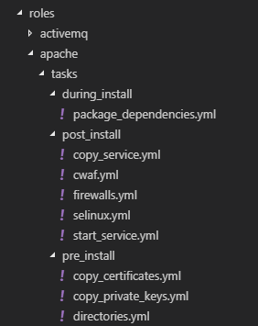
Ansible roles
Ansible roles allow you to very easily split a playbook into smaller parts
Extremely useful when you need to run different commands on different servers
Think of it as having one big playbook that imports many smaller playbooks
Just like variables in a programming language!
Setting up
<number>

Slide 25
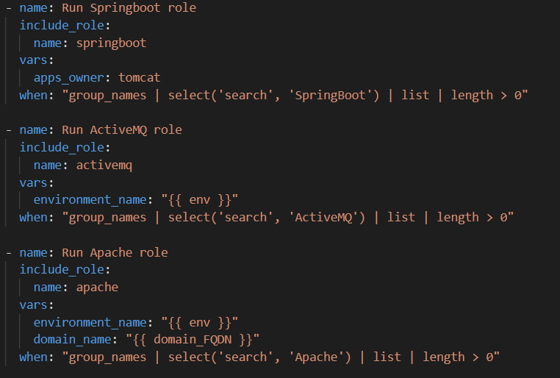
Ansible roles: assigning roles
You can assign different roles to different server groups using “when: ” (analogous to the “if” statement)
Easy and recommended syntax:
when: “’groupname’ in group_names”
More difficult syntax to the right
Setting up
<number>

Slide 26
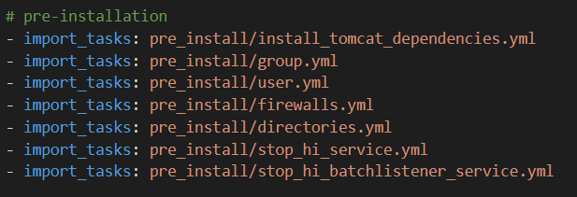
Ansible roles
Ansible roles can be split into smaller subroles when they become too large
The smaller subroles can then be included from a larger main role.
Example:
Setting up
<number>

Slide 27
Recommended architecture
Playbook1.yml
Playbook2.yml
inventory
roles/
tasks/
task1/
task1.yml
main.yml
group_vars/
all.yml
group1.yml
host_vars/
hostname1.yml
Introduction
<number>

Slide 28
Handson
Take your time, try to understand what is going on!
Useful commands:
vagrant up <name>
vagrant reload <name>
vagrant destroy <name>
vagrant provision <name>
Repository:
Introduction
<number>

Slide 29
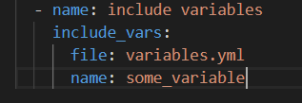
Ansible variables
Variables allow you to much more easily change your playbook
Variables can (and should) be included from variables files
Include the variables files like so
Setting up
<number>

Slide 30

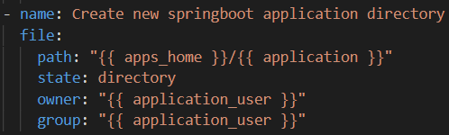
Ansible variable syntax
Setting variables is straightforward
Reading them is slightly less straightforward
Mind! Variables are read by Python parser
Trailing zero’s are cut off!
Be careful with special characters!
When in doubt, make it a string with “”
Setting up
<number>

Slide 31
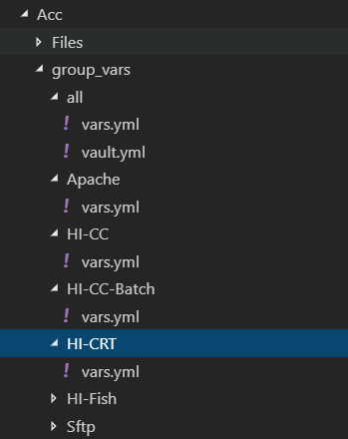
Ansible variables
You can allow Ansible to automatically fill in variables based on known information!
This removes the need to explicitly include variables files!
Ansible will start looking for variables files in the directory of your inventory file
This is where your Ansible repository architecture starts to become very important!
Setting up
<number>

Slide 32
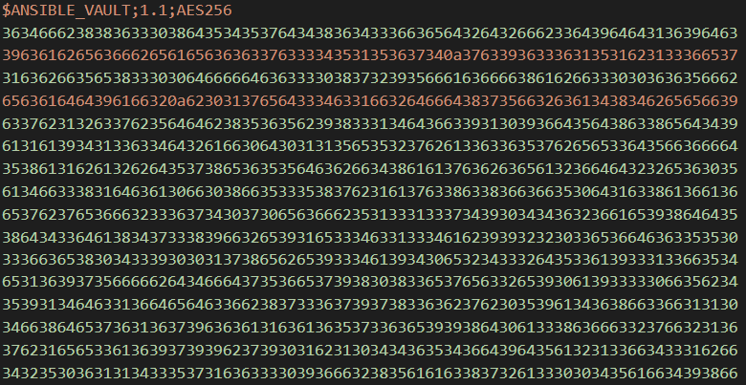
Ansible vault
Passwords in your source control? Ouch
Ansible can encrypt sensitive data using vault
Enter a password to encrypt a file; to decrypt the correct password must be supplied
Commands:
ansible-vault encrypt vault.yml
ansible-vault decrypt vault.yml
Setting up
<number>

