Slide 1
LRC Big Data Introduction
Analysis Using Hive & RStudio

Slide 2
Agenda
HWIN Data analytics/Cleaning the Data using Hadoop Hive
Data analytics result visualization using R
Predicting Renew status using R
TBD - Create Company similar list dataset
A typical Big Data use case: Monitoring , forecasting and visualize date/ forecasting air pollution

Slide 3
Why HIVE instead of MapReduce or Spark
SQL like Data-base which is very easy to use.
Map reduce / Spark:
Strengths:
Works both on structured and unstructured data.
good for writing complex business logic.
Weakness:
long development type
hard to achieve join functionality
Hive :
Strengths:
less development time.
suitable for adhoc analysis.
easy for joins
Weakness :
not easy for complex business logic.
deals only structured data.

Slide 4
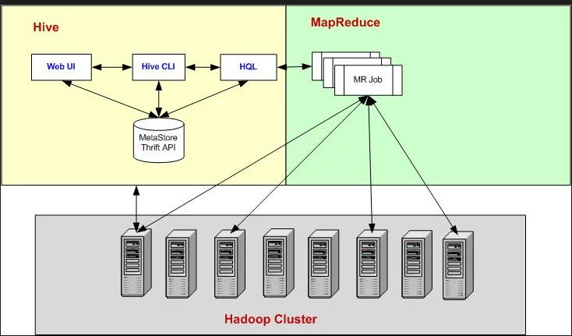
Hadoop HIVE Structure

Slide 5
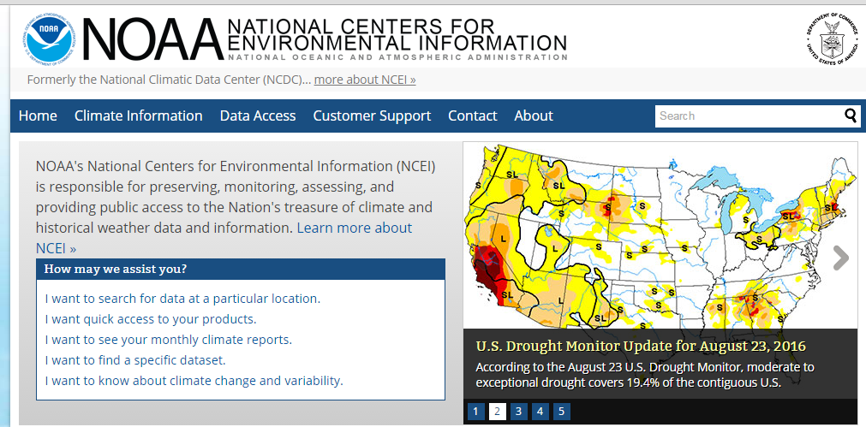
A typical MapReduce Sample - weather data analytics
Weather sensors collect data every hour at many locations across the globe and gather a large volume of log data, which is a good candidate for analysis with MapReduce because we want to process all the data, and the data is semi-structured and record-oriented. (tens of thousands of weather stations, and the Weather Dataset can download from the National Climatic Data Center, or NCDC.)

Slide 6
A typical MapReduce Sample - weather data analytics
Datafiles are organized by date and weather station. For example, here are the first entries for 1990:
% ls raw/1990 | head
010010-99999-1990.gz
010014-99999-1990.gz
010015-99999-1990.gz
010016-99999-1990.gz
010017-99999-1990.gz
010030-99999-1990.gz
010040-99999-1990.gz
010080-99999-1990.gz
010100-99999-1990.gz
010150-99999-1990.gz

Slide 7
Analyzing the Data with Hadoop MapReduce
The input to our map phase is the raw NCDC data
The map function merely extracts the year and the air temperature (indicated in bold text), and emits them as its output (the temperature values have been interpreted as
integers):
(1950, 0)
(1950, 22)
(1950, −11)
(1949, 111)
(1949, 78)

Slide 8
Analyzing the Data with Hadoop MapReduce
The output from the map function is processed by the MapReduce framework before being sent to the reduce function. This processing sorts and groups the key-value pairs
by key. So, continuing the example, our reduce function sees
the following input:
(1949, [111, 78])
(1950, [0, 22, −11])
All the reduce function has to do now is iterate through the list and pick up the maximum reading:
(1949, 111)
(1950, 22)

Slide 9
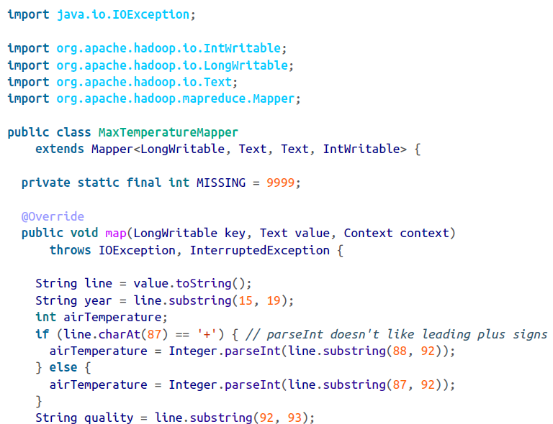
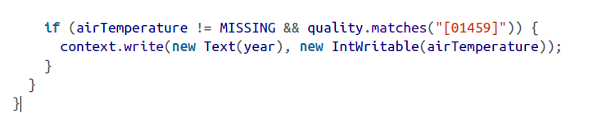

Slide 10
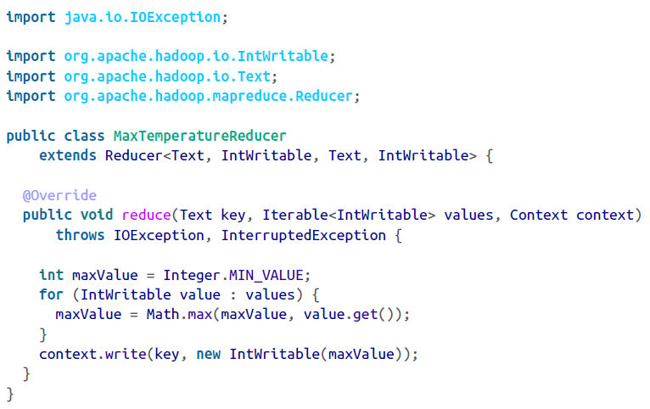

Slide 11
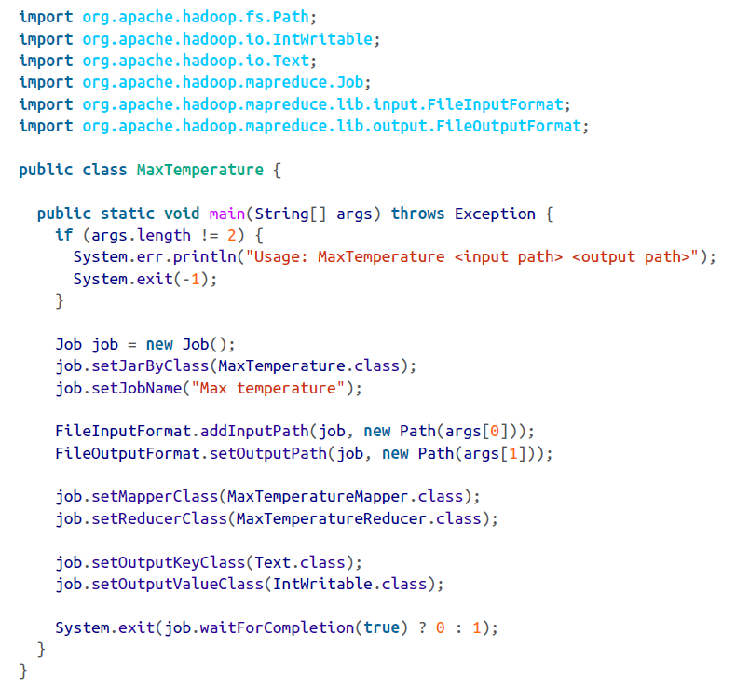

Slide 12
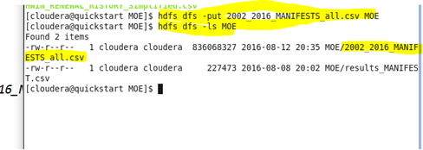
Upload the Manifest and renew history files to HDFS
Upload the data to HDFS by running the following commands.
$ hdfs dfs -mkdir MOE
$ hdfs dfs -put 2002_2016_MANIFESTS_all.csv MOE

Slide 13
Create HIVE tables and load manifest and renew history files
Create HIVE tables for manifests and renew history. Such as following command to reate manifest HIVE table:
CREATE TABLE `manifests`(`company_id` string, "generator_nunber` string, `carrier_number` string,
`receiver_number` string, `manifest_number` string, `date_shipped` string, `date_received` string,
`rec_handling_code` string, `quantity_own` string, `shipped_unit_of_measure` string,
`is_recyclable` string, `manifest_fee` smallint, `tonnage_fee` float, `ispapermanifest` string,
`manifest_fee_paid` string, `manifest_fee_refunded` string, `tonnage_fee_paid` string,
`tonnage_fee_refunded` string, `date_shipped_year` string, `date_shipped_mon` string,
`date_shipped_day` smallint, `sp_grav_fix3` float, `quantitykg` float)
COMMENT '2002_2016_MANIFESTS_all'
ROW FORMAT DELIMITED
FIELDS TERMINATED BY ','
STORED AS INPUTFORMAT 'org.apache.hadoop.mapred.TextInputFormat'
OUTPUTFORMAT 'org.apache.hadoop.hive.ql.io.HiveIgnoreKeyTextOutputFormat'
LOCATION 'hdfs://quickstart.cloudera:8020/user/hive/warehouse/moe.db/manifests'

Slide 14
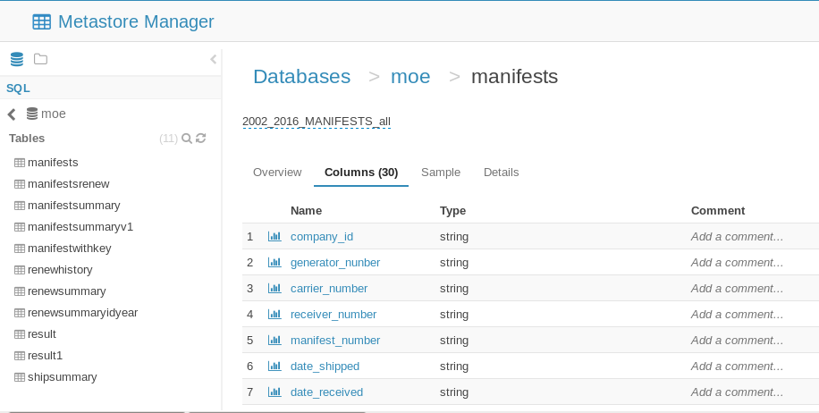
Load CSV files to HIVE Table
such as:
LOAD DATA INPATH '/user/2002_2016_MANIFESTS.csv' INTO TABLE `moe`.`manifests`

Slide 15
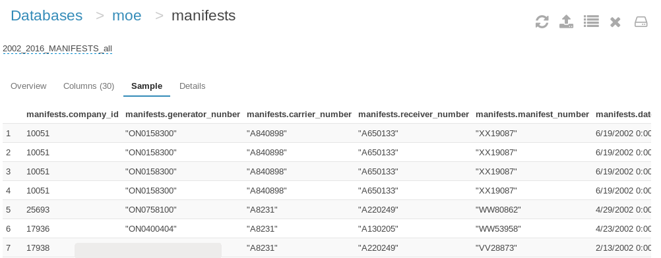
Sample Manifests records at the HIVE Table

Slide 16
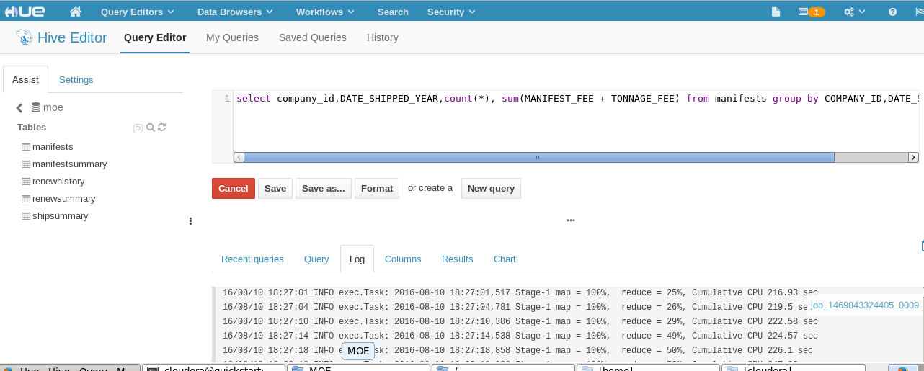
Analyses Manifests and Renew History using HIVE SQL
such as:
Following HIVE SQL get the total ship number and amount from manifests table and by company and year
select company_id,DATE_SHIPPED_YEAR,count(*), sum(MANIFEST_FEE + TONNAGE_FEE) from manifests group by COMPANY_ID,DATE_SHIPPED_YEAR
In the background, The HIVE SQL converts the HIVE SQL to Map and reduce tasks and put the result to HDFS

Slide 17
Analyses Manifests and Renew History using HIVE SQL
Following HIVE SQL get renew history entries with the renew data is before Feb 15 only
select company_id, date_renewal_complete, concat('20',substring(date_renewal_complete,8,2)) as Year from renewhistory where (lower(substring(date_renewal_complete,4,3))='jan' or (lower(substring(date_renewal_complete,4,3))='feb' or cast(substring(date_renewal_complete,1,2) AS BIGINT)<15))
Following HIVE SQL join manifests and renew history tables
SELECT m.company_id, r.date_renewal_complete, r.year, m.date_shipped_year,m.tshipnum,m.tamount FROM manifestwithkey m LEFT OUTER JOIN renewsummaryidyear r ON (m.idyear = r.idyear)

Slide 18
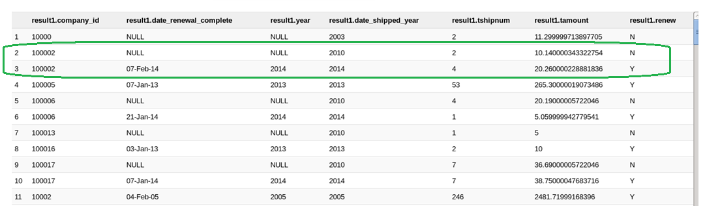
Analysis Result
The final result table include the total shipped number, amount and renew status by company and year. That also means this table list the manifests shipping and renew status for each company year by year.
TBD – Check and fix some NULL entries

Slide 19
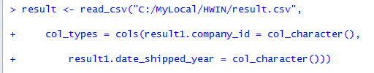
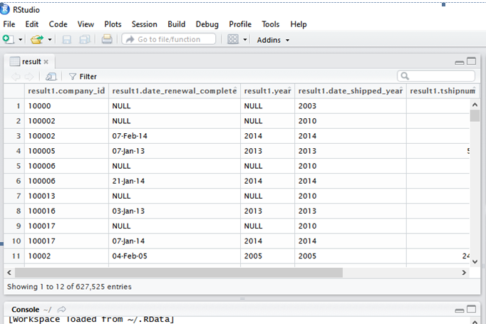
Result Visualization using R – Load Data

Slide 20
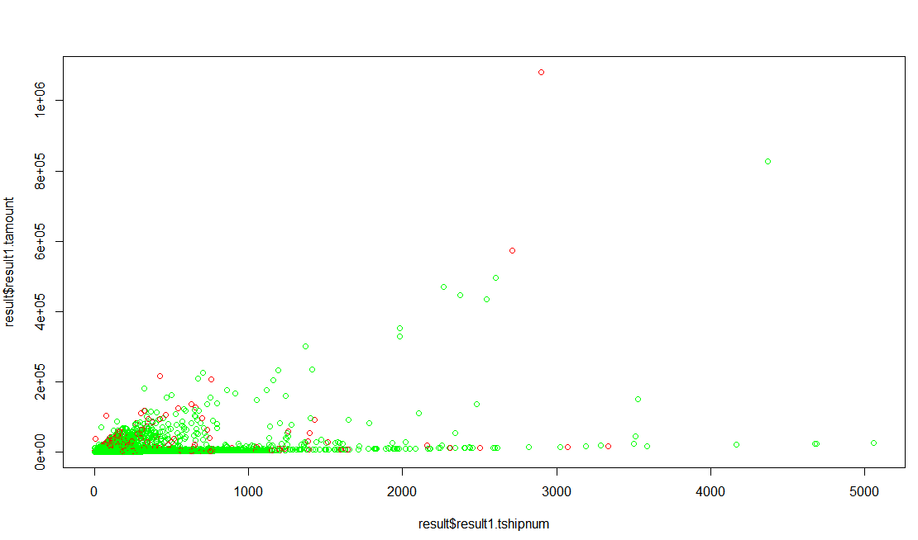
Visualization #1 - Full result data
plot(result$result1.tshipnum, result$result1.tamount, col=ifelse(result$result1.renew =="Y", "green", "red"))

Slide 21
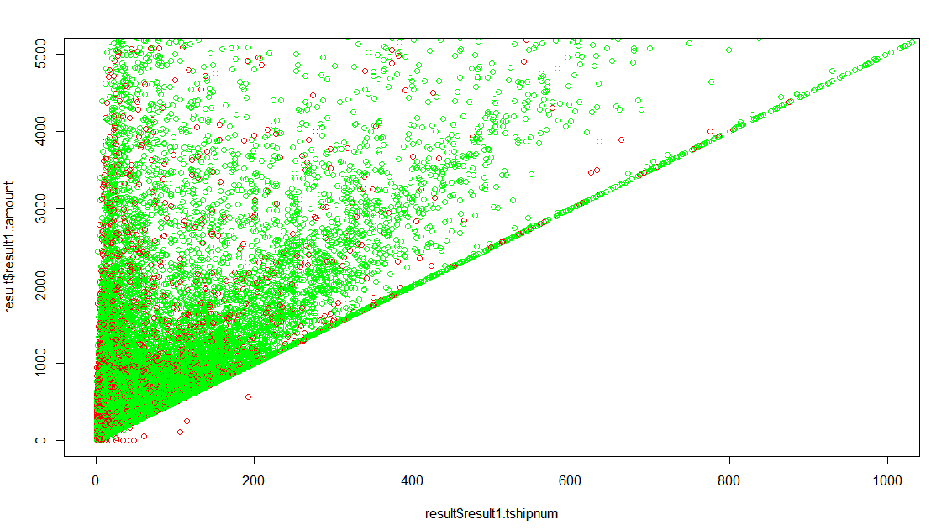
Visualization #2 - Zoom out. Shipp number less than 1000 and amount less than 5000
plot(result$result1.tshipnum, result$result1.tamount, xlim=c(0,1000), ylim=c(0,5000),col=ifelse(result$result1.renew =="Y", "green", "red"))

Slide 22
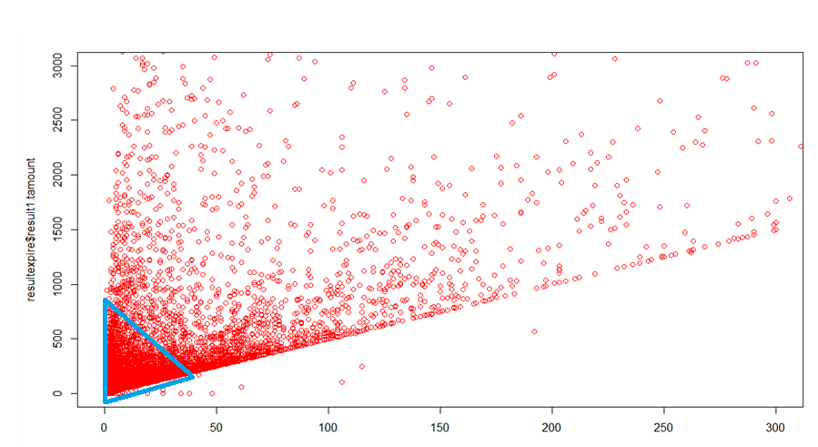
Visualization #3: Additional Zoom out. Shipp number less than 300 and amount less than 3000 with expire items only
plot(resultexpire$result1.tshipnum, resultexpire$result1.tamount, xlim=c(0,300), ylim=c(0,3000), col=ifelse(resultexpire$result1.renew =="Y", "green", "red"))

Slide 23
predictive analytics using Naive Bayes
Why Naive Bayes
Naive Bayes classifiers are a popular choice for classification problems. There are many reasons for this, including:
"Zeitgeist" - widespread awareness after the success of spam filters about ten years ago
Easy to write
The classifier model is fast to build
The model can be modified with new training data without having to rebuild the model

Slide 24
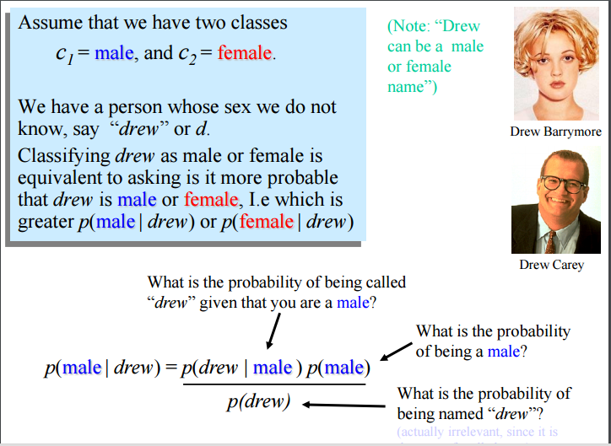
A typical sample to use Bayes

Slide 25
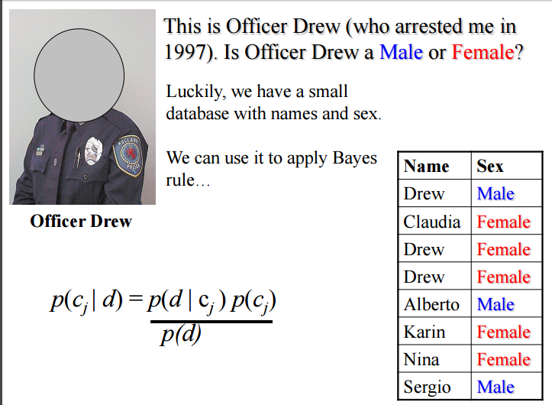
A typical sample to use Bayes

Slide 26
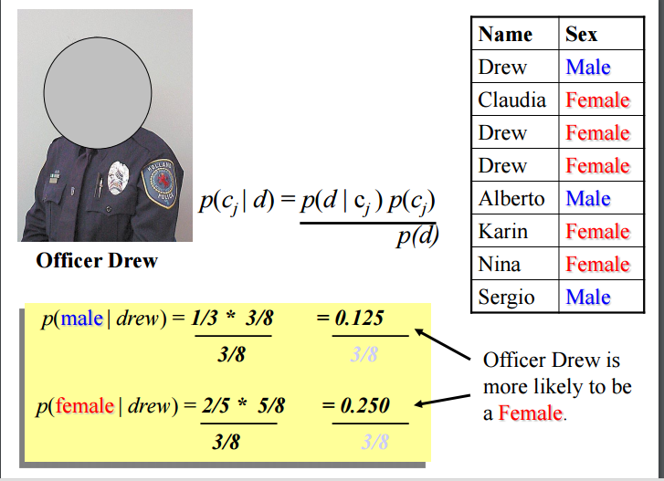
A typical sample to use Bayes

Slide 27
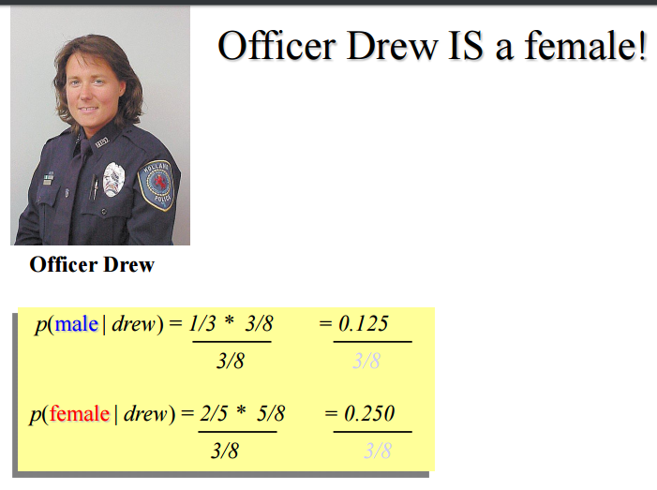
A typical sample to use Bayes

Slide 28
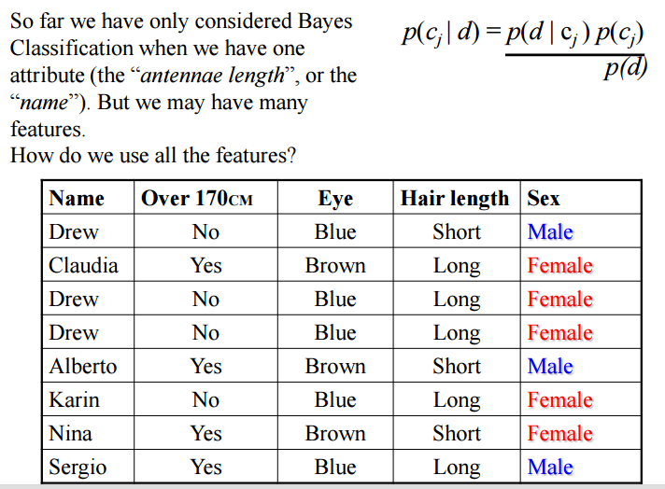

Slide 29
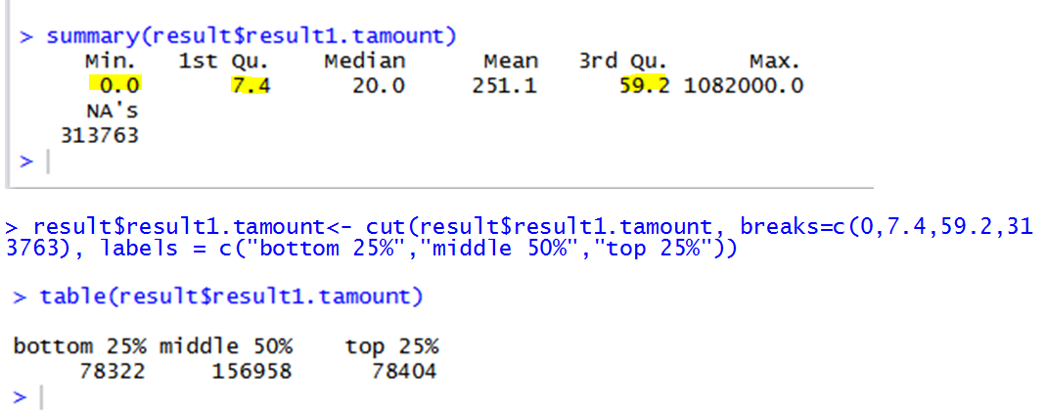
Bin quantitative variables
Naive Bayes calculates conditional probabilities given certain things happening. Therefore, when using naive Bayes we turn quantitative or continuous variables into categorical variables. In this case, let’s create a new variable for shipping amount that indicate whether the value is in the bottom 25%, middle 50% or top 25%.
TBD – Adjust the categorical variables

Slide 30
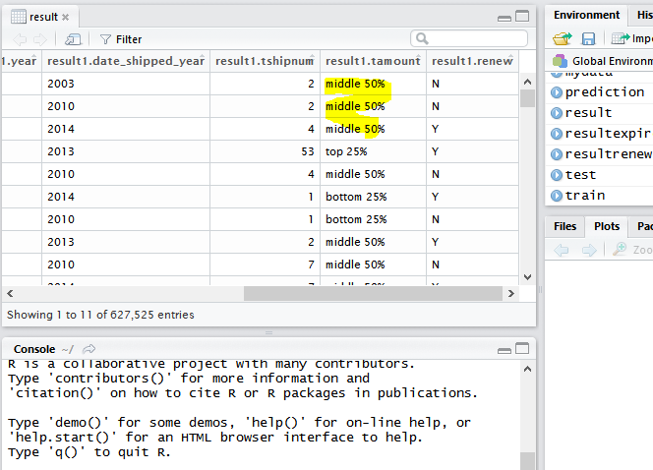

Slide 31
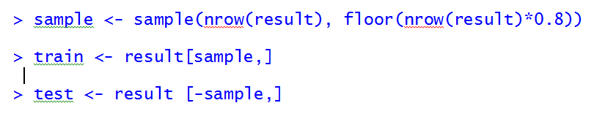
Split result data(manifest, renew status) into test and train. Use 80-20 split.

Slide 32
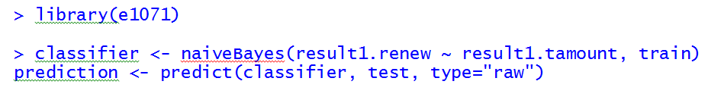
Estimate naive Bayes and make predictions

Slide 33
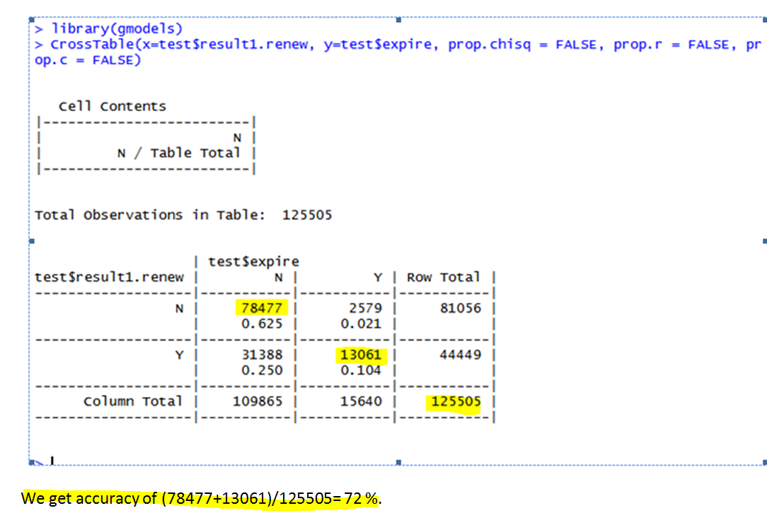
Accuracy

Slide 34
TBD-Create Company similar list dataset
One could use information about the company to identify similar companies. Such as we can use shipping amount, waste code and so on to identify companies that are similar. When one company renew their license, Env. Officer can use this list to identify all other similar companies which also supposed to renew their license. Or when one companies license expired, This list can also help to check all other similar companies.
The shipped waste code, historical renew status, Generate site address.. etc. can be used to identify those similar areas.
This similar company list can also be used as a feature to build the machine learning model.

Slide 35
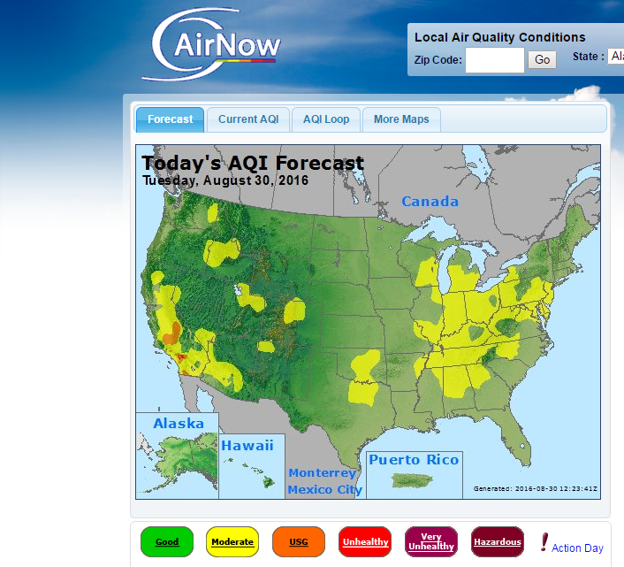
A typical Big Data use case: Environmental Monitoring using Big Data
Monitoring and forecasting air pollution
Collection and storage of sensor data from AirNow (historical data and Stream current data)

Slide 36
Data
Hourly readings of several key air quality metrics are being generated by over 2,000 monitoring sensor stations located in over 300 cities across the United States.
The data is provided by AirNow, which is a U.S. government EPA program that protects public health by providing forecast and real-time air quality information.
The two main collected metrics are PM2.5 and Ozone (o3).
PM2.5 is particles less than 2.5 micrometers in diameter, often called “fine” particles. These particles are so small they can be detected only with an electron microscope. Sources of fine particles include all types of combustion, including motor vehicles, power plants, residential wood burning, forest fires, agricultural burning, and industrial processes.
o3 (Ozone) occurs naturally in the Earth’s upper atmosphere, 6 to 30 miles above the Earth’s surface where it forms a protective layer that shields us from the sun’s harmful ultraviolet rays. Man-made chemicals are known to destroy this beneficial ozone.
Other collected metrics are: pm10 (particulate matter up to 10 micrometers in size), co (Carbon Monoxide), no2 (nitrogen dioxide) and so2 (sulfur dioxide).

Slide 37
Data execute data analytics and forecasts
Executing data analytics using Hadoop (Spark or Mapreduce)
Generating forecasts using R
Creating visualization portals using R
Automatically raising alerts in the case of abnormal deviations or threshold breaches.

Slide 38
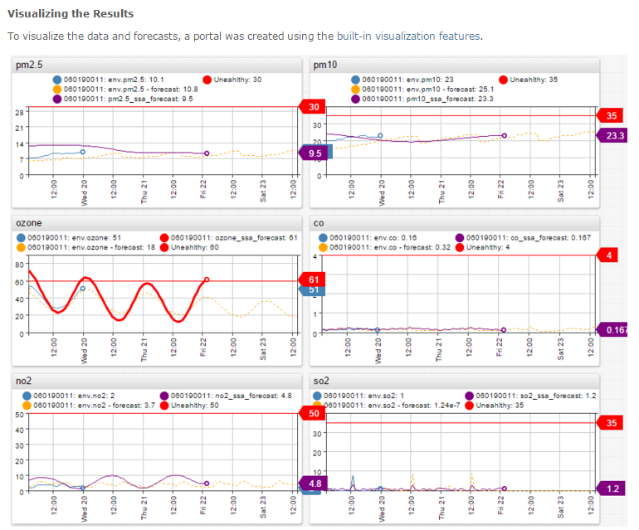

Slide 39
Q & A

