Slide 1



Comparing Analysis Method Implementations in Software (CAMIS)
Agnieszka Tomczyk & Lyn Taylor
(On Behalf of CAMIS WG)
14th June 2024

Slide 2

Agenda
Part 1: Lyn Taylor Introduction to CAMIS project
Why Do We Need CAMIS ?
Project Objectives
Progress To Date
Commons Reasons For Discrepancies
How You Can Benefit & Contribute !
Part 2: Agnieszka Tomczyk Wilcoxon Signed Rank Test
Example of a CAMIS project
Analysis in R, StatXact & SAS®
Results comparison & reasons
for discrepancies
Coming soon…

Slide 3




Why Do We Need CAMIS?
Shift in Industry from using SAS® to using R and Open source software
Aim is to make us more efficient and less costly = Drugs to market quicker for patients
pharmaverse packages providing industry wide standards and efficiencies
But what happens if we do statistical analysis in open-source software?
Do we get the same results as we got in SAS®?
Sometimes But not always
This causes uncertainty, apprehension and nervousness about the use of R
But was SAS® “Correct”?
Why do they differ?
Finding out is very time consuming !!!!
Notes:
Historically “All” Clinical Trial Phase III Submissions were completed in SAS®
However, recently there has been a shift to using R and python due to the additional functionality these software offer
Benefits include : Wide functionality and easy graphics, better interaction with other software allowing autopopulation of reporting & interactive reporting, and there is a community led effort (pharamverse) to standardize and share packages that make end to end Clinical trial reporting more efficient.
But what happens if we do statistical analysis in open source software?
Do we get the same results as we got in SAS?
Sometimes…. But not always
This causes uncertainty, apprehension and nervousness about the transition to R.
But what is “correct”, why do they differ and is there actually a Correct result? Finding out is very time consuming.

Slide 4

CAMIS Project Objectives
To increase understanding and awareness of analysis result discrepancies across software (R, SAS®, Python etc)
To demonstrate the methodology through examples
To document in open GitHub repository
To grow the repository, increasing quality and quantity of information
Repository location:
https://psiaims.github.io/CAMIS/
Notes:
CAMIS’s project objectives are:
To increase understanding and awareness of analysis result discrepancies across software (R, SAS®, Python etc)
The hope here is that by someone coming up against a discrepancy between software and spending the time looking at the methods in detail and documenting why things are different this will save another person wasting the same time !
Hence objective 2 is to: To demonstrate the methodology through examples
It’s really important that our findings are clearly explained with examples, so others can use them
Thes findings are stored in open GitHub repository which is completely open for contributions and people to access.
We would like To grow the repository, increasing quality and quantity of information. WE have made a good start in many areas, but now invite the wider community to read our content, and propose improvement and enhancements as well as investigating areas we have not managed to investigate yet. In order for our content to remain current, ti needs to be used, and as we see SAS users starting to use SAS Viya and R users embraceign analysis in python, we need to continually update our content and improve it.

Slide 5

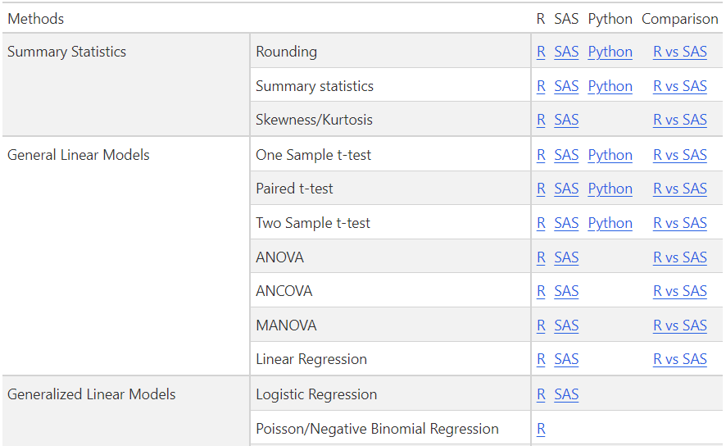
Progress to Date (1)
Notes:
As we have little time today, I wont go into the content, in detail, but just to say all with blue links, are places we have some content giving examples of running in R< SAS, Python and comparing the results obtained in a comparison file.

Slide 6
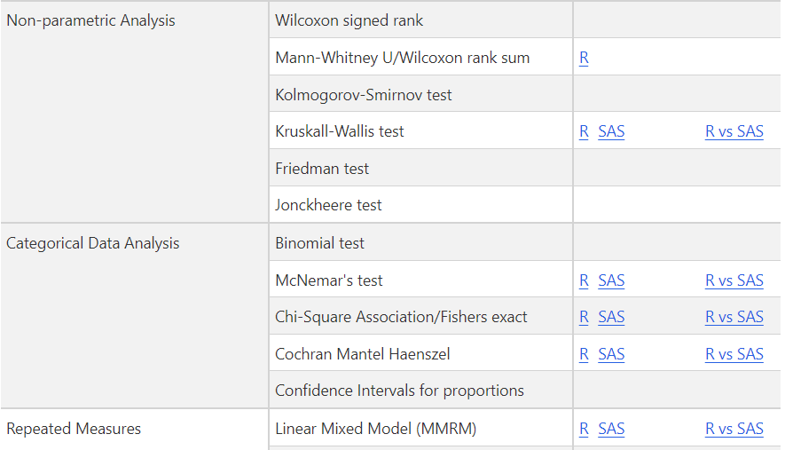
Progress to Date (2)

Slide 7

Common Reasons for Discrepancies
You are actually doing a different analysis method
SAP unclear so default options used and these mis-match between SAS & R
Lack of awareness that different options exist and should be specified in the SAP
Different optimization routines and convergence methods
Perhaps both are “correct” but are just different methods that give different results!
Discrepant for a subset of use cases
The results match, in most cases, except when your data is of a certain anomaly Example: Survival : Last event results in exactly survival estimate of 0.5 [median] Handling of such cases can be done differently in SAS & R and not well documented.
Bug in the software
We’ve observed this less often than the above as we use SAS® and common R packages
Notes:
You are actually doing a different analysis method
SAP unclear so default options used and these mis-match between SAS & R
Lack of awareness that different options exist and should be specified in the SAP & program
Different optimization routines and convergence methods
Perhaps both are “correct” but are just different methods that give different results!
This may not matter…. As long as you can explain WHY they are different and that it’s not an eror, but due to X and Y… hence both valid – if same conclusion in result, drug to market without issue !
Discrepant for a subset of use cases
The results match, in most cases, except when your data is of a certain anomaly (Last observation censored, last survival estimate exactly 50%, tied data, missing data – handling of such cases can be done differently in SAS & R and not well documented).
Bug in the software – but we’ve observed this often than the above

Slide 8

How You Can Benefit
Our industry often involves third parties reviewing our analysis and trying to replicate it – We need to be able to explain discrepancies
Use the repository as a database of common reasons for discrepancies
Save yourself substantial time having to investigate issues yourself
Read our white paper (under Publications on the repo)
Ensure your statistical analysis plans are written in a way to help replication across software through clearer specification of analysis methods
Learn how to research discrepancies and things to look out for

Slide 9

How You Can Contribute
Please share with us any discrepancies you observe to ensure we continue to grow our resource
See Contribute tab on repo for more detail on how to fork the repo.
We are happy to receive any contribute (big or small!)
Any questions: Lyn.Taylor@Parexel.com
Help us to improve our content, through review & propose changes
Help us to grow our content, by running datasets through methods in different software and investigating if you get the same results, if not Why?
Join our monthly meetings to hear about current scope of the project
Contact: Lyn.Taylor@Parexel.com to receive meeting invite.

Slide 10
Thank you Time for part 2!

Slide 11
Example of CAMIS project
Wilcoxon signed-rank test with Hodges-Lehmann estimate
Wilcoxon signed-rank test is a non-parametric equivalent of paired Student's t-test. It is a rank test, designed for analysing repeated measures or paired observations by a paired comparison to assess whether their population means differ.
Comparison of analysis in R, StatXact and SAS
StatXact® PROCs for SAS users is a clinical trial analysis software from Cytel for exact statistics. Package includes more than 150 procedures for exact inference statistical data and power analysis.

Slide 12
How did it start?
Analysis in one of the studies
2-period, cross-over study comparing treatments A and B in patients with asthma and acute airway obstruction induced by repeated mannitol challenges. Wilcoxon signed-rank test was applied to analyse the time to return to baseline FEV1 post-mannitol challenge 2. Median difference, p value and 90% CI were provided using the Hodges-Lehmann estimate.
Challenges we encountered
Lack of or unprecise documentation for SAS
Differences in nomenclature/understanding of methods
Many possible approaches in literature
As a starting point let’s consider:
Dataset with 240 paired observations, with no ties and no 0 differences

Slide 13
Analysis in R
Available in (amongst other packages):
stats::wilcox.test()
DOS2::senWilcox()
stats:
Provides exact/non-exact p values, exact/non-exact H-L estimate, exact/non-exact CIs, with or without continuity correction (for non-exact ones)
By default an exact p value is computed if the sample size is less than 50 and there are no ties. Otherwise, a normal approximation is used
If exact p values are available, an exact confidence interval is obtained by the algorithm described in Bauer (1972), and the Hodges-Lehmann estimator is employed. Otherwise, the returned confidence interval and point estimate are based on normal approximations

Slide 14
Analysis in R
stats:
If non-exact p-value is calculated, continuity correction in the normal approximation for the p-value can be applied with *correct* argument.
Provides V (=T+) statistic
DOS2:
Provides only non-exact H-L estimate and corresponding CI without continuity correction - then, matches stats’ results

Slide 15
Analysis in StatXact
PROC PAIRED can be used to perform Wilcoxon Signed-Rank test
Provides exact/non-exact p values, (exact) H-L estimate, exact/non-exact CIs
Using ZEROS option we can compute H-L estimate including all differences. Excludes 0s by default.
Provides T+ statistic (sum of ranks of the positive differences)
Follows Sprent (1993) approach for Wilcoxon Signed-Rank test and Lehmann (1975) for H-L estimate and CI

Slide 16
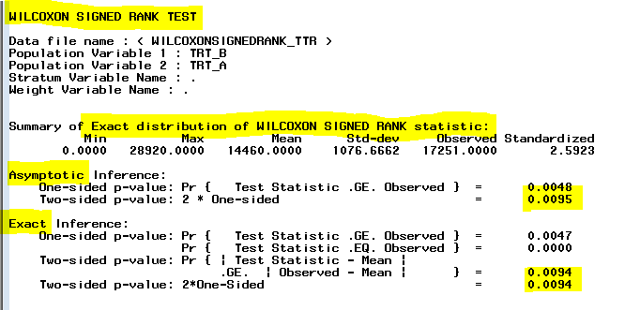
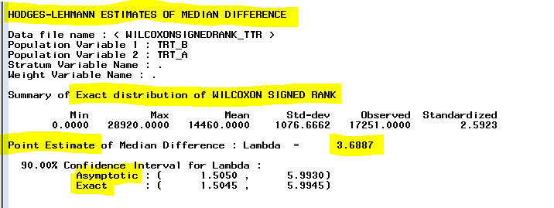
StatXact output
Our …

Slide 17
Analysis in SAS
PROC UNIVARIATE can be used to perform Wilcoxon Signed-Rank test
Provides only p value, based on Signed Rank (S) statistic (modification of a common T+), S = T+ − (n(n + 1)/4
It computes exact p-values only for n ≤ 20. For larger samples uses an asymptotic (t-Student/normal/Monte Carlo?) distribution of the test statistic
In SAS all the ties and 0 differences are disregarded (Hollander and Wolfe, 1973), algorithm considering them (Pratt, 1959 & Lehmann,1975) is not available
Using CIQUANTNORMAL option we can get confidence limits for quantiles, using noncentral t distribution (Hahn and Meeker,1991 & Odeh and Owen,1980) – 5 different definitions are available
Hodges-Lehmann estimate and CI are not available – have to be calculated manually

Slide 18
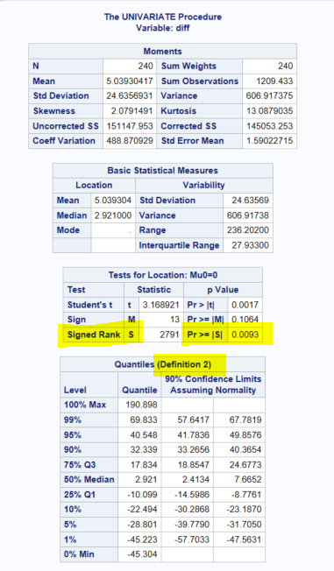
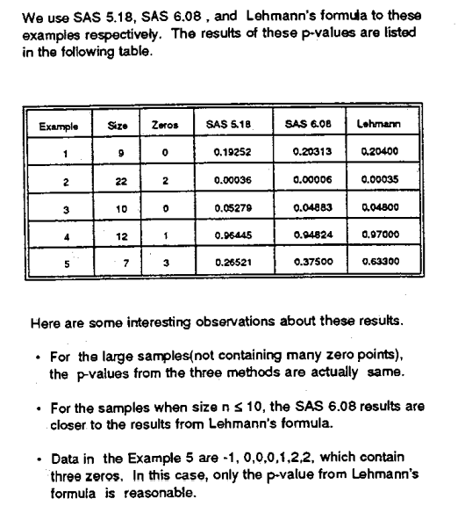
SAS output & p values
(Tian, 1994)

Slide 19
Results comparison
 |  | R (stats) | R (DOS2) | StatXact | SAS
method | statistic
exact | p value | 0.009379 | not available | 0.0094 | not available
 | estimate* | 3.68875 |  | 3.68875
 | CI | [1.5045, 5.9945] |  | [1.5045 , 5.9945]
non-exact, no correction | p value | 0.009535 | 0.009534732 | 0.0095 | 0.0093
 | estimate* | 3.688796 | 3.688796 | not available | not available
 | CI | [1.504991, 5.993011] | [1.50494, 5.99305] | [1.5050 , 5.9930]
non-exact, correction | p value | 0.009548 | not available | not available | ??
 | estimate* | 3.688796 |  |  | not available
 | CI | [1.504565, 5.994467]
* (pseudo) median estimate

Slide 20
Reasons for discrepancies
Rounding & presentation of p values with 4-9 decimal places
Different algorithms/approaches available (exact, asymptotic, with continuity correction, ...)
Lack of full documentation

Slide 21
Coming soon…
Analysis based on:
Very small dataset (up to 20 observations)
Dataset with ties and differences equal to 0
More packages in R
coin::wilcoxsign_test
DescTools::HodgesLehmann
rQCC:HL
p values in SAS UNIVARATE proc

Slide 22
For collaboration on Wilcoxon signed-rank test please contact me: agnieszka.tomczyk@parexel.com

Slide 23
Thank you!

