Slide 1




(Sample) size matters! – demonstrating sample size calculations across software
Agnieszka Tomczyk & Lyn Taylor
(On behalf of CAMIS WG)
11th June 2025

Slide 2


Agenda
Introduction to CAMIS project
Project objectives
Progress to date
Selected statistical tests
Comparison of analyses
Comparison of results
Main reasons for discrepancies

Slide 3
What is CAMIS & what are the project objectives?
CAMIS: Comparing Analysis Method Implementations in Software
To increase understanding and awareness of analysis result discrepancies across software (R, SAS®, Python etc)
To demonstrate the methodology through examples
To document in open GitHub repository
To grow the repository, increasing quality and quantity of information
Repository location:
https://psiaims.github.io/CAMIS/

Slide 4
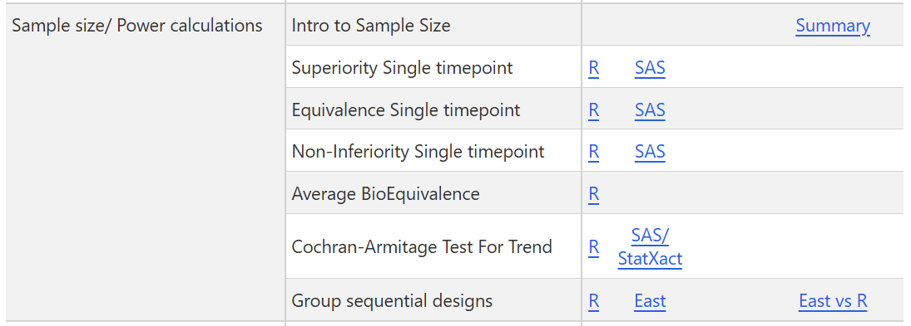

Current progress (in the sample size research)
StatXact
EAST
Considered software:
R
SAS

Slide 5
Selected statistical tests
Comparing means in superiority/ non-inferiority/ equivalence studies
Checking whether the test therapy is better/ as effective as/ difference between the test therapy and the standard therapy is of no clinical importance - considering in each case parallel (unpaired) and cross-over designs
Average BioEquivalence (BE)
Two one-sided tests (TOST) to determine whether the average values of the test vs. The standard therapy are comparable. For BE, the 90% CI for the ratio of the averages should fall within a BE limit, usually 80-125%
Cochran-Armitage Test For Trend
Testing whether there is a linear trend when the response is binary
Group sequential designs
Based on the example of a time-to-event endpoints - phase III oncology trial comparing the test therapy to the standard in terms of progression-free survival (PFS) and overall survival (OS)

Slide 6
Comparison of supported analyses (R/SAS)
Analysis | Supported in R | Supported in SAS | Notes
Means comparison - superiority | YES | YES | Results are matching. For different SD per group in parallel design SAS applies Satterthwaite t-test (Welch’s t-test) only, R supports classical t-test as well (MASS). samplesize doesn’t support balanced designs.
Means comparison - non-inferiority | YES | YES | Results are matching. Cross-over design is supported only in TrialSize.
Means comparison - equivalence | YES | NO | Results are matching only if the true mean difference = 0. Otherwise, TOST is performed in SAS.
Average Bioequivalence | YES | YES | Results are matching between R (PowerTOST) and SAS – several, more complex approximations are applied (Owen's Q function). TrialSize uses only normal approximation and only for means difference (not ratio).

Slide 7
Comparison of supported analyses (R/SAS)
Analysis | Supported in R | Supported in SAS | Notes
Cochran-Armitage Test | YES | NO, but in StatXact | Supported in R (multiCA) and StatXact only. StatXact is calculating the (exact or asymptotic) power of the exact CA test, and not the exact power of the asymptotic test. That is not implemented in multiCA package in R. R supports both multinomial and binary outcome; StatXact only the latter. Results often differ.
Group sequential designs | YES | NO, but in EAST | Both LF and KT methods are implemented in gsDesign, while KT method is implemented in EAST and rpact. gsDesign2 uses a modification of the LF method while applying an average hazard ratio (AHR) approach. Usage of different log hazard ratio variance assumptions: EAST uses the variance under the null hypothesis and provides an option for using the variance under the alternative hypothesis. gsDesign, on the other hand, is using both of these variances as suggested by LF. gsDesign2 can do either.

Slide 8
Sample size results comparison
Analysis | Details | R | SAS (StatXact/EAST)
means - superiority | SD1 = SD2, parallel | samplesize: 57 stats: 56.16413 pwr: 56.164 | 114 total = 57 per arm
 | SD1 =/= SD2, parallel | MESS: 328 = 164 + 164 samplesize: 252 = 56 + 196 | 330 = 165 + 165
means - equivalence | parallel, true mean diff = 0 | TrialSize: 43.8469 SampleSize4ClinicalTrials: 44 | 90 total = 45 per arm
 | parallel, true mean diff ≠0 | TrialSize: 107.0481 SampleSize4ClinicalTrials: 108 | 140 total = 70 per arm
 | cross-over, true mean diff = 0 | TrialSize: 7.612309 | 8 per arm
avg. bioequivalence | 2x2 crossover, mean ratio (log scale) | PowerTOST: 40 total | 38 total
 | 2x2 crossover, mean diff | PowerTOST: 70 total TrialSize: 21 per arm (42 total) | 69 total
C-A trend test |  | multiCA: 526.2628 total = 106 per arm | StatXact: asymptotic: 104 per arm exact: 108 per arm
Group sequential designs |  | gsDesign gsDesign2 rpact | EAST

Slide 9
Reasons for discrepancies
Different analysis method
Or even statistical test! (equivalence vs. TOST)
Confusing terms/parameters
Rounding…
Bug in the software

Slide 10
Reasons for discrepancies
Approach to SD if different per group
(parallel design)
SD vs. Effect size (Cohen’s d)
Intra vs. Inter subject variability – SD of the difference vs. SD between subjects
Distribution:
normal vs. ???
Confused
terms
Beta (β) = probability of making a Type II error vs.
Power = 1 – β
Sample size
per arm vs. total
Alternative hypothesis

Slide 11

Lyn
Agnieszka
To contribute to CAMIS & join our monthly meetings please contact Lyn at: lyn.taylor@parexel.com
For collaboration on sample size & power calculation please contact me at: agnieszka.tomczyk@parexel.com
Meet us at the „SIG at the Bar” session!
🥂
Thank you!

