Slide 1
Implementation

Slide 2
Implementation
We cheated
Re-implemented existing Matlab code in Python

Slide 3
Implementation
Algorithm:
Want to minimize energy
Iterative gradient descent
X

Slide 4
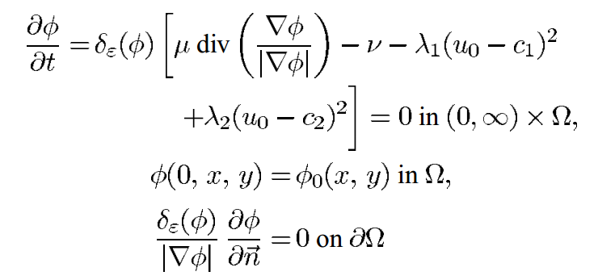
Implementation
Gradient given by:

Slide 5

Implementation
Gradient given by:
Regularized Dirac delta function:
ε is set to 1.0 for our experiments

Slide 6
Implementation
Gradient given by:
Curvature of level-set function
Biases contour towards surrounding larger objects rather than lots of small ones

Slide 7
Implementation
Gradient given by:
So larger μ means larger objects (or groupings of objects) are selected and smaller points are rejected – useful for countering noise
μ set to 1.0 by default in our implementation, but varies throughout our experiments

Slide 8
Implementation
Gradient given by:
We do not solve curvature with respect to time

Slide 9
Implementation
Gradient given by:
Correction term which pushes the contour towards an object even when curvature is zero or negative
Originates from simpler models using only curvature
v is set to zero in our implementation

Slide 10
Implementation
Gradient given by:
Functions of the mean values of the image inside the contour and outside the contour (c₁ and c₂)
λ₁ = λ₂ = 1 in our implementation

Slide 11
Results

Slide 12
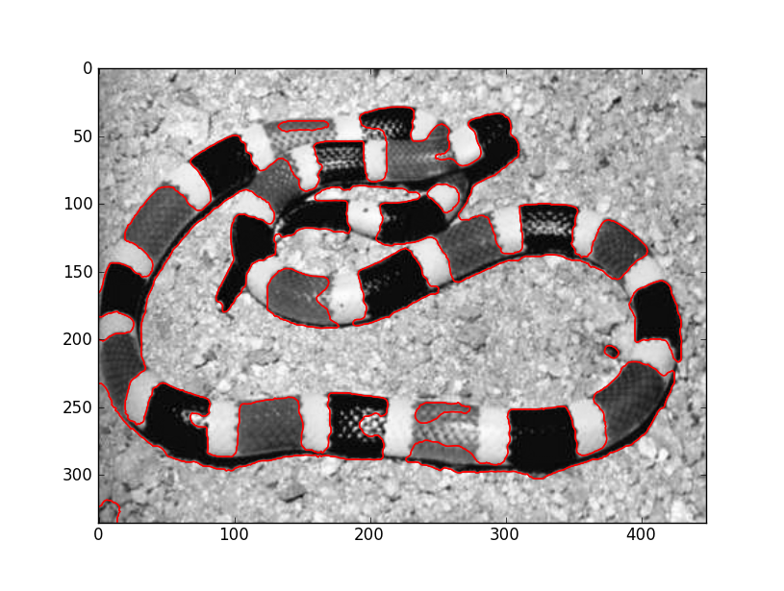
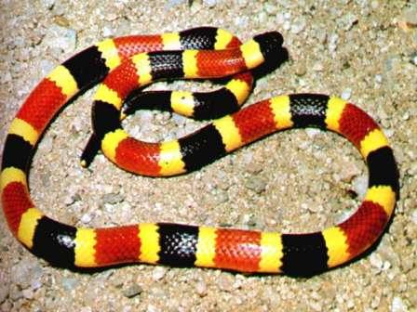
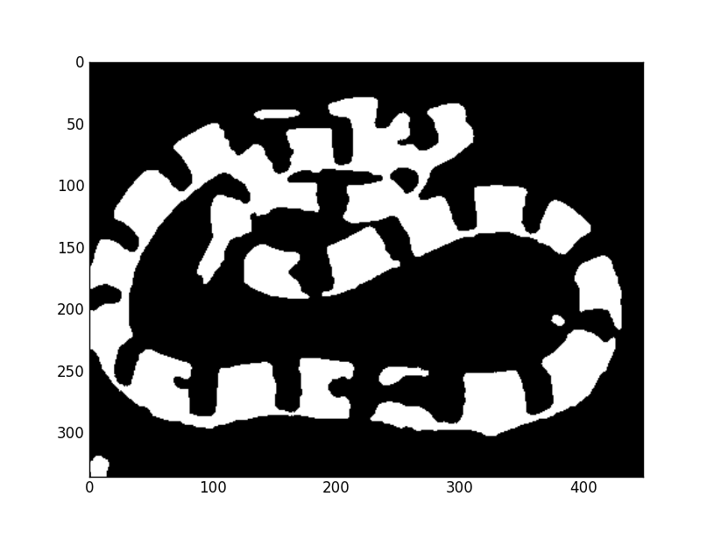
Results
50 iterations, μ = 50000

Slide 13
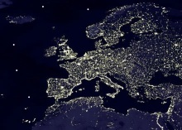
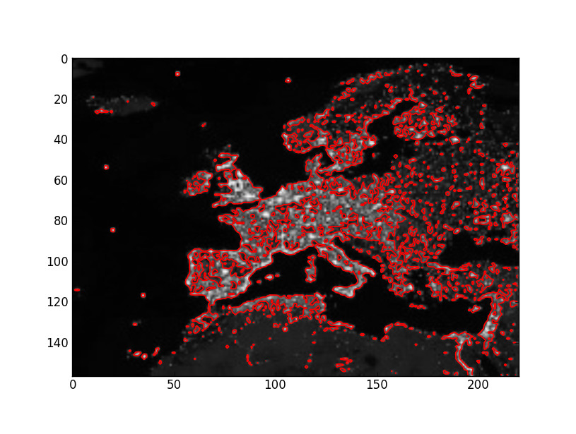
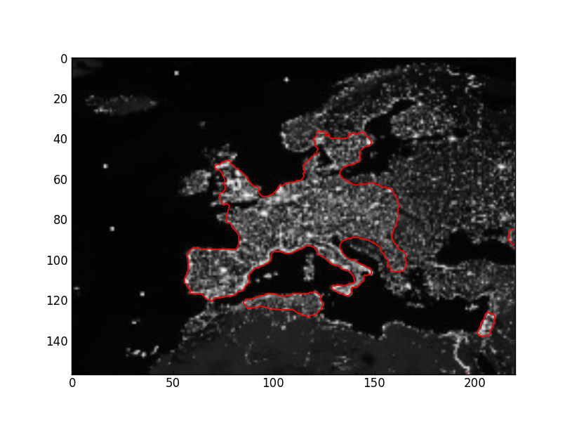
Results – Changing μ
100 iterations, μ = 1
100 iterations, μ = 15000

Slide 14
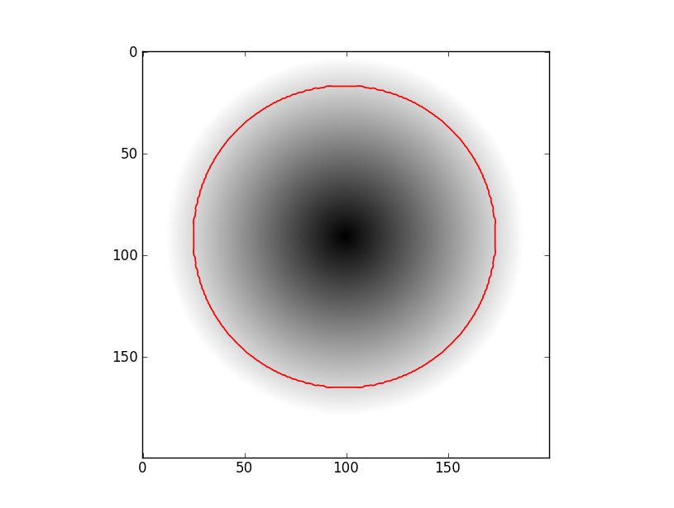

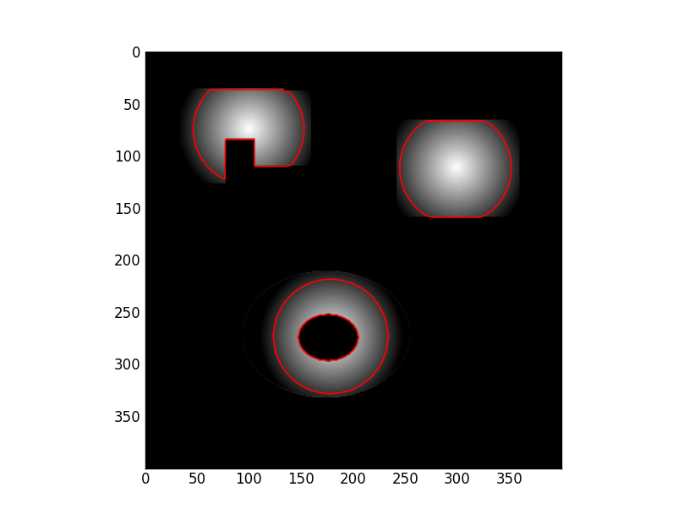
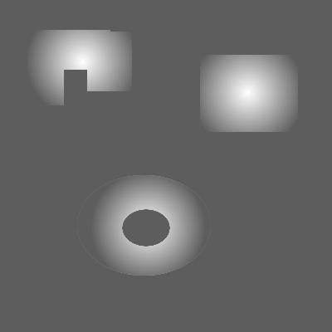
Results – Gradients
5 iterations, μ = 1

Slide 15
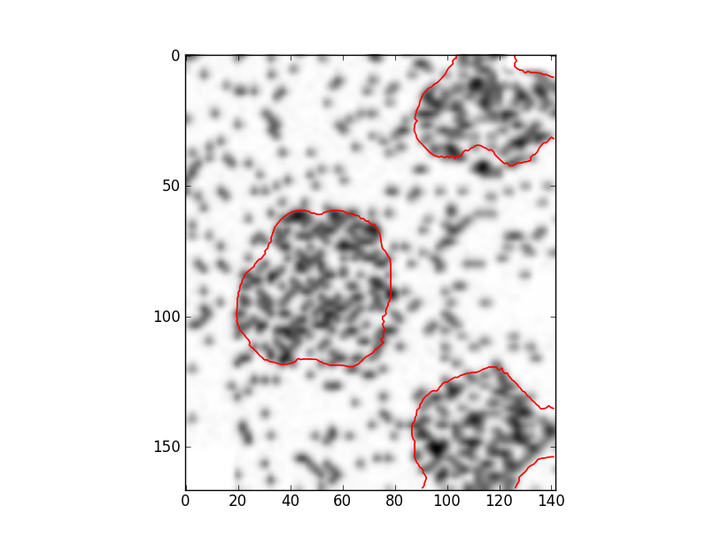
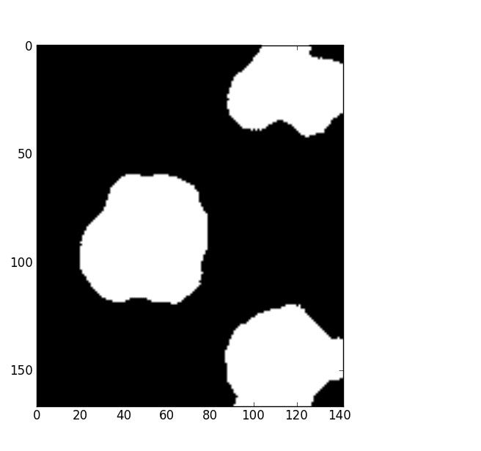
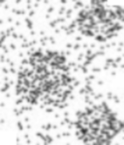
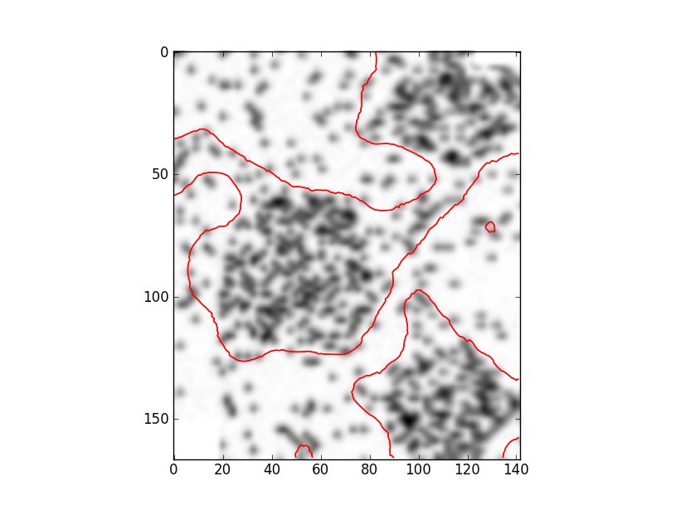
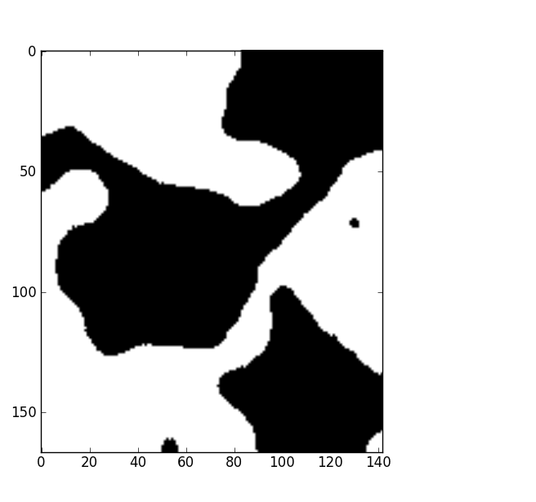
Results – Initial Level Set Functions
100 iterations, μ = 50000

Slide 16
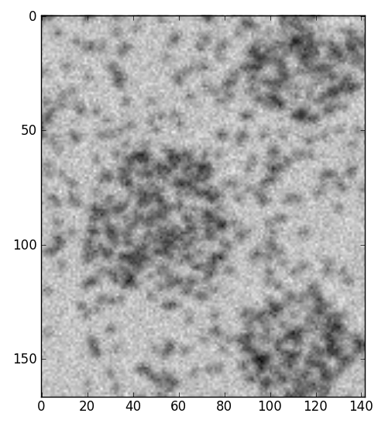
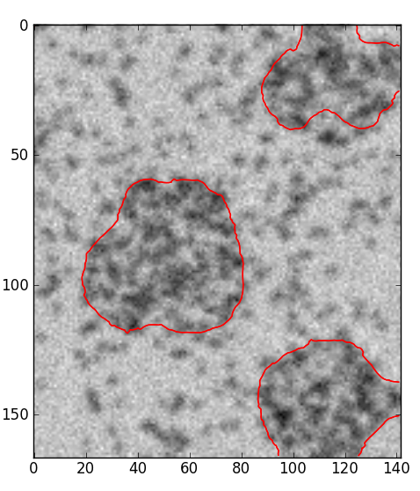
Results – Noise
100 iterations, μ = 50000
Additive Gaussian noise: mean = 0, std deviation = 20 (approx 0.1% of image mean)

Slide 17
Demo

Slide 18
Extensions
Solve time dependant PDE
They do say use of time dependant PDE is not crucial

Slide 19
References
[1] -

