Slide 1
Implementation

Slide 2
Algorithm
Want to minimize energy
Iterative gradient descent
X

Slide 3
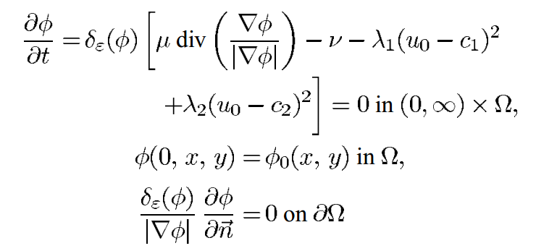
Algorithm
Gradient given by:

Slide 4

Algorithm
Gradient given by:
Regularized Dirac delta function:
ε is set to 1.0 for our experiments

Slide 5
Algorithm
Gradient given by:
Curvature of level-set function
Biases contour towards surrounding larger objects rather than lots of small ones

Slide 6
Algorithm
Gradient given by:
So larger μ means larger objects (or groupings of objects) are selected and smaller points are rejected – useful for countering noise
μ set to 1.0 by default in our implementation, but varies throughout our experiments

Slide 7
Algorithm
Gradient given by:
We do not solve curvature with respect to time

Slide 8
Algorithm
Gradient given by:
Correction term which pushes the contour towards an object even when curvature is zero or negative
Originates from simpler models using only curvature
v is set to zero in our implementation

Slide 9
Algorithm
Gradient given by:
Functions of the mean values of the image inside the contour (c₁) and outside the contour (c₂)
λ₁ = λ₂ = 1 in our implementation

Slide 10
Results

Slide 11
Results
NB: We cheated - Re-implemented existing Matlab code in Python

Slide 12
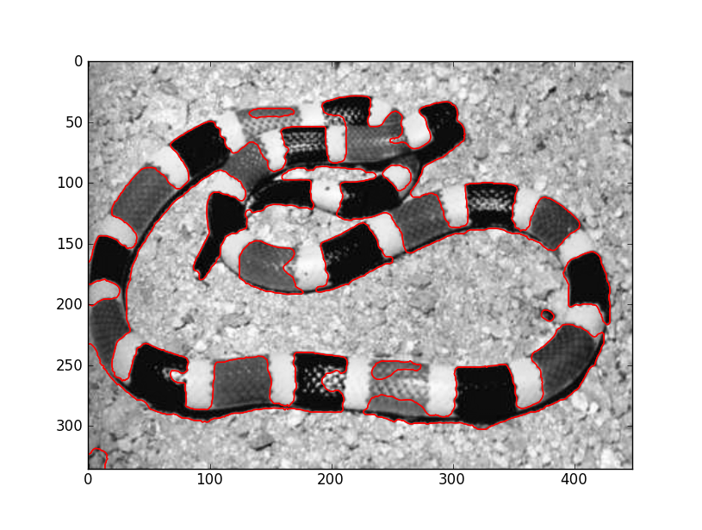
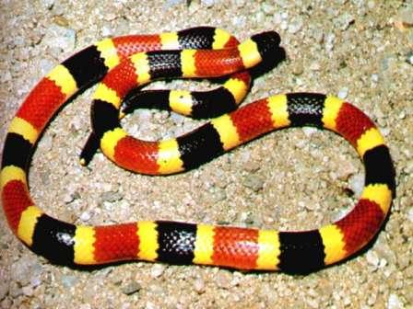
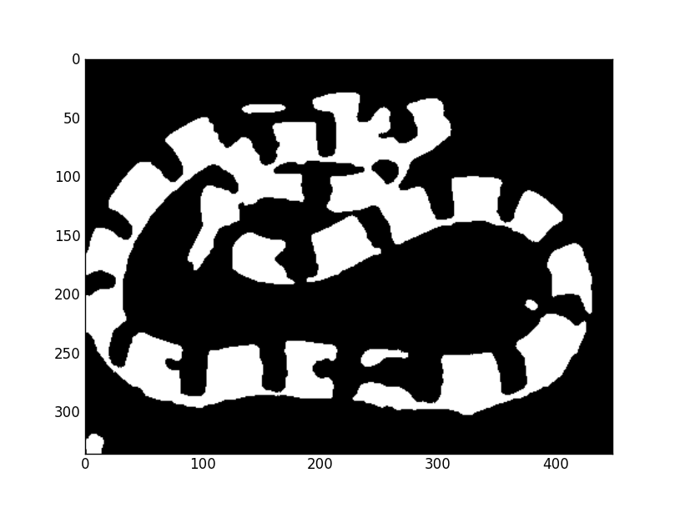
Results
50 iterations, μ = 50000

Slide 13
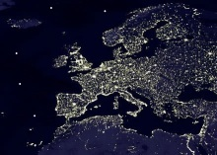
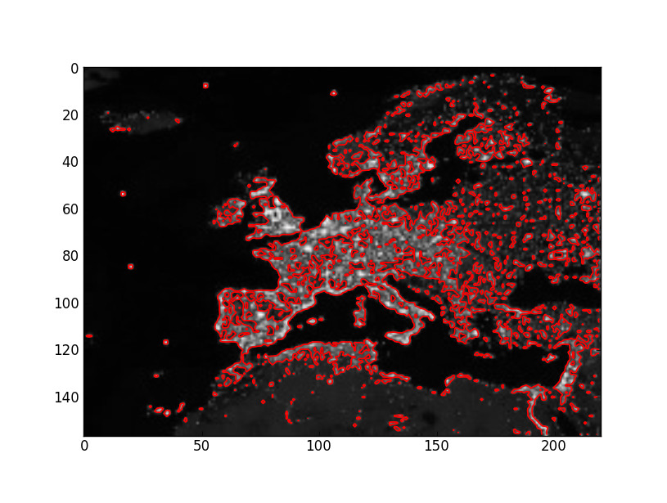
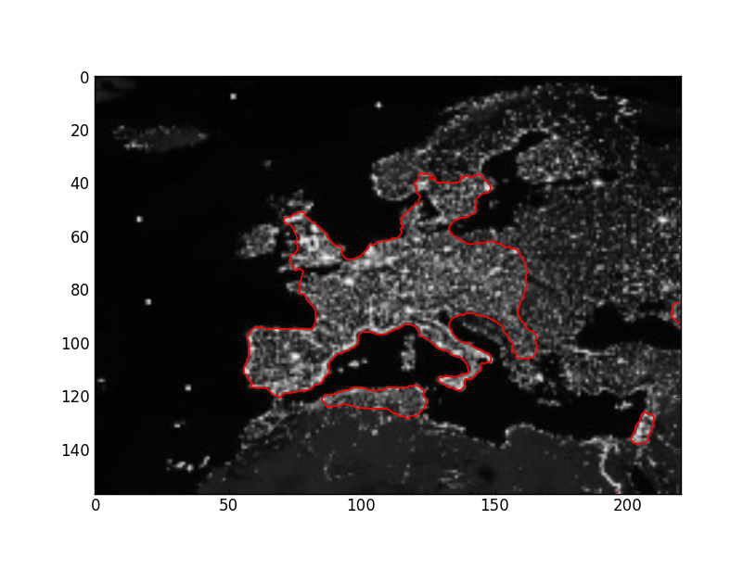
Results – Changing μ
100 iterations, μ = 1
100 iterations, μ = 15000

Slide 14
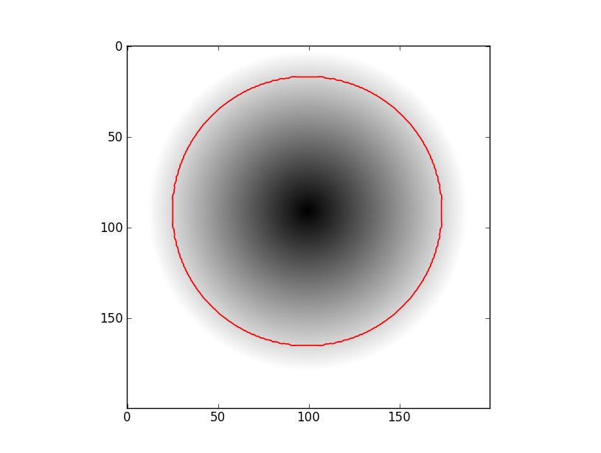

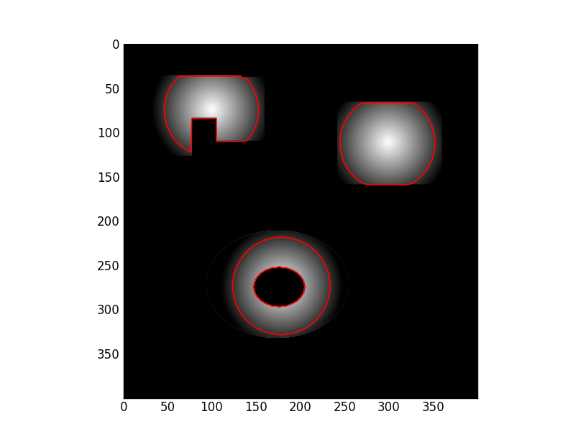
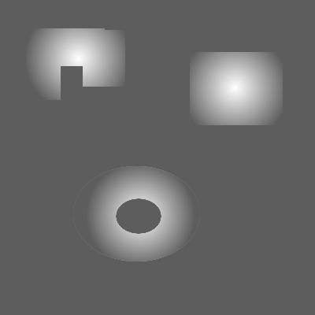
Results – Gradients
5 iterations, μ = 1

Slide 15
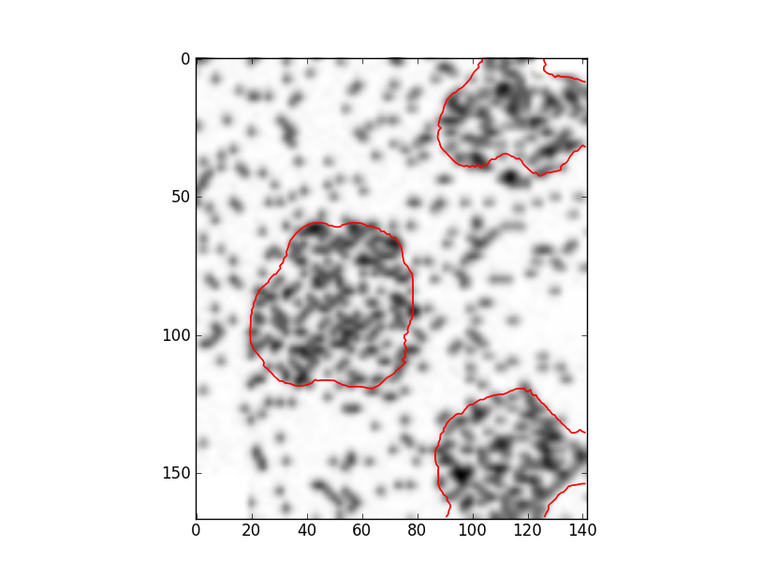
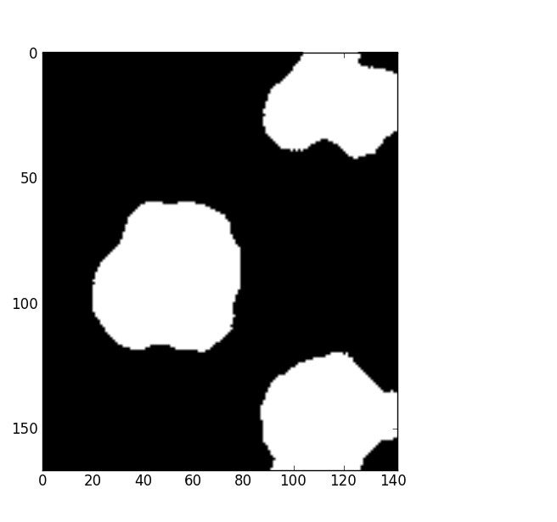
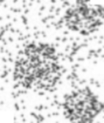
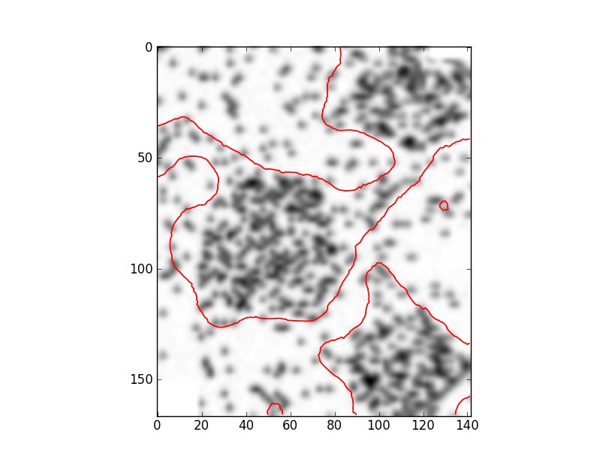
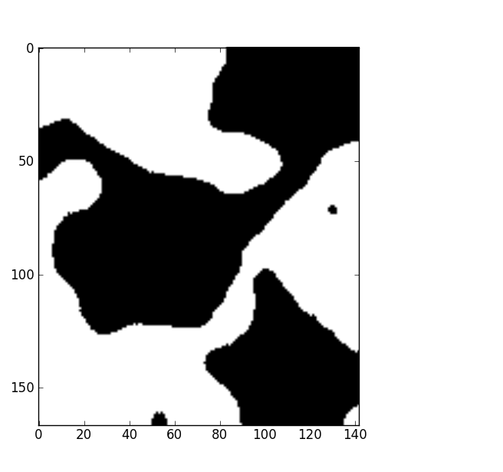
Results – Initial Level Set Functions
100 iterations, μ = 50000

Slide 16
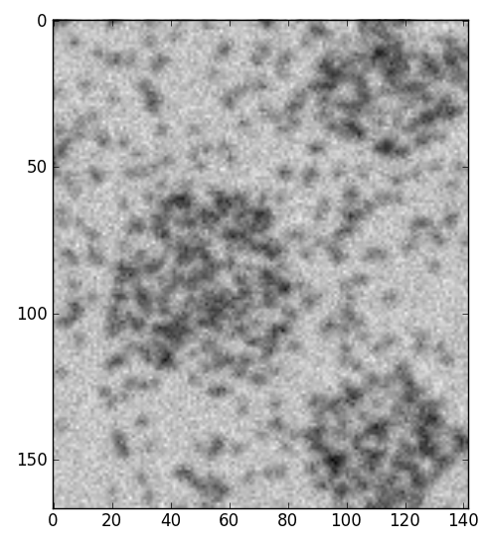
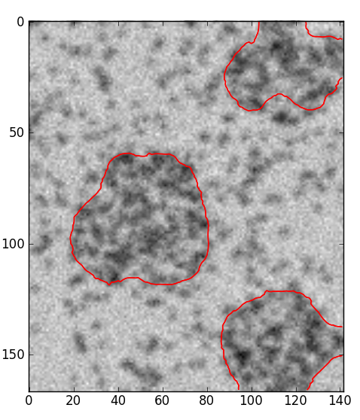
Results – Noise
100 iterations, μ = 50000
Additive Gaussian noise: mean = 0, std deviation = 20 (approx 0.1% of image mean)

Slide 17
Demo

Slide 18
Why Active Contours Without Edges?
Advantages:
Responds well to noise (no noise reduction required)
Extracts groupings of objects well
Objects need not be defined by edges
Exact placement of initial contour not critical
Extracts multiple separate objects with one contour

Slide 19
Why Active Contours Without Edges?
Disadvantages:
Computation time
Extracts multiple separate objects with one contour
Good parameters for different situations vary significantly

Slide 20
Extensions
Solve time dependant PDE
They do say use of time dependant PDE is not crucial

Slide 21
References
[1] -

