Slide 1
SUSAN Edge Detector
John Charlesworth – jgac1g08
Michael Hodgson – mh23g08

Slide 2
Introduction
SUSAN Edge Detector
Smallest Univalve Segment Assimilating Nucleus

Slide 3
Theory

Slide 4
Theory – The USAN
Comparison of pixel values to the nucleus within a mask
Sum of comparisons give a value for the “area” of the USAN
High in flat regions, lower at edges and corners

Slide 5
Theory – The Maths

Slide 6
Implementation

Slide 7
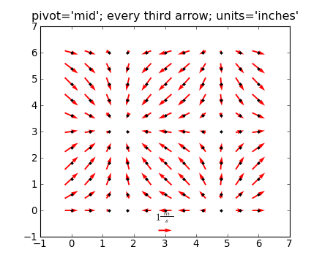
Implementation – Overview
Python with Numpy and Matplotlib
Slow pixel loop implementation
Images:
http://urania.udea.edu.co/sites/astronomia-2.0/pages/descargas.rs/files/descargasdt5vi/Cursos/CursosElectivos/FisicaAstrofisicaComputacional/2009-2/Documentacion/matplotlib/examples/pylab_examples/quiver_demo.html

Slide 8
Implementation – Achievements
Took iterative approach to implementation

Slide 9
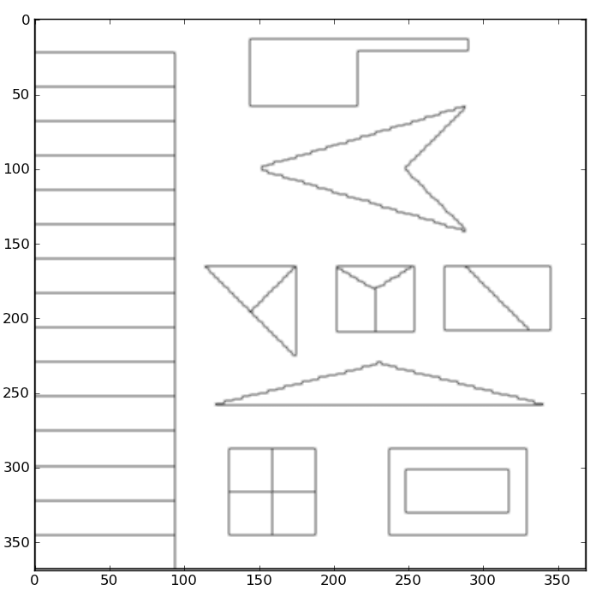
Implementation – Achievements
Implementation with square mask and simple similarity equation

Slide 10
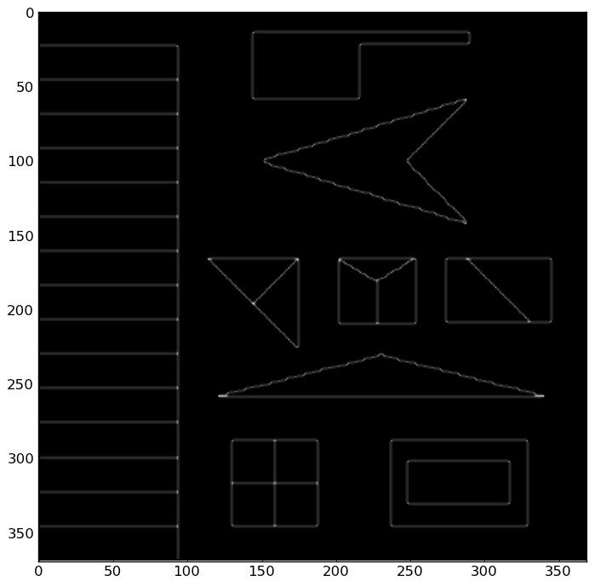
Implementation – Achievements
Smoothed similarity equation implemented
Algorithm vectorised to improve speed

Slide 11
Implementation – Achievements
Implementation with square mask and simple similarity equation
Smoothed similarity equation implemented
Circular mask implemented
Inter-Pixel edge direction measurement implemented
Intra-Pixel edge direction measurement implemented

Slide 12
Demo

Slide 13
Experimentation

Slide 14
Comparison

Slide 15
References
http://users.fmrib.ox.ac.uk/~steve/susan/susan/susan.html

