Slide 1
SUSAN Edge Detector
John Charlesworth – jgac1g08
Michael Hodgson – mh23g08

Slide 2
Introduction
SUSAN Edge Detector
Smallest Univalve Segment Assimilating Nucleus

Slide 3
Theory

Slide 4
Theory – The USAN
Comparison of pixel values to the nucleus within a mask
Sum of comparisons give a value for the “area” of the USAN
High in flat regions, lower at edges and corners

Slide 5
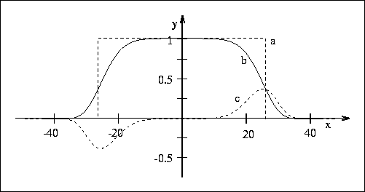
Theory – The Maths
Pixel values in the USAN need comparing to the nucleus
Simplest version: rectangular window
Better version: exp(-((pixel - nucleus)/t)^6)
http://users.fmrib.ox.ac.uk/~steve/susan/susan/node6.html#c_equation

Slide 6
Theory – The Maths
Once the area of the USAN is determined it is compared to a threshold (g = 3*nmax/4) and it is given a new value as:
Area < g : USAN value = g – area
Area > g : USAN value = 0
This converts minima to maxima, non-maximal suppression this sharpens the features further

Slide 7
Theory – Edge Direction
Simple case: “Inter-pixel” edge
The direction of an edge can be calculated using SUSAN
The difference between the “centre of gravity” and the nucleus can be used
Centre of gravity
Nucleus

Slide 8
Theory – Edge Direction
“Intra-pixel” edge

Slide 9
Implementation

Slide 10
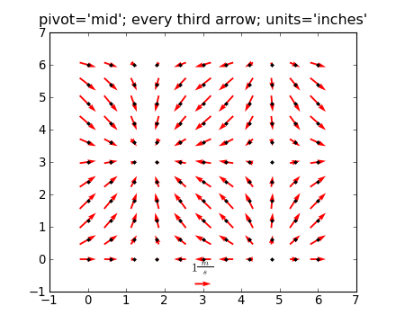
Implementation – Overview
Python with Numpy and Matplotlib
Slow pixel loop implementation
Images:
http://urania.udea.edu.co/sites/astronomia-2.0/pages/descargas.rs/files/descargasdt5vi/Cursos/CursosElectivos/FisicaAstrofisicaComputacional/2009-2/Documentacion/matplotlib/examples/pylab_examples/quiver_demo.html

Slide 11
Implementation – Achievements
Took iterative approach to implementation

Slide 12
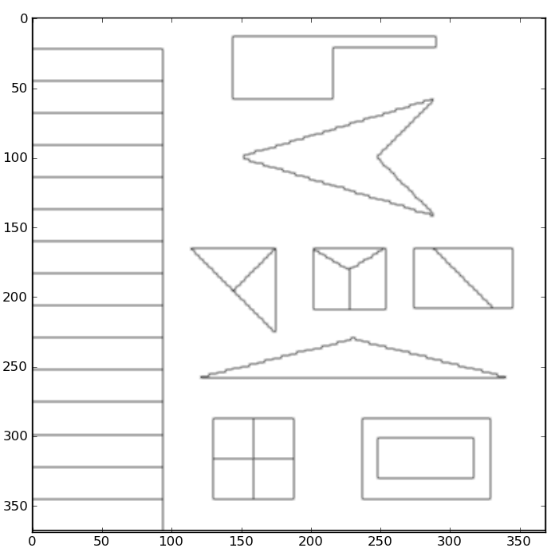
Implementation – Achievements
Implementation with square mask and simple similarity equation

Slide 13
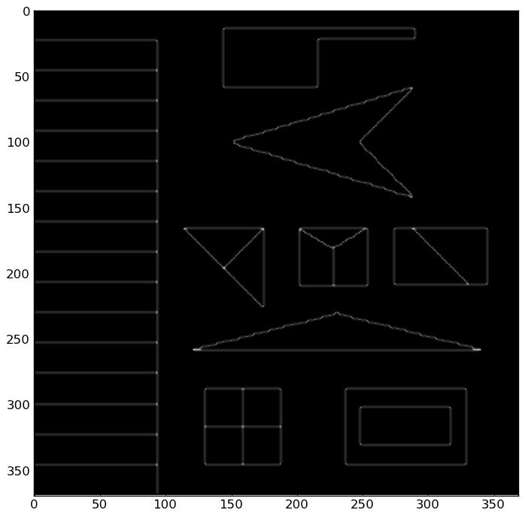
Implementation – Achievements
Smoothed similarity equation implemented
Algorithm vectorised to improve speed

Slide 14
Implementation – Achievements
Implementation with square mask and simple similarity equation
Smoothed similarity equation implemented
Circular mask implemented
Inter-Pixel edge direction measurement implemented
Intra-Pixel edge direction measurement implemented

Slide 15
Demo

Slide 16
Experimentation

Slide 17
Comparison

Slide 18
References
http://users.fmrib.ox.ac.uk/~steve/susan/susan/susan.html

