Slide 1
SUSAN Edge Detector
John Charlesworth – jgac1g08
Michael Hodgson – mh23g08

Slide 2
Introduction
SUSAN Edge Detector
Smallest Univalve Segment Assimilating Nucleus
Performs no differentiation etc
Performs well in the presence of noise
Quick to perform compared to other edge detection algorithms

Slide 3
Theory

Slide 4
Theory – The USAN
Comparison of pixel values to the nucleus within a mask
Sum of comparisons give a value for the “area” of the USAN
High in flat regions, lower at edges and corners

Slide 5
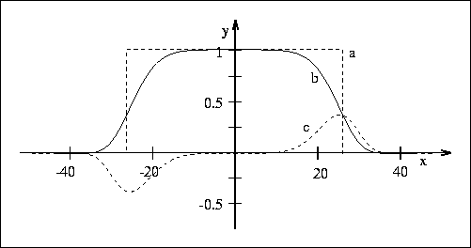
Theory – The Maths
Pixel values in the USAN need comparing to the nucleus
Simplest version: rectangular window
Better version: exp(-((pixel - nucleus)/t)^6)
http://users.fmrib.ox.ac.uk/~steve/susan/susan/node6.html#c_equation
Notes:
t is the same as the size of the rectangular window: the difference in intensity out of 255 that is considered similar (27)

Slide 6
Theory – The Maths
Once the area of the USAN is determined it is compared to a threshold (g = 3*nmax/4) and it is given a new value as:
Area < g : USAN value = g – area
Area > g : USAN value = 0
This converts minima to maxima, non-maximal suppression on this sharpens the features further
Notes:
Nmax is the maximum value that the USAN area can take
g calculated to give appropriate noise rejection in presence of Gaussian noise, as corners give stronger responses changing g can convert to a corner detector

Slide 7
Theory – Edge Direction
Simple case: “Inter-pixel” edge
The direction of an edge can be calculated using SUSAN
The difference between the “centre of gravity” and the nucleus can be used
CoG calculated by:
Sum(pixel * USAN(pixel))/ USAN area
Centre of gravity
Nucleus

Slide 8
Theory – Edge Direction
“Intra-pixel” edge
The “centre of gravity” cannot be used for this type of edge
The “longest axis of symmetry” is used instead
Axis calculated by:
AoSx = sum((pixelx – nucleusx)^2 * USAN)
AoSy = sum((pixely – nucleusy)^2 * USAN)
AoSxy = sum((pixelx – nucleusx) (pixely – nucleusy) * USAN)
Centre of gravity
Nucleus
Longest axis of symmetry
Notes:
Ratio of AoSx to AoSy gives edge direction, sign of AoSxy give positive or negative gradient to a diagonal edge.
Also interesting to note that SUSAN gives a stronger response at softer edges

Slide 9
Theory – Edge Direction
The correct algorithm has to be chosen for each edge
“Intra pixel” method is used if the USAN is less than the mask diameter or if the CoG is less than a pixel from the Nucleus
Otherwise the “Inter pixel” method is used

Slide 10
Implementation

Slide 11
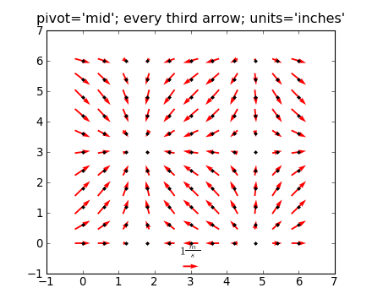
Implementation – Overview
Python with Numpy and Matplotlib
Slow pixel loop implementation
Images:
http://urania.udea.edu.co/sites/astronomia-2.0/pages/descargas.rs/files/descargasdt5vi/Cursos/CursosElectivos/FisicaAstrofisicaComputacional/2009-2/Documentacion/matplotlib/examples/pylab_examples/quiver_demo.html

Slide 12
Implementation
Took iterative approach to implementation
Simple -> Complex

Slide 13
Implementation
Implementation with square mask and simple similarity equation

Slide 14
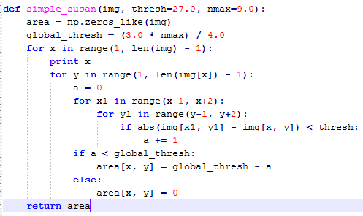
Implementation
Implementation with square mask and simple similarity equation

Slide 15
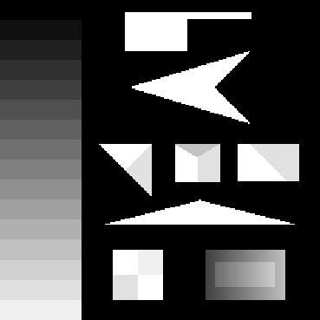
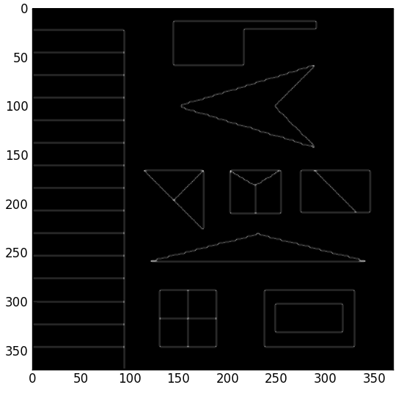
Implementation
Implementation with square mask and simple similarity equation

Slide 16
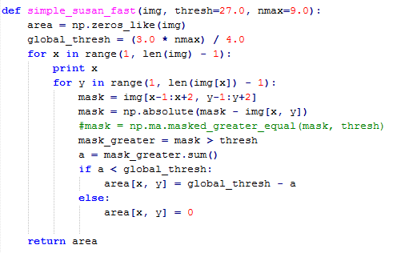
Implementation
Algorithm partially vectorized to improve speed

Slide 17
Implementation
Algorithm partially vectorized to improve speed

Slide 18
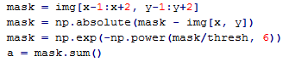
Implementation
Smoothed similarity equation implemented

Slide 19
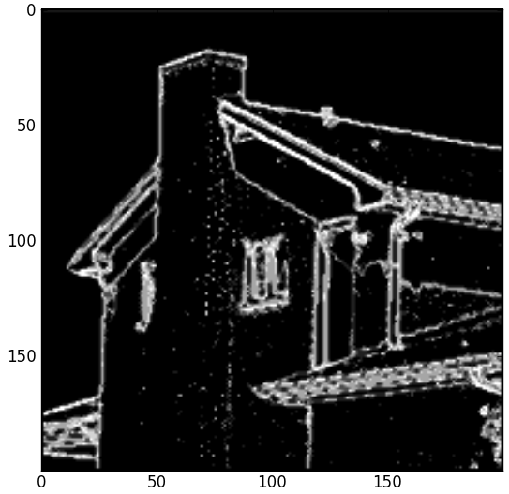

Implementation
Smoothed similarity equation implemented

Slide 20
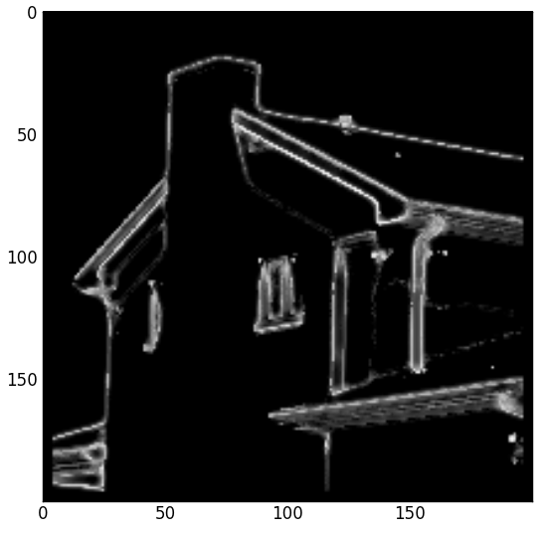
Implementation
Circular mask implemented
Square
Circle

Slide 21
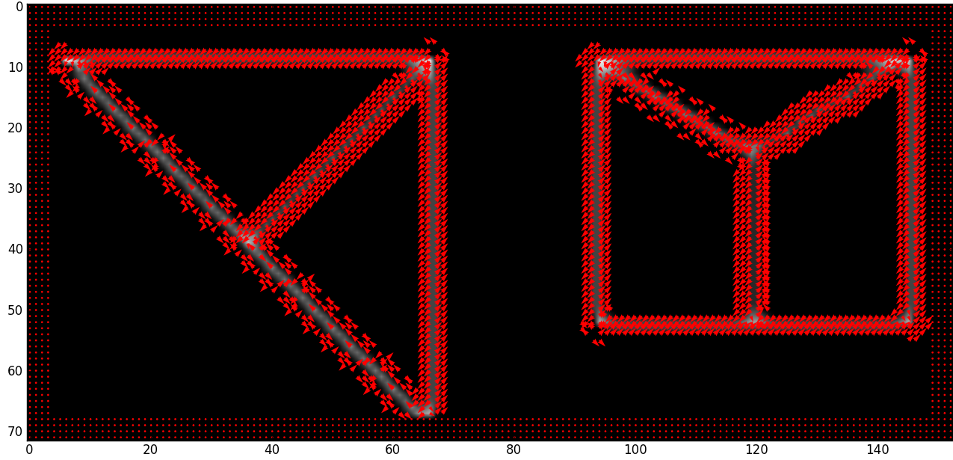
Implementation
Edge direction measurement implemented

Slide 22
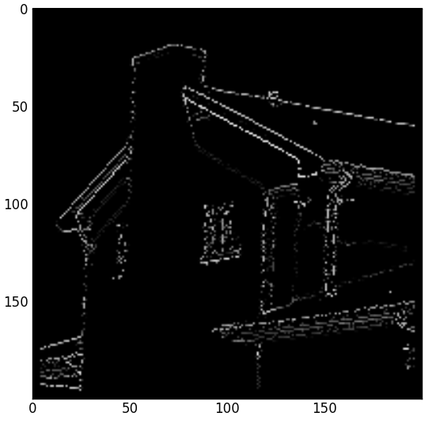
Implementation
Attempted to implement non-maximal suppression
No non-max
Non-max suppression

Slide 23

Implementation – Lessons Learnt
Adding command line options to python apps is easy

Slide 24
Implementation – Lessons Learnt
Profiling is useful
19625911 function calls (19622864 primitive calls) in 251.451 seconds
Ordered by: cumulative time
ncalls tottime percall cumtime percall filename:lineno(function)
1 0.010 0.010 251.458 251.458 susanedge.py:1(<module>)
1 0.000 0.000 250.653 250.653 susanedge.py:141(run_prog)
1 0.000 0.000 137.206 137.206 pyplot.py:123(show)
1 0.000 0.000 137.206 137.206 backend_bases.py:69(__call__)
1 0.000 0.000 128.177 128.177 backend_tkagg.py:68(mainloop)
1 0.000 0.000 128.177 128.177 Tkinter.py:323(mainloop)
1 128.099 128.099 128.177 128.177 {built-in method mainloop}
1 8.006 8.006 113.129 113.129 susanedge.py:114(smooth_susan_circle)
130321 45.999 0.000 92.756 0.001 susanedge.py:15(points_in_circle)
14477180 22.404 0.000 22.404 0.000 {method 'append' of 'list' objects}
2085860 13.766 0.000 13.766 0.000 susanedge.py:12(intceil)
528640 2.058 0.000 11.542 0.000 numeric.py:167(asarray)
130321 6.206 0.000 11.324 0.000 susanedge.py:103(find_edge_dir)
529270 9.504 0.000 9.505 0.000 {numpy.core.multiarray.array}
72/65 0.085 0.001 9.109 0.140 {built-in method call}

Slide 25
Demo

Slide 26
Results

Slide 27
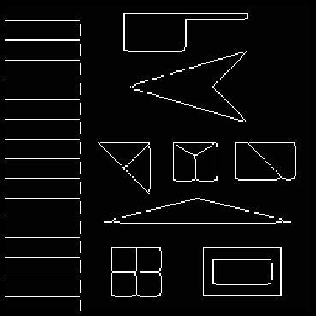

Results
Ours
(no non-max suppression)
Theirs

Slide 28
Results
No non-max
Non-max suppression

Slide 29
Summary
Based on USANs
Can be used to extract features from an image
Edges and corners
Edge direction can also be extracted
Fast operation (our implementation not optimal)
Resistant to noise

Slide 30
References
http://users.fmrib.ox.ac.uk/~steve/susan/susan/susan.html

