Slide 1
SUSAN Edge Detector
John Charlesworth – jgac1g08
Michael Hodgson – mh23g08

Slide 2
Introduction
SUSAN Edge Detector
Smallest Univalve Segment Assimilating Nucleus

Slide 3
Theory

Slide 4
Theory – The USAN
Comparison of pixel values to the nucleus within a mask
Sum of comparisons give a value for the “area” of the USAN
High in flat regions, lower at edges and corners

Slide 5
Theory – The Maths

Slide 6
Implementation

Slide 7
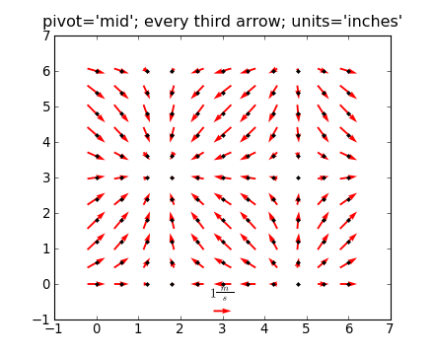
Implementation – Overview
Python with Numpy and Matplotlib
Slow pixel loop implementation
Images:
http://urania.udea.edu.co/sites/astronomia-2.0/pages/descargas.rs/files/descargasdt5vi/Cursos/CursosElectivos/FisicaAstrofisicaComputacional/2009-2/Documentacion/matplotlib/examples/pylab_examples/quiver_demo.html

Slide 8
Implementation
Took iterative approach to implementation
Simple -> Complex

Slide 9
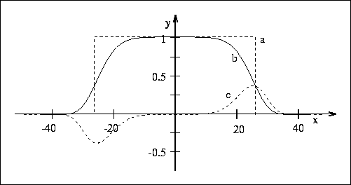
Implementation
Implementation with square mask and simple similarity equation

Slide 10
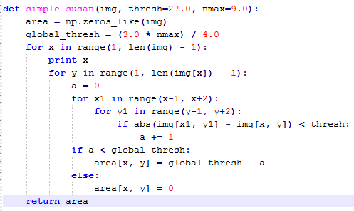
Implementation
Implementation with square mask and simple similarity equation

Slide 11
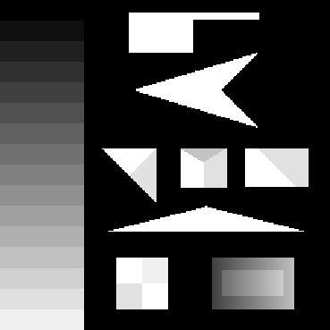
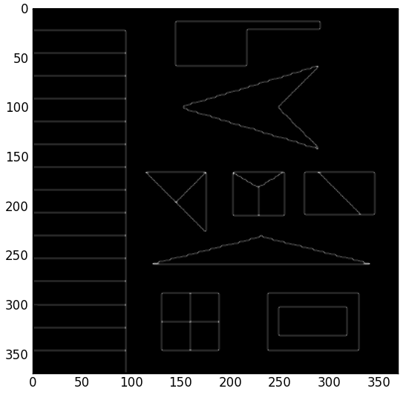
Implementation
Implementation with square mask and simple similarity equation

Slide 12
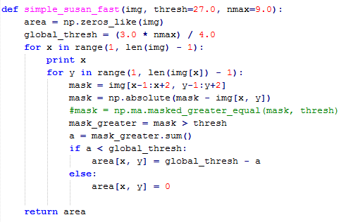
Implementation
Algorithm partially vectorized to improve speed

Slide 13
Implementation
Algorithm partially vectorized to improve speed

Slide 14
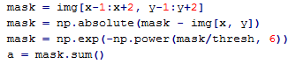
Implementation
Smoothed similarity equation implemented

Slide 15
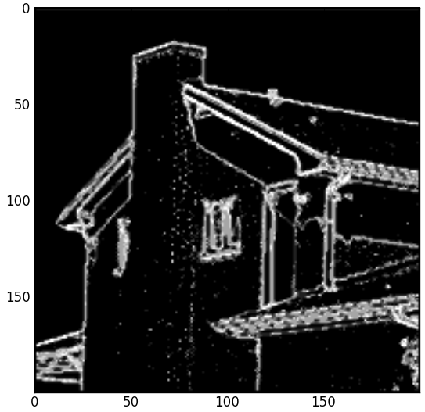

Implementation
Smoothed similarity equation implemented

Slide 16
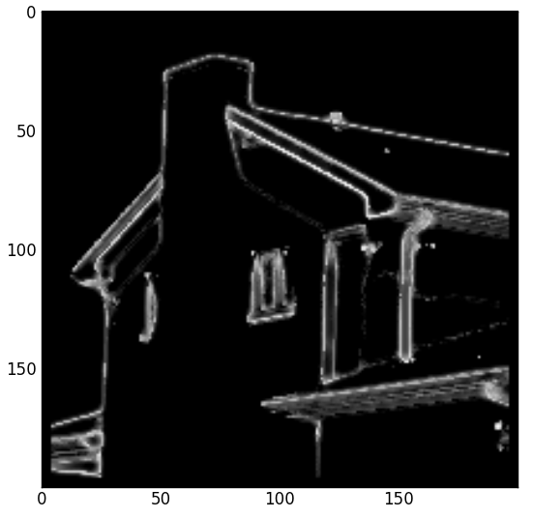
Implementation
Circular mask implemented
Square
Circle

Slide 17
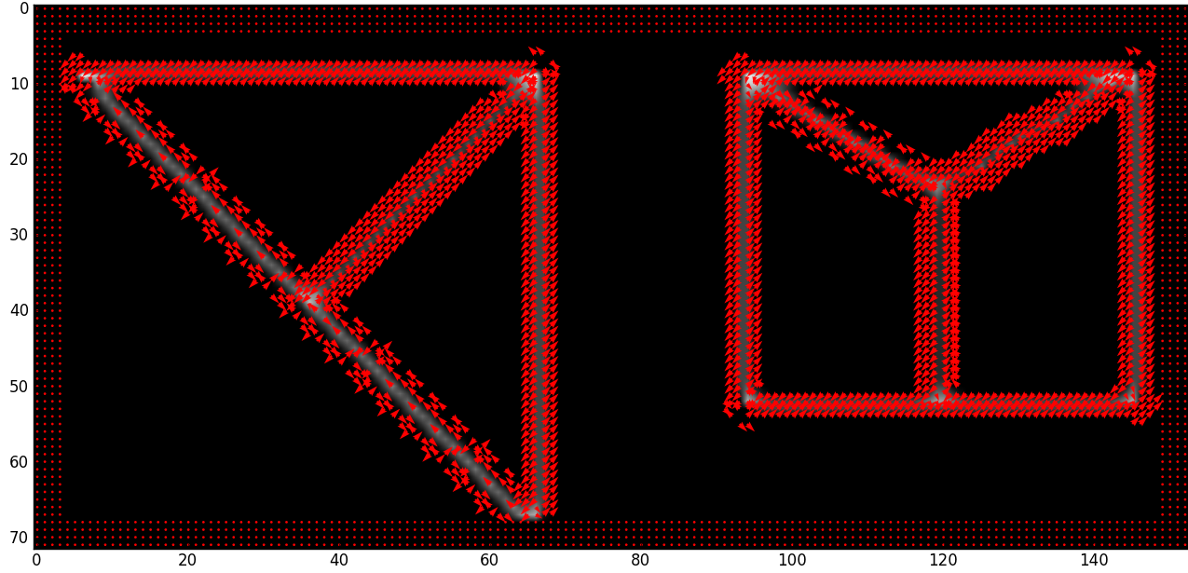
Implementation
Edge direction measurement implemented

Slide 18
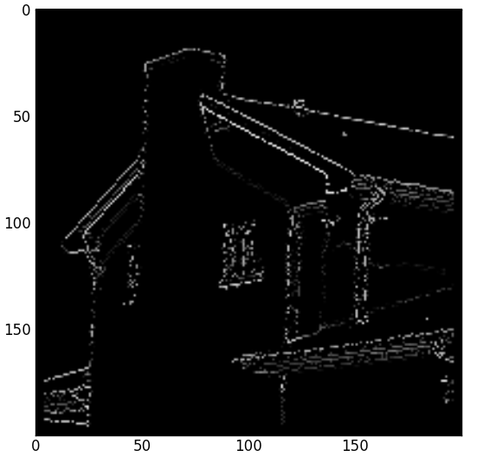
Implementation
Attempted to implement non-maximal suppression
No non-max
Non-max suppression

Slide 19

Implementation – Lessons Learnt
Adding command line options to python apps is easy

Slide 20
Implementation – Lessons Learnt
Profiling is useful
19625911 function calls (19622864 primitive calls) in 251.451 seconds
Ordered by: cumulative time
ncalls tottime percall cumtime percall filename:lineno(function)
1 0.010 0.010 251.458 251.458 susanedge.py:1(<module>)
1 0.000 0.000 250.653 250.653 susanedge.py:141(run_prog)
1 0.000 0.000 137.206 137.206 pyplot.py:123(show)
1 0.000 0.000 137.206 137.206 backend_bases.py:69(__call__)
1 0.000 0.000 128.177 128.177 backend_tkagg.py:68(mainloop)
1 0.000 0.000 128.177 128.177 Tkinter.py:323(mainloop)
1 128.099 128.099 128.177 128.177 {built-in method mainloop}
1 8.006 8.006 113.129 113.129 susanedge.py:114(smooth_susan_circle)
130321 45.999 0.000 92.756 0.001 susanedge.py:15(points_in_circle)
14477180 22.404 0.000 22.404 0.000 {method 'append' of 'list' objects}
2085860 13.766 0.000 13.766 0.000 susanedge.py:12(intceil)
528640 2.058 0.000 11.542 0.000 numeric.py:167(asarray)
130321 6.206 0.000 11.324 0.000 susanedge.py:103(find_edge_dir)
529270 9.504 0.000 9.505 0.000 {numpy.core.multiarray.array}
72/65 0.085 0.001 9.109 0.140 {built-in method call}

Slide 21
Demo

Slide 22
Results

Slide 23
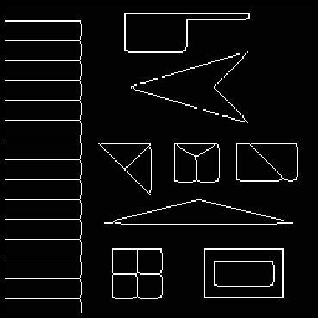

Results
Ours
(no non-max suppression)
Theirs

Slide 24
Results
No non-max
Non-max suppression

Slide 25
References
http://users.fmrib.ox.ac.uk/~steve/susan/susan/susan.html

