Slide 1
SUSAN Edge Detector
John Charlesworth – jgac1g08
Michael Hodgson – mh23g08

Slide 2
Introduction
SUSAN Edge Detector
Smallest Univalve Segment Assimilating Nucleus

Slide 3
Theory

Slide 4
Implementation

Slide 5
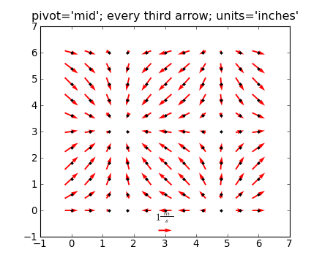
Implementation – Overview
Python with Numpy and Matplotlib
Slow pixel loop implementation
Images:
http://urania.udea.edu.co/sites/astronomia-2.0/pages/descargas.rs/files/descargasdt5vi/Cursos/CursosElectivos/FisicaAstrofisicaComputacional/2009-2/Documentacion/matplotlib/examples/pylab_examples/quiver_demo.html

Slide 6
Implementation – Achievements
Took iterative approach to implementation

Slide 7
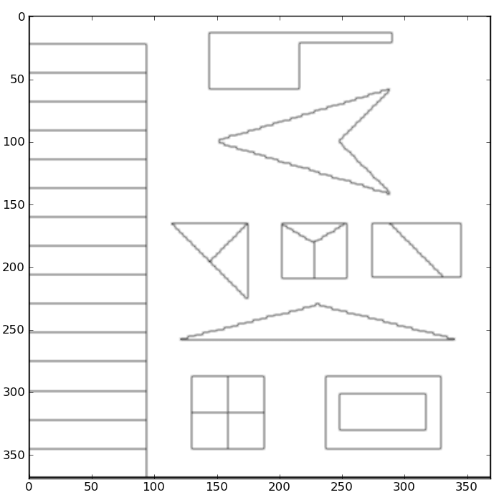
Implementation – Achievements
Implementation with square mask and simple similarity equation

Slide 8
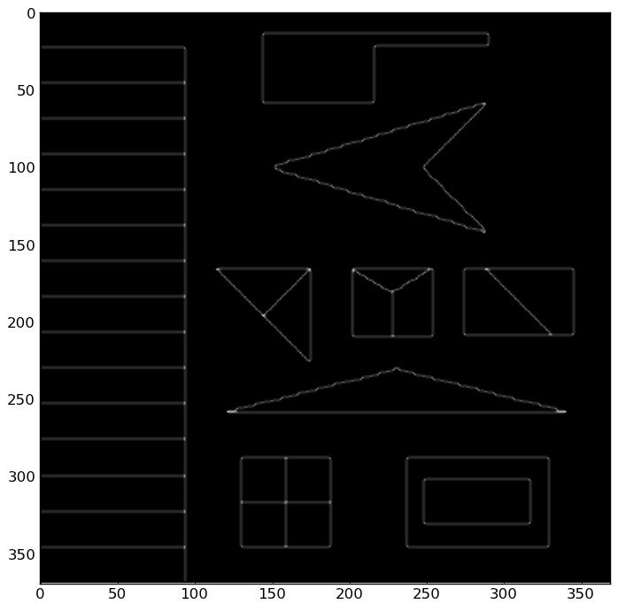
Implementation – Achievements
Smoothed similarity equation implemented
Algorithm vectorised to improve speed

Slide 9
Implementation – Achievements
Implementation with square mask and simple similarity equation
Smoothed similarity equation implemented
Circular mask implemented
Inter-Pixel edge direction measurement implemented
Intra-Pixel edge direction measurement implemented

Slide 10
Demo

Slide 11
Experimentation

Slide 12
Comparison

Slide 13
References

