Slide 1
Assembly Background

Slide 2
Assembly Background
Introduction to Assembly Problem
De novo Assembly
Read mapping

Slide 3
Sequencing Problem
Present day technology can’t read the whole genome in a single pass
To be able to read (sequence) the genome, it first needs to be fragmented into small pieces: https://youtu.be/fCd6B5HRaZ8
This leads to the need to put the pieces together (assemble) to recreate the whole genome
To help ourselves, we first make multiple copies of the genome and then break it randomly – which leads to the assembly problem

Slide 4
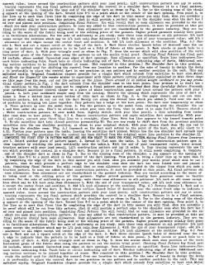
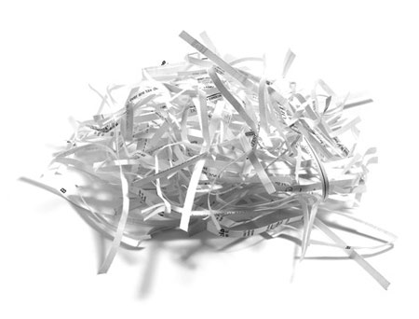
Assembly Problem
Microbial
Genome
(+/- Amplification)
Fragmentation &
Sequencing of Reads
Assembly
Expectation
Notes:
http://1.bp.blogspot.com/_B5nNZ6dCV3s/S8-rVzywYhI/AAAAAAAARSk/_qLweQvSui4/s400/sewing+textsewing+text+dark+mel+stampz.jpg
http://movers.pulseight.com/wp-content/uploads/sites/16/2013/05/packingpaper.jpg

Slide 5
Assembly Problem
This “recreation” or assembling of the genome is not straight-forward
Consider this example:
It was the best of times, it was the worst of times, it was the age of wisdom, it was the age of foolishness
Amplification and fragmentation
It was the best of times, it was the worst of times, it was the age of wisdom, it was the age of foolishness
It was the best of times, it was the worst of times, it was the age of wisdom, it was the age of foolishness
It was the best of times, it was the worst of times, it was the age of wisdom, it was the age of foolishness
It was the best of times, it was the worst of times, it was the age of wisdom, it was the age of foolishness
Notes:
A Tale of Two Cities
Charles Dickens

Slide 6
Assembly Problem
it was the best of
was the best of times,
the best of times, it
best of times, it was
of times, it was the
Repeat issue
of times, it was the
times, it was the worst
Multiple paths
times, it was the age

Slide 7
Terminology
Fragment/Insert
Fragment + Adaptors
Single-end reads
paired-end reads
Unknown gap/inner mate

Slide 8
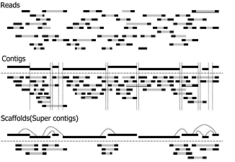
Terminology
Short (30-150 bp) sequence fragments generated by a sequencing machine
Contiguous lengths of genomic sequence in which the order of the bases is known to high confidence
Merged contigs with paired end support having gaps of known length filled with Ns
Adopted from: https://www.k.u-tokyo.ac.jp/pros-e/person/shinichi_morishita/genome-assembly.jpg

Slide 9

Additional Information: De novo Assembly
If the sequencing reads are considered jigsaw pieces…
Notes:
Starting with a bunch of reads

Slide 10

De novo Assembly
… a de novo assembly is trying to construct the jigsaw puzzle without the picture
Notes:
And trying to construct the puzzle

Slide 11
De novo Assembly
i.e., trying to construct the genome based on the sequencing reads without the aid of a reference genome
This process is naturally computationally intensive and requires substantial expertise to yield “good” assemblies
In a way, this is more of an art than a computational process

Slide 12
Genome Assembly Programs
Sequence Reads
Contigs
Genome Assembler
Parameter Set
Assembly Statistics
Bases assembled,
Contigs,
N50

Slide 13
Assessing the “goodness” of an assembly
The goal of genome assembly is to yield a finished contig which is exactly the same as the input microbial genome
An assembly is deemed good if it can get as close to this goal as possible
Goodness of assembly is measured by three parameters:
Number of bases assembled
Number of assembled contigs (length > 500bp)
N50 value

Slide 14
N50
If these are the assembled contigs:
and I order them by length in an ascending manner,
N50 is the length of contig which is in the center

Slide 15
Read Mapping
Reference genome / transcriptome
...GTGGGCCGGCAATTCGATATCGCGCATATATTTCGGCGCATGCTTAGC...
1
GCATATATTT
2
GCATATATTT
More specifically, genome mapping is the mapping of reads to a reference genome
3
TGGGCCGGCA
Reads
(unmapped)
4
ATTCGATATC
5
ATATTTCGGC
6
CCGGCAATTC
7
TCGCGCATAT
8
CATGCTTAGC
9
GATATCGCGC

Slide 16
Read Mapping
Reference genome / transcriptome
...GTGGGCCGGCAATTCGATATCGCGCATATATTTCGGCGCATGCTTAGC...
TGGGCCGGCA
GCATATATTT
CATGCTTAGC
CCGGCAATTC
ATATTTCGGC
ATTCGATATC
GCATATATTT
Reads
(mapped)
TCGCGCATAT
GATATCGCGC
More specifically, genome mapping is the mapping of reads to a reference genome

Slide 17
Read Mapping & Formats
Read mapping is the preferred analysis routine for genome resequencing projects and variant detection pipelines
A number of different formats are used throughout the process, each designed for a specific task

Slide 18
Read Mapping & Formats
Broadly,
SAM/BAM format is helpful in storing mapping information
MPILEUP format is helpful in making inferences at each base
VCF format is helpful in storing the list of variants and annotations
Other variant formats are helpful in analyzing variants in population data

Slide 19
Assessing the “goodness” of mapping
The goal of read mapping is to correctly and unambiguously map all the sequence reads to the corresponding position in the reference genome
A mapping is deemed good if it can get as close to this goal as possible

Slide 20
Assessing the “goodness” of mapping
Goodness of mapping is measured by one parameter:
Percent Overall Alignment
Read mapping can also be used in assessing similarity between genomes

Slide 21
Read Mapping & Similarity
Read mapping works on the assumption that the reference genome being mapped to is a “close” reference
This assumption influences the final mapping
If the reference genome doesn’t share enough sequence similarity to the query reads, the reads will fail to map properly and this will be reflected in the final mapping statistics

Slide 22

Read Mapping & Similarity
Reads
Ref 1
Mapping = 90%
Ref 2
Mapping = 80%
Ref 3
Mapping = 98%

