Slide 1
Exercise3
Michał Woźniak

Slide 2
Task
Pick a TV show that had its premieres on TV and thus has some viewership numbers reported on Wikipedia. E.g. Suits (see table just above the References)
Then create a short report (you can copy the content from Wikipedia or other pages for this task) that contains, for example (do a commit after each step!):
  A brief description of the show (use italics for names).
  A photo with the logo or a shot from the show itself.
  A summary of some basic statistics (e.g. on viewership or ratings).
  A graph of the viewership over time.
  A graph of the episode-to-episode (or season-to-season) changes in viewership.
  A short description of the observed changes that includes inline references to numbers (e.g. the viewership decreased by insert_calculated_number between seasons 3 and 5).
  Make sure your report looks nice -> this time we’re mostly interested in the output and not necessarily the codes used to achieve it.
  knitr your report and save it in the “RMarkdown folder” of your repo.
  Commit the changes and push them to Github.

Slide 3
A brief description of the show
The Big Bang Theory is an American comedy television series created and executively produced by Chuck Lorre and Bill Prady. Like the name of the series itself (with the exception of the first episode “Pilot”), episode titles of The Big Bang Theory always start with “The” and resemble the name of a scientific principle, theory or experiment, whimsically referencing a plot point or quirk in that episode.

Slide 4

A photo with the logo of the show | Source: Wikipedia

Slide 5
A summary of some basic statistics
 | overall_number_of_episode | us_viewers_in_mln
 | Min. : 1.0 | Min. : 7.34
 | 1st Qu.: 70.5 | 1st Qu.:12.69
 | Median :140.0 | Median :14.20
 | Mean :140.0 | Mean :14.20
 | 3rd Qu.:209.5 | 3rd Qu.:16.20
 | Max. :279.0 | Max. :20.44

Slide 6
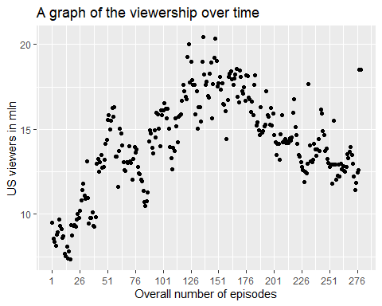
A graph of the viewership over time

Slide 7
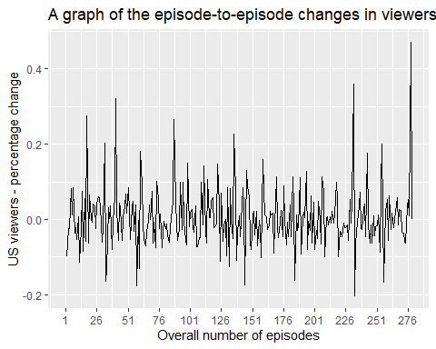
A graph of the episode-to-episode changes in viewership

Slide 8
A short description of the observed changes that includes inline references to numbers
  The viewership increase by 9 mln between first and last episode.
  The avarage percentage change from episode to episode is equal 0.005468 and its standard deviation is equal to 0.0810412.
  The difference between the audience for the best and weakest episode is 13.1 mln.

