Slide 1

Multi-class classification
Trying a softmax
classifier
deeplearning.ai

Slide 2
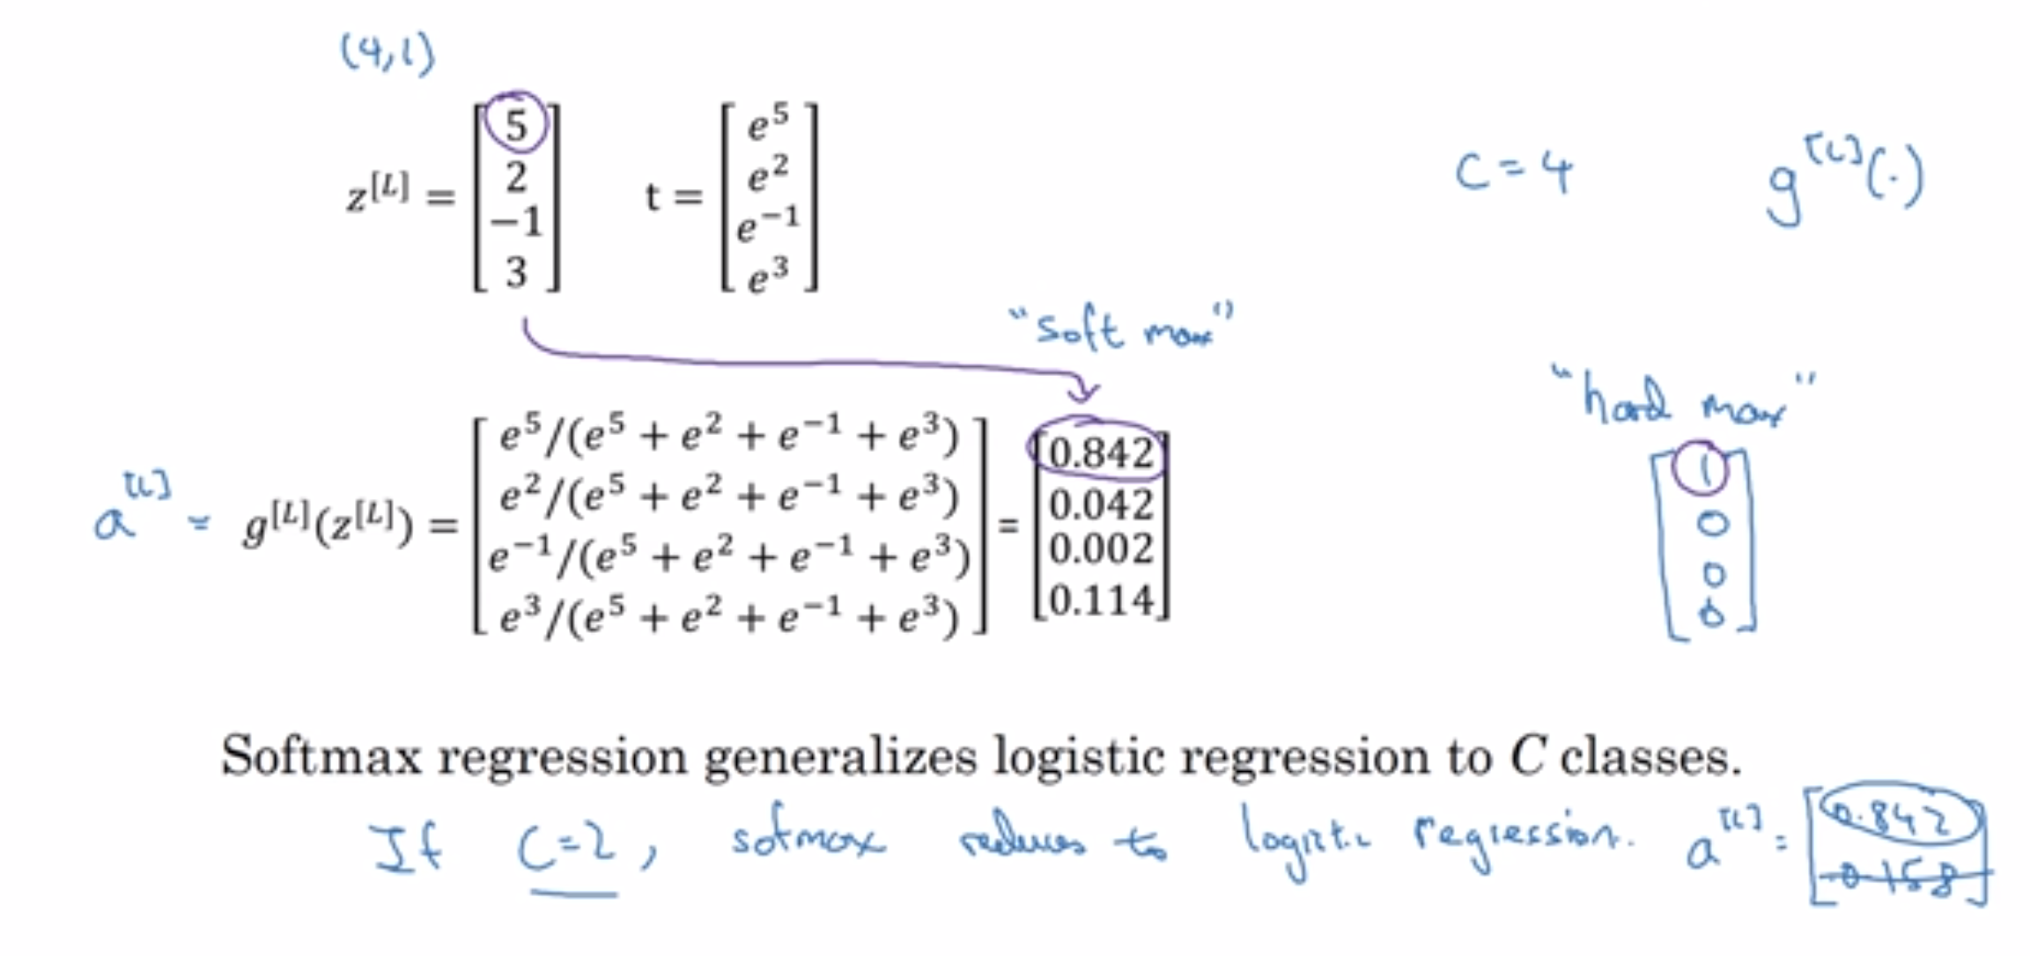
Understanding softmax

Slide 3
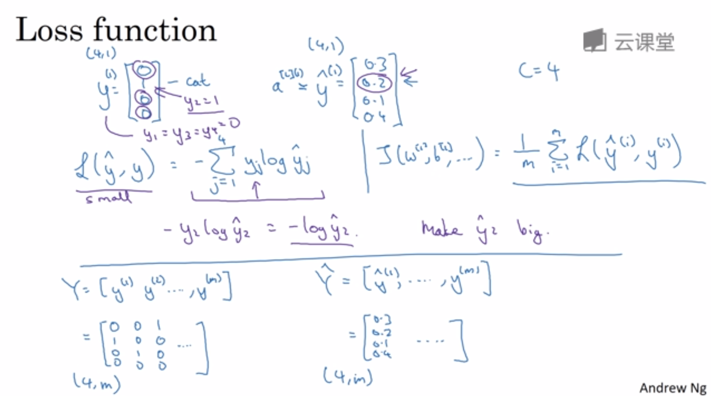
Loss function

Slide 4
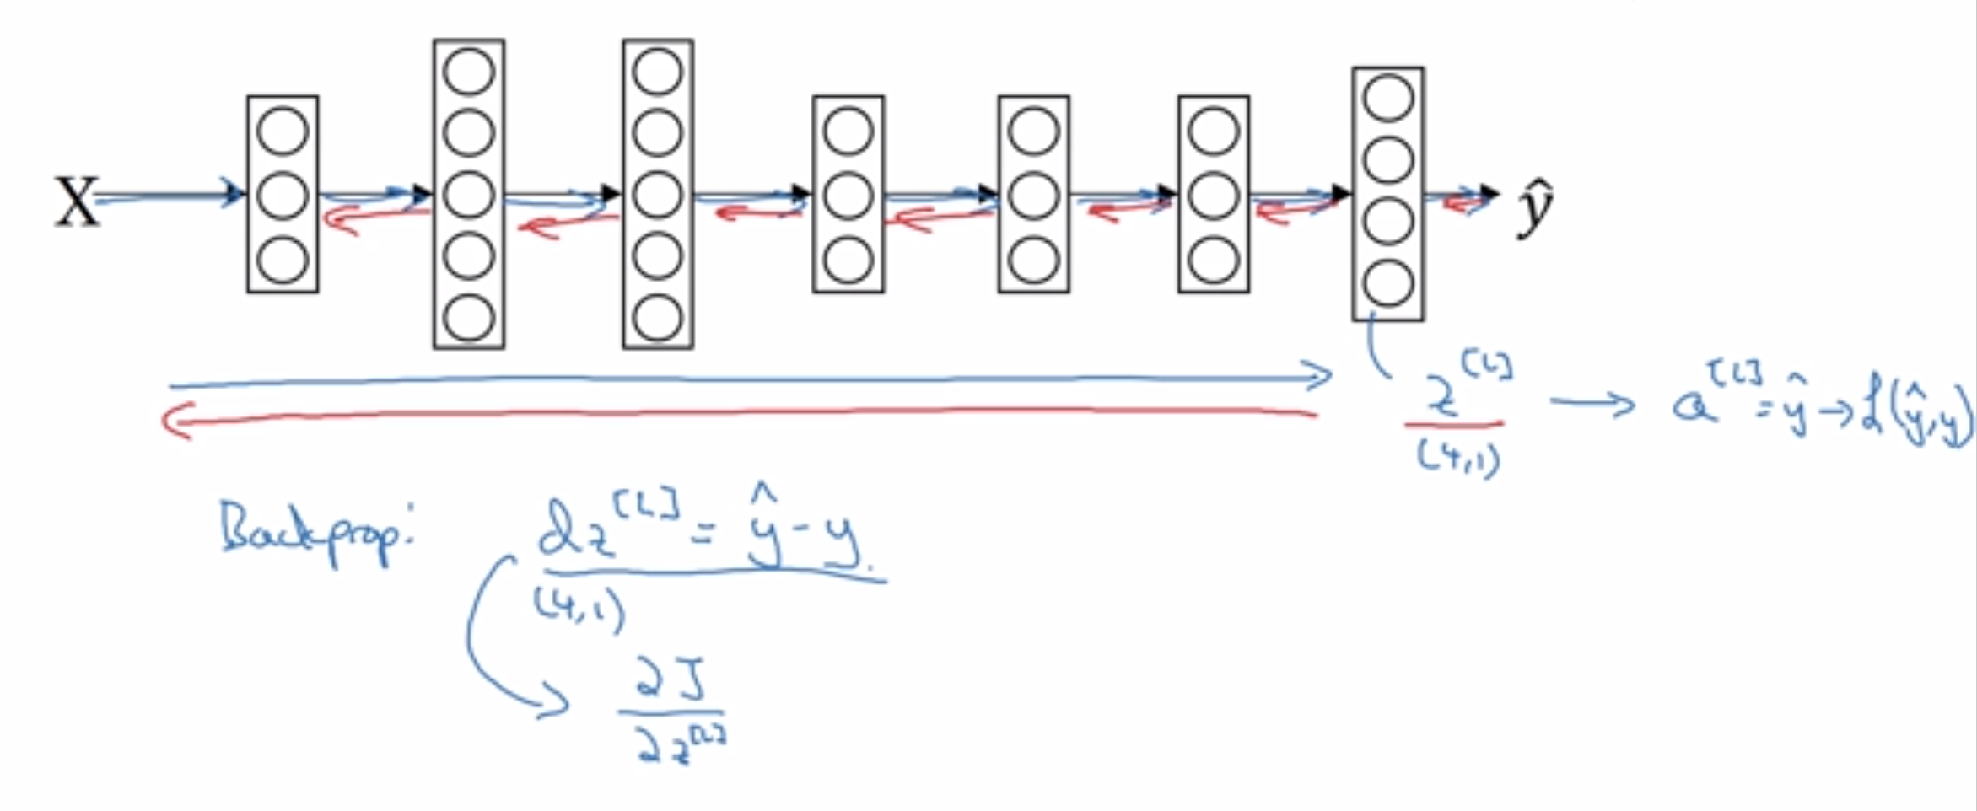
Summary of softmax classifier
X
$$\hat{y}$$

