Slide 1
Google’s DeepMind AI can lip-read TV shows better than a pro
Michael Wu

Slide 2
What is DeepMind?
A company owned by Alphabet, Google’s parent company, that does AI research
Uses neural networks, which are based on the human brain
Many applications, will be focusing on speech recognition

Slide 3
The Goal
Be able to recognize speech from video
Very challenging for even humans to do
Accuracy and versatility
Can be used to dictate input to devices
Used in the open world
How to do this?

Slide 4
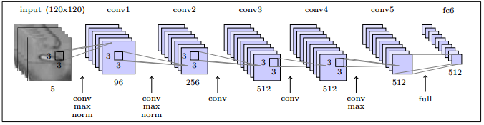
Neural Networks
Convolutional Neural Network (CNN)
Used for image processing
Each neuron has a receptive field
Deep learning with multiple layers
Assigns weight to different filters

Slide 5

Neural Networks
Long Short-Term Memory (LSTM) network
Type of Recurrent Neural Network (RNN)
Normally networks operate independently of previous outputs
LSTM networks allows previous data to be used

Slide 6
Watch, Listen, Attend, and Spell
Two modules Watch and Listen to process inputs
Both generate attention vectors used in the Attend module
Spell takes the outputs of Watch, Listen, and Attend, to generate a probability distribution for characters based on previous data
Multilayer perceptron (MLP)

Slide 7
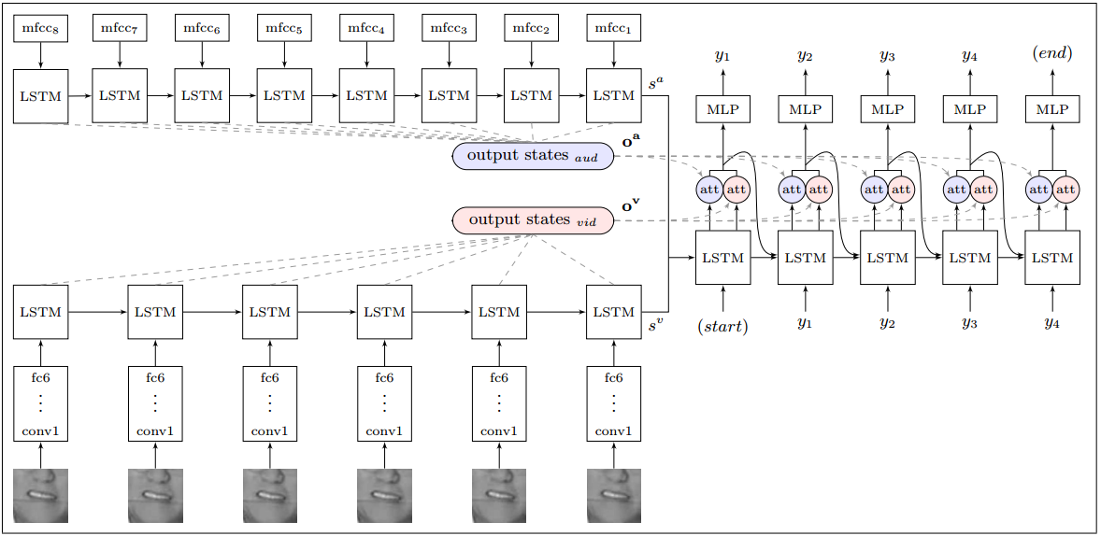
Watch, Listen, Attend, and Spell

Slide 8
Training
Generates the filters for the neural network
Unsupervised training
Runs data through the AI system and adjusts filters based on the correct output
Needs large amount of data
Audio, Visual, and Audio-Visual data prevents one channel dominating

Slide 9
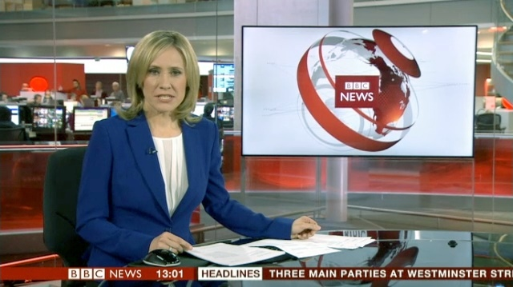
Data
Generated with facial recognition and audio subtitle alignment
4960 hours of video data from BBC
Audio-only data set
Significant improvement from other public data sets (GRID, LRW)

Slide 10
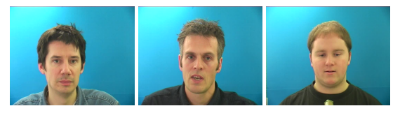
Data
GRID consists of limited vocabulary (51 words)
Recorded in controlled lab environment
Lip Reading in the Wild (LRW) consists of 500 individual words from BBC broadcasts

Slide 11
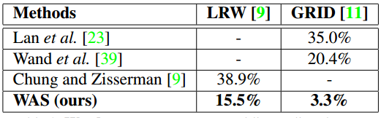
Results
On the BBC data 53.2% Word Error Rate using Watch only, compared to 73.8% Word Error Rate from a professional lip reader.

Slide 12
Takeaways
DeepMind has created a model for lip reading that performs far better than previous efforts
Eventually will be able to use this technology in consumer products
DeepMind generated a data set for learning for future lip reading efforts

Slide 13
Citations
Chung, J. S., Senior, A., Vinyals, O., & Zisserman, A. (2016) Lip Reading Sentences in the Wild. Computing Research Repository. Retrieved from https://arxiv.org/list/cs.CV/1611.
Sak, H., Senior, A., Beaufays, F. (2014) Long Short-Term Memory Based Recurrent Neural Network Architectures for Large Vocabulary Speech Recognition. Computing Research Repository. Retrieved from https://arxiv.org/list/cs.NE/1402.
Krizhevsky, A., Sutskever, I., Hinton, G. E. (2012) ImageNet Classification with Deep Convolutional Neural Networks. Advances in Neural Information Processing Systems, 25, 1097-1105. Retrieved from https://papers.nips.cc/book/advances-in-neural-information-processing-systems-25-2012.

